Slide 1


Slide 2

VLEE
Renovation & Construction Sdn Bhd
Incorporated on 2010, VLEE Renovation & Construction Sdn Bhd is a private limited company, located at S-9-01, The Gamuda Biz Suite No,12, Jalan Anggerik Vanilla 31/99, Kota Kemuning, 40460 Shah Alam, Selangor. The founders of VLEE is Mr. Lee Chee Chin, our Director. Mr. Lee was graduated from Inti College Malaysia, Nilai and hold a Higher Diploma in Civil Engineering. He have in excess of 10 year’s experience in the construction industry. He is the key person on company daily operation, strategic direction development, growth and expansion.
VLEE is growing from Mr. Lee alone himself until today comprise over 30 trained workers and supervisors. They are well trained to provide good quality and high standard of the construction works to our vast range of customers.

Slide 3

VLEE
Renovation & Construction Sdn Bhd
VLEE provide wide range of services:
Plumbing services
All kinds of renovation works
Construct bungalow, shop lot & others
Maintenance for Township and Factory
Our ATTENTION is to cost efficiency and to provide the good quality services to our customers

Slide 4

VLEE
Renovation & Construction Sdn Bhd
VISION
Our Vision is to be recognized as the most trusted and respected construction company, and to deliver the high quality and standards construction services.
MISSION
To provide any construction & renovation services, in any time, any place or environment; for the benefit of our customers and get the full satisfaction.

Slide 5
VLEE
Renovation & Construction Sdn Bhd
Organization Chart
DIRECTOR
JAY LEE CHEE CHIN
Maintenance Group
Renovation Group
Construction Group
Finance & Account Manager
Manager
Lee Chee Seng
Manager
Tan Kim Tee
Manager
JAY Lee Chee Chin
Tan Jia Hui
Operation Assistant
Lee Ngan
Site Assistant
Lee Mau Chiaa
Site Assistant
Tan Chi Heo
Admin & Account Assistant
Gan Choon Hwa

Slide 6
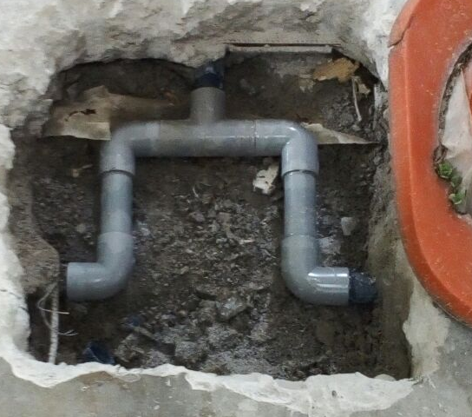
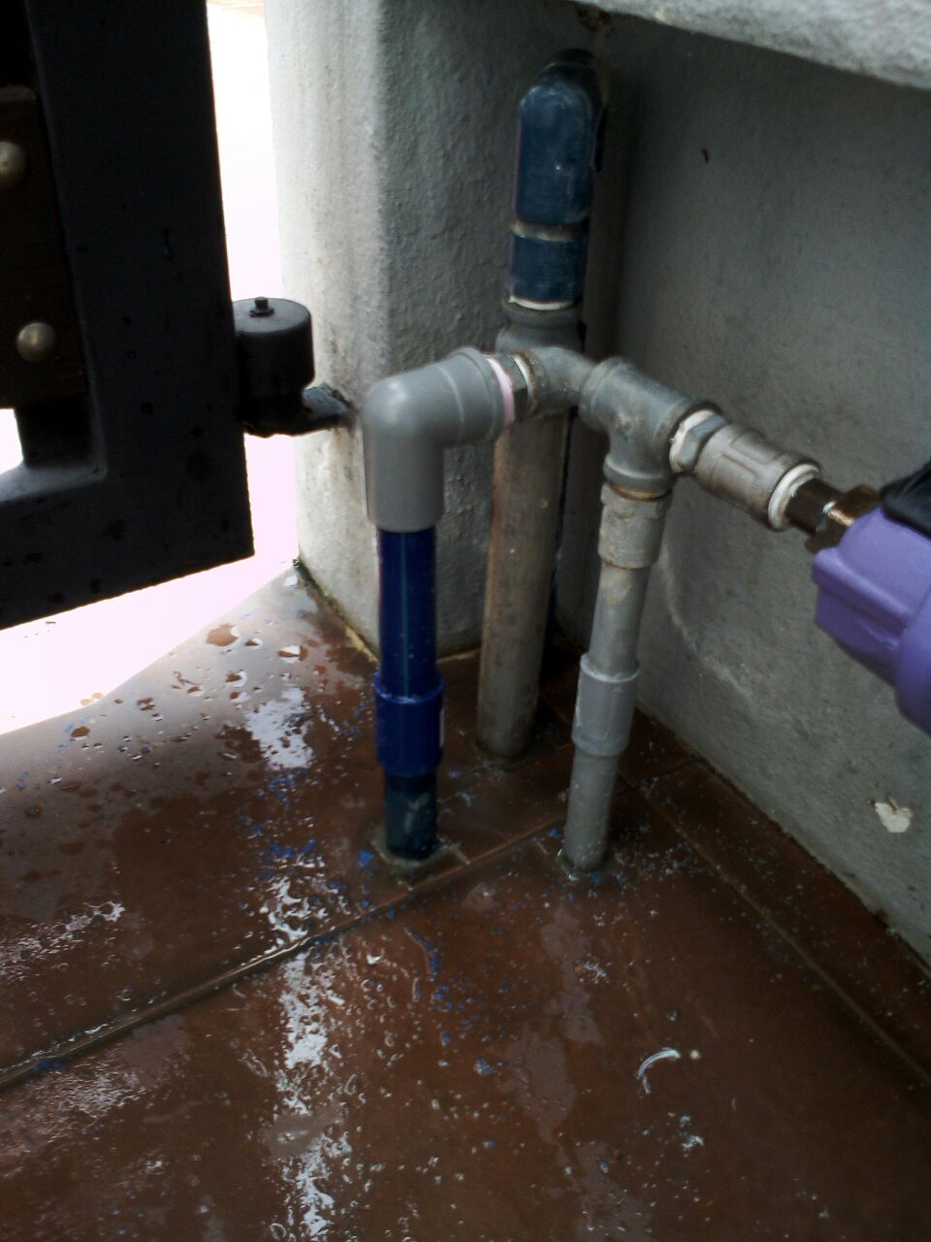
VLEE
Project Reference :
Maintenance
Renovation & Construction Sdn Bhd
Plumbing Works

Slide 7
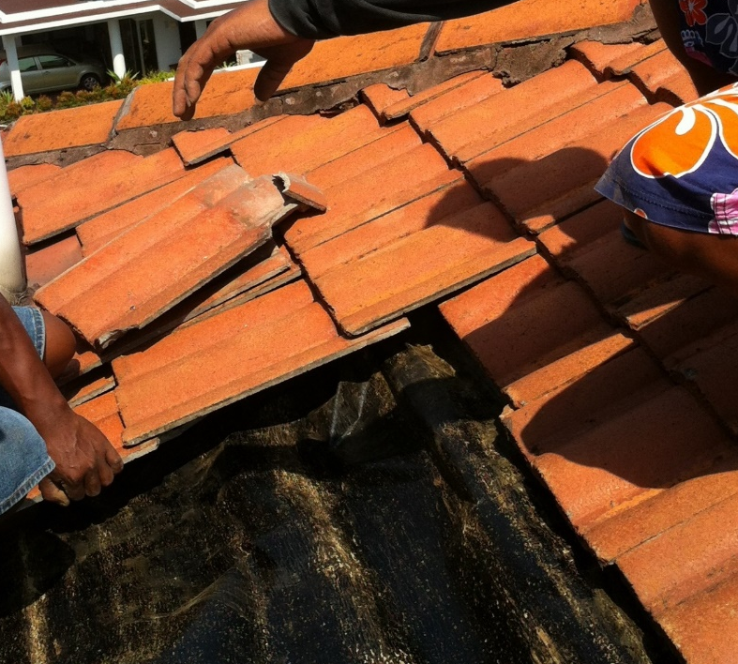
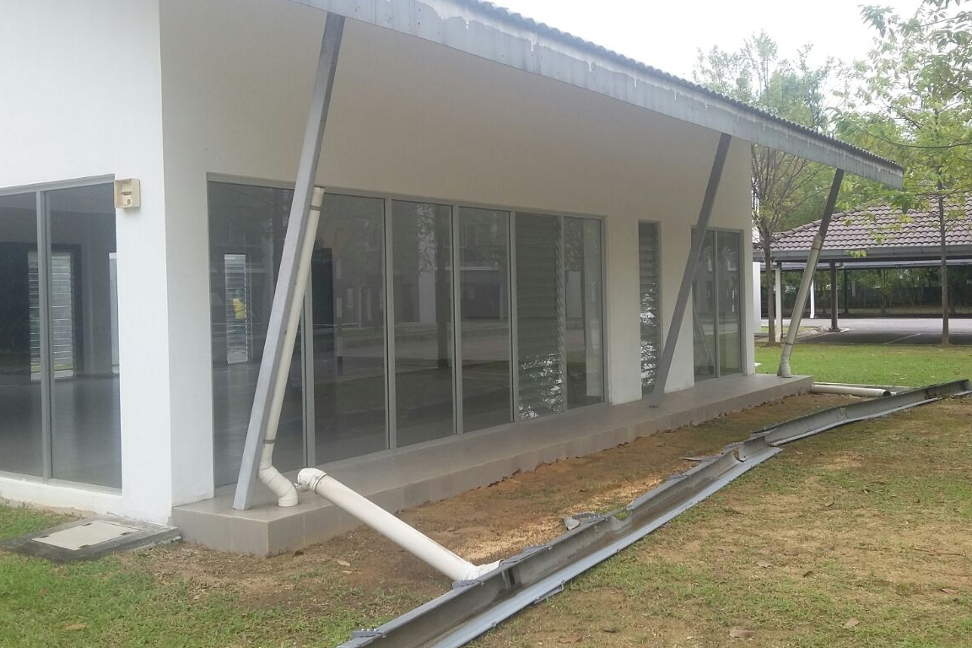
VLEE
Project Reference
Maintenance
Renovation & Construction Sdn Bhd
Repair Roof
Service Gutter

Slide 8
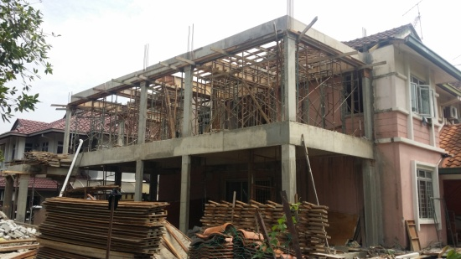
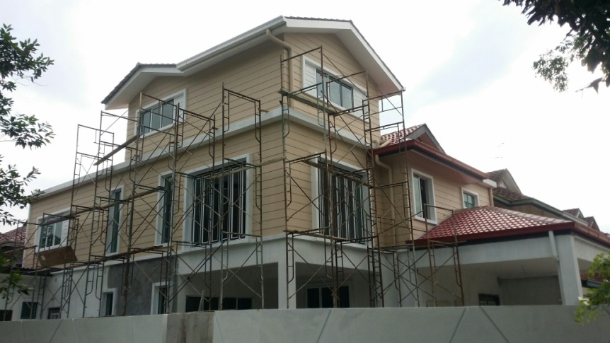
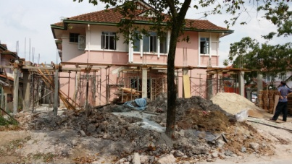
VLEE
Renovation & Construction Sdn Bhd
Project Reference :
Renovation
3 story Renovation work at Jalan Eria, Kota Kemuning

Slide 9
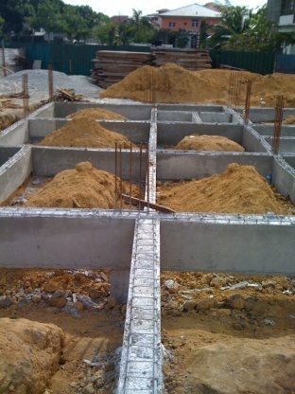
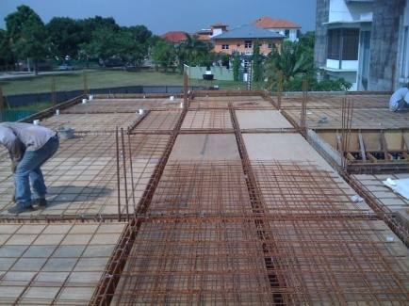
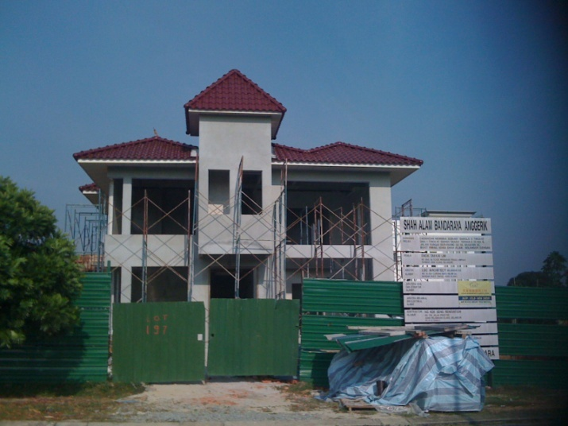
Project Reference :
Construction
A unit of Banglow at Sri Suria, Bukit Rimau

Slide 10
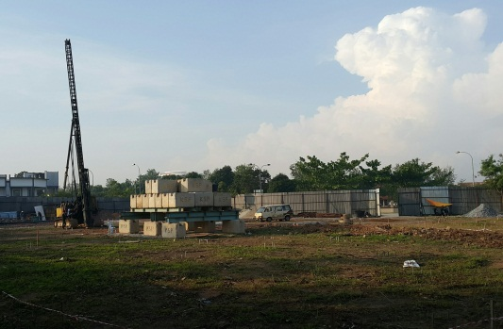
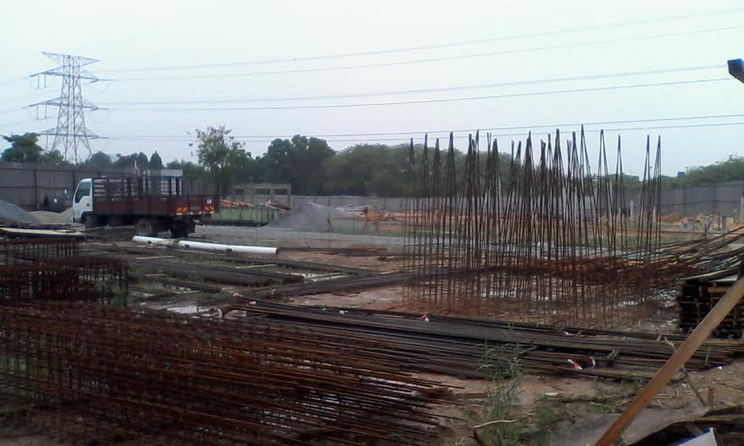
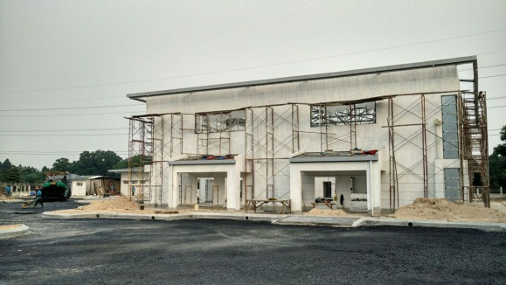
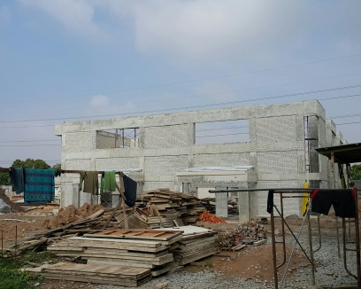
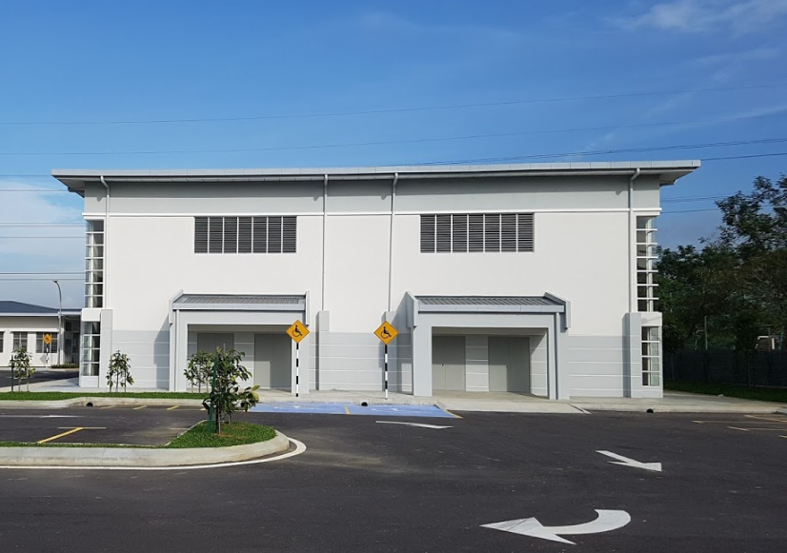
VLEE
Construction
Renovation & Construction Sdn Bhd
Job Title : A unit of Dewan
Client :HICOM-GAMUDA DEVELOPMENT SDN BHD

Slide 11
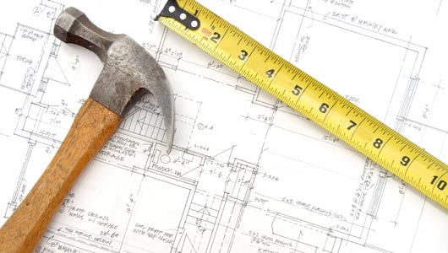
VLEE
Renovation & Construction Sdn Bhd
VLEE Renovation & Constructin Sdn Bhd (890354-M)
Tel: 03-5525 2859 Fax: 03-5131 9727
Email: vleerenovation@gmail.com
S-9-01, The Gamuda Biz Suite
No.12, Jalan Anggerik Vanilla 31/99,
Kota Kemuning 40460 Shah Alam, Selangor Darul Ehsan

Slide 12
CIDB Certificate
VLEE
Renovation & Construction Sdn Bhd

