Slide 1
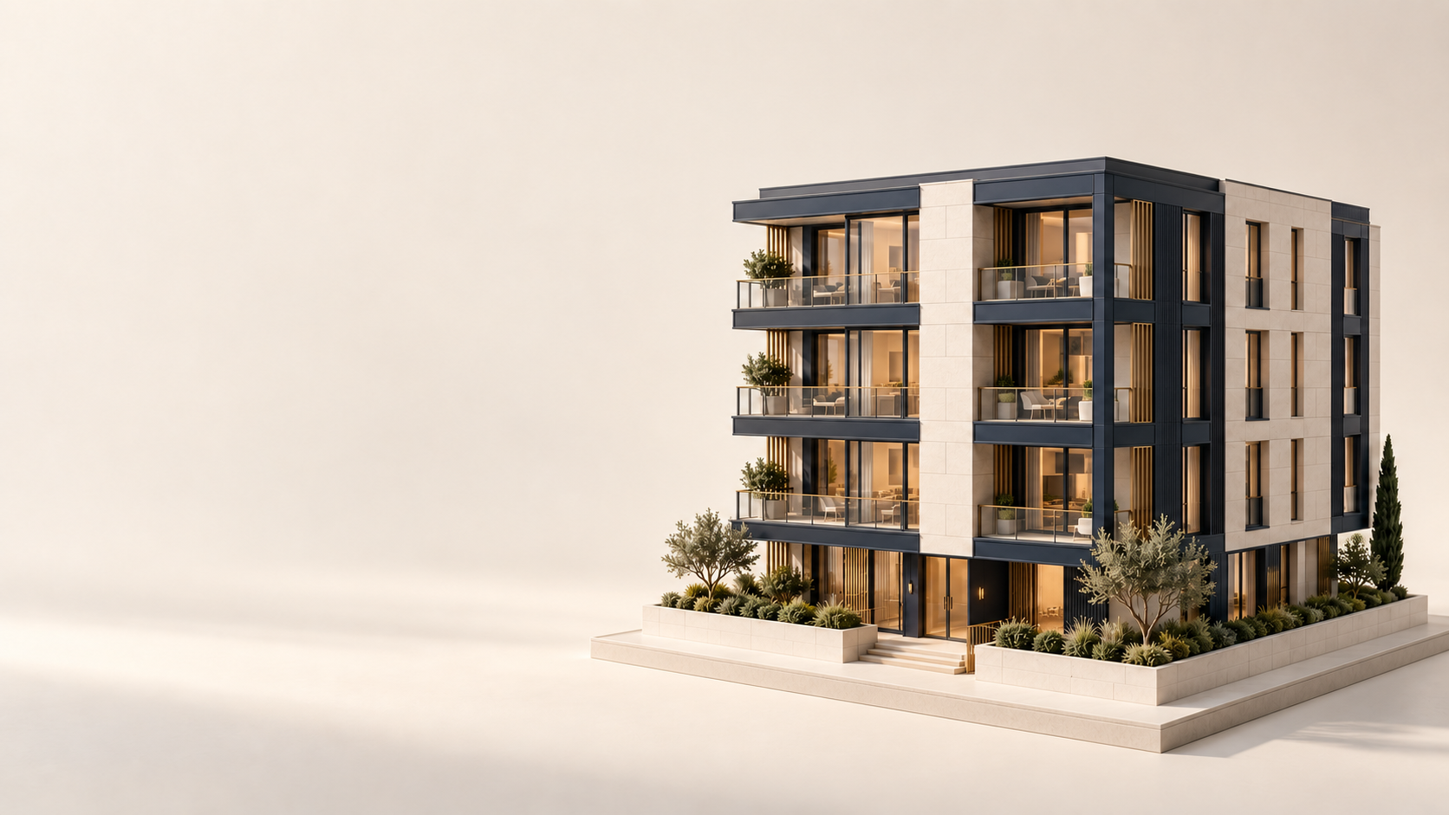
TENENT
Rental rules for
one property,
on one date
Investigate what applies.
Keep the evidence in view.
Notes:
0:00–0:15 | 15 seconds
SAY
City and state rental rules overlap and change on different dates. TENENT helps a property team investigate which rules might govern one building, why, and which missing fact matters next.
ACTION
Open on the cover. Keep the prepared live application in a separate tab.
SOURCES
https://github.com/vzhu08/realpage-eggs/blob/45f8ccf1b555102fb623eeda8bcaffd48d17ffa5/README.md
https://github.com/vzhu08/realpage-eggs/blob/45f8ccf1b555102fb623eeda8bcaffd48d17ffa5/frontend/src/styles/tokens.css
https://github.com/vzhu08/realpage-eggs/blob/45f8ccf1b555102fb623eeda8bcaffd48d17ffa5/frontend/public/assets/tenent-architecture.png
https://github.com/vzhu08/realpage-eggs/blob/45f8ccf1b555102fb623eeda8bcaffd48d17ffa5/frontend/public/assets/brand/tenent-mark-light.svg
Original project artwork is conceptual architecture, not a photograph of a benchmark property. No asset asserts a legal outcome.

Slide 2
Rental rules depend on context
Which rules apply to this property
on the date I choose?
Legal location
State and municipal boundaries
The date
Effective dates and proposal status
The facts
The details the record does not settle
The source
The text behind the interpretation
Notes:
0:15–0:35 | 20 seconds
SAY
Imagine your team researching one building today. A state rule may apply, a city rule may add another condition, and a proposal may not yet be law. TENENT brings the property, date and source together in one research workflow.
ACTION
Point once to the property question. Do not read all four rows.
SOURCES
https://github.com/vzhu08/realpage-eggs/blob/45f8ccf1b555102fb623eeda8bcaffd48d17ffa5/docs/CONTRACTS.md
https://github.com/vzhu08/realpage-eggs/blob/45f8ccf1b555102fb623eeda8bcaffd48d17ffa5/docs/ASSIST_CONTRACT.md
https://github.com/vzhu08/realpage-eggs/blob/45f8ccf1b555102fb623eeda8bcaffd48d17ffa5/navigator/engine.py
https://github.com/vzhu08/realpage-eggs/blob/45f8ccf1b555102fb623eeda8bcaffd48d17ffa5/navigator/evidence.py

Slide 3
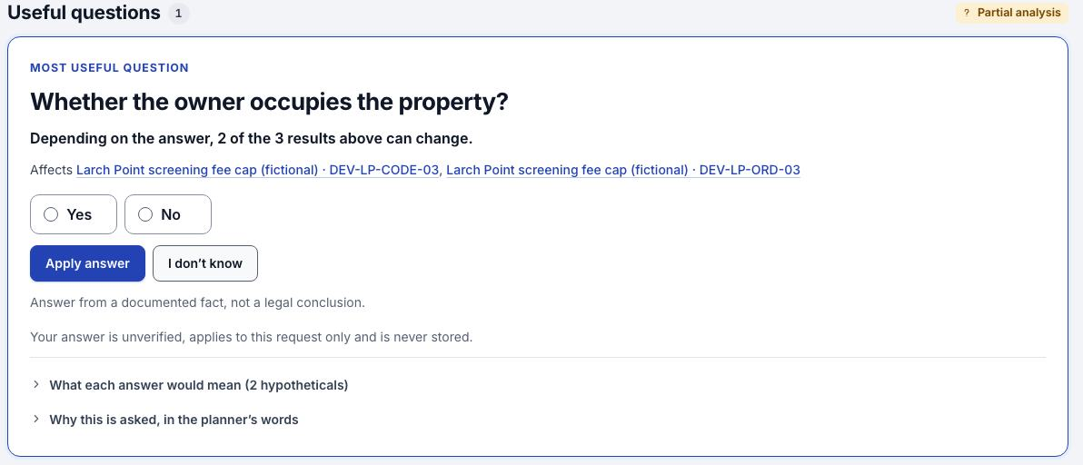
A useful follow-up question
Fictional demo screen. An answer can change a result while other gaps remain.
Notes:
0:35–1:00 | 25 seconds
SAY
These two interface examples use fictional demo data. TENENT asks the next useful question and explains which results your answer could change. Answer it, or say “I don’t know.” The evaluator updates the same research result and keeps the remaining unknowns visible, so you can focus on the fact that matters next.
ACTION
Show the question and the consequence line. The displayed two-of-three count belongs only to this fictional example.
SOURCES
https://github.com/vzhu08/realpage-eggs/blob/45f8ccf1b555102fb623eeda8bcaffd48d17ffa5/frontend/docs/demo-backup/README.md
https://github.com/vzhu08/realpage-eggs/blob/45f8ccf1b555102fb623eeda8bcaffd48d17ffa5/frontend/docs/demo-backup/04-consequential-question.jpg
https://github.com/vzhu08/realpage-eggs/blob/45f8ccf1b555102fb623eeda8bcaffd48d17ffa5/docs/ASSIST_CONTRACT.md
https://github.com/vzhu08/realpage-eggs/blob/45f8ccf1b555102fb623eeda8bcaffd48d17ffa5/navigator/question_planner.py
Historical UI capture uses DEV-P08, a fictional property on January 15, 2027. The screenshot crop enlarges the question; this slide retains an explicit fictional-data disclosure.

Slide 4
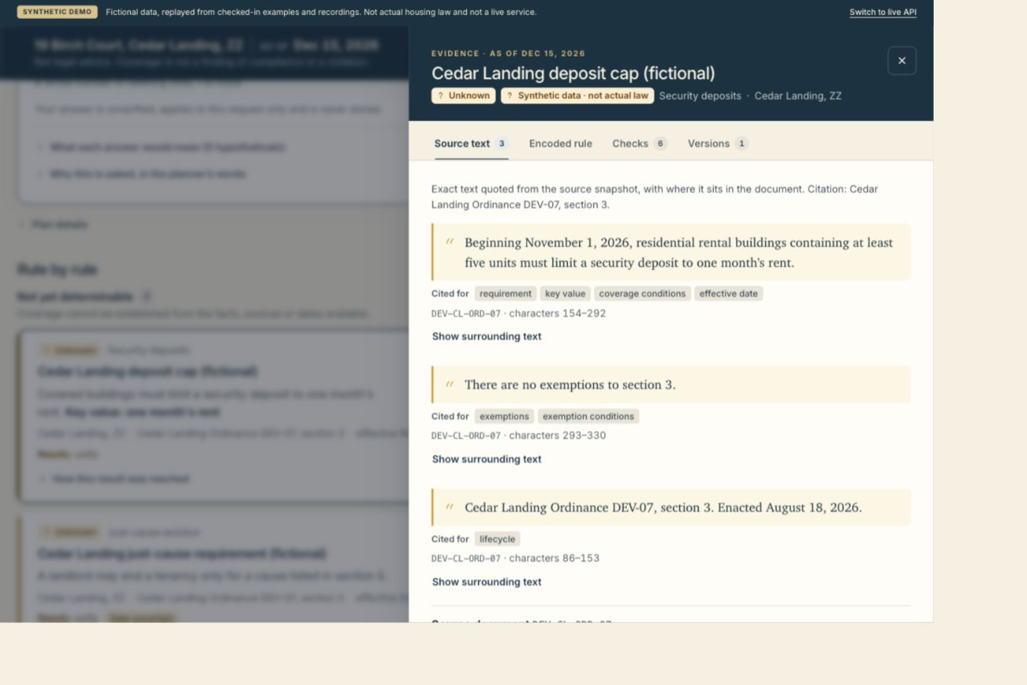
Evidence stays with the result
Original source text
Exact quote location
Separate review checks
Trace the result back to its captured source.
Fictional demo screen. Current source and interpretation gaps remain visible.
Notes:
1:00–1:20 | 20 seconds
SAY
Then open the evidence behind a result. TENENT keeps the original quote, its exact location and the review checks together. A researcher can inspect the interpretation and follow up on an open issue without losing the source that started the investigation.
ACTION
Point to the source quote, then to the location below it. Do not present the fictional deposit cap as actual law.
SOURCES
https://github.com/vzhu08/realpage-eggs/blob/45f8ccf1b555102fb623eeda8bcaffd48d17ffa5/frontend/docs/TENENT_PREVIEW.txt
https://github.com/vzhu08/realpage-eggs/blob/45f8ccf1b555102fb623eeda8bcaffd48d17ffa5/frontend/docs/tenent-preview/desktop-evidence.png
https://github.com/vzhu08/realpage-eggs/blob/45f8ccf1b555102fb623eeda8bcaffd48d17ffa5/navigator/evidence.py
https://github.com/vzhu08/realpage-eggs/blob/45f8ccf1b555102fb623eeda8bcaffd48d17ffa5/frontend/src/features/evidence/SourceTab.tsx
Matching source words does not establish a correct legal interpretation. Source identity, quote matching and semantic review remain separate checks. The screenshot is fictional and historical, not a statement of actual law.

Slide 5
Current law and possible changes
Actual on the selected date
If enacted
Use the recorded
legal lifecycle
Compare a clearly
labeled hypothetical
Pending proposals stay pending.
Stored law stays unchanged.
Definitely affected and uncertain properties remain separate.
Notes:
1:20–1:40 | 20 seconds
SAY
TENENT also compares dates and supports a clearly labeled “if enacted” scenario. A proposal stays pending in the actual record. For portfolio questions, the system separates definite impacts from uncertain ones, so an incomplete result does not disappear into a confident total.
ACTION
Describe this feature without running a cold portfolio comparison during the three-minute pitch. Use only a previously rehearsed comparison if time permits.
SOURCES
https://github.com/vzhu08/realpage-eggs/blob/45f8ccf1b555102fb623eeda8bcaffd48d17ffa5/navigator/changes.py
https://github.com/vzhu08/realpage-eggs/blob/45f8ccf1b555102fb623eeda8bcaffd48d17ffa5/navigator/engine.py
https://github.com/vzhu08/realpage-eggs/blob/45f8ccf1b555102fb623eeda8bcaffd48d17ffa5/docs/CONTRACTS.md
https://github.com/vzhu08/realpage-eggs/blob/45f8ccf1b555102fb623eeda8bcaffd48d17ffa5/frontend/docs/DEMO_SCRIPT.md
No slide claims that a proposal will be enacted, that all five competition cases pass, or that all affected-address sets have been established. The current full data-readiness gate remains partial.

Slide 6
One property to its source
60-second live walkthrough
1
Choose a property and date
2
Answer one useful question
3
Open the exact source
Research prototype. Coverage and interpretation gaps remain.
Not legal advice.
Notes:
1:40–3:00 | 10-second handoff, 60-second demo, 10-second close
SAY
Now I’ll show one property, the next useful question and the evidence behind a result.
[During demo] This starts with a property and an explicit date. The result keeps unknowns visible. I’ll use a hypothetical answer to show how it changes the analysis, without claiming that answer is verified. And here is the exact source quote behind this result.
[Close] TENENT helps a researcher see what applies, what might change and what still needs evidence. This remains a research prototype with partial coverage, not legal advice.
ACTION
Before presenting, rehearse the exact running snapshot and confirm its question. Preferred prepared starting point from ASSIST_DEMO.md: A0001 on October 1, 2026. During the 60 seconds: 0–12 open prepared result; 12–30 answer the current useful question using a clearly labeled hypothetical; 30–45 point out what changed and what remains open; 45–60 open Evidence and show the source quote. Return to this slide for the close. Do not force the historical owner-occupancy script if the repaired snapshot asks a different question. If live data is unavailable, explicitly announce a fictional walkthrough and use the already labeled screenshots rather than claiming a live result.
SOURCES
https://github.com/vzhu08/realpage-eggs/blob/45f8ccf1b555102fb623eeda8bcaffd48d17ffa5/docs/ASSIST_DEMO.md
https://github.com/vzhu08/realpage-eggs/blob/45f8ccf1b555102fb623eeda8bcaffd48d17ffa5/config/demo_requests.json
https://github.com/vzhu08/realpage-eggs/blob/45f8ccf1b555102fb623eeda8bcaffd48d17ffa5/frontend/docs/DEMO_SCRIPT.md
https://github.com/vzhu08/realpage-eggs/blob/45f8ccf1b555102fb623eeda8bcaffd48d17ffa5/docs/CHANGE_CASE_READINESS.md
The real-data rehearsal in ASSIST_DEMO.md documents partial research results. Its cached timing measurements are not a general performance claim, and this pitch makes no speed or accuracy benchmark claim.

