Slide 1

FG
MWS
SH
$$LN_{2}$$
X-Y
Circuit box
Pt100,
MWE,
Sample

Slide 2
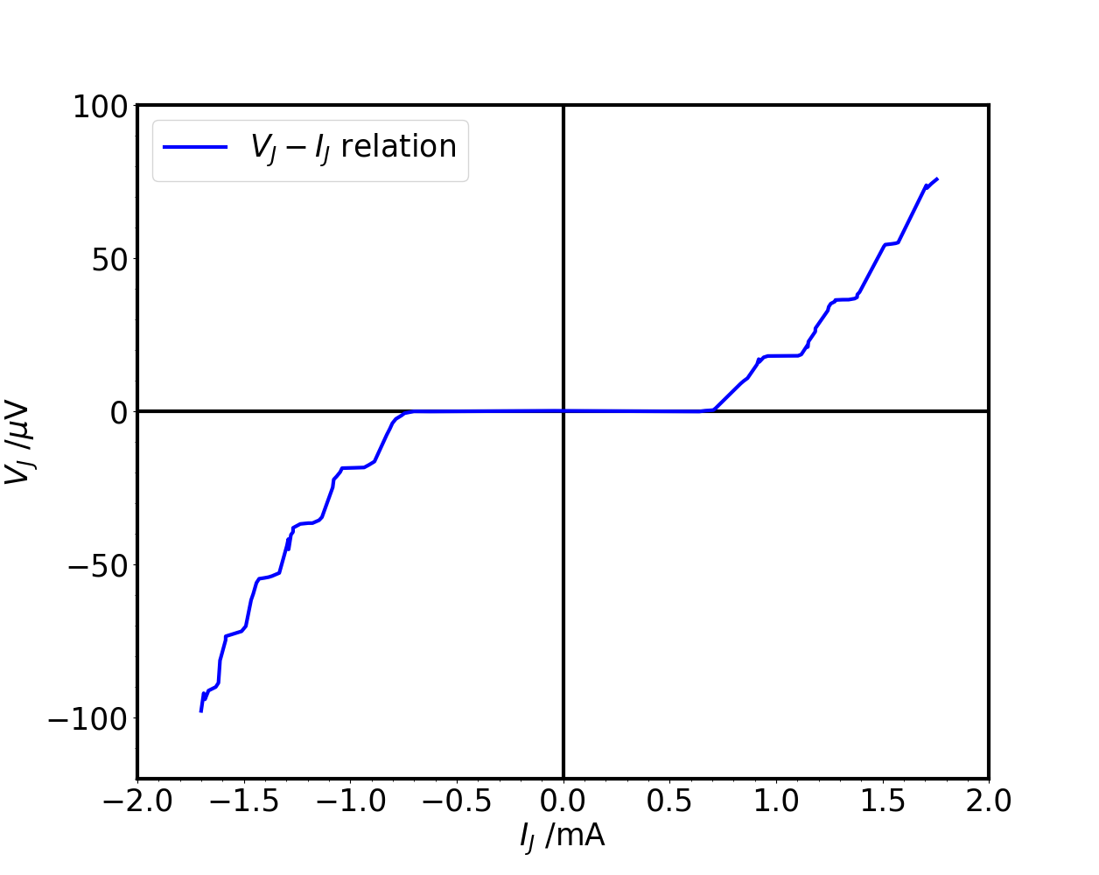
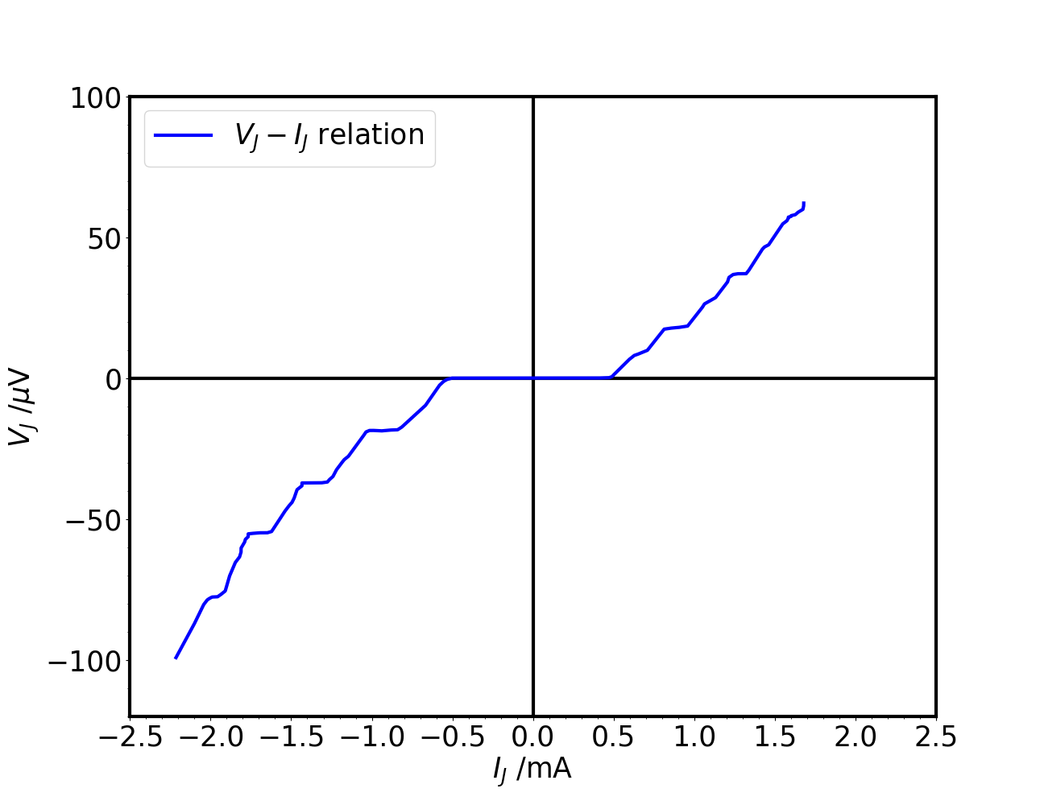
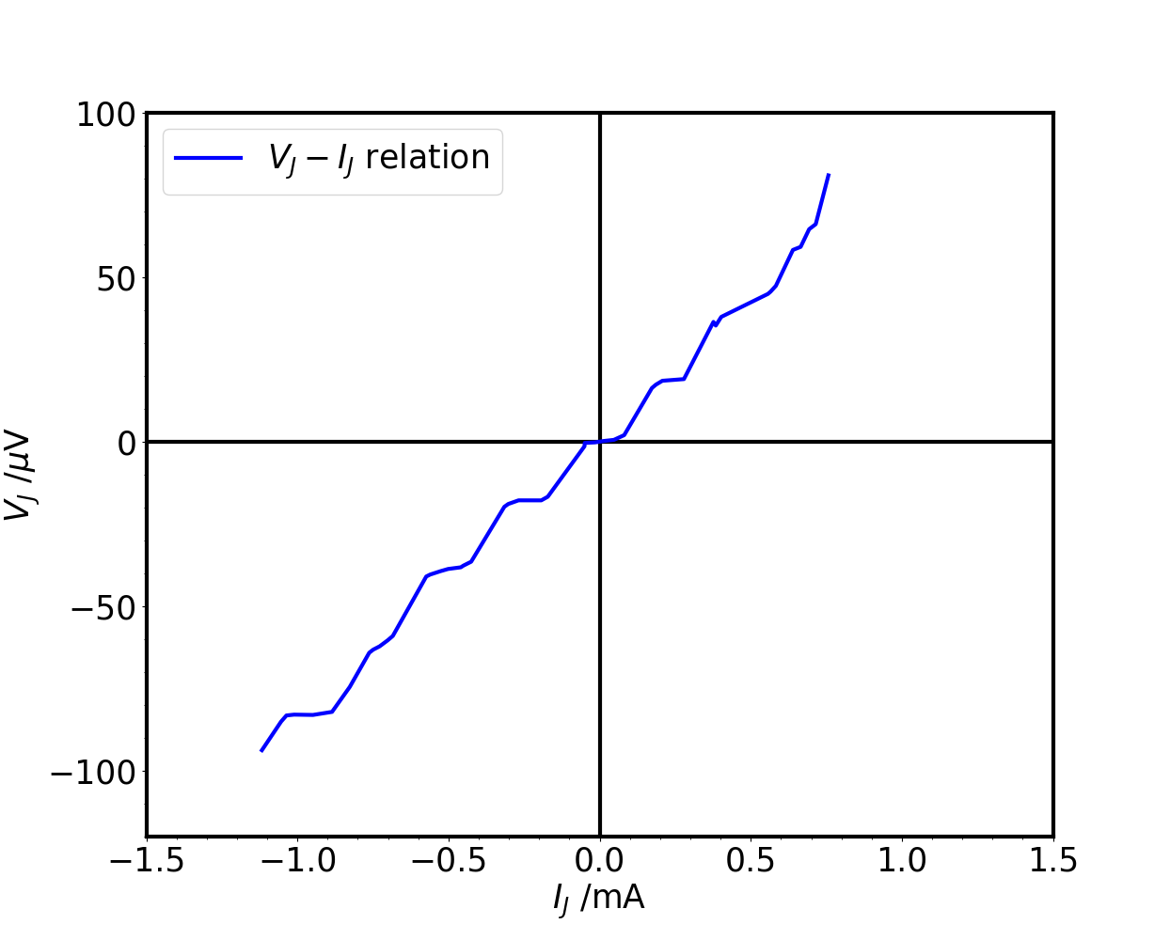
A
B
C

