Slide 1
Group 23

Slide 2

Data Exploration

Slide 3
Dataset
Item_id | Category | Price | Sellable Online | Other Colors | Depth | Height | Width
90291698 | Bookcases & shelving units | 175 | TRUE | No | NA | 64 | 60
80280515 | Chairs | 225 | TRUE | No | 46 | 76 | 54
39287398 | Bookcases & shelving units | 340 | TRUE | Yes | 30 | 202 | 40
89135944 | Sofas & armchairs | 1995 | TRUE | Yes | 99 | 83 | 198
29248345 | Bookcases & shelving units | 906 | TRUE | No | 50 | 226 | 134
…

Slide 4
Category
Category | Number
Tables & desks | 89
Bookcases & shelving units | 71
Sofas & armchairs | 58
Chairs | 57
Cabinets & cupboards | 44
Wardrobes | 32
Beds | 31
Outdoor furniture | 29
TV & media furniture | 28
…

Slide 5
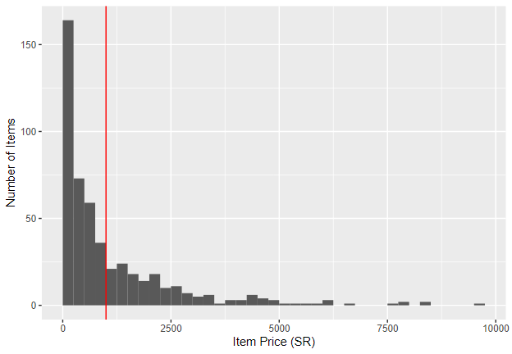
Price
Our target variable.
Aim: Which properties of furniture influence whether they cost more than 1000 Saudi Riyals?

Slide 6

Sellable Online & Other colors
Binary variable.
There are 495 pieces of furniture that can be sold online, and only 5 pieces can only be purchased offline.
The variable of online purchase may not be significant due to the large difference in quantity.
There are 304 pieces of items do not have other colors, and 196 pieces have other colors.

Slide 7

Depth & Height & Width
These three variables describe the physical dimensions of each item.
Numeric variable, measured in centimetres.

Slide 8
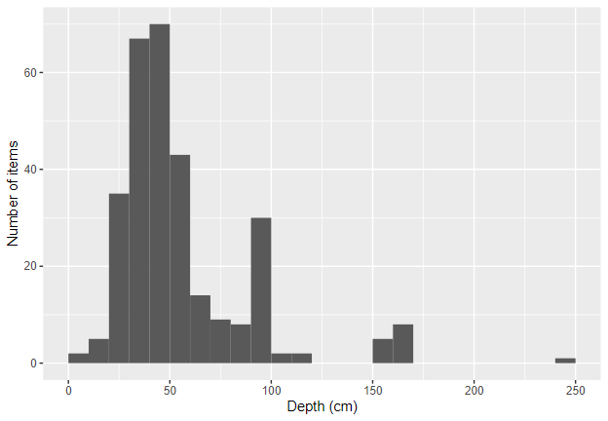
Depth
The most common values of depth is between 20cm and 60cm.
The peak of depth is located around 30cm to 50cm.
The frequency of depths drops off quickly above 60cm.
The value of spike between 90cm and 100cm is 30, and the proportion of sofas in the spike is 70%.

Slide 9
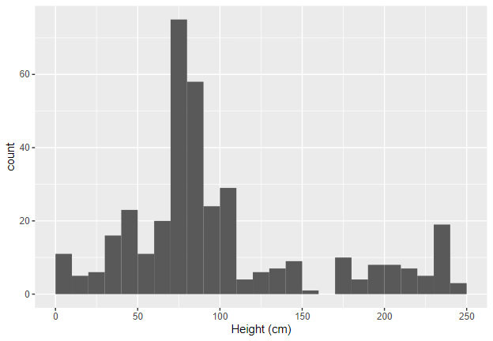
Height
The values of height are widely distributed from 0cm to 250cm.
The peak is located between 70cm and 90cm.
The items with the highest proportion of peaks are chairs, sofas or tables.
Wardrobes and bookcases form a significant proportion of the items over 165cm in height.

Slide 10
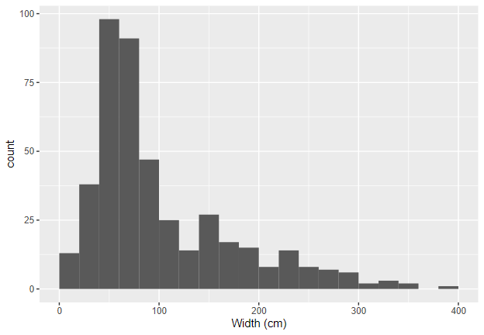
Width
The values of widths are widely separated from 0cm to 400cm.
The distribution has a long tail to the right.
The peak is roughly located between 60cm and 80cm.
Chairs and table form a high proportion of the items in the peak.

Slide 11
Missing data
The missing values only exist ​​in the height, depth and width variables.
Dropping all rows with a missing value would lose too much data
Find a proper way to deal with the missing values.
Consider replacing missing values ​​with the mean or the median.
Skim variable | Number of Missing value | Complete rate
Depth | 199 | 0.602
Height | 131 | 0.738
Width | 64 | 0.872

Slide 12
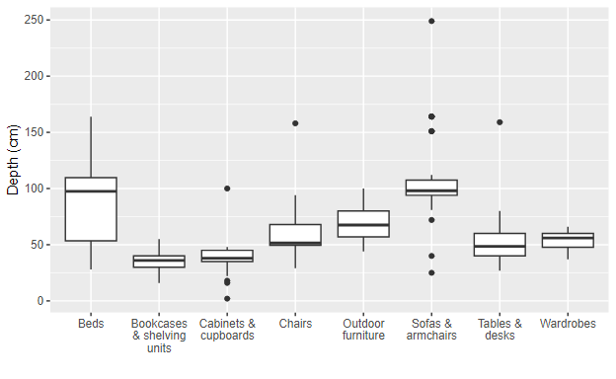
Missing data
The type of items should affect its size, check the distributions for each category.
Distributions vary a lot between categories, and often have outliers.
Use the median instead of the mean to replace the missing value.
Remove data that are missing in all three dimensions.

Slide 13

model Analysis

Slide 14
first model
 | Parameter Estimate | 95% CI Lower Bound | 95% CI Upper Bound
CategoryBeds | 15.072 | -2630.028 | 2660.171
CategoryChairs | 16.171 | -2628.928 | 2661.270
Sellable Online(TRUE) | 14.739 | -2775.501 | 2804.979
Other Colors(YES) | 0.007 | -0.602 | 0.617
Depth | 0.010 | -0.008 | 0.028
Height | 0.028 | 0.017 | 0.040
Width | 0.027 | 0.019 | 0.034
Two of sixteen categories are showed here, and none of them are significant.
Sellable online(TRUE), other colors(YES), and depth are also insignificant.
Build another model without categories to examine whether they are significant.
The AIC of this regression model is 359.3.

Slide 15
SEcond model
Sellable online(TRUE) and other colors(YES) are still not significant after simplifying the first model, however depth is significant.
The significant parameters here are depth, height, width.
Build the third model with three significant factors.
The AIC of this regression model is 398.8.
 | Parameter Estimate | 95% CI Lower Bound | 95% CI Upper Bound
Sellable Online(TRUE) | 13.056 | -1213.922 | 1240.034
Other Colors(YES) | 0.009 | -0.513 | 0.530
Depth | 0.022 | 0.011 | 0.033
Height | 0.007 | 0.002 | 0.012
Width | 0.019 | 0.014 | 0.024

Slide 16
Third model
Build the third multiple logistic regression model of depth, height and width.
All parameters are significant now.
The AIC of the second model is 395.6 which is less than the former one(398.8).
 | Parameter Estimate | 95% CI Lower Bound | 95% CI Upper Bound
(Intercept) | -4.700 | -5.593 | -3.806
Height | 0.007 | 0.002 | 0.012
Width | 0.019 | 0.014 | 0.024
Depth | 0.022 | 0.012 | 0.033

Slide 17
Third model
For every extra centimetre in depth, we expect the log-odds to increase by 0.022
Equivalent to multiplying the odds by 1.023.
For width, log-odds increases per centimetre by 0.019 (odds multiplier of 1.019).
For height, log-odds increases per centimetre by 0.007 (odds multiplier of 1.007).
 | Parameter Estimate | 95% CI Lower Bound | 95% CI Upper Bound
(Intercept) | -4.700 | -5.593 | -3.806
Height | 0.007 | 0.002 | 0.012
Width | 0.019 | 0.014 | 0.024
Depth | 0.022 | 0.012 | 0.033

Slide 18
Conclusion
Bigger furniture (high width, depth and height size) seem to have more probability to have selling prices over 1,000 Saudi Riyals.
The depth has the biggest impact, the width has the second, and the following one is height.
For further work, investigate the items volume as a variable.
We could also look further into the categories.

