Slide 1
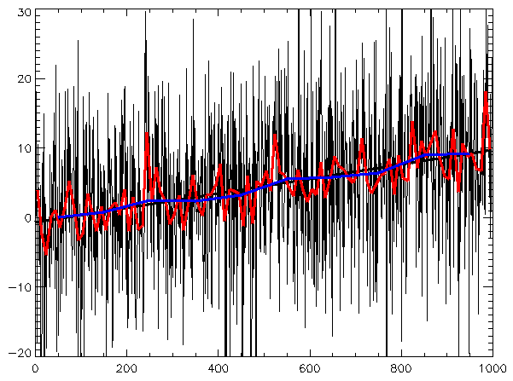
A Pipeline for Developmental EEG Data: An Introduction
Will Decker

Slide 2

Developmental EEG Data
Historically noisy
Data is likely to suffer from greater artifacts

Slide 3
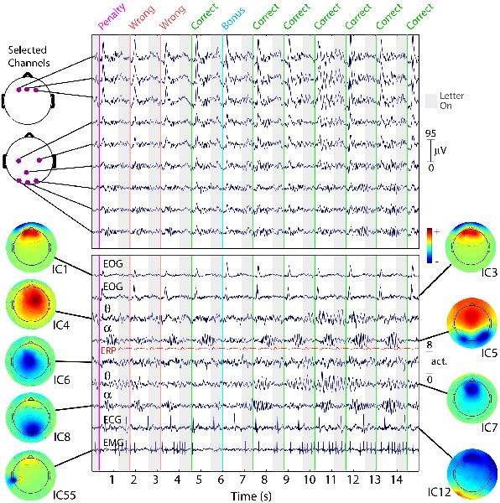
Preprocessing
Standard analytical techniques that make up EEG data processing to extract the brain signal and remove unwanted noise.
Examples: filtering, referencing, ICA, artifact removal

Slide 4
EEG Pipelines and Toolboxes
Currently, many tools exist to analyze EEG data.
Examples: EEGLAB, MNE, FieldTrip
Offer many options for preprocessing EEG data

Slide 5
Catch 22
There is no standardization of EEG analysis pipeline for developmental EEG data.
There is no metric to extrapolating meaning behind preprocessing choices made by the researcher.
Researchers overanalyze data inadvertently removing brain data along with noise.

Slide 6

Best preprocessing practices?
Delorme (2023) proposes the optimal analytical tools to employ when analyzing adult EEG data.

Slide 7
Current Study
We aim to further scrutinize Delorme (2023) and provide a robust pipeline for analyzing developmental EEG data.

Slide 8
Thanks for listening!

Slide 9
Contact
Email – jdecke5@lsu.edu; deckerwill7@gmail.com

