Slide 1
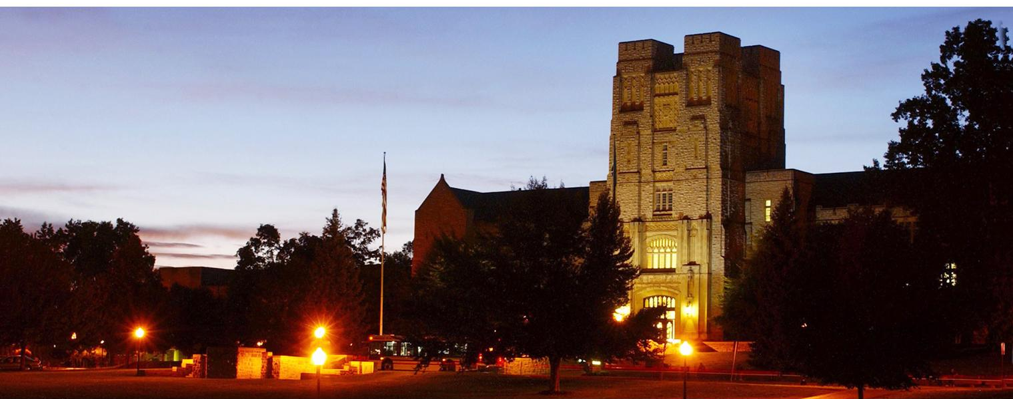
Project topics for CS 4505

Slide 2
Project Topic 1
Title: Adding support for the missing floating-point instructions in gem5 for POWER ISA
Example: fsqrt
floating-point instruction that computes the square root of a value
Outcome: Robust and validated floating point arithmetic instruction support
Input(s): floating point value in FRB register
Output: The square root of the floating-point operand in register FRB is placed into register FRT
Challenges:
Functionally correct floating-point representation
Issues: byte-swapping
Need to handle floating-point exceptions
Notes:
Is there’s snooping between L3 and L2 -> Presence of a bus. (the network by default is Crossbar).

