Slide 1
Computer Architecture
A Quantitative Approach, Sixth Edition
Chapter 3
Instruction-Level Parallelism and Its Exploitation
Part 1: A Brief Review
“Who’s first?”
“America.”
“Who’s second?”
“Sir, there is no second.”
-Dialog between two observers of the sailing race later named “The America’s Cup” and run every few years -- the inspiration for John Cocke’s naming of the IBM research processor as “America.” This processor was the precursor to the RS/6000 series and the first superscalar microprocessor.

Slide 2
Acknowledgements
Thanks to many sources for slide material
© 1990 Morgan Kaufmann Publishers, © 2001-present Elsevier
Computer Architecture: A Quantitative Approach by J. Hennessy & D. Patterson
© 1994 Morgan Kaufmann Publishers, © 2001-present Elsevier
Computer Organization and Design by D. Patterson & J. Hennessy
© 2002 K. Asinovic & Arvind, MIT
© 2002 J. Kubiatowicz, University of California at Berkeley
© 2006, © 2010 No Starch Press for Inside the Machine by J. Stokes
© 2007 W.-M. Hwu & D. Kirk, University of Illinois & NVIDIA
© 2007-2010 J. Owens, University of California at Davis
© 2010 CRC Press for Introduction to Concurrency in Programming Languages by M. Sottile, T. Mattson, and C. Rasmussen
© 2017, IBM POWER9 Processor Architecture by Sadasivam et al., IBM
© 2016, © 2019 POWER9 Processor User’s Manual, IBM
© The OpenPOWER Foundation
© 2022, W. Feng, Virginia Tech

Slide 3
Introduction
What is instruction-level parallelism (ILP)?
A measure of how many of the operations in a computer program can be performed simultaneously.
Pipelining → universal technique in 1985
Overlaps execution of instructions → exploits ILP
How do processors extract ILP to get faster?
More parallelism (or more work per pipeline stage): fewer clocks/instruction [more instructions/cycle]
Get WIDER
Deeper pipeline stages: fewer gates/clock
Get DEEPER
Transistors get faster (Moore’s Law): fewer ps/gate
Get FASTER
What do processors do to extract ILP? Later …
Does a faster processor mean a faster computer?
Notes:
How do processors extract ILP? That is, why do processors get faster?
Does a faster processor mean a faster computer? Why? Why not?
- Remember last chapter? Memory hierarchy.

Slide 4
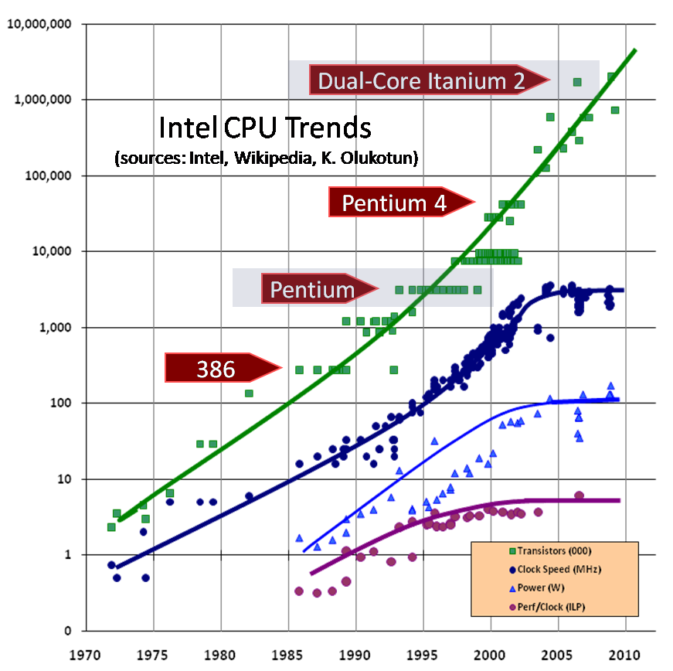
ILP
Notes:
Pipelining started the exponential increase through the 1980s-1990s.

Slide 5
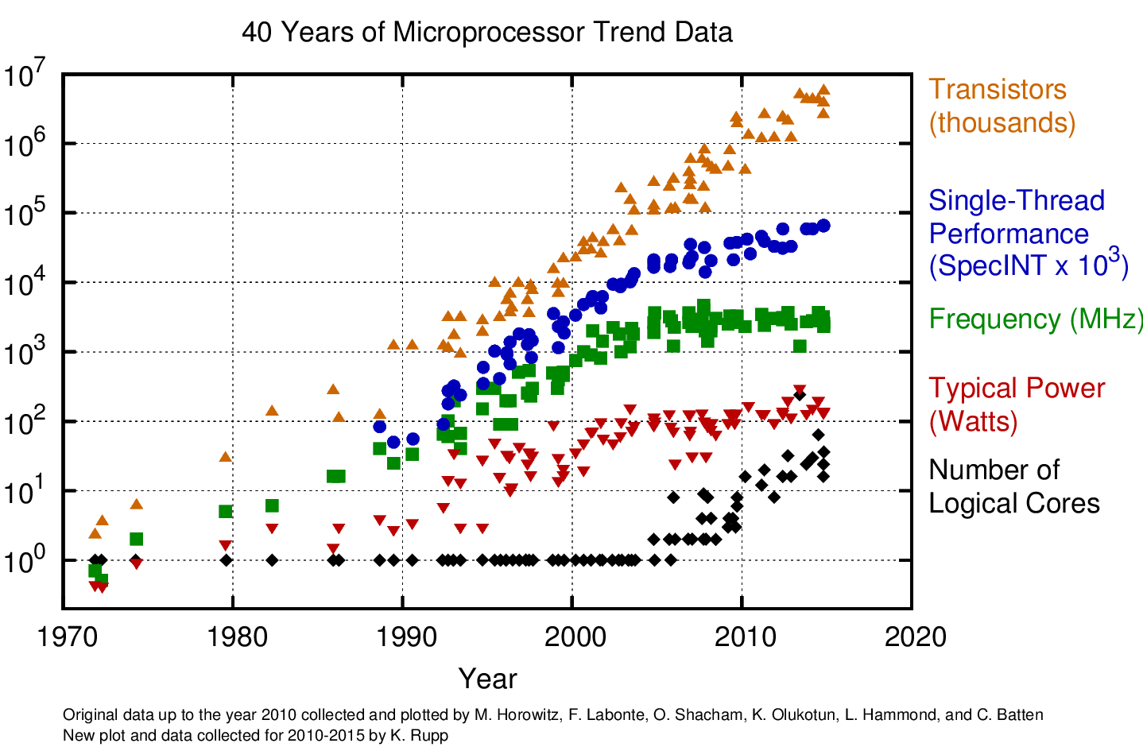
https://www.karlrupp.net/wp-content/uploads/2015/06/40-years-processor-trend.png

Slide 6
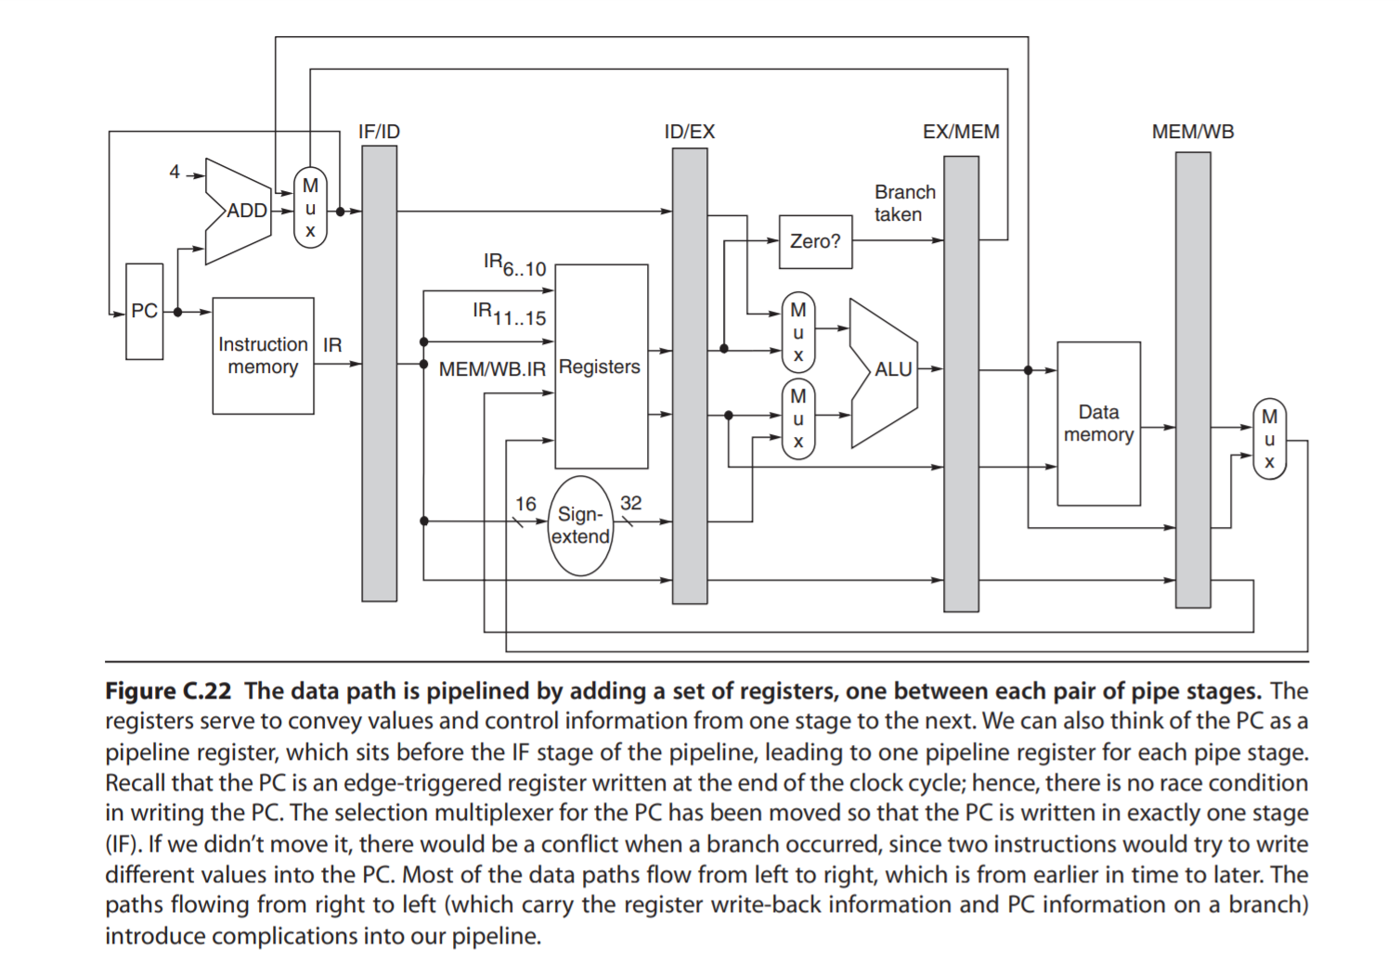
Instruction-Level Parallelism (ILP)
Goal: Minimize CPI (or maximize IPC)
Pipeline CPI =
Ideal pipeline CPI +
Structural-hazard stalls +
Data-hazard stalls +
Control-hazard stalls
Recall
CPI = cycles per instruction
= number of clock cycles required to execute the program / number of instructions executed in running the program
IPC = instructions per cycle = number of instructions executed while running a program / number of clock cycles required to execute the program

Slide 7
Extracting Yet More Performance
How do processors extract ILP to get faster?
More parallelism (or more work per pipeline stage): fewer clocks/instruction [more instructions/cycle]
Get WIDER → instruction width
Deeper pipeline stages: fewer gates/clock
Get DEEPER → instruction depth
Transistors get faster (Moore’s Law): fewer ps/gate
Get FASTER
IF | ID | EX | MEM | WB
 | IF | ID | EX | MEM | WB
 |  | IF | ID | EX | MEM | WB
 |  |  | IF | ID | EX | MEM | WB
 |  |  |  | IF | ID | EX | MEM | WB

Slide 8

Extracting Yet More Performance
Architectural Options: GET WIDER or GET DEEPER
Fetch (and execute) more than one instruction at one time (expand every pipeline stage to accommodate multiple instructions) — multiple-issue → superscalar or VLIW
How does this help performance?
What does it impact in the performance equation?
Increase the depth of the pipeline to increase the clock rate — superpipelining
How does this help performance? (What does it impact in the performance equation?)
Notes:
\frac{\text{seconds}}{\text{program}} = \frac{\text{instructions}}{\text{program}} \times \frac{\text{cycles}}{\text{instruction}} \times \frac{\text{seconds}}{\text{cycle}}
USE PICTURES!
Get Wider: Reduces the cycles/instruction, e.g., two-way superscalar means cutting cycles/instruction in HALF.
Get Deeper: Cycles/instruction stays the same but seconds/cycle decreases.

Slide 9
Basic MIPS Pipelined Architecture
IF | ID | EX | MEM | WB
Notes:
Simple pipeline system performs only one pipeline stage per clock cycle.
Increase ILP by getting wider or deeper. What are the tradeoffs?
Superpipelined system can perform 2 (or more) pipeline stages per clock cycle.
Superscalar system performs only one pipeline stage per clock cycle in each parallel pipeline.

Slide 10
IF | ID | EX | MEM | WB
IF | ID | EX | MEM | WB
 | IF | ID | EX | MEM | WB
 | IF | ID | EX | MEM | WB
 |  | IF | ID | EX | MEM | WB
 |  | IF | ID | EX | MEM | WB
 |  |  | IF | ID | EX | MEM | WB
 |  |  | IF | ID | EX | MEM | WB
 |  |  |  | IF | ID | EX | MEM | WB
 |  |  |  | IF | ID | EX | MEM | WB
Superscalar
CPI? IPC?
instruction stream
time in clock cycles
IF1 | IF2 | ID1 | ID2 | EX1 | EX2 | MEM1 | MEM2 | WB1 | WB2
 | IF1 | IF2 | ID1 | ID2 | EX1 | EX2 | MEM1 | MEM2 | WB1 | WB2
 |  | IF1 | IF2 | ID1 | ID2 | EX1 | EX2 | MEM1 | MEM2 | WB1 | WB2
 |  |  | IF1 | IF2 | ID1 | ID2 | EX1 | EX2 | MEM1 | MEM2 | WB1 | WB2
 |  |  |  | IF1 | IF2 | ID1 | ID2 | EX1 | EX2 | MEM1 | MEM2 | WB1 | WB2
 |  |  |  |  | IF1 | IF2 | ID1 | ID2 | EX1 | EX2 | MEM1 | MEM2 | WB1 | WB2
 |  |  |  |  |  | IF1 | IF2 | ID1 | ID2 | EX1 | EX2 | MEM1 | MEM2 | WB1 | WB2
 |  |  |  |  |  |  | IF1 | IF2 | ID1 | ID2 | EX1 | EX2 | MEM1 | MEM2 | WB1 | WB2
 |  |  |  |  |  |  |  | IF1 | IF2 | ID1 | ID2 | EX1 | EX2 | MEM1 | MEM2 | WB1 | WB2
 |  |  |  |  |  |  |  |  | IF1 | IF2 | ID1 | ID2 | EX1 | EX2 | MEM1 | MEM2 | WB1 | WB2
Superpipelined
CPI? IPC?
instruction stream
time in clock cycles
N. Jouppi, “Superscalar vs. Superpipelined Machines,” ACM SIGARCH Computer Architecture News, 16(3):71-80, June 1988.
Notes:
Superscalar machines can issue several instructions per cycle.
Superpipelined machines can issue only one instruction per cycle, but they have cycle times shorter than the time required for any operation. ...
Superpipelined machines are shown to have better performance and less cost than superscalar machines. Why?

Slide 11
Superscalar Processors
Launching multiple instructions per stage allows the instruction execution rate, CPI, to be less than 1.
So, let’s use the reciprocal (IPC: instructions per clock cycle)
Example
CPU: 3-GHz, 4-way multiple-issue processor
Peak Execution Rate: 12-billion instructions per second
Best-Case CPI of 0.25 → Best-Case IPC of 4
If the datapath has a five-stage pipeline, how many instructions are active in the pipeline at any given time?
How might this lead to difficulties?
Notes:
5 stages * 4 = 20 instructions in parallel?

Slide 12
Superpipelined Processors
Increase the depth of the pipeline leading to more instructions “in flight” at once …
The higher the degree of superpipelining …
the more forwarding/hazard hardware needed
the more pipeline latch overhead (i.e., the pipeline latch accounts for a larger and larger percentage of the clock cycle time),
the bigger the clock skew issues (i.e., because of faster and faster clocks)
We know there are limits to this (6–8 FO4 delays).
Notes:
One FO4 is the delay of an inverter, driven by an inverter 4x smaller than itself and driving an inverter 4x larger than itself.

Slide 13
Superpipelined vs. Superscalar
Superpipelined (SP) processors
Longer instruction latency (in terms of cycles) than superscalar (SS) processors which can degrade performance in the presence of true dependencies
Key: Improving throughput at the expense of latency!
Superscalar processors
More susceptible to resource conflicts—but we can fix this with hardware (to a point).
Notes:
Superpipelined
< Comment: Insert picture … >
Superscalar
< Comment: Insert picture … >
Why to a point?

Slide 14
Instruction vs Machine Parallelism
Instruction-Level Parallelism (ILP) of a Program
In Theory
A measure of the average # of instructions in a program that, in theory, a processor could execute at the same time
In Practice
A function of the number of true (data) dependencies and procedural (control) dependencies in relation to the number of other instructions
Take Away
ILP is traditionally “extracting parallelism from a single instruction stream working on a single stream of data”
(Recall Flynn’s Classification …)
Notes:
Remember blue defn - will ask questions about it soon

Slide 15
Instruction vs Machine Parallelism
Machine Parallelism of a Processor
A measure of the ability of a processor to take advantage of the ILP of the program
In Theory (or “In the Limit”)
A perfect machine with infinite machine parallelism can achieve the ILP of a program.
In Practice
A function of the number of instructions that can be fetched and executed at the same time
To achieve high performance, need both ILP and machine parallelism.
First more on instruction parallelism, then machine parallelism.

Slide 16
Points of Contemplation
Why is ILP a good idea?
If you were designing a computer system …
Why choose ILP instead of multiple processors/cores?
What kind of code has lots of ILP?
What kind of code has little ILP?
What is the reality?
Notes:
KEY POINT OF LECTURE: ILP is invisible to programmer.
Parallelism with basic block is limited
Typical size of basic block = 3-6 instructions
Must optimize across branches

Slide 17
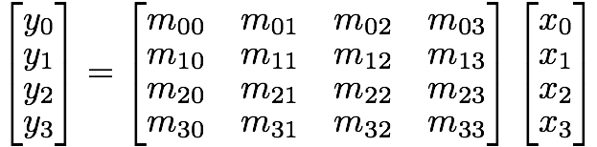
Matrix Multiplication
Notes:
\begin{bmatrix}
y_0\\y_1\\y_2\\y_3
\end{bmatrix}
=
\begin{bmatrix}
m_{00} & m_{01} & m_{02} & m_{03}\\
m_{10} & m_{11} & m_{12} & m_{13}\\
m_{20} & m_{21} & m_{22} & m_{23}\\
m_{30} & m_{31} & m_{32} & m_{33}
\end{bmatrix}
\begin{bmatrix}
x_0\\x_1\\x_2\\x_3
\end{bmatrix}

Slide 18
“Assembly Code” for y0
y0 = m00*x0 + m01*x1 + m02*x2 + m03*x3
t0 = m00 * x0 t1 = m01 * x1 t2 = m02 * x2 t3 = m03 * x3 t4 = t0 + t1 t5 = t2 + t3 y0 = t4 + t5
What is the ILP for one product (y0)?
What is the ILP for the entire matrix?
What is the ILP for doing 100 matrices in parallel?
In this case …
what will the machine parallelism be relative to the instruction-level parallelism?
Notes:
y0: 7/3 (7 instructions across 3 independent groups)
Whole matrix: 28/3
100 matrices in parallel: 2800/3
… but will machine parallelism support 100 matrices? There’s going to be problems in implementing it in hardware.
T/F The machine-level parallelism of a processor will always be greater than or equal to the available instruction-level parallelism.

Slide 19
Basics of a RISC Instruction Set
Key Properties
All operations on data apply to REGISTERS
(typically the entire register, i.e., 32 or 64 bits per register)
Only operations that affect memory?
LOAD and STORE
Instruction formats?
FEW (in contrast to CISC where there are many)
ALU instructions
LOAD and STORE instructions
BRANCH and JUMP instructions
FIXED-SIZE (in general)
32 bit or 64 bit, depending on architecture

Slide 20
Pipelined Processor
Time (Clock Cycles)
Cycle 1
Cycle 2
Cycle 3
Cycle 4
Cycle 5
Cycle 6
Cycle 7
Cycle 8
IF
ID
EX
MEM
WB
IF
ID
EX
MEM
WB
Instruction Order
IF
ID
EX
MEM
WB
IF
ID
EX
MEM
WB

Slide 21
Overview of MIPS64 ISA (see Appendix)
Registers
32 64-bit general-purpose registers (GPRs)
32 floating-pt registers (FPRs), holding 32 SP or 32 DP values
(When holding a SP number, the other half of the FPR is unused.)
Data Types → Integer and Floating Point
8-bit bytes; 16-bit half words, 32-bit words, 64-bit double-words
32-bit single-precision (SP); 64-bit double-precision (DP)
Addressing Modes → ONLY THREE natively supported!
Register
Immediate (16-bit field)
Displacement (16-bit field)
Register-indirect addressing: 0 in displacement field
Absolute addressing: R0 as the base register

Slide 22
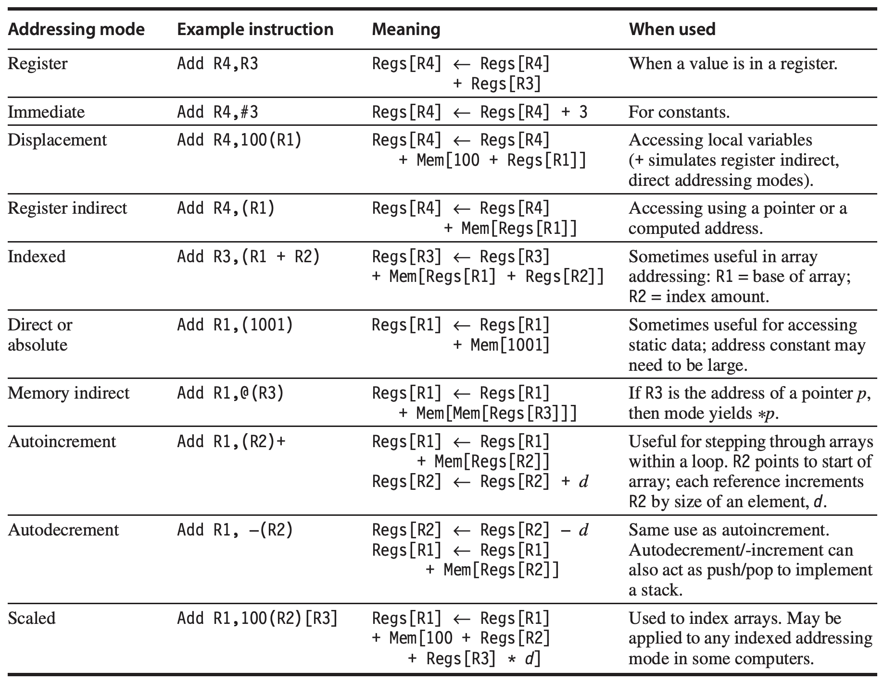
Addressing Modes of Past ISAs (see Fig. A.6)
Notes:
Addressing mode:
How architectures specify the address of an object they will address.

Slide 23
Encoding an Instruction Set
Balancing Act of Many Competing Forces
Desire to have as many registers and addressing modes as possible.
Impact of the size of the register and addressing mode fields (on average instruction size, and hence, on average program size).
Desire to have instructions encoded into lengths that will be easy to handle in a pipelined implementation.
Ideally, instructions should be in multiples of bytes (or words) rather than arbitrary bit length.

Slide 24
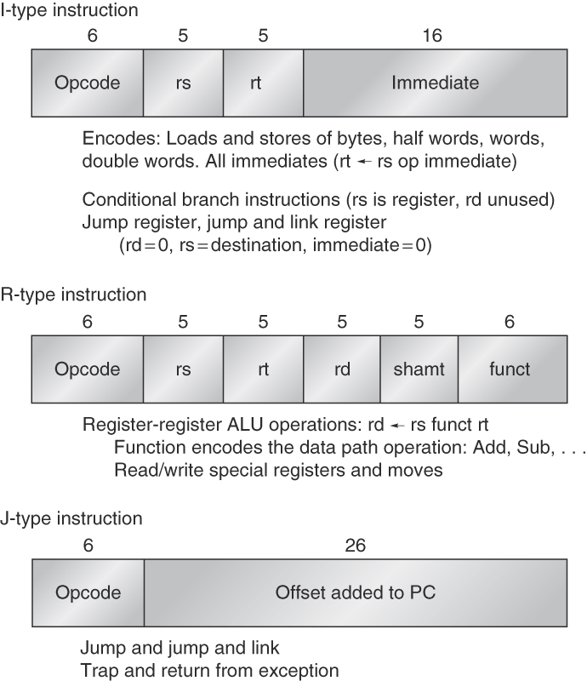
Instruction Layout for MIPS Pipelined Processor
This is for the MIPS32 ISA.
Resources for MIPS64 ISA
https://www.mips.com/products/architectures/mips64/
https://s3-eu-west-1.amazonaws.com/downloads-mips/documents/MD00083-2B-MIPS64INT-AFP-06.01.pdf

Slide 25
Basic Five-Stage Pipelined MIPS Architecture

Slide 26
Five-Stage Pipelined Processor
Instruction Fetch (IF)
Send PC to memory & fetch current instruction from memory
Update PC to next sequential PC (e.g., 4 for 32-bit architecture and 8 for 64-bit architecture)
Instruction Decode (ID) / Register Fetch
Decode instruction and read source registers in parallel
Why is this possible? “Fixed-field decoding”
Do EQUALITY test on registers during read for possible branch
Sign-extend the offset field of instruction, if needed
Compute possible branch target address (by adding offset to PC)
Notes:
ID: Register specifiers are in a FIXED location.
Branch could be completed in this stage by storing branch-target address into PC (if condition test yielded true)

Slide 27
Five-Stage Pipelined Processor
Execute (EXE) / Effective Address
EXE on operands from previous cycle
Memory reference calculation
Register-Register ALU instruction
Register-Immediate ALU instruction
Memory Access (MEM)
LOAD: Memory read using effective address calculated
STORE: Memory write data from register read to effective address
Write Back (WB)
Register-Register ALU instruction or LOAD instruction

Slide 28
Instruction-Level Parallelism
When exploiting instruction-level parallelism, goal is to minimize CPI (or maximize IPC)
Pipeline CPI =
Ideal pipeline CPI +
Structural stalls +
Data hazard stalls +
Control stalls
Nomenclature
Pipeline stalls are synonmous with “bubbles” in the pipeline.
Pipeline stalls are caused by hazards.

Slide 29
Review: Pipeline Hazards
Hazards
Situations that prevent the next instruction in the instruction stream from executing during its designated clock cycle.
Consequence
Insertion of “stalls” or “bubbles” into the pipeline
Types
Structural Hazards
Data Hazards
Control Hazards
Notes:
Structural Hazards: Arise from resource conflicts when HW cannot support all possible combos of instructions simultaneously in overlapped execution, e.g., one ALU but two ops
Data Hazards: Arise when an instruction depends on the results of a previous instruction in a way that is exposed by the overlapping of instructions in the pipeline.
Control Hazards: Arise from the pipelining of branches and other instructions that change the PC.

Slide 30
Review: Pipeline Hazards
Structural Hazards
What are they? How do we eliminate them?
Design pipeline to eliminate structural hazards
Time (Clock Cycles)
Cycle 1
Cycle 2
Cycle 3
Cycle 4
Cycle 5
Cycle 6
Cycle 7
Cycle 8
IF
ID
EX
MEM
WB
Instruction Order
IF
ID
EX
MEM
WB
IF
ID
EX
MEM
WB
Notes:
Design pipeline to eliminate structural hazards
Assume one ALU with an integer unit and floating-point unit only.
Example: LOAD, ADD, ADD. RAW inserts bubble into pipeline for second instruction but third instruction continues to move forward. Then both need the ALU at the same time.

Slide 31
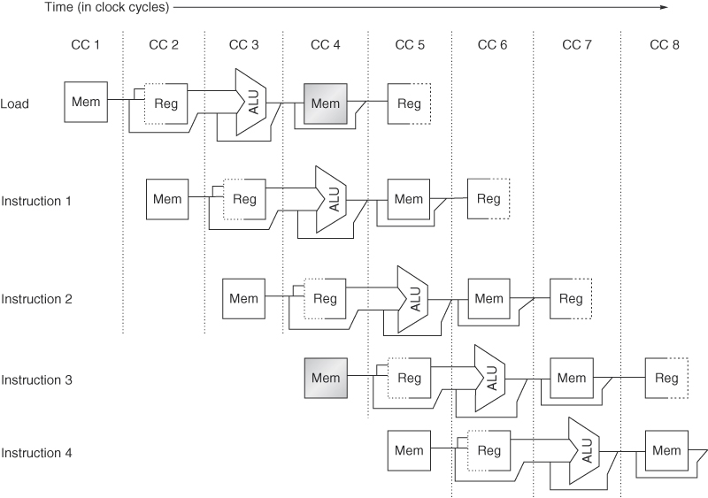
Structural Hazard
Assume a CPU with only one memory port
What does the pipeline schedule look like?
How does it compare to ideal?
Notes:
Figure C.4 A processor with only one memory port will generate a conflict whenever a memory reference occurs. In this example the load instruction uses the memory for a data access at the same time instruction 3 wants to fetch an instruction from memory.
Stall gets inserted at instruction 3 IF. See shaded boxes.

Slide 32
Review: Pipeline Hazards
Data Hazards – Read After Write (RAW)
What are they? How do we eliminate them?
Use data forwarding inside the pipeline
For those cases that forwarding won’t solve (e.g., load-use) include hazard hardware to insert stalls in the instruction stream
Time (Clock Cycles)
Cycle 1
Cycle 2
Cycle 3
Cycle 4
Cycle 5
Cycle 6
Cycle 7
Cycle 8
IF
ID
EX
MEM
WB
Instruction Order
IF
ID
EX
MEM
WB
IF
ID
EX
MEM
WB
Notes:
Use data forwarding inside the pipeline
For those cases that forwarding won’t solve (e.g., load-use) include hazard hardware to insert stalls in the instruction stream
In a traditional RISC pipeline, you can eliminate all but one RAW hazard.

Slide 33
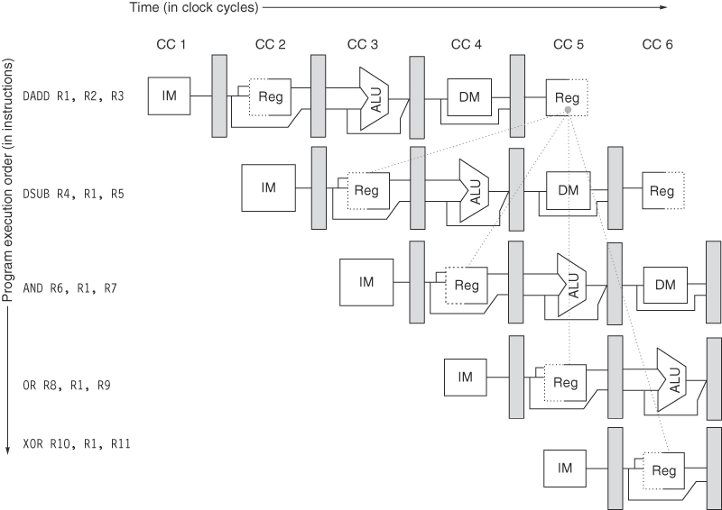
Data Hazard
What should the schedule look like?
Notes:
All the instructions after the DADD use the result of the DADD instruction.
What should the schedule look like without forwarding?
With forwarding?
ALU result from both EX/MEM and MEM/WB pipeline registers is always fed back to ALU inputs
If forwarding hardware detects that previous ALU op has written the register corresponding to a source for the current ALU op, control logic selects the forwarded results as the ALU input rather than the value read from the register file.

Slide 34
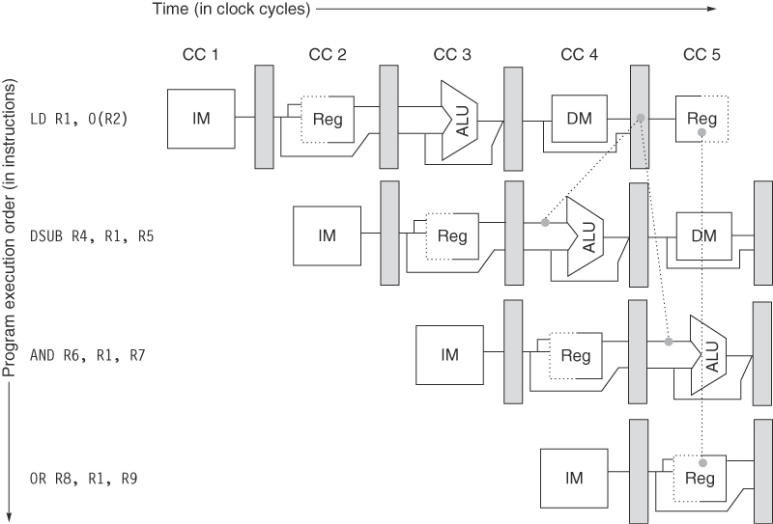
Unavoidable Data Hazards
Notes:
The load instruction can bypass its results to the AND and OR instructions, but not to the DSUB, since that would mean forwarding the result in “negative time.”

Slide 35
Data Dependence
Dependencies are a property of programs
Pipeline organization determines if dependence is detected and if it causes a stall
Data dependence conveys:
Possibility of a hazard
Order in which results must be calculated
Upper bound on exploitable instruction level parallelism
Dependencies that flow through memory locations are difficult to detect
Notes:
Aliasing with pointers …

Slide 36
Name Dependence
Two instructions use the same name but no flow of information
Not a true data dependence but is a problem when reordering instructions
Antidependence: instruction j writes a register or memory location that instruction i reads
Initial ordering (i before j) must be preserved
Output dependence: instruction i and instruction j write the same register or memory location
Ordering must be preserved
To resolve, use renaming techniques

Slide 37
Data Hazards
Data Hazards
Read after write (RAW)
Write after write (WAW)
Write after read (WAR)
Control Dependence
Ordering of instruction i with respect to a branch instruction
Instruction control dependent on a branch cannot be moved before the branch so that its execution is no longer controlled by the branch
An instruction not control dependent on a branch cannot be moved after the branch so that its execution is controlled by the branch

Slide 38
Pipelined Processor
Time (Clock Cycles)
Cycle 1
Cycle 2
Cycle 3
Cycle 4
Cycle 5
Cycle 6
Cycle 7
Cycle 8
IF
ID
EX
MEM
WB
IF
ID
EX
MEM
WB
Instruction Order
IF
ID
EX
MEM
WB
IF
ID
EX
MEM
WB

Slide 39
Review: Pipeline Hazards
Control Hazards – beq, bne, j, jr, jal
What are they?
Determines the ordering of an instruction i with respect to a “change-in-flow” instruction, i.e., branch or procedure call.
How do we eliminate them?
Stall, but it hurts performance
Move decision point to as early in the pipeline as possible
Reduces # of stalls at the cost of additional HW
Delay decision (requires compiler support)
Not feasible for deeper pipes requiring more than one delay slot to be filled
Predict (with more HW)
Reduces the impact of control hazard stalls
if branch prediction is correct and
if branched-to instruction is cached
Notes:
If p1 then s1;
If p2 then s2;
s1 control dependent on p1 and s2 control dependent on p2 but not on p1.
Control dependences must be preserved. Can execute instructions that should not have been executed but only if we can do so without affecting correctness.

Slide 40
Recall: Five-Stage Pipelined Processor
Instruction Fetch (IF)
Send PC to memory & fetch current instruction from memory
Update PC to next sequential PC (e.g., 4 for 32-bit architecture)
Instruction Decode (ID) / Register Fetch
Decode instruction and read source registers in parallel
Why is this possible? “Fixed-field decoding”
Do EQUALITY test on registers during read for possible branch
Sign-extend the offset field of instruction, if needed
Compute possible branch target address (by adding offset to PC)
Notes:
ID: Register specifiers are in a FIXED location.
Branch could be completed in this stage by storing branch-target address into PC (if condition test yielded true)

Slide 41
Constraints of Control Dependences
An instruction that is control-dependent on a branch
... cannot be moved BEFORE the branch so that its execution is no longer controlled by the branch.
An instruction that it not control-dependent on a branch
... cannot be moved AFTER the branch so that its execution is controlled by the branch.
Caveat?
May execute instructions that should not be executed, thus violating control dependences, but only IF we can do so without affecting the correctness of the program.
Notes:
If p1 then s1;
If p2 then s2;
s1 control dependent on p1 and s2 control dependent on p2 but not on p1.
Control dependences must be preserved. Can execute instructions that should not have been executed but only if we can do so without affecting correctness.
EXAMPLE:
CANNOT take instruction from THEN portion of an IF stmt and move it BEFORE the if stmt.
CANNOT take a statement before the IF stmt and move it into the THEN portion.

Slide 42
Examples
Example 1:
DADDU R1,R2,R3
BEQZ R4,L
DSUBU R1,R1,R6
L: …
OR R7,R1,R8
Example 2:
DADDU R1,R2,R3
BEQZ R12,skip
DSUBU R4,R5,R6
DADDU R5,R4,R9
skip:
OR R7,R8,R9
OR instruction dependent on DADDU and DSUBU
R1 used by OR depends on branch
Due to constraint of control dependence, DSUBU cannot be moved above branch.
(Caveat: Speculation?)
Assume R4 is not used after skip
Possible to move DSUBU before the branch
Property of whether a value is used by an upcoming instruction: liveness.
Notes:
Value of R1 dependent on branch. Both data and control dependence.
If R4 unused after skip, then changing R4 just before branch would not affect data flow since R4 would be “dead” in the code region after the skip.
→ Software speculation. (Compiler is betting on the branch outcome that it is usually not taken.)
DADDU R2, R3, R4
BEQZ R2, L1
LD R1, 0(R2)
L1:
Must maintain data dependence but if we ignore the control dependence and move LD before BEQZ, LD instruction cause memory protection exception. To do this, SPECULATION.

Slide 43
Summary: Hazards
Hazards are bad because they reduce the amount of achievable machine parallelism and keep us from achieving all the ILP in the instruction stream.

Slide 44
Recall: Instruction vs Machine Parallelism
Instruction-Level Parallelism (ILP) of a Program
In Theory
A measure of the average # of instructions in a program that, in theory, a processor could execute at the same time
In Practice
A function of the number of true (data) dependencies and procedural (control) dependencies in relation to the number of other instructions
Take Away
ILP is traditionally “extracting parallelism from a single instruction stream working on a single stream of data”
(Recall Flynn’s Classification …)
Notes:
Remember blue defn - will ask questions about it soon

Slide 45
Recall: Instruction vs Machine Parallelism
Machine Parallelism of a Processor
A measure of the ability of a processor to take advantage of the ILP of the program
In Theory (or “In the Limit”)
A perfect machine with infinite machine parallelism can achieve the ILP of a program.
In Practice
A function of the number of instructions that can be fetched and executed at the same time
To achieve high performance, need both ILP and machine parallelism.
First more on instruction parallelism, then machine parallelism.

Slide 46
Machine Parallelism
Two Approaches for Machine Parallelism
Responsibility of resolving hazards is …
Hardware-based
Dynamic-issue superscalar
Software-based
Static “VLIW: Very Long Instruction Word”
Notes:
first slide in second half of lecture (2007)

Slide 47
Multiple-Issue Processor Styles
Dynamic multiple-issue processors (aka superscalar)
Decisions on which instructions to execute simultaneously are being made dynamically (at run time by the hardware)
Examples: IBM Power 2, Pentium Pro/2/3/4, Core, MIPS R10K, HP PA 8500
Static multiple-issue processors (aka VLIW)
Decisions on which instructions to execute simultaneously are being made statically (at compile time by the compiler)
Examples: Intel Itanium and Itanium 2 for the IA-64 ISA—EPIC (Explicit Parallel Instruction Computer)

Slide 48
Supporting Machine Parallelism?
ALU
Ifetch
Reg
DMem
Reg
Now, how do we support multiple integer instructions?
Notes:
What do we need to add to each stage of the pipeline to support multiple instructions per cycle?
What are going to be some of the problems when we do?

Slide 49
Supporting Machine Parallelism?
ALU
Ifetch
Reg
DMem
Reg
First, let’s support parallel integer & FP instructions (MIPS)
Notes:
What do we need to add to each stage of the pipeline to support multiple instructions per cycle?
What are going to be some of the problems when we do?

Slide 50
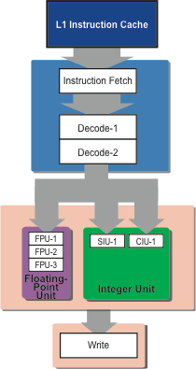
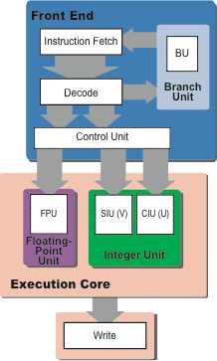
Pentium Microarchitecture
Notes:
Left is logical diagram, right is pipeline diagram
March 1993 / 0.8 micron / 3.1M transistors / 60-66 Hz / L1 8 KB instr, 8 KB data
30% of transistors for x86 decode
Pentium pipeline: IF D1 D2 EX (WB)
Multi-cycle instructions that write to memory must stall second pipe until last write

Slide 51
Multiple-Issue Datapath Responsibilities
Datapath handled with a combination of HW and SW.
Fundamental limitations of hazards
Storage (data) dependencies—aka data hazards
Most instruction streams do not have huge ILP so …
... this limits performance in a superscalar processor
Notes:
What sort of things could you do in hardware?
- register renaming, bigger register file
Software?
- move instructions to reduce/eliminate conflicts

Slide 52
Multiple-Issue Datapath Responsibilities
Datapath handled with a combination of HW and SW.
Fundamental limitations of hazards
Procedural dependencies—aka control hazards
Ditto, but even more severe
Use dynamic branch prediction to help resolve the ILP issue
Notes:
What sort of things could you do in hardware?
- branch prediction, predication, speculation
Software?
- branch hinting

Slide 53
Multiple-Issue Datapath Responsibilities
Datapath handled with a combination of HW and SW.
Fundamental limitations of hazards
Resource conflicts – aka structural hazards
A SS/VLIW processor has a much larger number of potential resource conflicts
Functional units may have to arbitrate for result buses and register-file write ports
Resource conflicts can be eliminated by duplicating the resource or by pipelining the resource
Notes:
Pipelining is much less expensive than duplicating

