Slide 1

Project topics for CS 4505

Slide 2
Project Topic 1
Title: Adding support for the missing floating-point instructions in gem5 for POWER ISA
Example: fsqrt
floating-point instruction that computes the square root of a value
Outcome: Robust and validated floating point arithmetic instruction support
Input(s): floating point value in FRB register
Output: The square root of the floating-point operand in register FRB is placed into register FRT
Challenges:
Functionally correct floating-point representation
Issues: byte-swapping
Need to handle floating-point exceptions

Slide 3
Project Topic 2
Title: Adding support for the out-of-order execution model O3CPU for POWER ISA in gem5
Example:
O3CPU is supported for X86 ISA in gem5. Use X86 O3CPU as a reference and implement O3CPU for POWER.
Outcome: Robust and validated O3CPU support
Input(s): A benchmark suite ex. SPEC’17
Output: Functionally correct output for the benchmark along with out of order execution
Challenges:
Requires significant efforts to implement and to ensure correctness
Much harder to implement O3CPU with speculation
Consider implementing O3CPU without speculation for baseline and then think about including speculation if time permits

Slide 4
Project Topic 3
Title: Finding the best cache configuration for a given set of workloads
Example:
Search space exploration into best performing cache parameters for a given workload. Tunable parameters include cache size, number of caches (2/3/4-level hierarchy) cache associativity, cache replacement policy etc.
Outcome: Identification of best performing cache configuration
Input(s): A set of workloads taken from a benchmark suite ex. SPEC’17
Output: Best performing cache configuration for each workload
Challenges:
Large number of tunable parameters
Difficult to automate the evaluation process

Slide 5
Project Topic 4
Title: Manual vectorization using VSX and MMA instructions
Example:
Vectorize the image convolution operation
Outcome: Vectorized code with correct outputs
Input(s): A set of workloads taken from a benchmark suite ex. SPEC’17
Output: A vectorized implementation of the input code that delivers significant performance improvements over the input code
Challenges:
VSX/MMA kernels are tedious to write and verify

Slide 6
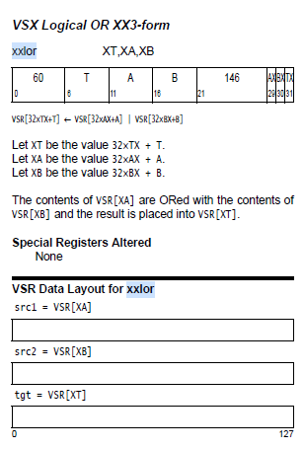
Project Topic 5
Title: Adding new instructions in Microwatt
Add one (or more) VSX instructions
Example xxlor : Performs bitwise or on two vectors
Outcome: Functionally correct implementation of xxlor
Input & output
Useful links
Demo from the Open Power Summit: https://youtu.be/g3slH03MCmo?t=526
Step by step instructions for adding a “wait” instruction. Great simple example. https://www.talospace.com/2019/09/a-beginners-guide-to-hacking-microwatt.html
Source: POWER ISA v3.0B

