Slide 1
Computer Architecture
A Quantitative Approach, Sixth Edition
Chapter 4
Data-Level Parallelism (DLP) in Vector, SIMD, and GPU Architectures
Part 2: Advanced Vector Architectures
“We call these algorithms data parallel algorithms because their parallelism comes from simultaneous operations across large sets of data, rather than from multiple thread of control.”
- W. Daniel Hillis and Guy L. Steele
”Data Parallel Algorithms,” Comm. ACM (1986)
“If you were plowing a field, which would you rather use, two strong oxen or 1024 chickens?”
- Seymour Cray, Father of the Supercomputer
(arguing for two powerful vector processors
versus many simple processors)

Slide 2
Acknowledgements
Thanks to many sources for slide material
© 1990 Morgan Kaufmann Publishers, © 2001-present Elsevier
Computer Architecture: A Quantitative Approach by J. Hennessy & D. Patterson
© 1994 Morgan Kaufmann Publishers, © 2001-present Elsevier
Computer Organization and Design by D. Patterson & J. Hennessy
© 2002 K. Asinovic & Arvind, MIT
© 2002 J. Kubiatowicz, University of California at Berkeley
© 2006, © 2010 No Starch Press for Inside the Machine by J. Stokes
© 2007 W.-M. Hwu & D. Kirk, University of Illinois & NVIDIA
© 2007-2010 J. Owens, University of California at Davis
© 2010 CRC Press for Introduction to Concurrency in Programming Languages by M. Sottile, T. Mattson, and C. Rasmussen
© 2017, IBM POWER9 Processor Architecture by Sadasivam et al., IBM
© 2016, © 2019 POWER9 Processor User’s Manual, IBM
© The OpenPOWER Foundation
© 2022, W. Feng, Virginia Tech

Slide 3
DAXPY (Y = a * X + Y)
Assuming vectors X, Y are length 64
Scalar vs. Vector
LD F0,a ;load scalar a
LV V1,Rx ;load vector X
MULTS V2,F0,V1 ;vector-scalar mult.
LV V3,Ry ;load vector Y
ADDV V4,V2,V3 ;add
SV Ry,V4 ;store the result
LD F0,a
ADDI R4,Rx,#512 ;last address to load
loop: LD F2, 0(Rx) ;load X(i)
MULTD F2,F0,F2 ;a*X(i)
LD F4, 0(Ry) ;load Y(i)
ADDD F4,F2, F4 ;a*X(i) + Y(i)
SD F4,0(Ry) ;store into Y(i)
ADDI Rx,Rx,#8 ;increment index to X
ADDI Ry,Ry,#8 ;increment index to Y
SUB R20,R4,Rx ;compute bound
BNZ R20,loop ;check if done
578 (2+9*64) vs. 321 (1+5*64) ops (1.8X)
578 (2+9*64) vs. 6 instructions (96X)
64 operation vectors + no loop overhead
also 64X fewer pipeline hazards

Slide 4
Vector Execution Time
Vector Architectures
Execution time depends on several factors:
Length of operand vectors
Structural hazards
Data dependencies
Pipeline depth → start-up latency (short vs. long vectors?)
VMIPS functional units consume one element per clock cycle
Execution time is approximately the vector length
Convoy
Set of vector instructions that could potentially execute together
Notes:
You can estimate performance by estimating the number of convoys.
Conveys MUST NOT contain structural hazards. Why? Instructions would need to be serialized and initiated in different convoys.
To keep analysis simple, assume that a convoy of instructions must complete execution before any other instructions (scalar or vector) can begin execution.

Slide 5
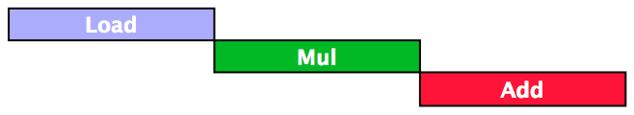

Vector Inefficiency
Vector Architectures
Must wait for last element of result to be written before starting dependent instruction
Notes:
SAXPY / DAXPY example

Slide 6
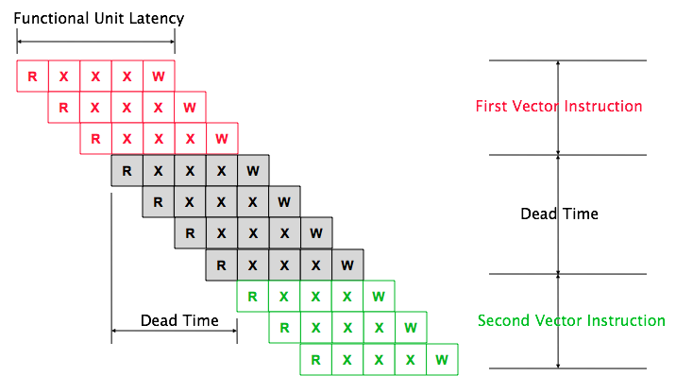
Vector Startup
Vector startup penalty
Functional unit latency (time thru pipeline)
Dead time or recovery time (time before another vector instruction can start down pipeline)
Vector Architectures
Notes:
Start-up latency and dead time for a single vector pipeline. Each element has a 5-cycle latency: 1 cycle to read the vector-register file, 3 cycles in execution, then 1 cycle to write the vector-register file. Elements from the same vector instruction can follow each other down the pipeline, but this machine inserts 4 cycles of dead time between two different vector instructions. The dead time can be eliminated with more complex control logic. (Reproduced with permission from Asanovic [1998].)

Slide 7
Vector Execution Time
Vector Architectures
Execution time depends on several factors:
Length of operand vectors
Structural hazards
Data dependencies
Pipeline depth → start-up latency (short vs. long vectors?)
VMIPS functional units consume one element per clock cycle
Execution time is approximately the vector length
Convoy
Set of vector instructions that could potentially execute together
Notes:
You can estimate performance by estimating the number of convoys.
Conveys MUST NOT contain structural hazards. Why? Instructions would need to be serialized and initiated in different convoys.
To keep analysis simple, assume that a convoy of instructions must complete execution before any other instructions (scalar or vector) can begin execution.

Slide 8
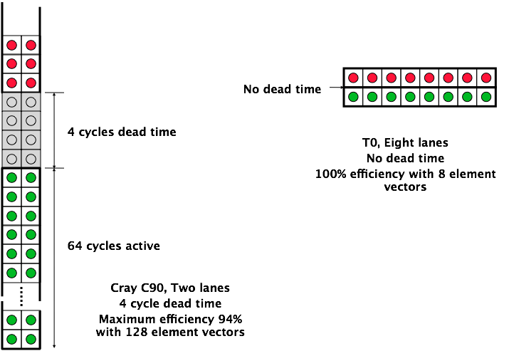
Dead Time and Short Vectors
Vector Architectures

Slide 9
Chimes
Vector Architectures
Chime
Unit of time to execute one convoy (or a vector operation)
m convoys executes in m chimes
For vector length of n, requires m x n clock cycles
When does this estimation become more accurate? Less accurate?
Notes:
(Less accurate for short vectors as start-up overhead cannot be amortized.)
Vector instructions belong to same convoy if no hazards: structural or data. However, RAW hazards can be in same convoy via chaining.
Convoy 1: 1st chime
Convoy 2: 2nd chime
Convoy 3: 3rd chime
…
Convoy m: mth chime
Each chime takes time proportion to vector length n, mxn clock cycles. Less accurate for short vectors as start-up overhead cannot be amortized.

Slide 10
Chaining
Vector Architectures
Sequences with read-after-write dependency hazards can be in the same convoy via chaining
Chaining
Allows a vector operation to start as soon as the individual elements of its vector source operand become available
Notes:
Vector instructions belong to same convoy if no hazards: structural or data. However, RAW hazards can be in same convoy via chaining.
Convoy 1: 1st chime
Convoy 2: 2nd chime
Convoy 3: 3rd chime
…
Convoy m: mth chime
Each chime takes time proportion to vector length n, mxn clock cycles. Less accurate for short vectors as start-up overhead cannot be amortized.

Slide 11
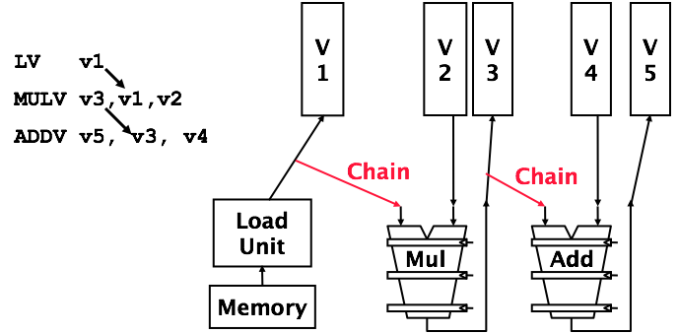
Vector Chaining
Vector version of register bypassing
Introduced with Cray 1
Notes:
The LV, MULV, ADDV sequence is considered a single convoy.

Slide 12
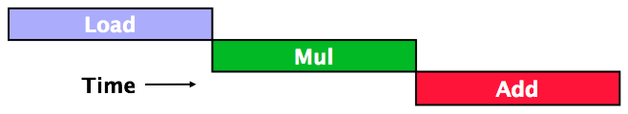
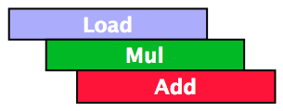
Vector Chaining
Without chaining, must wait for last element of result to be written before starting dependent instruction
With chaining, can start dependent instruction as soon as first result appears
Notes:
Convoy time = length of vector + start-up overhead.
(Each chime takes time proportion to vector length n, mxn clock cycles. Less accurate for short vectors as start-up overhead cannot be amortized).

Slide 13
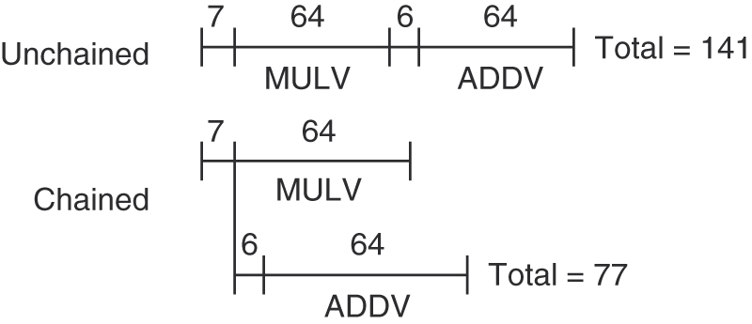
Unchained vs. Chained
Timing diagram for a sequence of dependent vector operations ADDV and MULV
Notes:
The 6- and 7-clock-cycle delays are the latency of the adder and multiplier.

Slide 14
Example
Vector Architectures
LV V1,Rx ;load vector X
MULVS.D V2,V1,F0 ;vector-scalar multiply
LV V3,Ry ;load vector Y
ADDVV.D V4,V2,V3 ;add two vectors
SV Ry,V4 ;store the sum
Convoys:
1 LV MULVS.D
2 LV ADDVV.D
3 SV
3 chimes, 2 FP ops per result, cycles per FLOP = 1.5
For 64 element vectors, requires 64 x 3 = 192 clock cycles
Notes:
128 floating-point ops per64-element vector x 1.5 cycles/floating-point op = 192 cycles

Slide 15
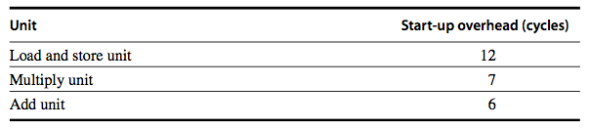
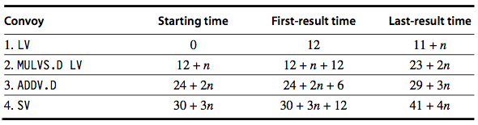
Convoy Time
Vector Architectures
Show the time that each convoy can begin and the total # of cycles needed.
Vector Start-Up Overhead
Answer in terms of convoys, vector length n, and no convoy overlap

Slide 16
Convoy Time vs. Chime Approx
How does the time compare to the chime approximation for a vector of length 64?
Tricky Question: When is the vector sequence actually done?
The total time is given by the time until the last vector instruction in the last convoy completes. This is an approximation, and the start-up time of the last vector instruction may be seen in some sequences and not in others.
For simplicity, we always include it. The time per result for a vector of length 64 is 4 + (42/64) = 4.65 clock cycles, while the chime approximation would be 4. The execution time with start- up overhead is 1.16 times higher.
Notes:
When is the vector sequence actually done?
This determines whether the start-up time of the SV is visible or not.
Already assume instructions cannot fit in same convoy and convoys do not overlap.

Slide 17
Challenges
Start-up time
Latency of vector functional unit
Assume the same as Cray-1
Floating-point add => 6 clock cycles
Floating-point multiply => 7 clock cycles
Floating-point divide => 20 clock cycles
Vector load => 12 clock cycles
Improvemeants
> 1 element per clock cycle
Non-64 wide vectors
IF statements in vector code
Memory system optimizations to support vector processors
Multiple dimensional matrices
Sparse matrices
Programming a vector computer
Vector Architectures

Slide 18
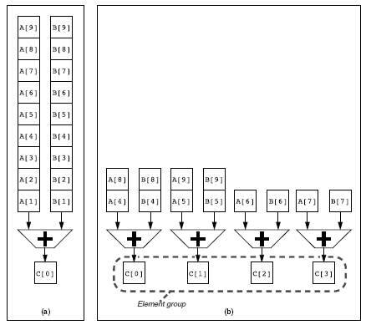
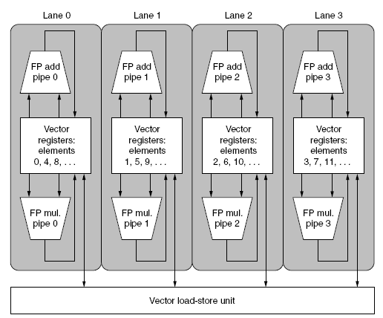
Multiple Lanes
Vector Architectures
Element n of vector register A is “hardwired” to element n of vector register B
Allows for multiple hardware lanes
Advantages? Disadvantages?
Notes:
Pipelined vector units in parallel. (Similar to superscalar pipeline, but rather than with instructions, doing it with data elements, i.e., DLP.)
Single add pipeline that can complete one addition per cycle.
Four add pipelines that can complete four additions per cycle.
Actual structure of a four-lane vector unit. Three types of vector functional units: FP add, FP multiply, and load-store. FOUR EXECUTION PIPELINES
Popular technique to improve vector performance:
Requires little increase in control complexity
Does not require changes to existing machine code.
Allows designers to trade-off die area, clock rate, voltage, and energy without sacrificing peak performance, e.g., halve the clock rate … how do you retain the same potential performance? Double the # of lanes.
Advantage: Easy way to higher throughput.
Disadvantage: Must support long vectors; else you’ll run out of instruction bandwidth.

Slide 19
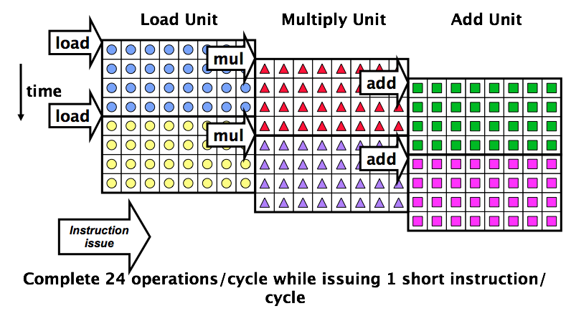
Vector Instructions with Multiple Lanes and Chaining
Can overlap execution of multiple vector instructions
Notes:
Example machine has 8 lanes.
Example machine has 32 elements per vector register and 8 lanes.

Slide 20
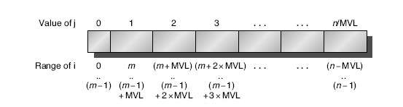
Vector Length Register
Vector Architectures
Vector length not known at compile time?
Use Vector Length Register (VLR) <= max vector length
Use strip mining for vectors over the maximum length:
low = 0;
VL = (n % MVL); /* find odd-size piece using modulo op % */
for (j = 0; j <= (n/MVL); j=j+1) { /* outer loop */
for (i = low; i < (low+VL); i=i+1) /* runs for length VL */
Y[i] = a * X[i] + Y[i] ; /* main operation */
low = low + VL; /* start of next vector */
VL = MVL; /* reset the length to maximum vector length */
}
Notes:
MVL determines the # of data elements in a vector of an architecture.
This parameter allows length of vector registers to grow in later computer generations without changing the instruction set.
Multimedia SIMD extensions have no equivalent of MVL, so they change the instruction set every time they increase their vector length.
In strip mining,
Each vector operation is done for a size <= MVL.
The length of the first segment is (n%MVL).
All subsequent segments are length MVL.

Slide 21
Vector Mask Registers
Vector Architectures
Consider the following code snippet
for (i = 0; i < 64; i=i+1)
if (X[i] != 0)
X[i] = X[i] – Y[i];
Use vector mask register to “disable” elements
LV V1,Rx ;load vector X into V1
LV V2,Ry ;load vector Y
L.D F0,#0 ;load FP zero into F0
SNEVS.D V1,F0 ;sets VM(i) to 1 if V1(i)!=F0
SUBVV.D V1,V1,V2 ;subtract under vector mask
SV Rx,V1 ;store the result in X
GFLOPS rate decreases!
This loop cannot normally be vectorized because of the conditional.
Notes:
Vector-mask control to the rescue!
- Uses a Boolean vector to control the execution of a vector instruction.
Using the vector-mask register does have overhead but may still be significantly faster than scalar mode.
From Amdahl’s law, speedup on programs with low to moderate levels of vectorization is limited.
Two main reasons for lower levels of vectorization:
Presence of conditionals inside loops (as IF statement introduces control dependences into loops)
Use of sparse matrices

Slide 22
Memory Banks
Vector Architectures
Memory system must be designed to support high bandwidth for vector loads and stores
Spread accesses across multiple banks
Control bank addresses independently
Load or store non-sequential words
Support multiple vector processors sharing the same memory
Example:
32 processors, each generating 4 loads and 2 stores/cycle
Processor cycle time is 2.167 ns, SRAM cycle time is 15 ns
How many memory banks needed?
Notes:
Behavior of load/store vector unit more complicated than arithmetic units, mainly due to the back that memory bank stalls can reduce effective throughput.
Start-up time for a load is the time for first word from memory into a register. If rest of vector can be supplied without stalling, then vector initiation rate is equal to rate at which new words are fetched and stored.
Penalties for start-up on load/store units are generally higher than those for arithmetic units
100+ clock cycles. For VMIPS, assume 12 clock cycles, same as Cray-1.
To maintain an initiation rate of one word fetched or stored per clock, the memory system must be capable of producing or accepting this much data. Spreading accesses across multiple independent memory banks usually delivers the desired rate.
Max # of memory references each cycle is 192 (32 x 6 refs/CPU). Each SRAM bank is busy for 15/2.167 = 6.92 clock cycles, which we round up to 7 processor cycles. Minimum of 192 x 7 = 1344 memory banks!
(This machine is actually a Cray T932 and had 1024 memory banks.)

