Slide 1
Computer Architecture
A Quantitative Approach, Sixth Edition
Chapter 3 (and Appendix C)
Instruction-Level Parallelism and Its Exploitation
Part 3: Advanced Scheduling
“Who’s first?”
“America.”
“Who’s second?”
“Sir, there is no second.”
-Dialog between two observers of the sailing race later named “The America’s Cup” and run every few years -- the inspiration for John Cocke’s naming of the IBM research processor as “America.” This processor was the precursor to the RS/6000 series and the first superscalar microprocessor.

Slide 2
Acknowledgements
Thanks to many sources for slide material
© 1990 Morgan Kaufmann Publishers, © 2001-present Elsevier
Computer Architecture: A Quantitative Approach by J. Hennessy & D. Patterson
© 1994 Morgan Kaufmann Publishers, © 2001-present Elsevier
Computer Organization and Design by D. Patterson & J. Hennessy
© 2002 K. Asinovic & Arvind, MIT
© 2002 J. Kubiatowicz, University of California at Berkeley
© 2006, © 2010 No Starch Press for Inside the Machine by J. Stokes
© 2007 W.-M. Hwu & D. Kirk, University of Illinois & NVIDIA
© 2007-2010 J. Owens, University of California at Davis
© 2010 CRC Press for Introduction to Concurrency in Programming Languages by M. Sottile, T. Mattson, and C. Rasmussen
© 2017, IBM POWER9 Processor Architecture by Sadasivam et al., IBM
© 2016, © 2019 POWER9 Processor User’s Manual, IBM
© The OpenPOWER Foundation
© 2022, W. Feng, Virginia Tech

Slide 3
Instruction Issue and Completion
Instruction issue—initiate execution
Instruction lookahead capability—fetch, decode and issue instructions beyond the current instruction
Instruction completion—complete execution
Processor lookahead capability—complete issued instructions beyond the current instruction
Instruction commit—write back results to the RegFile or D$ (i.e., change the machine state)
Scenarios
In-order issue w/ in-order completion
In-order issue w/ out-of-order completion
Out-of-order issue w/ out-of-order completion & in-order commit
Out-of-order issue w/ out-of-order completion
Notes:
Instruction issue, i.e., when an instruction begins execution phase.
Instruction completion, i.e., when an instruction completes execution.
Because a OOC pipeline allows multiple instructions to be in execution at the same time, it requires multiple functional units, pipelined functional units, or both.

Slide 4
In-Order Issue, In-Order Completion (IOI-IOC)
Simplest policy is to issue instructions in exact program order and to complete them in the same order they were fetched (i.e., in program order)
Example
Assume pipelined processor that can fetch & decode 2 instructions per cycle, has 3 functional units (single-cycle adder, a single-cycle shifter, and a two-cycle multiplier), and can complete (and write back) two results per cycle
Instruction sequence: I1 – needs two execute cycles (a multiply) I2 I3 I4 – needs the same function unit as I3 I5 – needs data value produced by I4 I6 – needs the same function unit as I5
Static Scheduling
Notes:
EXAM QUESTION: Modify the pipeline a bit …
Structural and data hazards

Slide 5
Example: IOI-IOC
I1: two execute cycles
I2
I3
I4: same function unit as I3
I5: data value produced by I4
I6: same function unit as I5
I1
I2
I3
I4
I5
I6
IF
ID
EX
EX
WB
I
n
s
t
r.
O
r
d
e
r
IF
ID
IF
ID
EX
WB
IF
ID
EX
WB
IF
ID
IF
ID
EX
WB
IF
ID
EX
WB
In parallel can
fetch/decode 2
and complete 2
IF
ID
IF
ID
WB
EX
Static Scheduling
Notes:
(Why does I2 wait to launch? That’s just the way this pipeline is designed. “Since I have to write back in order, I won’t even start yet.”)
How many cycles to finish? (8)
Where do we have to do a data forward? (EX4-5)
Why can’t I3 issue at time 2? (Two results per cycle.) How about I5+I6, I1+I2, I3+I4?
Limitation of static: Instr issued in order, one instruction that stalls causes entire pipeline to stall, leaving multiple functional units idle.
DIV.D F0, F2, F4; ADD.D F10, F0, F8; SUB.D F12, F8, F14.
SUB.D cannot execute because of dependence of ADD.D on DIV.D causes pipeline to stall.
Turn slide + code fragment above into an EXAM QUESTION.

Slide 6
In-Order Issue, Out-of-Order Completion
With out-of-order completion, a later instruction may complete before a previous instruction
Out-of-order completion is used in single-issue pipelined processors to improve the performance of program that has long-latency operations such as divide
When using out-of-order completion, instruction issue is stalled when there is a resource conflict (e.g., for a functional unit) or when the instructions ready to issue need a result that has not yet been computed
Dynamic Scheduling
Notes:
EXAM QUESTION: Give an example of IOI-OOC.
DIV.D F0, F2, F4; ADD.D F10, F0, F8; SUB.D F12, F8, F14.
SUB.D cannot execute because of dependence of ADD.D on DIV.D causes pipeline to stall.
Executing SUB.D amounts to checking for two things. Checking for the absence of
Structural hazard
Data hazard

Slide 7
Example: IOI-OOC
I1
I2
I3
I4
I5
I6
IF
ID
EX
EX
WB
I1: two execute cycles
I2
I3
I4: same function unit as I3
I5: data value produced by I4
I6: same function unit as I5
I
n
s
t
r.
O
r
d
e
r
IF
ID
EX
WB
IF
ID
EX
WB
IF
ID
IF
ID
EX
WB
IF
ID
EX
WB
IF
ID
IF
ID
EX
WB
Dynamic Scheduling
Notes:
What has made this faster? (I2 can finish out of order)
How many cycles to finish? (7)
What is the best case time and what is the worst case time for a 6-instruction sequence?
- Best case time: single cycle, no conflicts (shift, add, shift, add, shift, add). 5 cycles total.
- Worst case: multiply, all dependent. 14 cycles total (2*6 + 2 startup)

Slide 8
Handling Output Dependencies
One more situation that stalls instruction issue w/ IOI-OOC
I1 – writes to R3 I2 – writes to R3 I5 – reads R3
If the I1 write occurs after the I2 write, then I5 reads an incorrect value for R3
I2 has an output dependency on I1—write after write
The issuing of I2 would have to be stalled if its result might later be overwritten by a previous instruction (i.e., I1) that takes longer to complete—the stall happens before instruction issue
While IOI-OOC yields higher performance, it requires more dependency checking hardware (both write-after-read and write-after-write hazards)
Dynamic Scheduling
Notes:
Need arbitration and more ports because there probably are not enough to satisfy all instructions that can complete simultaneously

Slide 9
Example: IOI-OOC
I1
I2
I3
I4
I5
I6
IF
ID
EX
EX
WB
I1: two execute cycles + WB to R3
I2: WB to R3
I3
I4: same function unit as I3
I5: read R3 + data value produced by I4
I6: same function unit as I5
I
n
s
t
r.
O
r
d
e
r
rename
IF
ID
EX
WB
IF
ID
EX
WB
IF
ID
IF
ID
EX
WB
IF
ID
EX
WB
IF
ID
IF
ID
EX
WB
Dynamic Scheduling
Notes:
WAW hazard with I1 and I2.
Address by register renaming, e.g., rename R3 in I2 and I5 to R20, for example.

Slide 10
Out-of-Order Issue with Out-of-Order Completion (OOI-OOC)
With in-order issue, CPU stops ID when decoded instruction has resource conflict or a data dependency on an issued but uncompleted instruction
CPU is unable to look beyond conflicted instruction even though more downstream instructions might have no conflicts and thus be issuable
Fetch & decode instructions beyond the conflicted one (“instruction window”: Tetris), store them in an instruction buffer (if room), and flag those instructions in buffer that do NOT have resource conflicts or data dependencies
Flagged instructions are then issued from the buffer w/o regard to their program order → re-order buffer (ROB)
Dynamic Scheduling
Notes:
An instruction being in the instruction window only implies that the processor has sufficient information about the instruction to know whether or not it can be issued
Instr window == Tetris

Slide 11
OOI-OOC Example
I1
I2
I3
I4
I5
I6
IF
ID
EX
EX
WB
I
n
s
t
r.
O
r
d
e
r
I1: two execute cycles
I2
I3
I4: same function unit as I3
I5: data value produced by I4
I6: same function unit as I5
IF
ID
EX
WB
IF
ID
EX
WB
IF
ID
IF
ID
WB
EX
IF
ID
IF
ID
WB
EX
IF
ID
EX
WB
Dynamic Scheduling
Notes:
How many cycles? (6)
What’s changed? 6 issues before 5.
What assumption do we need to make when we reorder?
- Assume that I4 is using a different functional unit than I6

Slide 12
Overview: Dynamic Scheduling
Definition: Rearrange order of instructions to reduce stalls while maintaining data flow
Implications
Out-of-order execution
Out-of-order completion
Advantages
Compiler does NOT need to have knowledge of microarchitecture
Handles cases where dependencies are unknown at compile time
Disadvantages
Substantial increase in hardware complexity
Complicates exception-handling
Creates the possibility for WAR and WAW hazards
Tomasulo’s Algorithm
Notes:
Tomasulo’s Approach
Tracks when operands are available
Introduces register renaming in hardware
Minimizes WAW and WAR hazards

Slide 13
Recap: Dependencies
Each of the three data dependencies …
True data dependencies (read after write)
Antidependencies (write after read)
Output dependencies (write after write)
… manifests itself through the use of registers
(or other storage locations)
True dependencies represent the flow of data and information through a program
Anti- and output dependencies arise because the limited number of registers mean that programmers reuse registers for different computations
storage conflicts
Notes:
Storage conflicts, like other resource conflicts can be reduced or eliminated by duplicating the troublesome resource
Formerly last bullet on slide:
When instructions issued out-of-order, correspondence between registers and values breaks down and values conflict for registers

Slide 14
Recap: Pipeline Scheduling
Statically Scheduled Pipeline
Fetches an instruction and issues it unless there is a data dependence that cannot be hidden with forwarding.
Implication: In-order issue; in-order completion
Dynamically Scheduled Pipeline
Rearranges the order of instructions to reduce stalls while maintaining data flow
Implication: In-/out-of-order issue; out-of-order completion
Observation
Commonality: Both must maintain data flow for correctness.
Difference: Other than static vs. dynamic …
Static: Minimize stalls by separating dependent instructions
Dynamic: Minimize stalls by re-arranging instructions based on dynamic presence of dependences
Notes:
What’s the diff?
BOTH must abide by the data flow of the program for correctness.

Slide 15
Example: IOI-OOC
I1
I2
I3
I4
I5
I6
IF
ID
EX
EX
WB
I1: two execute cycles + WB to R3
I2: WB to R3
I3
I4: same function unit as I3
I5: read R3 + data value produced by I4
I6: same function unit as I5
I
n
s
t
r.
O
r
d
e
r
rename
IF
ID
EX
WB
IF
ID
EX
WB
IF
ID
IF
ID
EX
WB
IF
ID
EX
WB
IF
ID
IF
ID
EX
WB
Dynamic Scheduling
Notes:
WAW hazard with i1 and i2.
Address by register renaming, e.g., rename R3 in I2 and I5 to R20, for example.

Slide 16
Dynamic Scheduling with Tomasulo’s Algorithm
Tracks when operands are available (minimize RAW hazards)
Introduces register renaming in hardware
Addresses WAW & WAR
hazards
Extends to handle
speculation
Technique used to reduce
effect of control dependences
IF precedes ID and fetches into an IR or equivalent (e.g., a queue of pending instructions → re-order buffer). ID has two sub-stages:
Issue: Decode instruction + check for structural hazards
Read Operands: Wait until no data hazards
I1: two execute cycles + WB to R3
I2: WB to R3
I3
I4: same function unit as I3
I5: read R3 + data value produced by I4
I6: same function unit as I5
rename
Delineate between when instruction begins exect’n
& when it completes execut’n
Dynamic Scheduling
Notes:
WAW & WAR hazards introduced. WAW: output dependence. WAR: anti-dependence.
IF stage precedes the issue stage and may fetch either into an IR or into a queue of pending instructions, e.g., re-order buffer (ROB)
To allow out-of-order execution, ID needs to be split into two sub-stages (implicit before, explicit now to enable "register renaming")
Issue (decode & check for structural hazards)
Read Operands (wait until no data hazards, and THEN read operands)
Distinguish between when an instruction begins execution and when it completes execution. Between then, the instruction is in execution.
Having multiple instructions in execution at the same time requires multiple functional units, pipelined functional units or both.
In an IOI-OOC, all instructions pass through the issue stage in order (“in-order issue”) but can be stalled or bypassed by each other in the second stage (i.e., read operands).
In an OOI-OOC, instructions may pass through the stage out of order.
A technique for allowing instructions to execute out of order when sufficient resources and no data dependences: SCOREBOARDING. (Named after CDC 6600 scoreboard.)
We focus on a more sophisticated technique called Tomasulo’s algorithm, which handles antidependence and output dependence by renaming the registers dynamically.
Tomasulo’s algorithm came from IBM. Goal: Achieve high floating-pt performance.
Issues: IBM’s 360 only had 4 DP floating-pt. units, long floating-point delays, and long memory accesses (on miss).

Slide 17
Another Example: IOI-OOC Introduces WAR & WAW
Can dynamically schedule with IOI-OOC
OOC introduces possibility of WAR and WAW hazards, which are NOT issues in a statically scheduled pipeline.
DIV.D F0, F2, F4
ADD.D F6,F0,F8
SUB.D F8,F10,F14
MUL.D F6,F10,F8
How to avoid the above? Register renaming
Eliminates WAR & WAW hazards by renaming all destination registers, including those with a pending read or write for an earlier instruction, so that the out-of-order write does not affect any instructions that depend on an earlier value of an operand.
Antidependence between ADD.D and SUB.D
If pipeline tries SUB.D before ADD.D, antidependence violated & yields WAR hazard.
Output dependence between ADD.D and MUL.D
If pipeline tries MUL.D before ADD.D, output dependence violated & yields WAW hazard.
Dynamic Scheduling
Notes:
PROBLEM
SUB.D cannot execute because of dependence of ADD.D on DIV.D causes pipeline to stall.
YET SUB.D is NOT data dependent on anything in the pipeline
This hazard creates a performance limitation that can be eliminated by not requiring instructions to execute in program order.
In classic 5-stage pipeline, both structural and data hazards can be checked during ID (reason for splitting ID stage into two sub-stages)
To allow SUB.D to execute early, two parts must be satisfied:
Checking for structural hazards
Waiting for absence of data hazards
Antidependence between ADD.D and SUB.D. If pipeline executes SUB.D before ADD.D (which is waiting for the DIV.D), it will violate antidependence, yielding a WAR hazard.
Output dependence between ADD.D and MUL.D. If pipeline executes MUL.D before ADD.D (which is waiting for the DIV.D), it will violate output dependence, yielding a WAW hazard.
OOC creates major complications in handling exceptions. Dynamic scheduling with OOC must preserve exception behavior in the sense that EXACTLY those exceptions that would arise ifthe program were executed in strict program order ACTUALLY do arise.

Slide 18
Register Renaming
Identify all the data hazards for an IOC pipeline.
Identify all the data hazards for an OOC pipeline.
Example
DIV.D F0,F2,F4
ADD.D F6,F0,F8
S.D F6,0(R1)
SUB.D F8,F10,F14
MUL.D F6,F10,F8
antidependence
output dependence
antidependence
Two antidependences (WAR) and an output dependence (WAW)
Dynamic Scheduling
Note: The above code snippet uses the MIPS ISA. The textbook uses the RISC V ISA.
Notes:
Two antidependences and an output dependence (F6)
EXAM QUESTION: (1) Identify all the data hazards for a IOC pipeline. (2) Identify all the hazards for a OOC pipeline.
RAW (3): DIV.D and ADD.D; SUB.D and MUL.D, and ADD.D and S.D.
WAR (2): Use of F8 by ADD.D and use of F6 by SUB.D.
WAW (1): ADD.D may finish later than the MUL.D.
WAR and WAW dependences can be eliminated by register renaming.

Slide 19
Register Renaming
Example
DIV.D F0,F2,F4
ADD.D S,F0,F8
S.D S,0(R1)
SUB.D T,F10,F14
MUL.D F6,F10,T
Now only RAW hazards remain, which can be strictly ordered
Any subsequent uses of F8 must be replaced by the register T
DIV.D F0,F2,F4
ADD.D F6,F0,F8
S.D F6,0(R1)
SUB.D F8,F10,F14
MUL.D F6,F10,F8
Dynamic Scheduling
Note: The above code snippet uses the MIPS ISA. The textbook uses the RISC V ISA.
Notes:
Assume the existence of two temporary registers, S and T. WAW and WAR hazards are now gone.
Could this renaming process have occurred at compile time? Y.
CAUTION: Any subsequent uses of F8 must be replaced by the register T.
Finding any uses of F8 that are later in the code requires sophisticated compiler or hardware support since there may be intervening branches between above code and a later use of F8.
Tomasulo’s algorithm can handle renaming across branches.

Slide 20
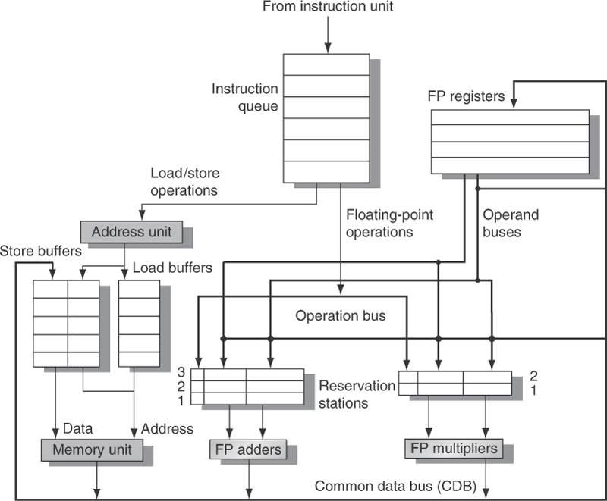
Register Renaming
Tomasulo’s Approach
Tracks when operands are available
Introduces register renaming in hardware
via reservation stations (RS)
Minimizes WAW and WAR hazards (by renaming destination regs)
Register renaming is provided by reservation stations (RS)
Contains:
The instruction
Buffered operand values (when available)
Reservation station number of instruction providing the operand values
Dynamic Scheduling

Slide 21
Register Renaming
Register renaming provided by reservation stations (RS)
RS fetches and buffers an operand as soon as it becomes available, eliminating the need to get the operand from a register
Pending instructions designate the RS to which they will send their output
Result values broadcast on a result bus called common data bus (CDB)
Only the last output updates the register file
Observations
As instructions are issued, the register specifiers are renamed with the reservation station
May be more reservation stations than registers
Load and store buffers
Contain data and addresses, act like
reservation stations
Dynamic Scheduling
Notes:
RS buffers the operands of instructions waiting to issue.
Basic idea: RS fetches and buffers an operand as soon as available, eliminating the need to get the operand from a register. (This is the renaming but done in HW.)
Pending instructions designate the RS that will provide their input.
When successive writes to a register overlap in execution, only the last one is actually used to update the register. (See code fragment again).
Better performance, but the tradeoff is … more complexity and more power consumption.
Solution: Let the compiler do it. See previous slide. What are S and T? They ultimately have to be actual registers. Problem? Limited registers.
Hence, Tomasulo’s algorithm in hardware.
- Generally more RS than real registers → can eliminate more hazards arising from name dependences.

Slide 22
High-Level Architecture for Tomasulo’s Algorithm
Register renaming via
reservation stations (RS)
Load and store buffers
Contain data & addresses,
act like reservation stations
Advantages
Distribution of hazard
detection logic
Elimination of stalls for
WAW and WAR hazards
by renaming all destination
registers
Dynamic Scheduling
No execution tables shown.
Notes:
Register renaming eliminates WAR and WAW hazards by renaming all destination registers, including those with a pending read or write for an earlier instruction.
Register renaming is provided by reservation stations (RS)
Contains:
The instruction
Buffered operand values (when available)
Reservation station number of instruction providing the operand values
Advantages:
Hazard detection and execution control are distributed.
Info held in RS at each functional unit determines when an instruction can being execution at that unit.
Results are passed directly to functional units from RS where they are buffered, rather than going through registers. (This bypassing is done with a common result bus that allows all units waiting for an operand to be loaded simultaneously.
Each RS holds an inst that has been issued and is awaiting execution at a functional unit (structural hazard) and either operand values (data hazard), if already computed or names of RS that will provide operand values.
(In pipelines with multiple execution units AND issuing multiple instructions per clock, more than one results bus will be needed.)

Slide 23
Tomasulo’s Algorithm at High Level
Three steps that an instruction goes through …
Issue (or Dispatch), where register renaming occurs
Get next instruction from FIFO queue
If available RS, issue instruction to RS w/ operand values, if available. If operand values not available, stall instruction in RS and keep track of the functional units that will produce operand values.
If no available RS, structural hazard → stall until RS or buffer free …
Execute
When operand available (via CDB), store it in any RS waiting for it
When all operands ready (i.e., no RAW hazard), issue instruction
Loads & store maintained in program order via effective address calc.
No instruction allowed to initiate execution until all branches that precede it in program order have completed (to preserve exception behavior)
Write result
Write result on CDB into registers and RS (including store buffers)
(Stores must wait until address and value are received)
Dynamic Scheduling
Notes:
First step is actually an IF (instruction fetch).
ISSUE
FIFO order: Ensures maintenance of correct data flow.
No available RS? Structural hazard. How many FP adders and FP multipliers in previous diagram? 3 and 2.
If operands are NOT in registers, keep track of the functional units that will produce the operands. This step renames registers, eliminating WAR and WAW hazards.
EXECUTE
If one or more of the operands is not yet available, monitor the CDB for it. When operand available, …
By delaying instruction execution until operands are available, RAW hazards are avoided.
When multiple instructions become ready in the same clock cycle for the same functional unit, the unit chooses among them. (L.D. and S.D are trickier. See below.)
L.D in load buffer execute as soon as memory unit available.
S.D in store buffer MUST wait for value to be stored in buffer before sending to memory unit.
L.D and S.D are maintained in program order through the effective address calculation, thus preventing hazard via memory.
To preserve exception behavior, no instruction is allowed to initiate execution until a branch that precedes the instruction in program order has completed. This restriction guarantees that an instruction that causes an exception during execution really would have executed.
All this means is that in a CPU with branch prediction, the CPU must know that the branch prediction is correct BEFORE allowing an instruction AFTER the branch to begin execution.
WRITE RESULT
When result is available, write onto CDB and into registers and into any reservation stations, including store buffers.
The data structures and associated tags that detect and eliminate hazards are attached to the (1) RS, (2) reg file, and (3) load & store buffers.

Slide 24
High-Level Architecture for Tomasulo’s Algorithm
Each RS has seven fields:
Op
Op to do on src operands
Qj, Qk
RS that produce corresponding src operand
(Zero value means src operand in Vj or Vk or not needed)
Vj, Vk
Value of src operands
(Only one V field or Q field valid for each operand)
A
Holds info for memory addr calc
Busy
Indicates RS and associated functional unit are busy
Notes:
The data structures and associated tags that detect and eliminate hazards are attached to the (1) RS, (2) reg file, and (3) load & store buffers.
The tags are effectively NAMES for an extended set of virtual registers used for renaming. In OUR example (see next slide briefly),
Tag field is a 4-bit quantity denoting 1 of 5 RS or 1 of 5 load buffers → Equivalent of 10 (virtual) registers that can be designated as result registers (vs. the 4 DP registers in the IBM 360 mainframe). In a CPU with more real registers (e.g., 32), want renaming to provide an even larger set of virtual registers, i.e., HUNDREDS.
Tag field indicates the RS containing the instruction that will produce a result needed as a source operand.
ONCE an instruction has issued and is waiting for a source operand, it refers to the operand by the RS # (NOT the register number).
So, WAW and WAR hazards are eliminated by renaming results using RS #s, one of the two noted advantages. What was the other?
Distribution of hazard detection logic. In statically scheduled pipeline, e.g., MIPS32 ISA, forwarding & bypassing centralized in HW. Here it is distributed.
→ Combination of the CDB and the retrieval of results from the CDB by the RS implements forwarding & bypassing.
Each RS has 7 fields. Switch back and forth between this slide and next.
Op: Source operands S1 and S2.
Qj, Qk: RS that will produce the corresponding source operand; a value of 0 indicates that the source operand is already in Vj, Vk or is not needed.
Vj, Vk: For loads, the Vk field is used to hold the offset field.
A: Holds info for memory address calc for a L.D or S.D. Initially immediate field of instruction stored; after address calc, effective address stored.
The register file has a field, Qi:
Qi: # of the reservation station that contains the operation whose results should be stored into this register.
(If Qi is blank or zero, no active instruction is computing a result destined for this register.
The load and store buffers each have a field, A:
A: Holds result of effective address.

Slide 25
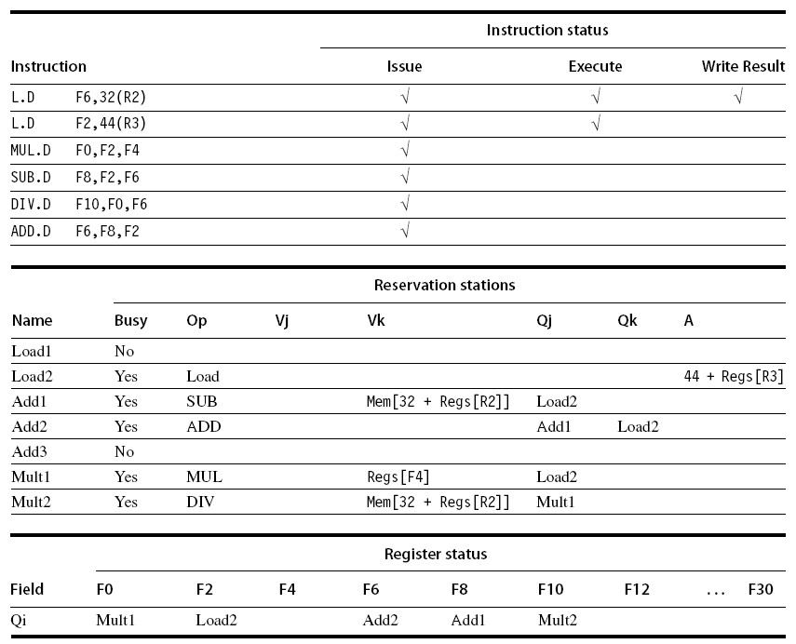
Example: Tomasulo’s in Action
Assume the following execute latencies:
L.D 1 cycle
ADD.D 2 cycles
MUL.D 6 cycles
DIV.D 12 cycles
What do the status tables look like when MUL.D is ready to write its result?
Let’s find out!
Dynamic Scheduling
Note: The above code snippet uses the MIPS ISA. The textbook uses the RISC V ISA.
Notes:
Orientation:
# appended to names Add, Mult, and Load stand for the tag for that RS. NOT actually part of hardware; included here to help understanding. In hardware, RS keeps state of each operation that has issued.
Hazard detection and execution control are distributed. Results are passed directly to functional units from RS, where they are buffered rather going through registers.
Reservation stations & register tags shown when all instructions have issued but only first L.D has completed and written its result to the CDB.
Second L.D has completed effective address calculation but waiting on the memory unit.
Use the array Regs[ ] to refer to the register file and the array Mem[ ] to refer to the memory
An operand is specified by either a Q field or a V field at any time.
Notice ADD.D instruction, which has a WAR hazard at the WB stage, has issued and could complete before DIV.D initiates.
Elimination of WAW and WAR hazards. See the DIV.D and ADD.D just discussed.
WAR hazard involving F6
Eliminated via register renaming to RS.
If instr providing value for DIV has completed, then Vk will store the result (rather than F6 storing the result), allowing DIV.D to execute independent of ADD.D. THIS IS THE CASE THAT IS SHOWN with Load1.
If first L.D instruction, which writes to F6, did NOT complete, then Qk would point to the Load1 RS.
Thus, in either case, ADD.D can issue and begin executing as the register renaming has resolved the WAR hazard.
That is, any uses of the result of the DIV.D will point to the RS, allowing ADD.D to complete and store its values into the registers without affecting the DIV.D

Slide 26
Example: Tomasulo’s for IOI/OOI-OOC
I1
I2
I3
I4
I5
I6
IF
ID
EX
EX
EX
EX
WB
I
n
s
t
r.
O
r
d
e
r
IF
ID
EX
EX
EX
EX
IF
ID
IF
ID
IF
ID
IF
ID
IF
ID
IF
ID
IF
ID
IF
ID
IF
ID
IF
ID
Notes:
What would the likely latencies be in this case? Assuming a single-issue pipeline.
What about assuming a dual-issue pipeline?

Slide 27
Tomasulo’s w/ Straightline Code
Assume the following execute latencies:
L.D 1 cycle
ADD.D 2 cycles
MUL.D 6 cycles
DIV.D 12 cycles
What do the status tables look like when MUL.D is ready to write its result?
Dynamic Scheduling
Note: The above code snippet uses the MIPS ISA. The textbook uses the RISC V ISA.
Notes:
ADD.D has completed because the operands of DIV.D were copied (renamed), thus overcoming the WAR hazard.
See next (hidden) slide for details.

Slide 28
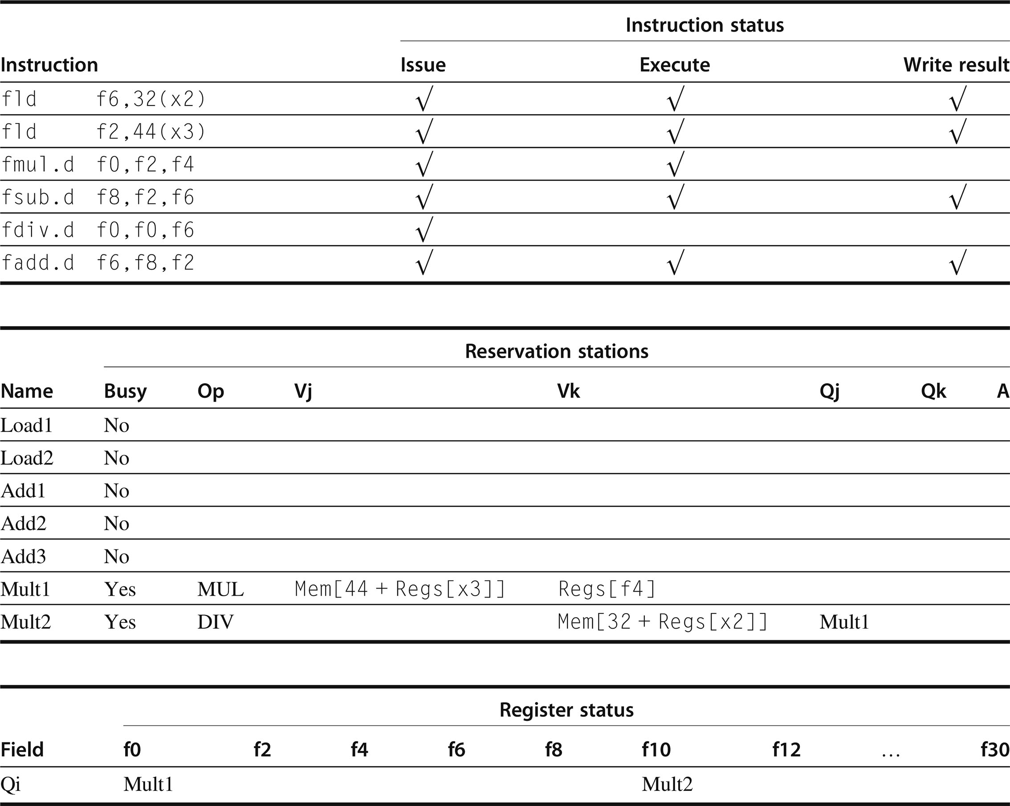
L.D F6,32(R2)
L.D F2,44(R3)
MUL.D F0,F2,F4
SUB.D F8,F2,F6
DIV.D F10,F0,F6
ADD.D F6,F8,F2
R3
F4
R2

Slide 29
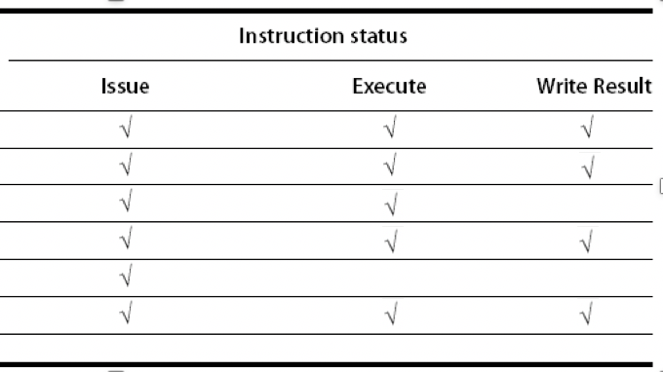
Example: Tomasulo’s for IOI/OOI-OOC
I
n
s
t
r.
O
r
d
e
r
I1
I2
I3
I4
I5
I6
Notes:
Homework problem!
Assume a single-issue pipeline.
Assume a dual-issue pipeline.

Slide 30
Tomasulo’s with Loop-Based Code
RISC-V Loop-Based Code
Loop: fld f0,0(x1)
fmul.d f4,f0,f2
fsd f4,0(x1)
addi x1,x1,8
bne x1,x2,Loop // branches if x1 != x2
Assumption
Predict branches taken.
Implication: RS allow multiple executions of the loop to run simultaneously, an advantage gained WITHOUT changing the code. Loop is unrolled dynamically by hardware using the RS obtained by “register renaming.” (Ignore integer ALU operation for now as branch is predicted as taken.)
Dynamic Scheduling
Notes:
This loop merely multiplies the elements of an array by a scalar in f2.
Observations:
Once system is executing two iterations, CPI ~ 1.0 if multiplies can execute in 4 cycles.
If multiplies take 6 cycles, then additional iterations will be needed before the steady state can be reached. This requires more RS to hold instructions that are in execution.

Slide 31
Tomasulo’s with Loop-Based Code
Loop: fld f0,0(x1)
fmul.d f4,f0,f2
fsd f4,0(x1)
addi x1,x1,8
bne x1,x2,Loop // branches if x1 != x2
Observations
A load (fld) and a store (fsd) can be safely done out of order iff they access different locations, but what if they access the same?
Load is before store in program order & interchanging them → WAR hazard
Store is before load in program order & interchanging them → RAW hazard
Also, interchanging two stores → WAW hazard
How to Detect Hazards on Loads & Stores?
Dynamic Scheduling
Notes:
To understand the full power of eliminating WAW and WAR hazards via dynamic renaming of registers, let’s look at a loop.
→ means “results in” here
WAR Hazard: To determine if a load can be executed, CPU checks if any uncompleted stores that precedes the load in program order share the same data memory address as the load. (See earlier figure with ROB.)
RAW & WAW Hazard: Similarly, a store must wait until there are no unexecuted loads or stores that are earlier in program order that share the same data memory address.

Slide 32
Tomasulo’s with Loop-Based Code
Loop: fld f0,0(x1)
fmul.d f4,f0,f2
fsd f4,0(x1)
addi x1,x1,8
bne x1,x2,Loop // branches if x1 != x2
How to Detect Hazards on Loads & Stores?
Loads
Compute the data memory address associated with any earlier memory operation → pragmatically check the “A” field of all active (store) buffers
If load address matches address of any active entry in store buffer, load is not sent to load buffer until conflicting store completes (i.e., respect RAW hazard)
Stores
Similar to loads except that CPU must check for conflicts on both the load buffers AND store buffers (since conflicting stores cannot be reordered with respect to either a load or a store, i.e., WAR or WAW).
Dynamic Scheduling
Notes:
To understand the full power of eliminating WAW and WAR hazards via dynamic renaming of registers, let’s look at a loop.
→ means “results in” here
WAR Hazard: To determine if a load can be executed, CPU checks if any uncompleted stores that precedes the load in program order share the same data memory address as the load. (See earlier figure with ROB.)
RAW & WAW Hazard: Similarly, a store must wait until there are no unexecuted loads or stores that are earlier in program order that share the same data memory address.

Slide 33
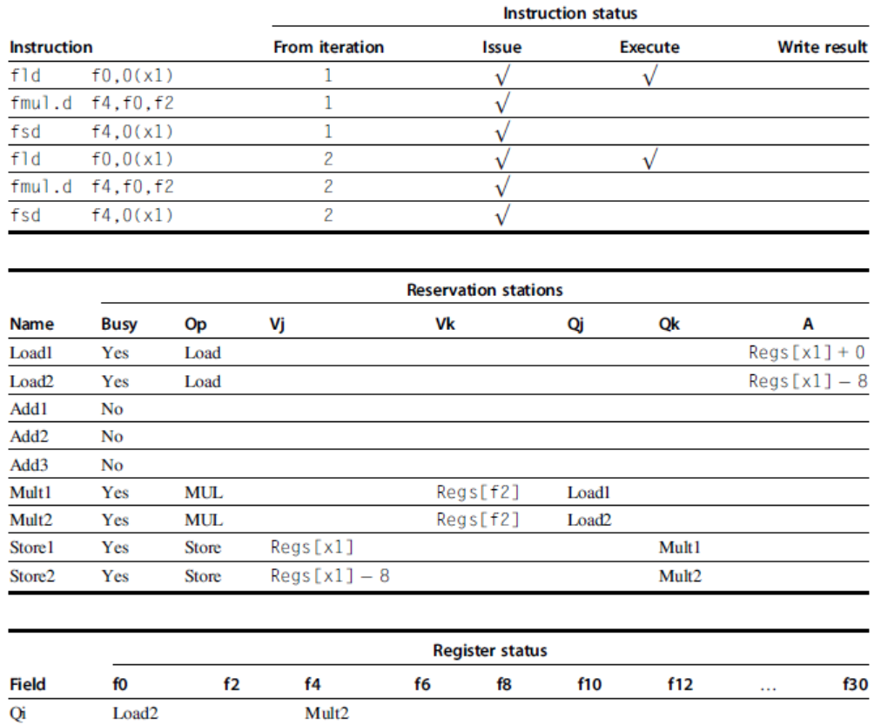
Tomasulo’s with Loop-Based Code
VLIW approach later
Dynamic Scheduling
Notes:
Convince yourself that the RAW, WAR, and WAW hazards on loads and stores is handled in this example.

Slide 34
Adoption of Tomasulo’s Algorithm
Proposed in 1967! 😳
Not widely adopted until … the 1990s!
Intro of caches created unpredictable delays → need for dynamic scheduling
Out-of-order execution (and completion) allows CPU to continue executing instructions while waiting the completion of a cache miss, thus hiding all or part of the cache-miss penalty.
What kind of advanced cache optimization is this?
CPUs became more aggressive about their issue capability while CPU designers concerned with the performance of difficult-to-schedule code (e.g., non-numeric code → graphs) → need for automated register renaming, dynamic scheduling, and speculation (coming up next)
Can achieve higher performance without the compiler needing to target code to a specific pipeline structure (i.e., architecture)
Dynamic Scheduling
Notes:
What kind of advanced cache optimization is this? Non-blocking $

Slide 35
Recap: Dynamic Scheduling
Dynamic scheduling implies
Out-of-order execution
Out-of-order completion
Creates the possibility for WAR and WAW hazards
Tomasulo’s Approach
Tracks when operands are available
Introduces register renaming in hardware
Minimizes WAW and WAR hazards
Dynamic Scheduling
Notes:
Tomasulo’s WITHOUT speculation thus far.

Slide 36
Hardware-Based Speculation
Execute instructions along predicted execution paths but only commit the results if prediction was correct
Instruction commit
Allow an instruction to update the register file when instruction is no longer speculative
Need an additional piece of hardware to prevent any irrevocable action until an instruction commits
i.e., updating state or taking an execution
Dynamic Scheduling & Hardware-based Speculation

Slide 37
Hardware-Based Speculation
Dynamic Scheduling vs. (Hardware-Based) Speculation
Dynamic Scheduling
Fetch, decode, and issue instructions
Speculation
Fetch, decode, issue, and execute instructions
Key Ideas Behind Hardware-Based Speculation
Dynamic branch prediction
Choose which instructions to execute
Speculation
Execute instructions before control dependences are resolved
Dynamic scheduling
Deal with the scheduling of different combinations of basic blocks

Slide 38
Re-order Buffer (ROB)
Re-order buffer
Holds the result of instruction between completion and commit
Four fields
Instruction type: branch/store/register
Destination field: register number
Value field: output value
Ready field: completed execution?
Modify reservation stations
Operand source is now reorder buffer instead of functional unit
Dynamic Scheduling & Hardware-based Speculation
Notes:
Why is the operand source now the reorder buffer instead of functional unit?
Recall: Execute instructions along predicted execution paths but only commit the results if prediction was correct.
This means we need a place *after* EXE to hold speculative results (across a branch) before we commit to register file.

Slide 39
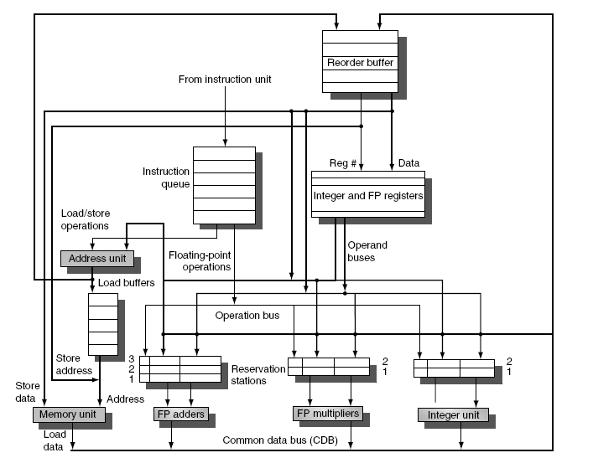
Tomasulo’s with Reorder Buffer
Dynamic Scheduling & Hardware-based Speculation
Notes:
We’ll first show how the ROB impacts the previous code example, i.e., no loop.
Talking about what but not how this works …

Slide 40
Reorder Buffer
Issue
Allocate RS and ROB; read available operands
Execute
Begin execution when operand values are available
Write result
Write result and ROB tag on CDB
Commit
When ROB reaches head of ROB, update register
When a mispredicted branch reaches head of ROB, discard all entries
Dynamic Scheduling & Hardware-based Speculation

Slide 41
Re-order Buffer (ROB)
Register values and memory values are not written until an instruction commits
On misprediction
Speculated entries in reorder buffer (ROB) are cleared
Exceptions
Not recognized until it is ready to commit
Hardware-based Speculation

Slide 42
Tomasulo’s with Reorder Buffer
Dynamic Scheduling & Hardware-based Speculation
Notes:
We’ll first show how the ROB impacts the previous code example, i.e., no loop.
Talking about what but not how this works …

Slide 43
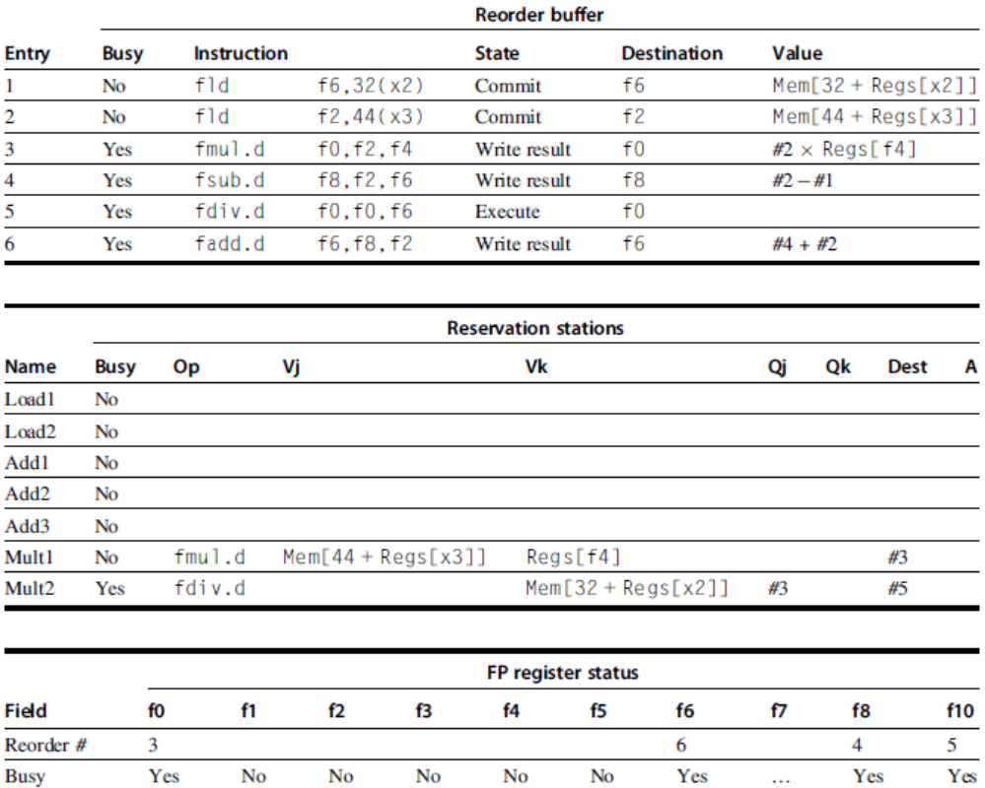
ROB w/ Previous Straightline Code (no loop)
L.D F6,32(R2)
L.D F2,44(R3)
MUL.D F0,F2,F4
SUB.D F8,F2,F6
DIV.D F10,F0,F6
ADD.D F6,F8,F2
F6
F2
F0
F8
F10*
F6
R2
R3
Dynamic Scheduling & Hardware-based Speculation
MUL
R3
DIV
R2
Notes:
F10* is correct. F0 in (old) textbook incorrect.

Slide 44
ROB with Loop-Based Code
MIPS Loop-Based Code
Loop: L.D F0,0(R1)
MUL.D F4,F0,F2
S.D F4,0(R1)
ADDI R1,R1,#8
BNE R1,R2,Loop // branches if R1 != R2
RISC-V Loop-Based Code
Loop: fld f0,0(x1)
fmul.d f4,f0,f2
fsd f4,0(x1)
addi x1,x1,8
bne x1,x2,Loop // branches if x1 != x2
Dynamic Scheduling & Hardware-based Speculation
Notes:
To understand the full power of eliminating WAW and WAR hazards via dynamic renaming of registers, let’s look at a loop.

Slide 45
ROB with Loop-Based Code
RISC-V Loop-Based Code
Loop: fld f0,0(x1)
fmul.d f4,f0,f2
fsd f4,0(x1)
addi x1,x1,8
bne x1,x2,Loop // branches if x1 != x2
Assumption
Predict branches taken.
Implication: RS allow multiple executions of the loop to run simultaneously, an advantage gained WITHOUT changing the code. Loop is unrolled dynamically by hardware using the RS obtained by “register renaming.” (Ignore integer ALU operation for now as branch is predicted as taken.)
Dynamic Scheduling & Hardware-based Speculation
Notes:
This loop merely multiplies the elements of an array by a scalar in f2.
Observations:
Once system is executing two iterations, CPI ~ 1.0 if multiplies can execute in 4 cycles.
If multiplies take 6 cycles, then additional iterations will be needed before the steady state can be reached. This requires more RS to hold instructions that are in execution.

Slide 46
ROB with Loop-Based Code
Loop: fld f0,0(x1)
fmul.d f4,f0,f2
fsd f4,0(x1)
addi x1,x1,8
bne x1,x2,Loop // branches if x1 != x2
Observations
A load (fld) and a store (fsd) can be safely done out of order iff they access different locations, but what if they access the same?
Load is before store in program order & interchanging them → WAR hazard
Store is before load in program order & interchanging them → RAW hazard
Also, interchanging two stores → WAW hazard
How to Detect Hazards on Loads & Stores?
Dynamic Scheduling & Hardware-based Speculation
Notes:
To understand the full power of eliminating WAW and WAR hazards via dynamic renaming of registers, let’s look at a loop.
→ means “results in” here
WAR Hazard: To determine if a load can be executed, CPU checks if any uncompleted stores that precedes the load in program order share the same data memory address as the load. (See earlier figure with ROB.)
RAW & WAW Hazard: Similarly, a store must wait until there are no unexecuted loads or stores that are earlier in program order that share the same data memory address.

Slide 47
ROB with Loop-Based Code
Loop: fld f0,0(x1)
fmul.d f4,f0,f2
fsd f4,0(x1)
addi x1,x1,8
bne x1,x2,Loop // branches if x1 != x2
How to Detect Hazards on Loads & Stores?
Loads
Compute the data memory address associated with any earlier memory operation → pragmatically check the “A” field of all active (store) buffers
If load address matches address of any active entry in store buffer, load is not sent to load buffer until conflicting store completes (i.e., respect RAW hazard)
Stores
Similar to loads except that CPU must check for conflicts on both the load buffers AND store buffers (since conflicting stores cannot be reordered with respect to either a load or a store, i.e., WAR or WAW).
Dynamic Scheduling & Hardware-based Speculation
Notes:
To understand the full power of eliminating WAW and WAR hazards via dynamic renaming of registers, let’s look at a loop.
→ means “results in” here
WAR Hazard: To determine if a load can be executed, CPU checks if any uncompleted stores that precedes the load in program order share the same data memory address as the load. (See earlier figure with ROB.)
RAW & WAW Hazard: Similarly, a store must wait until there are no unexecuted loads or stores that are earlier in program order that share the same data memory address.

Slide 48
ROB with Loop-Based Code
Tomasulo’s
Algorithm
VLIW approach later
Dynamic Scheduling & Hardware-based Speculation
Notes:
Convince yourself that the RAW, WAR, and WAW hazards on loads and stores is handled in this example.

Slide 49
Adoption of Tomasulo’s
Proposed in 1967! 😳
Not widely adopted until … the 1990s!
Intro of caches created unpredictable delays → need for dynamic scheduling
Out-of-order execution (and completion) allows CPU to continue executing instructions while waiting the completion of a cache miss, thus hiding all or part of the cache-miss penalty.
What kind of advanced cache optimization is this?
CPUs became more aggressive about their issue capability while CPU designers concerned with the performance of difficult-to-schedule code (e.g., non-numeric code → graphs) → need for automated register renaming, dynamic scheduling, and speculation (coming up next)
Can achieve higher performance without the compiler needing to target code to a specific pipeline structure (i.e., architecture)
Dynamic Scheduling & Hardware-based Speculation
Notes:
Non-blocking $

Slide 50
ROB with Loop-Based Code
MIPS Loop-Based Code
Loop: L.D R2,0(R1) // R2 = array element
ADDI R2,R2,#1 // increment R2
S.D R2,0(R1) // store result
ADDI R1,R1,#8 // increment ptr to next elt
BNE R2,R3,Loop // branch if not last
RISC-V Loop-Based Code
Loop: ld x2,0(x1) // x2=array element
addi x2,x2,1 // increment x2
sd x2,0(x1) // store result
addi x1,x1,8 // increment pointer
bne x2,x3,Loop // branch if not last
Dynamic Scheduling, Multiple Issue, and Speculation
Notes:
To understand the full power of eliminating WAW and WAR hazards via dynamic renaming of registers, let’s look at a loop.
This loop merely increments each element of an array.

Slide 51
ROB with Loop-Based Code
RISC-V Loop-Based Code
Loop: ld x2,0(x1) // x2=array element
addi x2,x2,1 // increment x2
sd x2,0(x1) // store result
addi x1,x1,8 // increment pointer
bne x2,x3,Loop // branch if not last
Assumptions
Predict branches taken.
Implication: RS allow multiple executions of the loop to run simultaneously, an advantage gained WITHOUT changing the code. Loop is unrolled dynamically by hardware using the RS obtained by “register renaming.”
Dynamic Scheduling, Multiple Issue, and Speculation
Notes:
BEFORE: For loop unrolling, register renaming at compile time and using real registers, which, in turn, causes register pressure.
Now: For loop unrolling, register renaming at run time using RS (“virtual registers”)

Slide 52
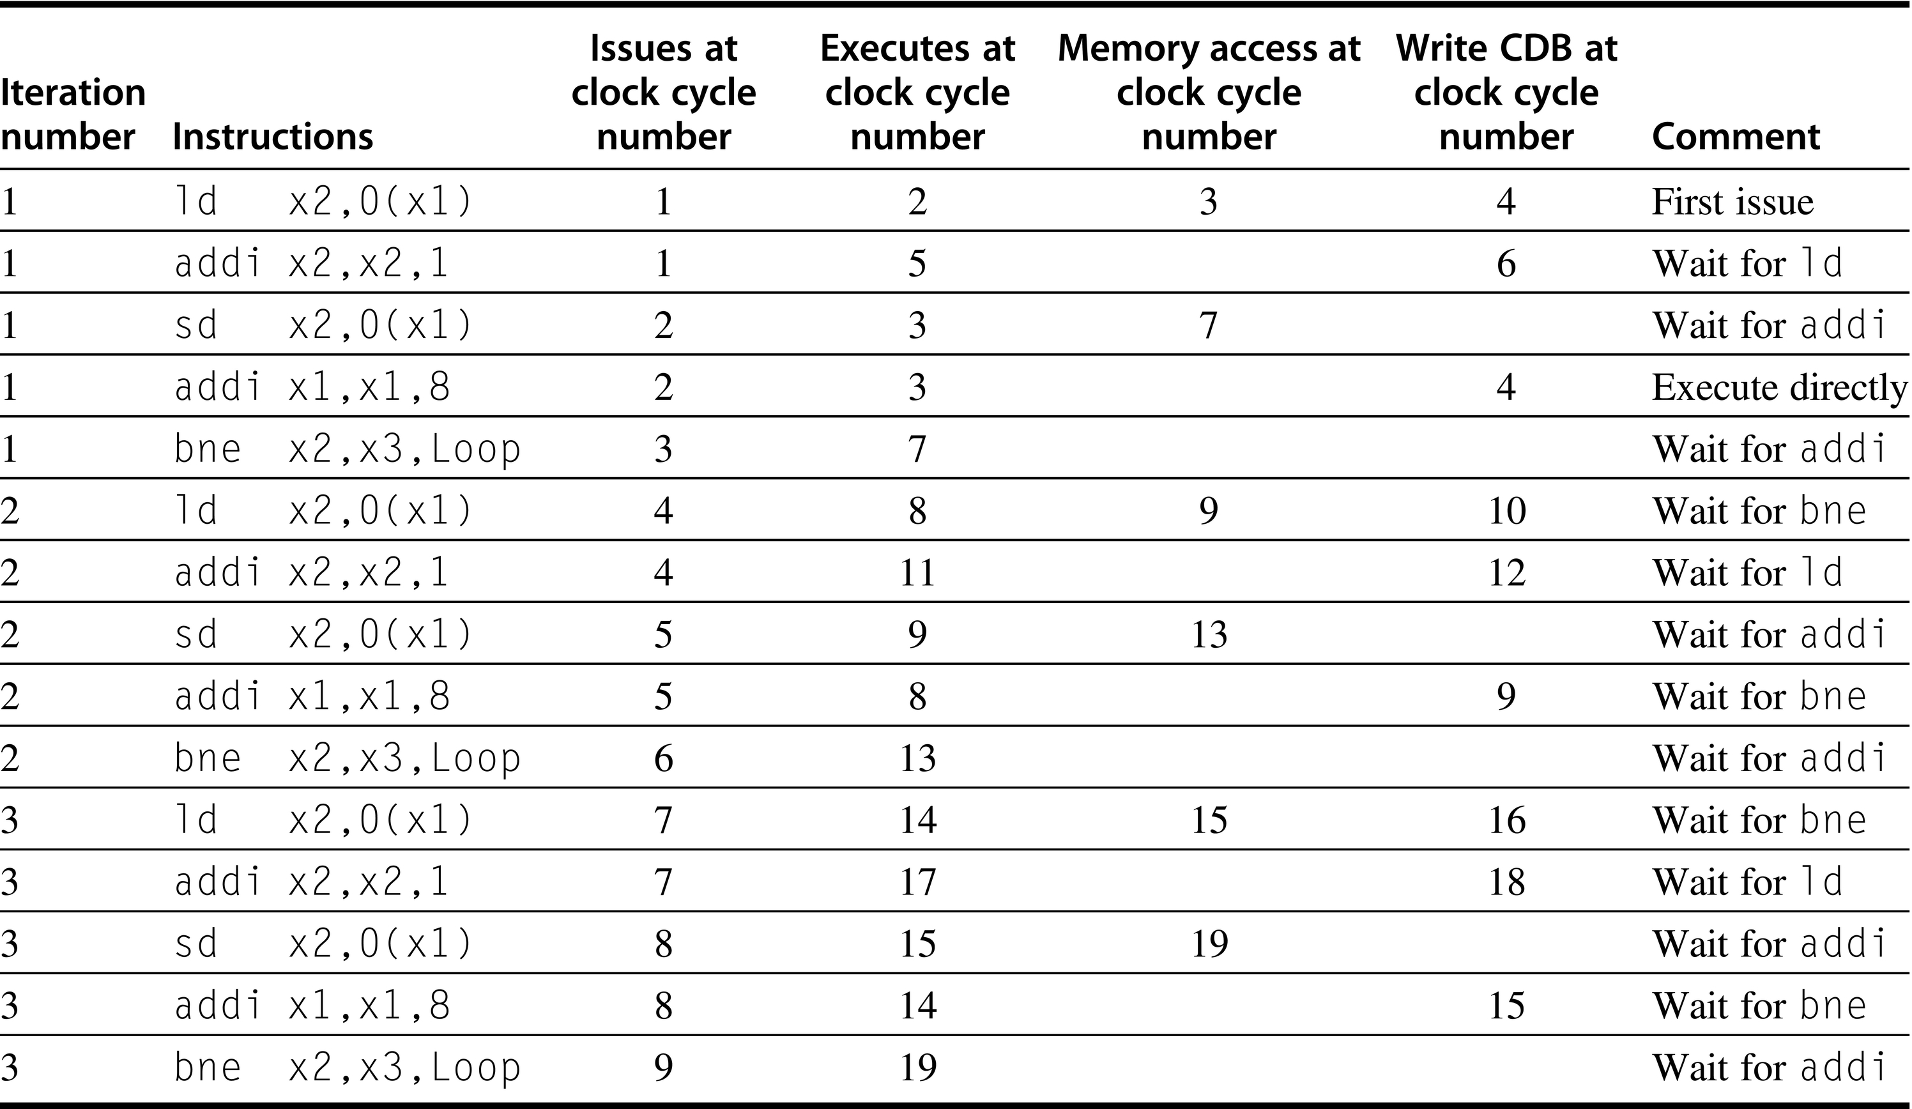
ROB Example (No Speculation)
Dynamic Scheduling, Multiple Issue, and Speculation
Notes:
Is this a single- or multiple-issue pipeline? If multiple, how many way-multiple? 2-way

Slide 53
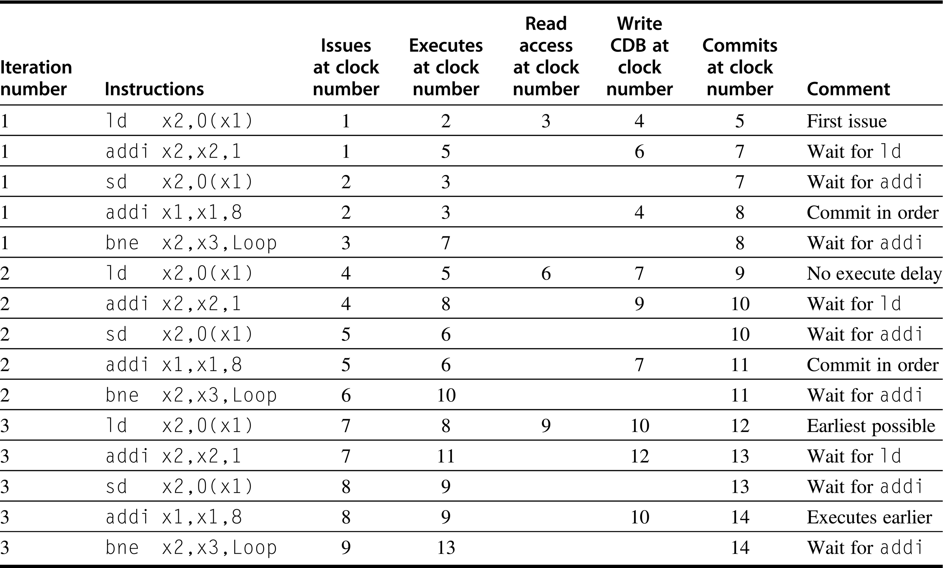
ROB Example (with Speculation)
Dynamic Scheduling, Multiple Issue, and Speculation

Slide 54
Recall: Hardware-Based Speculation
Execute instructions along predicted execution paths but only commit the results if prediction was correct
Instruction commit
Allow an instruction to update the register file when instruction is no longer speculative
Need an additional piece of hardware to prevent any irrevocable action until an instruction commits
i.e., updating state or taking an execution
Dynamic Scheduling & Hardware-based Speculation
Notes:
Exploiting more instruction-level parallelism (ILP) requires that we overcome the limitations of control dependences.
How?
Speculate on the outcome of branches
Execute the program as if our predictions are correct
How is this similar to the dynamic scheduling (via Tomasulo’s algorithm) that we have been talking about?
Dynamic scheduling: Fetches, decodes, and issues instructions.
Speculation: Fetches, decodes, issues, and EXECUTES instructions, as if our branch predictions are always correct.
In this class, we only talked about hardware-based speculation (via re-order buffer or ROB).
Appendix H discusses ways to support speculation by the compiler.

Slide 55
Recall: Hardware-Based Speculation
Dynamic Scheduling vs. (Hardware-Based) Speculation
Dynamic Scheduling
Fetch, decode, and issue instructions
Speculation
Fetch, decode, issue, and execute instructions
Key Ideas Behind Hardware-Based Speculation
Dynamic branch prediction
Choose which instructions to execute
Speculation
Execute instructions before control dependences are resolved
Dynamic scheduling
Deal with the scheduling of different combinations of basic blocks

Slide 56
Dynamic, Multiple Issue, and Speculation
Modern Microarchitectures
Dynamic scheduling + multiple issue + speculation
Approaches
Assign reservation stations and update pipeline control table in half clock cycles
Only supports 2 instructions/clock
Design logic to handle any possible dependencies between the instructions
Hybrid approaches
Issue logic is the bottleneck in dynamically-scheduled superscalar processors
Dynamic Scheduling & Multiple Issue
Notes:
Dynamic scheduling: Fetches, decodes, and issues instructions.
Speculation: Fetches, decodes, issues, and EXECUTES instructions, as if our branch predictions are always correct.
ISSUE logic is the bottleneck, not fetch and decode logic

Slide 57
Multiple Issue
Limit the number of instructions of a given class that can be issued in a “bundle” (to simplify RS allocation)
Example: one FP, one integer, one load, one store
Examine all the dependencies between the instructions in the bundle
If dependencies exist in bundle, encode them in reservation stations
Need multiple completion/commit
Dynamic Scheduling & Multiple Issue
Dynamic Scheduling
Notes:
What does “encoding them in reservation stations” mean?

Slide 58
Re-visiting Re-order Buffer
Dynamic Scheduling & Multiple Issue
Dynamic Scheduling
Notes:
Talking about what but not how this works …

Slide 59
Example
Loop: LD R2,0(R1) ; R2=array element
DADDIU R2,R2,#1 ; increment R2
SD R2,0(R1) ; store result
DADDIU R1,R1,#8 ; increment pointer
BNE R2,R3,LOOP ; branch if not last element
Assumptions
Predict branches taken
Implication: RS allow multiple executions of the loop to run simultaneously, an advantage gained WITHOUT changing the code. Loop is unrolled dynamically by hardware using the RS obtained by “register renaming.”
Dynamic Scheduling & Multiple Issue
Dynamic Scheduling
Notes:
Loop increments each element of an integer array on a two-issue processor.

Slide 60
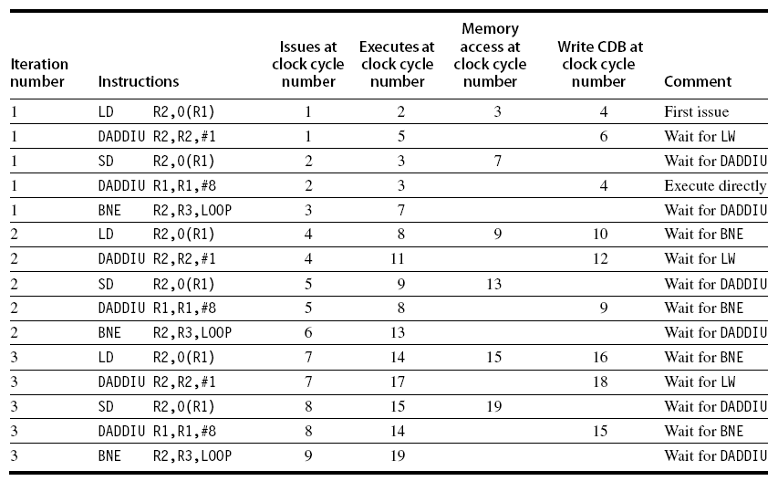
Example (No Speculation)
Dynamic Scheduling & Multiple Issue
Dynamic Scheduling
Notes:
Assume separate integer functional units for effective address calculation, for ALU operations, and for branch condition evaluation.
Assume that up to two instructions of any type can commit per clock.
Third branch executes in clock cycle 19 on the nonspeculative pipeline.
Third branch executes in clock cycle 13 on the speculative processor.
Because the completion rate on the nonspeculative pipeline is falling behind the issue rate rapidly, the nonspeculative pipeline will stall when a few more iterations are issued.
The performance of the nonspeculative processor can be improved by allowing load instructions to complete effective address calculation before a branch is decided, but unless speculative memory accesses are allowed, this improvement will gain only 1 clock per iteration.

Slide 61
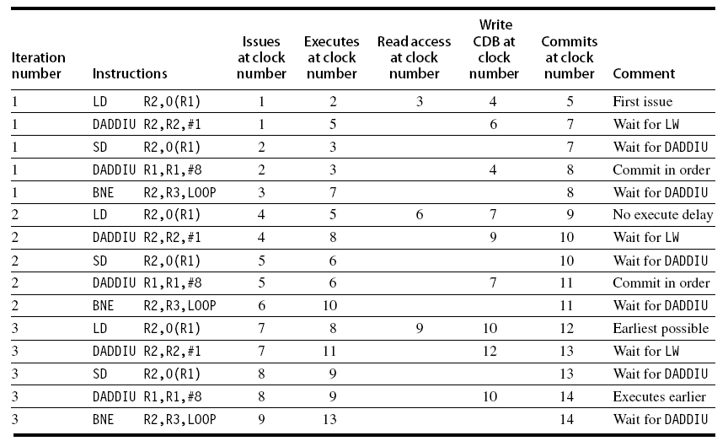
Example (Speculation)
Dynamic Scheduling & Multiple Issue
Notes:
LD following the BNE can start execution early because it is speculative.

Slide 62
Speculation: How Much?
How much to speculate
Mis-speculation degrades performance and power relative to no speculation
May cause additional misses (cache, TLB)
Prevent speculative code from causing higher costing misses (e.g., L2)
Speculating through multiple branches
Complicates speculation recovery
No processor can resolve multiple branches per cycle
Energy efficiency
Speculation is only energy efficient when it significantly improves performance
Adv. Techniques for Instruction Delivery and Speculation

Slide 63
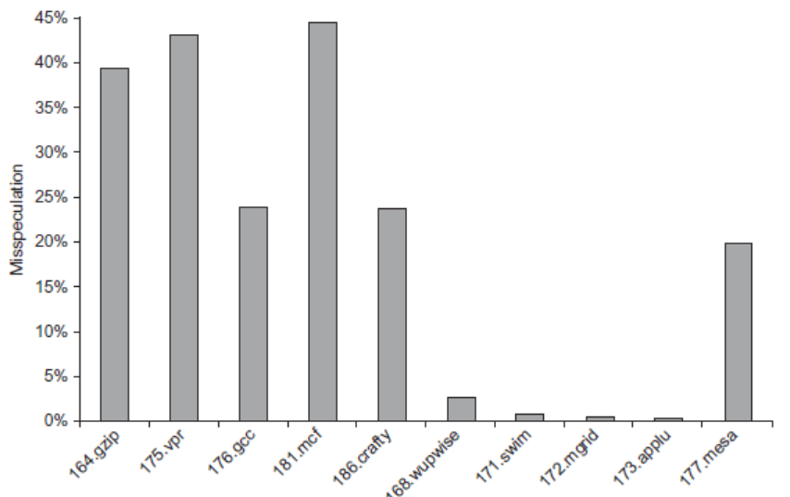
How Much?
integer
Adv. Techniques for Instruction Delivery and Speculation

Slide 64
Energy Efficiency
Speculation and energy efficiency
Speculation is only energy-efficient when it significantly improves performance
Value prediction
Uses:
Loads that load from a constant pool
Instruction that produces a value from a small set of values
Not been incorporated into modern processors
Similar idea--address aliasing prediction--is used on some processors
Adv. Techniques for Instruction Delivery and Speculation

Slide 65
Recap
What is instruction-level parallelism (ILP)?
A measure of how many of the operations in a computer program can be performed simultaneously.
Pipelining → universal technique in 1985
Overlaps execution of instructions → exploits ILP
How do processors extract ILP to get faster?
More parallelism (or more work per pipeline stage): fewer clocks/instruction [more instructions/cycle]
Get WIDER
Deeper pipeline stages: fewer gates/clock
Get DEEPER
Transistors get faster (Moore’s Law): fewer ps/gate
Get FASTER
What do processors do to extract ILP?
ILP
Notes:
How do processors extract ILP? That is, why do processors get faster?
Does a faster processor mean a faster computer? Why? Why not?
- Remember last chapter? Memory hierarchy.

Slide 66
Get WIDER: Multiple Issue
To achieve CPI < 1, need to complete multiple instructions per clock
Solutions
Dynamically scheduled superscalar processors
Statically scheduled superscalar processors
VLIW (very long instruction word) processors
ILP

Slide 67
Get WIDER: Machine Parallelism
Two approaches for machine parallelism, where the responsibility of resolving hazards is …
Hardware-based dynamic approaches
Dynamic-issue superscalar
Typically used in server and desktop processors
Not used as extensively in PMP processors
Software-based static approaches (i.e., compiler)
Static “VLIW: Very Long Instruction Word”
Not as successful outside of scientific applications
Notes:
How do processors extract ILP? That is, why do processors get faster?
Does a faster processor mean a faster computer? Why? Why not?
- Remember last chapter? Memory hierarchy.

Slide 68
Multiple-Issue Processor Styles
Dynamic multiple-issue processors (aka superscalar)
Decisions on which instructions to execute simultaneously are being made dynamically (at run time by the hardware)
Example: IBM Power 2, Pentium Pro/2/3/4, Core, MIPS R10K, HP PA 8500
Static multiple-issue processors (aka VLIW)
Decisions on which instructions to execute simultaneously are being made statically (at compile time by the compiler)
Example: Intel Itanium and Itanium 2 for the IA-64 ISA—EPIC (Explicit Parallel Instruction Computer)

Slide 69
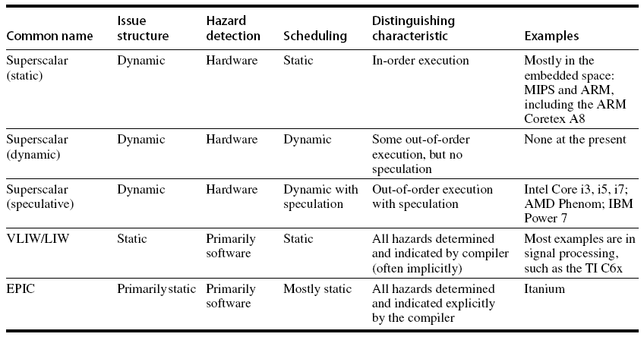
Multiple-Issue Processor Styles
Dynamic Scheduling
Notes:
Dynamic scheduling implies:
Out-of-order execution
Out-of-order completion
Which of these architectures is the simplest in hardware?
Which of these architectures is the most complex in hardware?

Slide 70
Multiple-Issue Processor Styles
Dynamic multiple-issue processors (aka superscalar)
Decisions on which instructions to execute simultaneously are being made dynamically (at run time by the hardware)
Example: IBM Power 2, Pentium Pro/2/3/4, Core, MIPS R10K, HP PA 8500
Static multiple-issue processors (aka VLIW)
Decisions on which instructions to execute simultaneously are being made statically (at compile time by the compiler)
Example: Intel Itanium and Itanium 2 for the IA-64 ISA—EPIC (Explicit Parallel Instruction Computer)

Slide 71

VLIW Beginnings
VLIW: Very Long Instruction Word
Led to a startup (MultiFlow) whose computers worked, but which went out of business ... the ideas remain influential.

Slide 72
History of VLIW Processors
Started with (horizontal) microprogramming
Very-wide microinstructions used to directly generate control signals in single-issue processors (e.g., IBM 360 series)
VLIW for multi-issue processors first appeared in the Multiflow and Cydrome (in the early 1980’s)
Commercial VLIW processors from past decade
Intel i860 RISC (dual mode: scalar and VLIW)
Intel I-64 (EPIC: Itanium and Itanium 2)
Transmeta Crusoe (the chip that powered Green Destiny)
Lucent/Motorola StarCore, ADI TigerSHARC, Infineon (Siemens) Carmel
Notes:
SKIP THIS

Slide 73
Overview: VLIW Processors
Package multiple operations into one instruction
Example: VLIW processor
One integer instruction (or branch)
Two independent floating-point operations
Two independent memory references
Must be enough parallelism in code to fill the available slots
Multiple Issue and Static Scheduling

Slide 74
VLIW Processors (Static Multiple-Issue Machines)
Static multiple-issue processors (aka VLIW) use the compiler to decide which instructions to issue and execute simultaneously
Issue packet or “bundle”
The set of instructions that are bundled together and issued in one clock cycle—think of it as one large instruction with multiple operations
The mix of instructions in the packet (bundle) is usually restricted—a single “instruction” with several predefined fields
e.g., VLIW: one integer (or branch), two FP, two memory
Performance
Must be enough parallelism in code to fill the available slots
The compiler does static branch prediction and code scheduling to reduce (ctrl) or eliminate (data) hazards
Notes:
→ Package multiple operations into one instruction

Slide 75
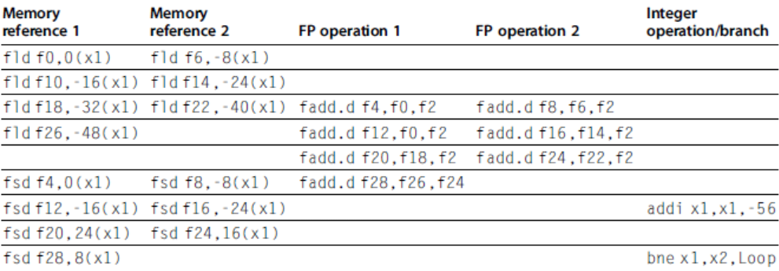
VLIW Processors
Advantages
Simpler hardware (potentially less power hungry)
Potentially more scalable
Allow more instructions per bundle & add more FUs
Disadvantages:
Statically finding parallelism
Code size
No hazard detection hardware
Binary code compatibility
RISC-V Code Snippet
Loop: fld f0,0(x1)
fadd.d f4,f0,f2
fsd f4,0(x1)
addi x1,x1,-8
bne x1,x2,Loop
Multiple Issue and Static Scheduling
Notes:
Overview here (code from page 171 in 6th edition). We’ll do another example in more detail with MIPS-based code later but with only 2-way issue instead of … what appears to be at least 4-way issue here.
This code merely increments a vector of values in memory, starting at 0(x1) and ending at 0(x2), by a scalar in register f2.
Note: Disadvantage of statically finding parallelism? Difficult for compilers to deal with aliasing and long latencies → slow compilation times
Given that the VLIW compiler knows that bundle can have at most 2 memory refs, 2 floating-point ops, and an integer op,
… what do you notice that the compiler has done to improve the performance of the code for VLIW execution?
Loop unrolling (with a loop-unrolling factor of 7)
Significant pressure on the register file. 5 registers (f0,f2,f4,x1,x2) to 17 registers (f0,f2,f4,f6,f8,f10,f12,f14,f16,f18,f20,f22,f24,f26,f28,x1,x2)

Slide 76
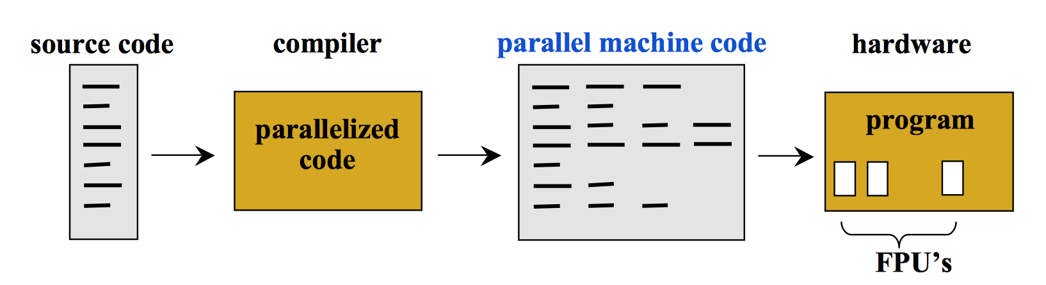
VLIW in Illustration
Characteristics
Hardware does not need to re-analyze code to detect dependences
Hardware does not perform OoO execution
Each instruction controls multiple functional units
Each instruction is explicitly parallel

Slide 77
Static Multiple-Issue Machines (VLIW)
Profile of VLIWs
Multiple functional units (like SS processors)
Multi-ported register files (again like SS processors)
Wide program bus
Example of VLIW Processor
One integer instruction (or branch)
Two independent floating-point operations
Two independent memory references
Key
Must be enough parallelism in code to fill the available slots
Notes:
Disadvantages of VLIW
Statically finding parallelism → difficult for compilers to deal with aliasing and long latencies → slow compilation times
Code size
No hazard detection hardware
No binary code compatibility

Slide 78
An Example: VLIW MIPS
64 bits
ALU Op (R format)
or
Branch (I format)
Load or Store (I format)
Consider a 2-issue MIPS with a 2-instr bundle
Instructions are always fetched, decoded, and issued in pairs
What happens if one instr slot is not used?
What does the register file have to support?
What other hardware must we add?
Notes:
If one instr of the pair cannot be used, it is replaced with a “no op” (nop)
Need 4 read ports and 2 write ports and a separate memory address adder

Slide 79
An Example: VLIW MIPS
64 bits
ALU Op (R format)
or
Branch (I format)
Load or Store (I format)
Consider a 2-issue MIPS with a 2-instr bundle
Instructions are always fetched, decoded, and issued in pairs
If one instr of the pair cannot be used, it is replaced with a “no op” (nop)
Need 4 read ports and 2 write ports and a separate memory address adder
Notes:
Assume load and stores take two cycles.

Slide 80
A MIPS VLIW (2-issue) Datapath
No hazard hardware (so load-use needs explicit nop instruction(s) inserted by compiler)
Add
Add
8
ALU
Instruction
Memory
Register
File
PC
Write Addr
Data
Memory
Write Data
Add
Sign
Extend
Let’s say we wanted more functional units. What would need to change?
Sign
Extend
Notes:
Assume forwarding hardware as necessary.
Label IF, ID, EX, MEM, WB.
What is the top mux input to the ALU doing?
What about the bottom mux inputs to the ALU?

Slide 81
Code Scheduling Example
i = n;
do {
a[i] += const;
} while (--i != 0);
Consider the following loop code: lp: lw $t0,0($s1) # $t0=array element addu $t0,$t0,$s2 # add scalar in $s2 sw $t0,0($s1) # store result addi $s1,$s1,-4 # decrement pointer bne $s1,$0,lp # branch if $s1 != 0
Must “schedule” the instructions to avoid pipeline stalls
Instructions in one bundle must be independent
Must separate load-use instructions from their loads by one cycle
Notice that the first two instructions have a load-use dependency, the next two and last two have data dependencies
Assume branches are perfectly predicted by the hardware
Notes:
i = n;
do {
a[i] += const;
} while (--i != 0);

Slide 82
The Scheduled Code (Not Unrolled)
 | ALU or branch | Data transfer | CC
lp: | addi $s1,$s1,-4 | lw $t0,0($s1) | 1
 |  |  | 2
 | addu $t0,$t0,$s2 |  | 3
 | bne $s1,$0,lp | sw $t0,4($s1) | 4
Four clock cycles to execute 5 instructions for a
CPI of 0.8 (versus the best case of 0.5)
IPC of 1.25 (versus the best case of 2.0)
“no op” instructions don’t count towards performance !!
Notes:
How many registers used? 3

Slide 83
Scheduled Code (Not Unrolled)
 | ALU or branch | Data transfer | CC
lp: |  |  | 1
 |  |  | 2
 |  |  | 3
 |  |  | 4
 |  |  | 5
How many clock cycles?
How many instructions?
CPI? Best case?
IPC? Best case?
Notes:
How many registers used? 3

Slide 84
Loop Unrolling
Loop unrolling—multiple copies of the loop body are made and instructions from different iterations are scheduled together as a way to increase ILP
Apply loop unrolling (4 times for our example) and then schedule the resulting code
Eliminate unnecessary loop overhead instructions
Schedule so as to avoid load-use hazards
During unrolling, the compiler applies register renaming to eliminate all data dependencies that are not true dependencies

Slide 85
Unrolled Code Example
lp: lw $t0,0($s1) # $t0=array element
lw $t1,-4($s1) # $t1=array element
lw $t2,-8($s1) # $t2=array element
lw $t3,-12($s1) # $t3=array element
addu $t0,$t0,$s2 # add scalar in $s2
addu $t1,$t1,$s2 # add scalar in $s2
addu $t2,$t2,$s2 # add scalar in $s2
addu $t3,$t3,$s2 # add scalar in $s2
sw $t0,0($s1) # store result
sw $t1,-4($s1) # store result
sw $t2,-8($s1) # store result
sw $t3,-12($s1) # store result
addi $s1,$s1,-16 # decrement pointer
bne $s1,$0,lp # branch if $s1 != 0
Notes:
What assumption have we made in unrolling this loop code?
- # of iterations is a multiple of 4
How do we fix this?
How many clock cycles?
How many instructions?
CPI? Best case?
IPC? Best case?
How many registers? 6
What is the increase in code size? Effectively, 4x

Slide 86
Scheduled Code (Unrolled)
 | ALU or branch | Data transfer | CC
lp: | addi $s1,$s1,-16 | lw $t0,0($s1) | 1
 |  | lw $t1,12($s1) | 2
 | addu $t0,$t0,$s2 | lw $t2,8($s1) | 3
 | addu $t1,$t1,$s2 | lw $t3,4($s1) | 4
 | addu $t2,$t2,$s2 | sw $t0,16($s1) | 5
 | addu $t3,$t3,$s2 | sw $t1,12($s1) | 6
 |  | sw $t2,8($s1) | 7
 | bne $s1,$0,lp | sw $t3,4($s1) | 8
Eight clock cycles to execute 14 instructions for a
CPI of 0.57 (versus the best case of 0.5)
IPC of 1.8 (versus the best case of 2.0)
Notes:
Is this the same number of instructions?
What’s the theoretical best if we unrolled 1000 times? (0.75, I think, l/s is full but ALU is half full)

Slide 87
Scheduled Code (Unrolled)
 | ALU or branch | Data transfer | CC
lp: |  |  | 1
 |  |  | 2
 |  |  | 3
 |  |  | 4
 |  |  | 5
 |  |  | 6
 |  |  | 7
 |  |  | 8
Notes:
Eight clock cycles to execute 14 instructions for a
CPI of 0.57 (versus the best case of 0.5)
IPC of 1.8 (versus the best case of 2.0)
Is this the same number of instructions?
What’s the theoretical best if we unrolled 1000 times? (0.75, I think, l/s is full but ALU is half full)

Slide 88
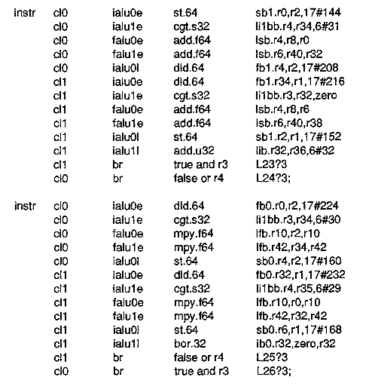
What does N=14 assembly look like?
Two instructions from a scientific benchmark (Linpack) for a MultiFlow CPU with 14 operations per instruction.
Notes:
Anyone know what this looks like in the Intel/AMD CPU ISA?
Think about what instruction contains multiple sub-instructions?
MMX ( single instruction, multiple data (SIMD) instruction set designed by Intel )
SSE ( streaming SIMD extensions )
AVX ( advanced vector extensions )
Here's how you operate on 8 ints at a time.
For ints, the arithmetic uses _epi32, and the load and store use the weird _si256 type, which just means one giant 256-bit block of integer data.
#include "immintrin.h"
void foo(void) { int f[8]={1,2,0,3,5,5,10,11};
__m256i v=_mm256_load_si256((const __m256i *)&f[0]);
v=_mm256_add_epi32(v,v);
_mm256_store_si256((__m256i *)&f[0],v);
iarray_print(f,8);
}

Slide 89
Defining Attributes of VLIW
Compiler
1. MultiOp: instruction containing multiple independent operations
2. Specified number of resources of specified types
3. Exposed, architectural latencies
Icache
add
nop
nop
load
store
Add
Add
Mpy
Mem
Mem
Register File
VLIW instruction =
5 independent operations

Slide 90
Compiler Support for VLIW Processors
The compiler packs groups of independent instructions into the bundle
Because branch prediction is not perfect, done by code re-ordering (trace scheduling)
The compiler uses loop unrolling to expose more ILP
The compiler uses register renaming to solve name dependencies and ensures no-load use hazards occur

Slide 91
Compiler Support for VLIW Processors
While superscalars use dynamic prediction, VLIWs primarily depend on the compiler for extracting ILP
Loop unrolling reduces the number of conditional branches
Predication eliminates if-the-else branch structures by replacing them with predicated instructions
We’ll cover this in a future lecture as well
The compiler predicts memory bank references to help minimize memory bank conflicts
Notes:
Predication works by executing instructions from both paths of the branch and only permitting those instructions from the taken path to modify architectural state.
ONLY the instructions from the taken path can modify architectural state because they have been associated (predicated) with a predicate, which is a Boolean value used by the instruction to control whether the instruction is allowed to modify the architectural state or not.
Predication is best explained by example. Consider the C if-then-else statement and its pseudoassembly language implementation in Listing One. Each path through the assembly code requires a branch so that only the true or false leg is executed. If the branch is mispredicted, the program can incur a performance penalty. Now imagine that, instead of using a branch to control execution of the statement in Listing One, you compute Boolean values, b1 and b2, and use those Boolean values to switch on/off instructions that make up the if-then-else statement. The code might look something like Listing Two.

Slide 92
VLIW Advantages
Advantages
Simpler hardware (potentially less power hungry)
Potentially more scalable
Allow more instructions per VLIW bundle and add more FUs
Notes:
Also need bigger RegFile since renaming uses programmer visible registers (not an RUU as with SS)

Slide 93
VLIW Disadvantages
Programmer/compiler complexity and longer compilation times
Deep pipelines and long latencies can be confusing (making peak performance elusive)
Lock-step operation, i.e., on hazard all future issues stall until hazard is resolved (hence need for predication)
Object (binary) code incompatibility
Needs lots of program memory bandwidth
Code bloat
“No ops” are a waste of program memory space
Loop unrolling to expose more ILP uses more program memory space
Notes:
Also need bigger RegFile since renaming uses programmer visible registers (not an RUU as with SS)

Slide 94
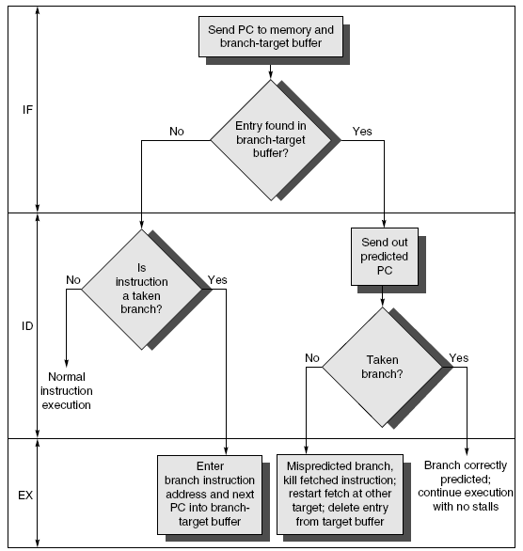
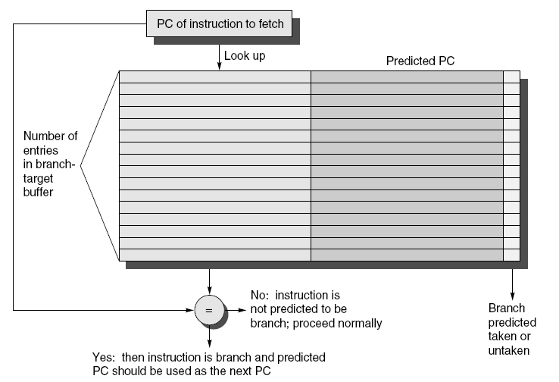
Branch-Target Buffer
Need high instruction bandwidth!
Branch-Target buffers
Next PC prediction buffer, indexed by current PC
Adv. Techniques for Instruction Delivery and Speculation

Slide 95
Branch Folding
Optimization:
Larger branch-target buffer
Add target instruction into buffer to deal with longer decoding time required by larger buffer
“Branch folding”
Adv. Techniques for Instruction Delivery and Speculation

Slide 96
Return Address Predictor
Most unconditional branches come from function returns
The same procedure can be called from multiple sites
Causes the buffer to potentially forget about the return address from previous calls
Create return address buffer organized as a stack
Adv. Techniques for Instruction Delivery and Speculation

Slide 97
Integrated Instruction Fetch Unit
Design monolithic unit that performs:
Branch prediction
Instruction prefetch
Fetch ahead
Instruction memory access and buffering
Deal with crossing cache lines
Adv. Techniques for Instruction Delivery and Speculation

Slide 98
Register Renaming
Register renaming vs. reorder buffers
Instead of virtual registers from reservation stations and reorder buffer, create a single register pool
Contains visible registers and virtual registers
Use hardware-based map to rename registers during issue
WAW and WAR hazards are avoided
Speculation recovery occurs by copying during commit
Still need a ROB-like queue to update table in order
Simplifies commit:
Record that mapping between architectural register and physical register is no longer speculative
Free up physical register used to hold older value
In other words: SWAP physical registers on commit
Physical register de-allocation is more difficult
Adv. Techniques for Instruction Delivery and Speculation

Slide 99
Integrated Issue and Renaming
Combining instruction issue with register renaming:
Issue logic pre-reserves enough physical registers for the bundle (fixed number?)
Issue logic finds dependencies within bundle, maps registers as necessary
Issue logic finds dependencies between current bundle and already in-flight bundles, maps registers as necessary
Adv. Techniques for Instruction Delivery and Speculation

Slide 100
Review: Multiple-Issue Processor Styles
Dynamic multiple-issue processors (aka superscalar)
Decisions on which instructions to execute simultaneously (in the range of 2 to 8 in 2005) are being made dynamically (at run time by the hardware)
E.g., IBM Power 2, Pentium 4, MIPS R10K, HP PA 8500 IBM
Static multiple-issue processors (aka VLIW)
Decisions on which instructions to execute simultaneously are being made statically (at compile time by the compiler)
E.g., Intel Itanium and Itanium 2 for the IA-64 ISA – EPIC (Explicit Parallel Instruction Computer)
128-bit “bundles” containing 3 instructions each 41 bits + 5 bit template field (specifies which FU each instr needs)
Five functional units (IntALU, MMedia, DMem, FPALU, Branch)
Extensive support for speculation and predication

Slide 101
CISC vs RISC vs SS vs VLIW
 | CISC | RISC | Superscalar | VLIW
Instr size | variable size | fixed size | fixed size | fixed size (but large)
Instr format | variable format | fixed format | fixed format | fixed format
Registers | few, some special | many GP | GP and rename | many, many GP
Memory reference | embedded in many instrs | load/store | load/store | load/store
Key Issues | decode complexity | data forwarding, hazards | hardware dependency resolution | (compiler) code scheduling
Instruction flow
IF
ID
EX
M
WB
IF
ID
EX
M
WB
IF
ID
EX
M
WB
IF
ID
EX
M
WB
IF
ID
EX
M
WB
EX
M
WB
IF
ID
EX
M
WB
IF
ID
EX
M
WB
IF
ID
EX
M
WB
IF
ID
EX
M
WB
EX
M
WB
Notes:
Pipelining helps instruction bandwidth, not instruction latency
Loop unrolling and software pipelining to help with data hazards
Dynamic branch prediction + early branch target address calculation for speculative execution

Slide 102
Multiple Issue

