Slide 1
Computer Architecture
A Quantitative Approach, Sixth Edition
Chapter 4
Data-Level Parallelism (DLP) in Vector, SIMD, and GPU Architectures
Part 3: SIMD Extensions and GPU Intro
“We call these algorithms data parallel algorithms because their parallelism comes from simultaneous operations across large sets of data, rather than from multiple thread of control.”
- W. Daniel Hillis and Guy L. Steele
”Data Parallel Algorithms,” Comm. ACM (1986)
“If you were plowing a field, which would you rather use, two strong oxen or 1024 chickens?”
- Seymour Cray, Father of the Supercomputer
(arguing for two powerful vector processors
versus many simple processors)

Slide 2
Acknowledgements
Thanks to many sources for slide material
© 1990 Morgan Kaufmann Publishers, © 2001-present Elsevier
Computer Architecture: A Quantitative Approach by J. Hennessy & D. Patterson
© 1994 Morgan Kaufmann Publishers, © 2001-present Elsevier
Computer Organization and Design by D. Patterson & J. Hennessy
© 2002 K. Asinovic & Arvind, MIT
© 2002 J. Kubiatowicz, University of California at Berkeley
© 2006, © 2010 No Starch Press for Inside the Machine by J. Stokes
© 2007 W.-M. Hwu & D. Kirk, University of Illinois & NVIDIA
© 2007-2010 J. Owens, University of California at Davis
© 2010 CRC Press for Introduction to Concurrency in Programming Languages by M. Sottile, T. Mattson, and C. Rasmussen
© 2017, IBM POWER9 Processor Architecture by Sadasivam et al., IBM
© 2016, © 2019 POWER9 Processor User’s Manual, IBM
© The OpenPOWER Foundation
© 2022, W. Feng, Virginia Tech

Slide 3
SIMD Extensions
Media applications operate on data types narrower than the native word size
Examples: graphics and sound
Major limitations (compared to vector instructions)
Number of data operands encoded into op code
Consequence?
No sophisticated addressing modes (strided, scatter-gather)
Consequence?
No mask registers
Consequence?
SIMD Instruction Set Extensions for Multimedia
Notes:
SIMD started with observation that many media applications operate on narrower data types than what 32-bit processors were optimized for.
Example:
Graphics: 8 bits for each of three primary colors plus 8 bits for transparency.
Sound: 8 to 16 bits.
# data operands encoded in opcode?
Consequence: Addition of HUNDREDS of instructions in MMX, SSE, and AVX extensions of the x86 architecture. (Potential special topics talk on Thursday.)
No sophisticated addressing modes
Consequence: Limits what can be vectorized. (More on this later.)
No mask registers
Conditional execution on individual vector elements not supported.
Why SSE so popular if so problematic?
Low cost
Easy to implement
Little extra state needed (vs. vector architectures (particularly context-switch overhead)
Need lots of memory BW to support vector architecture, which many computers don’t have.
SIMD does not have to deal with problems in VM when a single instruction that can generate 64 memory accesses can get a page fault in the middle of a vector.
SIMD extensions use separate data transfers per SIMD group of operands that are ALIGNED in memory so they cannot cross page boundaries.
Short, fixed-length “vectors” of SIMD allows easy introduction of instructions that can help with new media standards.

Slide 4
SIMD Implementations
Implementations
Intel MMX (1996)
Eight 8-bit integer ops or four 16-bit integer ops
Streaming SIMD Extensions (SSE) (1999)
Eight 16-bit integer ops
Four 32-bit integer/fp ops or two 64-bit integer/fp ops
Advanced Vector Extensions (2010)
Four 64-bit integer/fp ops
Operands must be consecutive and aligned memory locations
SIMD Instruction Set Extensions for Multimedia
Notes:
Intel MMX: Re-purposed 64-bit floating-point registers.
SSE: Added separate registers that were 128 bits wide, but because of these separate registers, also needed to add separate data transfer instructions. ISA bloat.
AVX: Doubles the width of SSE registers, thus doubling the # of ops on narrower data types.

Slide 5
Example SIMD Code: DAXPY
L.D F0,a ;load scalar a
MOV F1, F0 ;copy a into F1 for SIMD MUL
MOV F2, F0 ;copy a into F2 for SIMD MUL
MOV F3, F0 ;copy a into F3 for SIMD MUL
DADDIU R4,Rx,#512 ;last address to load
Loop:
L.4D F4,0[Rx] ;load X[i], X[i+1], X[i+2], X[i+3]
MUL.4D F4,F4,F0 ;a×X[i],a×X[i+1],a×X[i+2],a×X[i+3]
L.4D F8,0[Ry] ;load Y[i], Y[i+1], Y[i+2], Y[i+3]
ADD.4D F8,F8,F4 ;a×X[i]+Y[i], ..., a×X[i+3]+Y[i+3]
S.4D 0[Ry],F8 ;store into Y[i], ..., Y[i+3]
DADDIU Rx,Rx,#32 ;increment index to X
DADDIU Ry,Ry,#32 ;increment index to Y
DSUBU R20,R4,Rx ;compute bound
BNEZ R20,Loop ;check if done
SIMD Instruction Set Extensions for Multimedia
Notes:
Assume we add 256-bit SIMD multimedia instructions to MIPS.
4D → 4 DP operands at once → 4 lanes as in a vector architecture.
Assume starting addresses of X and Y are in Rx and Ry.
Changes:
Replace every MIPS DP instruction with its 4D equivalent, increasing the increment from 8 to 32.
Change registers F2 and F4 to F4 and F8 to get enough space in the register file for four sequential double-precision operands.
So each SIMD lane has its own copy of the scalar a, copy value into F1, F2, and F3.
Result: Multiply does F4*F0, F5*F1, F6*F2, and F7*F3.
Not as dramatic as 100x reduction in dynamic instruction bandwidth of VMIPS … but does get a 4x reduction, i.e., 149 vs. 578 executed for MIPS.

Slide 6
SSE (Streaming SIMD)
Intel 4-wide floating point
Pentium III: 2 fully-pipelined, SIMD, single-precision FP units
Eight 128-bit registers added to ISA
In HW, (historically) broke 4-wide instructions into two 2-wide instructions
Interrupts are a problem
MMX + SSE: added 10% to PIII die
SIMD Instruction Set Extensions for Multimedia

Slide 7
Multimedia Extensions
Very short vectors added to existing ISAs for micros
Usually 64-bit registers split into 2x32b or 4x16b or 8x8b
Newer designs have 128-bit registers (Altivec, SSE2)
Limited instruction set:
no vector length control
no strided load/store or scatter/gather
unit-stride loads must be aligned to 64/128-bit boundary
Limited vector register length:
Requires superscalar dispatch to keep multiply/add/load units busy
Requires loop unrolling to hide latencies but increases register pressure
Trend towards fuller vector support in microprocessors
SIMD Instruction Set Extensions for Multimedia

Slide 8
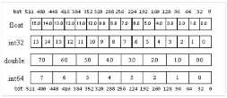
Larrabee Vectors (Intel’s Initial “GPU” Offering)
32 512b-wide new registers
8 16b-wide vector mask registers
Register ops generally ternary (a=b op c)
Extensive use of masks
SIMD Instruction Set Extensions for Multimedia

Slide 9
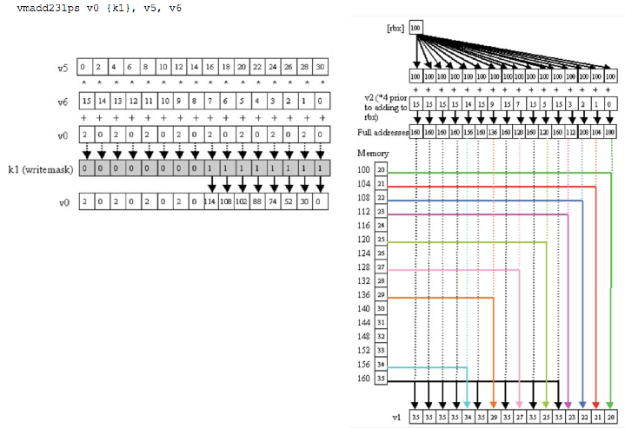
Larrabee Example
SIMD Instruction Set Extensions for Multimedia

Slide 10
Graphical Processing Units
Given the hardware invested to do graphics well, how can be supplement it to improve performance of a wider range of applications?
Basic Idea
Heterogeneous execution model
CPU is the host, GPU is the device
What makes this model challenging?
Develop a C/C++-like programming language for GPU
Unify all forms of GPU parallelism as CUDA thread (NVIDIA)
OpenCL: Emerging vendor-independent language for multiple platforms
Programming model is “Single Instruction Multiple Thread”
Graphical Processing Units
Notes:
What makes this model challenging?
Extraction of good performance out of the GPU
Coordination of
The scheduling of computation on the CPU and GPU.
The transfer of data between system memory and GPU memory
GPUs have virtually EVERY type of parallelism that can be captured by the programming environment: multithreading, MIMD, SIMD, and even ILP.

Slide 11
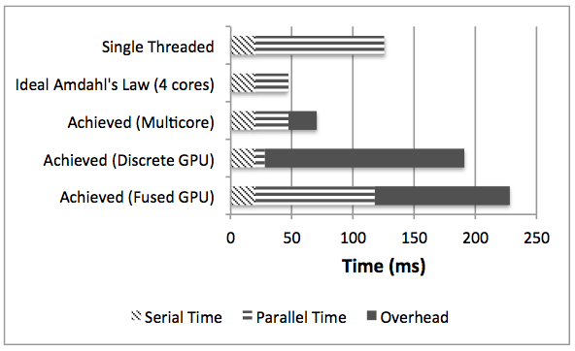
Amdahl’s Law: Different Parallel Devices
Notes:
16:30
The x86 CPU cores and the vector (SIMD) engines are attached to the system memory via the same high speed bus and memory controller.
This architectural artifact allows the AMD Fusion architecture to alleviate the fundamental PCIe constraint that has traditionally limited performance on discrete GPUs.
The first-generation implementation of Fusion divides system memory into two halves — one that is visible to and managed by the operating system running on x86 cores and one that is managed by the software running on the SIMD engines. Therefore, even on the Fusion architecture, data has to be moved from the operating system’s portion of system memory to that portion that is visible to the SIMD engines.

Slide 12
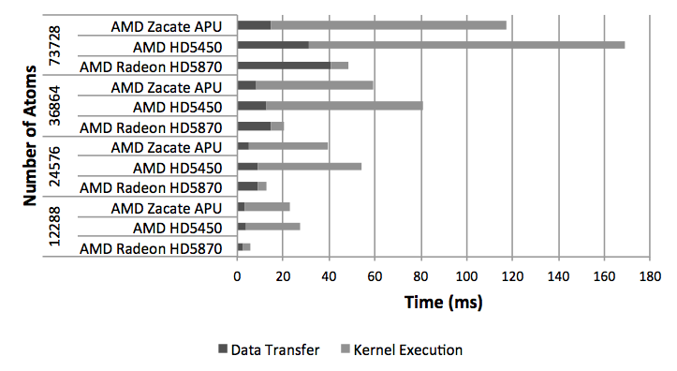
Performance: Molecular Modeling (N-Body)
APU reduces data transfer times for all problem sizes.
The efficacy of the APU increases as the problem size increases, but …
The kernel executes fastest on discrete AMD 5870 due to more and faster GPU cores. The fused AMD Zacate APU is next fastest.
Notes:
17:00
COMPUTE-BOUND APPLICATION … < animation >

Slide 13
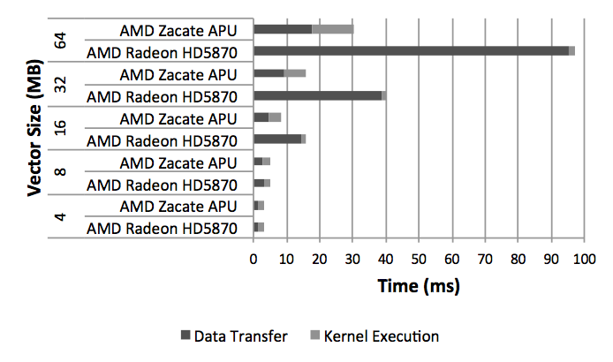
Performance: Reduction (Dense Linear Algebra)
The execution time profiles of the fused AMD APU and the discrete AMD 5870 are complementary.
Fused AMD APU die with only 80 GPU cores significantly improves data transfer time.
Discrete AMD 5870 die with 1600 faster GPU cores significantly improves kernel execution time.
Notes:
19:00
I/O-bound. A reduce algorithm uses a binary operation to reduce an input sequence to a a single value. For example, the sum of an array of numbers is obtained by reducing the array with a plus operation.
The execution times of the fused AMD Zacate APU and discrete AMD 5870 are approximately the same despite the fact that:
The AMD Zacate APU has 20x less cores, i.e., 80 vs. 1600.
The AMD Zacate APU has slower cores.

Slide 14
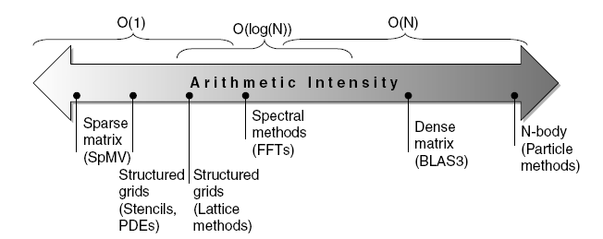
Roofline Performance Model [Williams et al., 2009]
Basic Idea
Plot peak floating-point throughput as a function of arithmetic intensity
Ties together floating-point performance, memory performance for a target machine, and arithmetic intensity
Arithmetic Intensity
Floating-point operations per byte read
SIMD Instruction Set Extensions for Multimedia
Notes:
Arithmetic intensity = # of Floating-point ops per program divided by # of data bytes transferred to main memory.
Memory performance defined by the memory system behind the cashes.

Slide 15
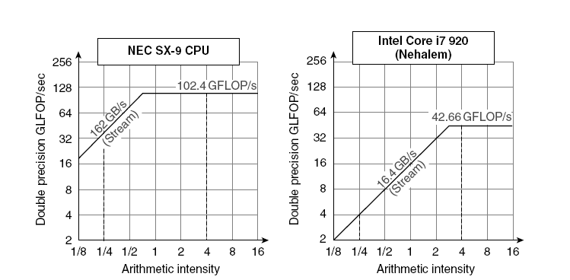
Examples
Attainable GFLOPs/sec = min (Peak Memory BW × Arithmetic Intensity, Peak Floating Point Perf.)
SIMD Instruction Set Extensions for Multimedia
Notes:
Slanted part of roof: Memory bandwidth limited
Flat part of roof: Computationally limited.
Peak computational performance of SX-9 ix 2.4x faster than Core i7.
Memory performance is 10x faster.

