Slide 1
Computer Architecture
A Quantitative Approach, Sixth Edition
Chapter 4
Data-Level Parallelism (DLP) in Vector, SIMD, and GPU Architectures
Part 1: Introduction & Vector Architectures
“We call these algorithms data parallel algorithms because their parallelism comes from simultaneous operations across large sets of data, rather than from multiple thread of control.”
- W. Daniel Hillis and Guy L. Steele
”Data Parallel Algorithms,” Comm. ACM (1986)
“If you were plowing a field, which would you rather use, two strong oxen or 1024 chickens?”
- Seymour Cray, Father of the Supercomputer
(arguing for two powerful vector processors
versus many simple processors)

Slide 2
Acknowledgements
Thanks to many sources for slide material
© 1990 Morgan Kaufmann Publishers, © 2001-present Elsevier
Computer Architecture: A Quantitative Approach by J. Hennessy & D. Patterson
© 1994 Morgan Kaufmann Publishers, © 2001-present Elsevier
Computer Organization and Design by D. Patterson & J. Hennessy
© 2002 K. Asinovic & Arvind, MIT
© 2002 J. Kubiatowicz, University of California at Berkeley
© 2006, © 2010 No Starch Press for Inside the Machine by J. Stokes
© 2007 W.-M. Hwu & D. Kirk, University of Illinois & NVIDIA
© 2007-2010 J. Owens, University of California at Davis
© 2010 CRC Press for Introduction to Concurrency in Programming Languages by M. Sottile, T. Mattson, and C. Rasmussen
© 2017, IBM POWER9 Processor Architecture by Sadasivam et al., IBM
© 2016, © 2019 POWER9 Processor User’s Manual, IBM
© The OpenPOWER Foundation
© 2022, W. Feng, Virginia Tech

Slide 3
What We Know
Processor
Control
Datapath
What new techniques have we learned that make …
… control go fast?
… datapath go fast?
Notes:
Control: Multiple fetch; trace cache; branch prediction; out of order; VLIW; EPIC
Datapath: Multiple issue; out of order; branch prediction; predication; speculation; loop unrolling

Slide 4

Flynn’s Classification Scheme
SISD – single instruction, single data stream
uniprocessors
SIMD – single instruction, multiple data streams
single control unit broadcasting operations to multiple datapaths
MISD – multiple instruction, single data stream
no such machine
(though some people put vector machines in this category)
MIMD – multiple instructions, multiple data streams
a.k.a multiprocessors (SMPs, MPPs, clusters, NOWs)

Slide 5
Continuum of Granularity
“Coarse”
Each processor is more powerful
Usually fewer processors
Communication is more expensive between processors
Processors are more loosely coupled
Tend toward MIMD
“Fine”
Each processor is less powerful
Usually more processors
Communication is cheaper between processors
Processors are more tightly coupled
Tend toward SIMD
“If you were plowing a field, which would you rather use? Two strong oxen or 1024 chickens?”
- Seymour Cray
Notes:
Granularity: Size of chunks of work given to each processor

Slide 6
The Road Ahead
What’s Up?
Chapter 4: Data-level parallelism (DLP). Fine-grained parallelism.
Vector & stream processors
SIMD extensions: MMX → SSE
Graphics processing units (GPUs)
What We Just Completed
Chapter 5: Thread-level parallelism (TLP). Coarse-grained parallelism.
Multicore
Multiprocessors
Clusters

Slide 7
Introduction to SIMD
Introduction
SIMD architectures can exploit significant data-level parallelism for
Matrix-oriented scientific computing
Media-oriented image and sound processors
SIMD is more energy efficient than MIMD
Only needs to fetch one instruction per data operation
Makes SIMD attractive for personal mobile devices
SIMD allows programmer to continue to think sequentially
Notes:
Power wall leads architects to value architectures that can deliver high performance without the energy and design complexity costs of highly out-of-order superscalar processors.
Vector instructions are ideal. Why?
Increase performance of simple in-order scalar processors without increasing design complexity (and hence, without greatly increasing energy demands).
Allows for slow but wide execution units to achieve high performance at low power.
Independence of elements within a vector instruction set allows scaling of functional units without performing additional costly dependency checks (a la Tomasulo’s)
Can naturally accommodate varying data sizes: 64 64-bit elts, 128 32-bit elts, 256 16-bit elts.

Slide 8
SIMD Parallelism
Introduction
Vector architectures (VMIPS, Motorola AltiVec)
SIMD extensions (MMX → SSE → AVX)
Graphics processing units (GPUs)
For x86 processors
Expect two additional cores per chip per year
Expect SIMD width to double every four years
Expect potential speedup from SIMD to be twice that from MIMD

Slide 9
SIMD Parallelism
Introduction
Vector architectures (VMIPS, Motorola AltiVec)
SIMD extensions (MMX → SSE → AVX)
Graphics processing units (GPUs)
For x86 processors
Expect two additional cores per chip per year
Expect SIMD width to double every four years
Expect potential speedup from SIMD to be twice that from MIMD

Slide 10

Seymour Cray The Father of Supercomputing
Introduction
An American electrical engineer and supercomputer architect who designed a series of computers that were the fastest in the world for decades..
“Anyone can build a fast CPU. The trick is to build a fast system.”
When asked what kind of CAD tools he used for the Cray-1, Cray said that he liked “#3 pencils with quadrille pads.”
When he was told that Apple Computer had just bought a Cray to help design the next Apple Macintosh, Cray commented that he had just bought a Macintosh to design the next Cray.
In 70s–80s, Supercomputer ≡ Vector Machine
Notes:
Cray recommended using the backs of the pages so that the lines were not so dominant.

Slide 11
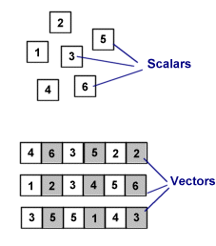
Scalar vs. Vector
Introduction
Representing Vectors
Multiple items within same data word
Multiple data words
“The basic unit of SIMD is the vector, which is why SIMD computing is also known as vector processing. A vector is nothing more than a row of individual numbers or scalars.”
SIMD Architectures by Jon “Hannibal” Stokes
http://arstechnica.com/articles/paedia/cpu/simd.ars

Slide 12
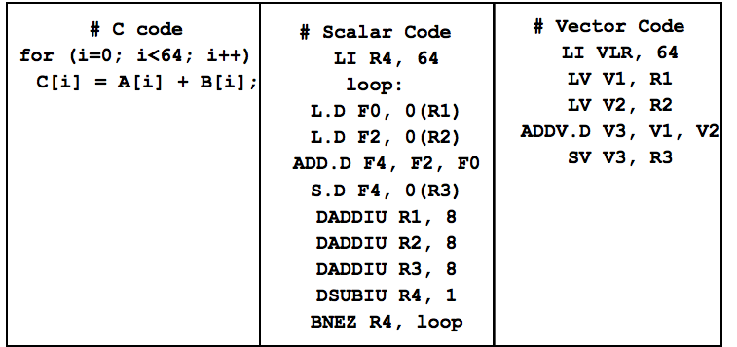
Vector Code Example
What are the advantages of vector code?
Notes:
TWO big advantages to this code: parallel (lots of ILP) and also compact (little instruction bandwidth)
When we get to the SIMD extensions, think about how this vector code might translate to MMX or SSE code.

Slide 13
Vector Instruction Set
Vector Architectures
Compact
one short instruction encodes N operations
Expressive … tells hardware that these N operations:
are independent
use the same functional unit
access disjoint registers
access registers in the same pattern as previous instructions
access a contiguous block of memory (unit-stride load/store), or
access memory in a known pattern (strided load/store)
Scalable
can run same object code on more parallel pipelines or lanes

Slide 14
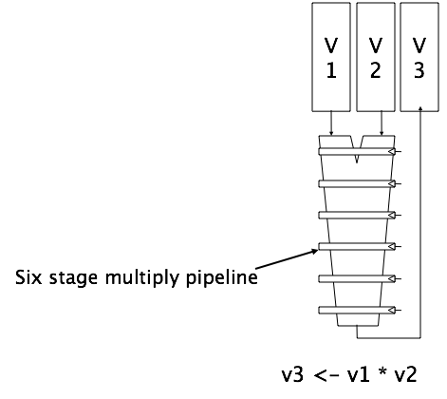
Vector Arithmetic
Vector Architectures
Use deep pipeline (=> fast clock) to execute element operations
Simplifies control of deep pipeline because elements in vector are independent (=> no hazards!)
Notes:
Remember: Computer architecture is all about tradeoffs.

Slide 15
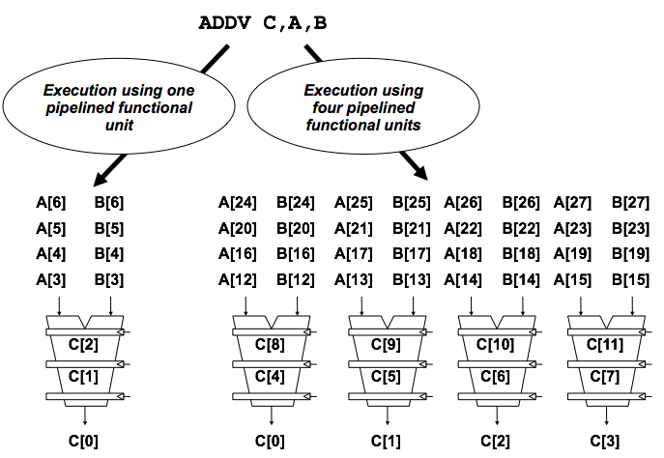
Vector Instruction
Vector Architectures
Notes:
Multiple lanes

Slide 16
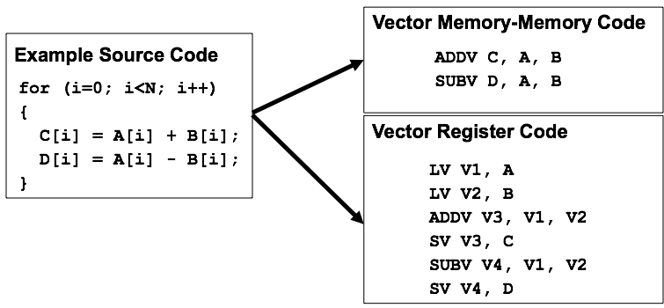
Vector Memory-Memory vs. Vector Register Machines
Vector Architectures
Vector memory-memory instructions hold all vector operands in main memory
The first vector machines, CDC Star-100 (‘73) and TI ASC (‘71), were memory-memory machines

Slide 17
Vector Memory-Memory vs. Vector Register Machines
Vector Architectures
Vector memory-memory architectures (VMMA) require greater main memory bandwidth. Why?
VMMAs make it difficult to overlap execution of multiple vector operations. Why?
VMMAs incur greater startup latency.
Scalar code was faster on CDC Star-100 for vectors < 100 elements.
For Cray-1, vector/scalar breakeven point was around 2 elements.
Apart from CDC follow-ons (Cyber-205, ETA-10) all major vector machines since Cray-1 have had vector register architectures.
We ignore vector memory-memory from now on.

Slide 18
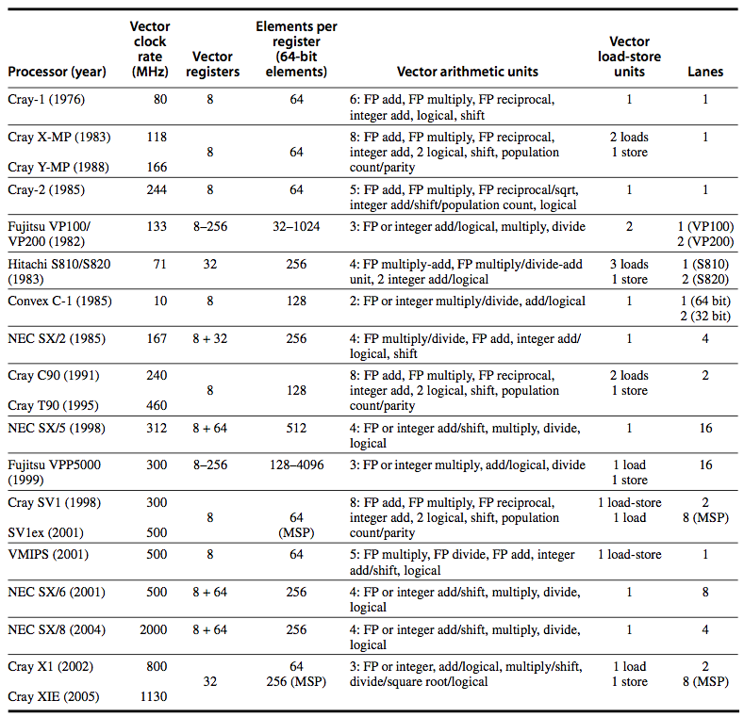
Vector Register Architectures
Basic idea
Read sets of data elements into “vector registers”
Operate on those registers
Disperse the results back into memory
Registers are controlled by compiler
Used to hide memory latency
Leverage memory bandwidth

Slide 19
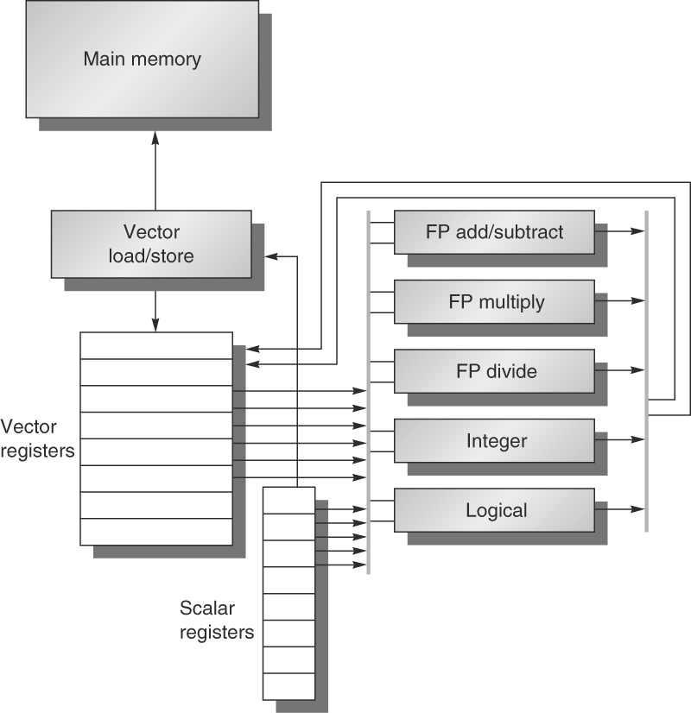
Vector Register Architectures
Vector Architectures
Basic idea
Read sets of data elements into “vector registers”
Operate on those registers
Disperse the results back into memory
Registers are controlled by compiler
Used to hide memory latency
Leverage memory bandwidth
VMIPS
(next slide)

Slide 20
VMIPS
Vector Architectures
Example architecture: VMIPS
Loosely based on Cray-1
Vector registers
Each register holds a 64-element, 64 bits/element vector
Register file has 16 read ports and 8 write ports
Vector functional units
Fully pipelined
Data and control hazards are detected
Vector load-store unit
Fully pipelined
One word per clock cycle after initial latency
Scalar registers
32 general-purpose registers
32 floating-point registers

Slide 21
VMIPS Instructions
Vector Architectures
ADDVV.D: add two vectors
ADDVS.D: add vector to a scalar
LV/SV: vector load and vector store from address
Example: DAXPY
L.D F0,a ; load scalar a
LV V1,Rx ; load vector X
MULVS.D V2,V1,F0 ; vector-scalar multiply
LV V3,Ry ; load vector Y
ADDVV V4,V2,V3 ; add
SV Ry,V4 ; store the result
Requires 6 instructions vs. almost 600 for MIPS

Slide 22
Vector Execution Time
Vector Architectures
Execution time depends on three factors:
Length of operand vectors
Structural hazards
Data dependencies
VMIPS functional units consume one element per clock cycle
Execution time is approximately the vector length
Convoy
Set of vector instructions that could potentially execute together
Notes:
You can estimate performance of a section of code by counting the number of convoys.
Instructions in a convoy must NOT contain any structural hazards.

