Slide 1
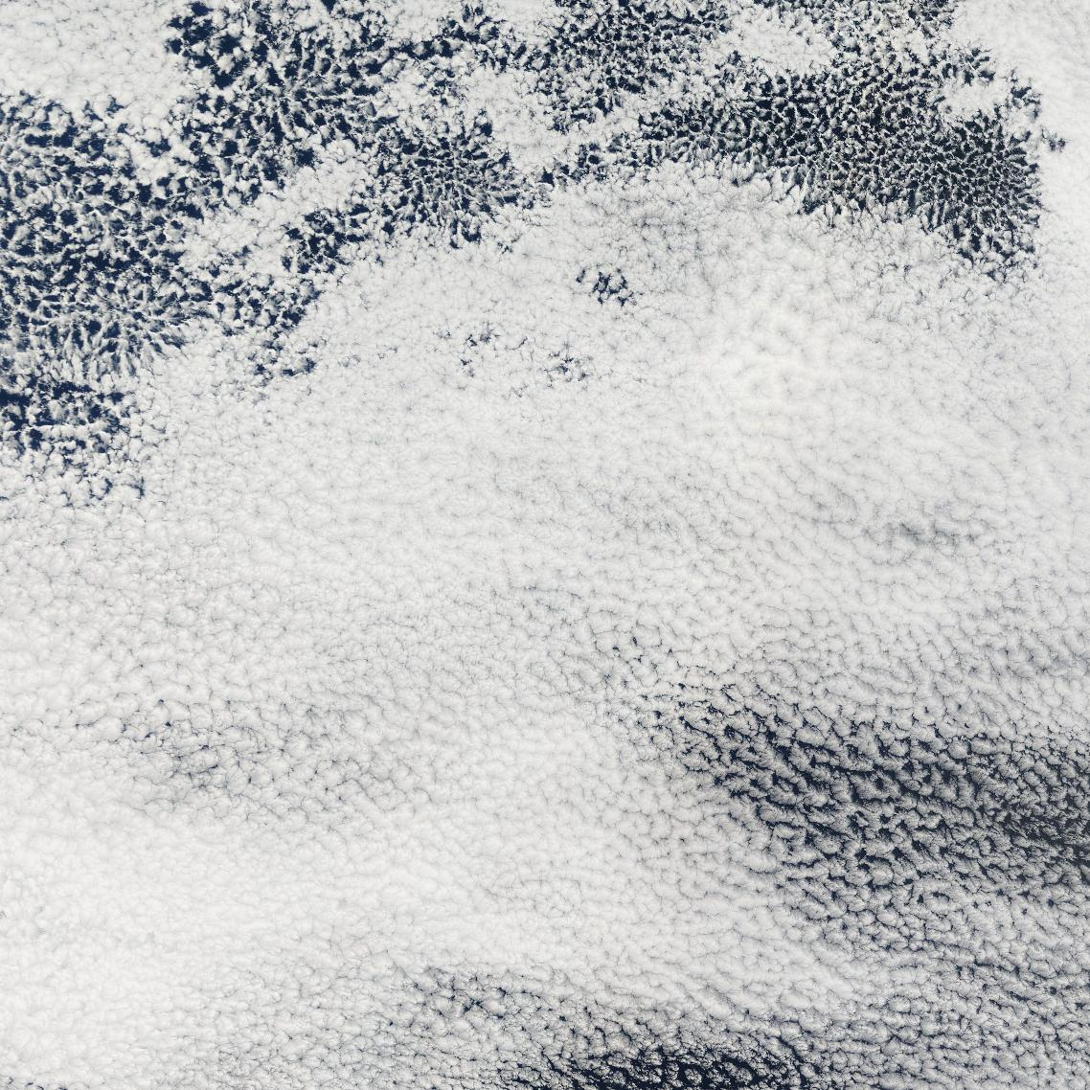
Stratocumulus clouds: EarthCare vs models
southeastern Pacific -20...-10 N, -90...-80 W
10 Sep 2025

Slide 2
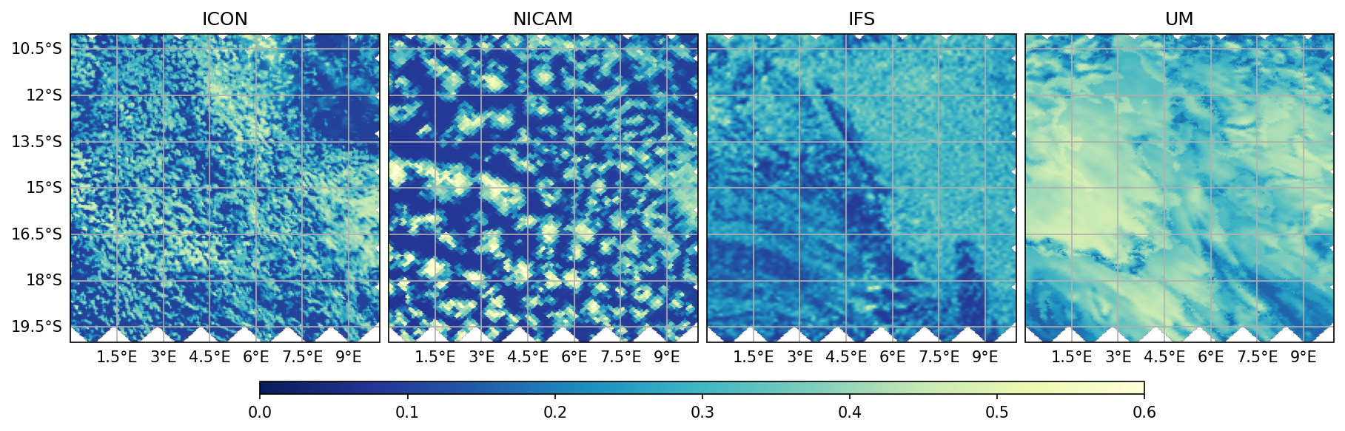
Stratocumulus clouds: EarthCare vs models: subtopics
Correlation among macroscopic properties: albedo, liquid water path, cloud fraction, rain rate |  | global km-scale climate models
Langrangian transitions from closed to open cells with focus on the role of cold pools |  | regional simulation over southeastern Pacific
Small-scale cloud heterogeneity and 3D effects |  | 3D Monte Carlo radiative transfer
Notes:
all subtopics relate to models
use same products

