Slide 1
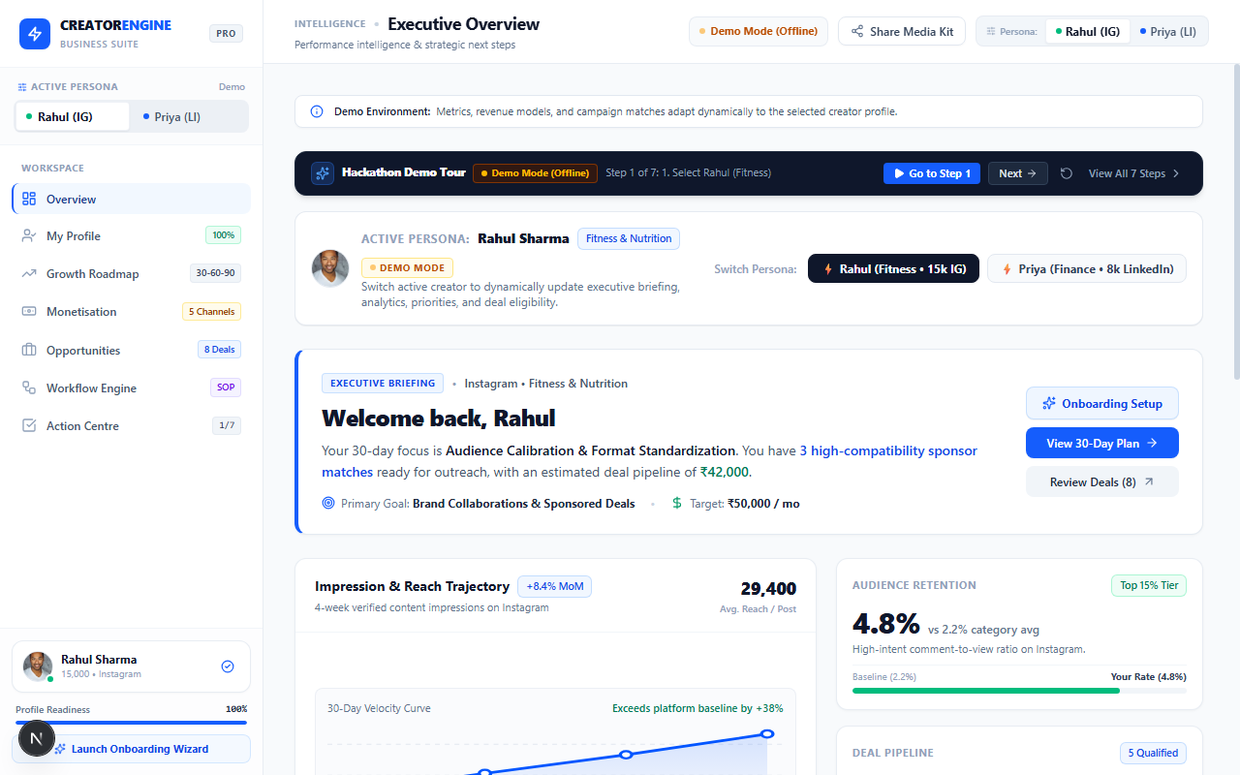
CODEX 3.0 HACKATHON • PROBLEM STATEMENT 3 (PS3)
Creator Engine
From Creator Profile to Growth, Monetisation & Opportunity Execution
An ongoing creator execution suite connecting niche audience calibration with AI-synthesized 30/60/90-day roadmaps, 5 diversified monetisation pathways, and a deterministic brand opportunity marketplace.
PROJECT METADATA & TEAM INFORMATION
Team Name: [CodeX 3.0 Finalist Team] | Track: Web3 & Creator Economy (PS3)
Team Members: [Presenter 1, Presenter 2, Presenter 3]
Stack: Next.js 16 Turbopack • React 19 • Supabase RLS • Google Gemini API
Live Working Prototype — Next.js 16
Notes:
Good morning judges. Welcome to Creator Engine, built for CodeX 3.0 Problem Statement 3: Build a Creator Monetisation and Brand Opportunity Engine. Today, we are showcasing a fully functioning Next.js 16 application backed by Supabase and the Google Gemini API. Instead of another passive analytics dashboard, Creator Engine provides an ongoing execution system that tells creators what content to produce, how to monetize their specific audience, and which brand sponsorships they are genuinely qualified to win.

Slide 2
THE REAL CREATOR DILEMMA
Creators Are Drowning in Metrics But Starving for Direction
The creator journey is currently broken into 4 disconnected silos, leading to burnout and monetization failure.
01
02
03
04
Content & Format Paralysis
Skill & Growth Blindspots
Commercial & Pricing Confusion
Scattered Deals & Vanity Metrics
• Creators guess what to post daily without algorithmic retention context.
• Lacks clear visibility into 3-second hook drop-offs or missing save-rate mechanisms.
• Results in sporadic posting schedules and algorithm suppression.
• Creators know they must improve, but cannot prioritize specific operational skills.
• Unclear whether to focus on video editing, rate negotiation, or slide hierarchy.
• No structured 30/60/90-day trajectory aligned to audience stage.
• 93% of nano/micro creators undervalue their audience or rely solely on low-yield links.
• Missing pricing frameworks, media kits, or revision boundary standards.
• Uncertain how to package 1 Reel + 3 Stories with commercial usage rights.
• Traditional dashboards (SocialBlade, HypeAuditor) show past graphs, not next steps.
• Brand deals are buried in spam DMs with hidden follower and engagement barriers.
• Creators waste hours pitching brands where they are fundamentally ineligible.
Notes:
Let's look at the core problem. Today, creators don't fail because they lack passion—they fail because their workflow is totally fragmented. In our research and problem statement analysis, we identified four main bottlenecks: First, content paralysis: creators don't know why their hooks drop off after 3 seconds. Second, skill blindspots: they have no roadmap to level up. Third, monetization confusion: they have no idea what rate card to quote. And fourth, analytics tools tell them what happened last week, but never what exact action to take today.

Slide 3
THE SOLUTION ARCHITECTURE
Creator Engine: The Ongoing Creator Execution Loop
A continuous 5-stage feedback system that transforms self-reported creator profile parameters into closed deals and daily execution.
STAGE 1
STAGE 2
STAGE 3
STAGE 4
STAGE 5
Creator Profile
AI Growth Strategy
Monetisation Pathway
Opportunity Match
Next Best Action
Calibrates stage, niche, audience demographics, primary platform, and monthly income targets.
Google Gemini synthesizes 30/60/90-day roadmaps, algorithmic content gaps, and skill acceleration priorities.
Evaluates viability across 5 diversified revenue channels with realistic readiness scores and first steps.
Deterministic algorithms match vetted brand briefs; hard eligibility checks filter unqualified applicants.
Prioritizes execution tasks with explainable 'Why It Matters' rationales, deadlines, and real-time velocity tracking.
Notes:
Here is our solution. Creator Engine is built as a closed-loop execution system with 5 interconnected stages: Stage 1: The creator defines their profile, verified platforms, and income targets. Stage 2: Gemini AI analyzes this data to generate tailored 30, 60, and 90-day growth plans. Stage 3: We evaluate 5 revenue pathways to find the most viable monetisation stream. Stage 4: Our deterministic matchmaking engine compares creator metrics against vetted brand campaign criteria. And Stage 5: Everything funnels into the Action Centre—giving the creator a prioritized daily execution queue.

Slide 4
FEATURE IMPLEMENTATION STATUS
How Creator Engine Works in the Prototype
Clear transparency: Features confirmed functional in code vs. upcoming production roadmap.
FUNCTIONAL IN THE CODEBASE TODAY (VERIFIED PROTOTYPE)
LIVE INTEGRATION STATUS
✓
4-Step Creator Onboarding Wizard
Collects handles, niches, stages, audience demographics, formats, and income targets (/onboarding).
Supabase Cloud Database
Status: Connected & Verified
PostgreSQL relational schema with RLS policies, 5 tables, and auto updated_at triggers.
✓
Persona Switcher & Hackathon Demo Bar
Instant state toggle between Rahul (Fitness, 15k IG) and Priya (Finance, 8k LI) across all 5 core routes.
Google Gemini API
Status: Connected & Verified
Server-side /api/recommendations route via @google/genai with candidate model fallback and schema validator.
✓
30/60/90-Day Phased Growth Roadmap
Interactive milestone checklists, high-impact content gaps, and skill priorities with overall progress calculation.
✓
5-Pathway Monetisation Engine
Evaluates micro-sponsorships, affiliate links, consulting, digital guides, and PR with suitability scores 0-100.
Deterministic Match Engine
Status: Active in App Code
Strict mathematical scoring preventing AI hallucination of brand criteria or campaign availability.
✓
Deterministic Opportunity Marketplace
8 vetted brand briefs with mathematical compatibility scoring and hard eligibility checks (e.g. MyProtein vs Wint Wealth).
OAuth Live Scraping
Status: Planned (Read-Only)
Consent-based official Instagram Graph API & LinkedIn API authentication on production launch.
✓
Action Centre & Real-time Velocity
Status transitions ('Not started' -> 'In progress' -> 'Completed'), velocity tracking, custom action creation, and Supabase sync.
Notes:
In slide 4, we maintain absolute technical honesty for the hackathon judges. On the left, you see the working features implemented in our Next.js 16 codebase today: the onboarding wizard, dynamic persona switcher, phased roadmaps, 5-pathway monetisation engine, opportunity marketplace, and the Action Centre. On the right is our live integration status: Supabase and the Gemini API are connected and verified. Our opportunity match scoring is kept strictly deterministic in application code to guarantee zero AI hallucination.

Slide 5
STRATEGIC AI GUIDANCE
AI-Powered Growth Engine: Calibrated Roadmap & Gap Analysis
Synthesizing structured strategic guidance via Google Gemini with deterministic fallback.
CREATOR POSITIONING THESIS
ALGORITHMIC CONTENT GAPS
• Synthesizes a sharp, defensible market thesis for creator bio and media kit.
• Example (Rahul): 'Democratizing accessible fitness for 15,000+ Indian university students through realistic hostel meal preps & zero-equipment bodyweight training.'
• Differentiates the creator from generic fitness models by focusing on student dorm realities.
• Identifies specific retention flaws suppressing organic algorithmic distribution.
• 3-Second Hook Drop-off (Critical): Missing bold on-screen text in frames 0-45; noise-sensitive student viewers swipe past.
• Zero Long-term Saves (High): Reels lack a downloadable slide; algorithmic exploration decays within 24 hours.
SKILL ACCELERATION PRIORITIES
HIGH-IMPACT TOPIC OPPORTUNITIES
• Categorizes high-leverage skills into Content Production, Commercial Pitching & Strategy.
• Visual Retention Hooks (Critical): Add dynamic movement or bold problem statements upfront.
• Sponsorship Rate Negotiation (High): Package 1 Reel + 3 Story frames with 30-day organic usage rights.
• Formulates specific video angles with psychological hooks and suggested formats.
• Topic 1: '5 High-Protein Hostel Mess Hacks Under ₹40' (Fast-paced vertical reel with price callouts).
• Topic 2: 'Zero-Equipment Pull-Up Progression in a Dorm Doorframe' (Step-by-step form tutorial reel).
Notice: Recommendations synthesized via Gemini API server route (/api/recommendations) with schema sanitization and offline fallback.
Notes:
Slide 5 shows the AI-Powered Growth Engine in detail. Notice that Gemini isn't generating generic text prompts—it generates a tightly structured JSON response containing: 1. A unique Creator Positioning Thesis. 2. Algorithmic Content Gaps with specific reasons, like 3-second hook drop-offs and missing save slides. 3. Clear Skill Priorities with tangible action steps. And 4. High-impact video topic angles with formats and target demographics. If external API keys are unavailable, our deterministic fallback engine produces matching high-fidelity recommendations instantly.

Slide 6
REVENUE & MARKETPLACE ENGINE
Monetisation Pathways & Deterministic Opportunity Marketplace
Evaluating 5 distinct revenue streams and connecting creators to transparent brand briefs.
5 DIVERSIFIED REVENUE PATHWAYS
VETTED OPPORTUNITY CARD BREAKDOWN
Micro-Sponsorships & Dedicated Reels (Score: 94%)
D2C brands hunt for creators with >4% ER; student dorm setups deliver 3x higher trust than studio shoots.
[BRAND BRIEF] MyProtein India • Campus Fitness Fuel
Niche: Fitness & Nutrition | Platform: Instagram | Budget: ₹25,000 – ₹40,000
Deliverables: 2x Instagram Reels (60s) + 3x Story Frames with exclusive discount link.
Deterministic Match Score: 96% Match • Status: VERIFIED ELIGIBLE
✓ Follower Count: 15,000 (Required: >= 10,000)
✓ Engagement Rate: 4.8% (Required: >= 3.5%)
✓ Primary Platform: Instagram (Matches brief platform)
✓ Niche Alignment: Fitness & Nutrition (100% keyword match)
✓ Target Demographic: 18-24 Student audience in India
*Demo Notice: Fictional campaign brief reflecting standard industry brand deliverables.
Curated Supplement & Gear Affiliate Codes (Score: 88%)
Immediate passive revenue answering frequent DM queries with 10-15% commission coupons.
Dorm Calisthenics Blueprint (Digital Guide) (Score: 82%)
₹299 low-friction PDF + unlisted video workout program with zero ongoing delivery overhead.
1:1 Advisory Calls & Consultations (Score: 74%)
High suitability for technical/finance creators (e.g. Priya) offering private 30-min strategy sessions.
Corporate Workshops & PR Speaking (Score: 68%)
B2B employee financial wellness seminars charging ₹25k-₹40k per corporate session.
Notes:
On slide 6, we examine how monetization works. In Creator Engine, we don't assume brand sponsorships are the only way to earn. We evaluate 5 diversified pathways with quantitative suitability scores from 0 to 100. On the right is a live example of our brand opportunity card: MyProtein India. Look at the eligibility breakdown: Rahul is scored at 96% and verified eligible because he demonstrably passes all 5 criteria. If a creator does not meet a hard requirement, the engine explicitly marks them ineligible and explains why.

Slide 7
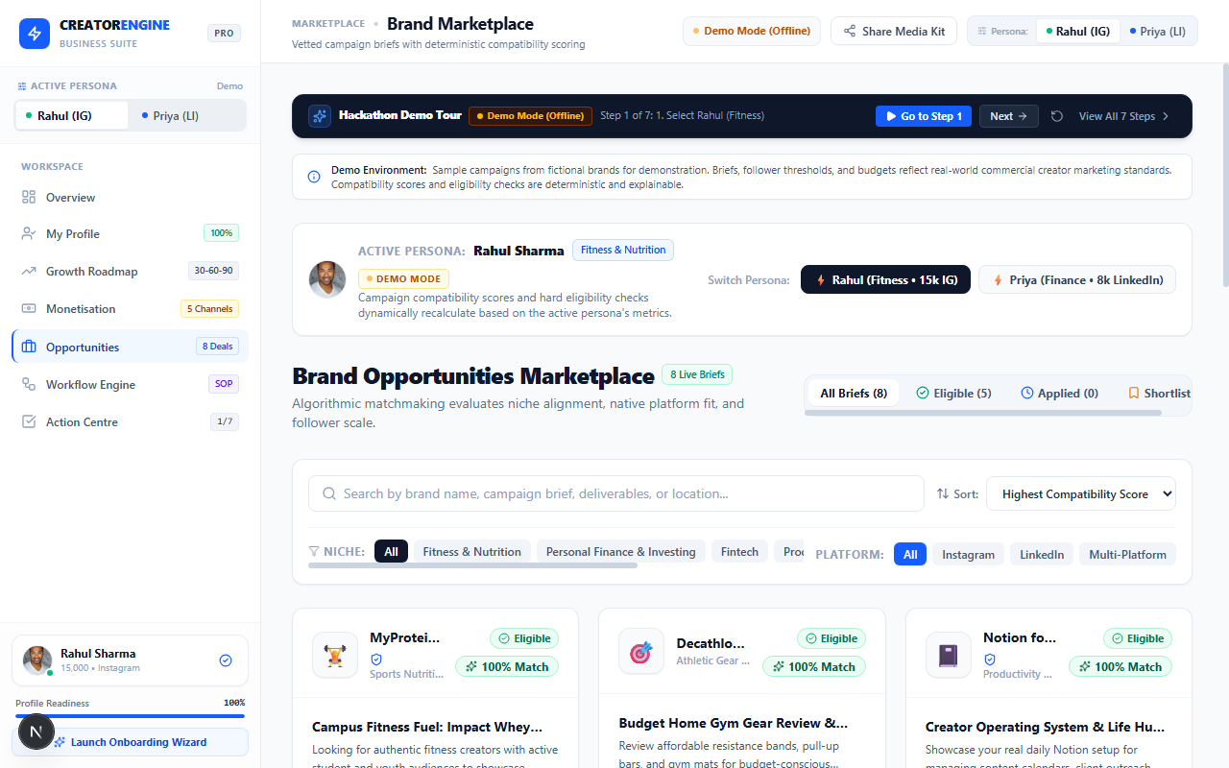

CRITICAL HACKATHON DEMONSTRATION
Two Creators, Two Completely Different Strategic Playbooks
Demonstrating deep personalization: Recommendations completely invert between Rahul and Priya.
CREATOR A: RAHUL SHARMA (@rahulfit.india) • FITNESS
CREATOR B: PRIYA NAIR (@priya.finance) • PERSONAL FINANCE
Audience & Scale: 15,000 Instagram Followers • 4.8% Engagement • 18-24 Students
Income Goal: ₹75,000/month via commercial fitness sponsorships
Strategic Positioning: Hostel nutrition hacks under ₹40 & dorm-friendly calisthenics
Top Monetisation: 1. Brand Collaborations (94%) | 2. Affiliate Codes (88%)
Top Brand Deal: MyProtein India Campus Fuel (96% Match — VERIFIED ELIGIBLE)
Disqualified Deal: Wint Wealth Bonds (INELIGIBLE — Requires LinkedIn & Finance Niche)
Next Best Action: Submit customized pitch deck to MyProtein & audit Reels 3-sec hook dropoff
Audience & Scale: 8,000 LinkedIn Followers • 3.8% Engagement • 24-35 Tech Pros
Income Goal: ₹1,20,000/month via corporate financial wellness & advisory calls
Strategic Positioning: Zero-jargon visual frameworks for tax optimization & RSUs
Top Monetisation: 1. 1:1 Advisory Calls (96%) | 2. Corporate Wellness Webinars (91%)
Top Brand Deal: Wint Wealth Fixed Income Series (97% Match — VERIFIED ELIGIBLE)
Disqualified Deal: Cult.fit Home Challenge (INELIGIBLE — Requires Instagram Fitness Videos)
Next Best Action: Standardize SEBI-compliant disclaimer footer & launch Topmate booking link
Notes:
Judges, this slide represents the core requirement of Problem Statement 3: proving that two creators in different niches receive completely distinct recommendations. On the left, Rahul is a student fitness creator on Instagram with 15k followers. His top opportunities are MyProtein India and ₹299 digital workout guides. Wint Wealth is strictly disqualified because he's on Instagram in fitness. On the right, Priya is a LinkedIn finance educator with 8k connections. For Priya, recommendations completely invert: her top monetization is corporate wellness webinars and 1:1 strategy calls. Wint Wealth is a 97% match, while Cult.fit is disqualified. This proves our personalization is real, contextual, and explainable.

Slide 8
TECHNICAL ARCHITECTURE
Technology Stack & AI Integration Architecture
Engineered for reliability: Server-side API security, deterministic logic, and Row-Level Security.
PRESENTATION TIER: Next.js 16.4 (Turbopack) • React 19 • Tailwind CSS v4 • Lucide Icons
Client-side App Router with responsive dashboard layouts, Hackathon Demo Bar, Persona Switcher, and stateful Action Centre tracking.
STATE & CLIENT SERVICES: CreatorContext.tsx • compatibility.ts • supabaseService.ts
Global React Context managing active persona state, optimistic UI updates, and deterministic matchmaking algorithm preventing AI hallucination.
AI RECOMMENDATIONS ROUTE: Next.js Server API (/api/recommendations) • @google/genai SDK
Secure server-side route executing Gemini API (gemini-3.5-flash-lite / gemini-3.8-flash) with 20s timeout, schema sanitization, and fallback engine.
PERSISTENCE & SECURITY: Supabase PostgreSQL • Row Level Security (RLS) • UUIDs
Relational schema covering creator_profiles, creator_preferences, opportunities, opportunity_applications, and action_items with public demo access policies.
Notes:
Slide 8 outlines our technical implementation. We built this with Next.js 16.4 using the Turbopack engine and React 19. Security was a priority: the Gemini API key is never exposed to the client. All AI generation goes through our server route `/api/recommendations` with strict output schema validation and a 20-second timeout. For database storage, we deployed a PostgreSQL relational schema on Supabase configured with Row-Level Security, allowing public read for demo profiles while ensuring user data is private and secure.

Slide 9
MARKET POSITIONING & GUARDRAILS
Differentiation Matrix & Responsible Design Principles
Why Creator Engine is uniquely actionable, and how we protect creators and brands.
PRODUCT COMPARISON MATRIX
RESPONSIBLE DESIGN GUARDRAILS
Capability ➔ Creator Engine
Alternative Tools: Analytics Dashboards vs Caption AI Tools vs Blind Marketplaces
[GUARDRAIL] No Guaranteed Virality Claims
Creator Engine explicitly avoids fraudulent promises of follower growth or guaranteed earnings; all price ranges are labeled as illustrative benchmarks.
Target Output ➔ Next Best Action
Alternative Tools: Historical Graphs vs Isolated Captions vs Spam Listing Boards
[GUARDRAIL] No Unauthorized Scraping
We do not scrape private data or bypass platform anti-bot controls; data is self-reported and consent-driven.
Growth Roadmap ➔ 30/60/90 Days Phased
Alternative Tools: None (Static) vs None vs None
Monetisation Model ➔ 5 Viable Pathways
Alternative Tools: None vs None vs Bidding Only
[GUARDRAIL] Zero AI Campaign Hallucination
Gemini advises strictly on content and strategy; brand campaign criteria are governed deterministically in application code.
Matchmaking Logic ➔ Deterministic & Explainable
Alternative Tools: None vs None vs Black-box Bidding
[GUARDRAIL] Regulatory Compliance Built-In
Incorporates statutory disclosure guidelines (ASCI influencer norms, SEBI educational research disclaimers).
Compliance Guidance ➔ ASCI & SEBI Norms
Alternative Tools: None vs None vs Terms-of-Service Only
Notes:
On slide 9, we highlight our market differentiation and ethical guardrails. Most creator tools fall into two extremes: either vanity analytics dashboards that don't tell you what to do, or AI caption generators that provide isolated text. Creator Engine bridges this by being an action-oriented execution system. Equally important are our responsible design guardrails: we make zero claims of guaranteed virality, we do not perform unauthorized scraping, and we never allow generative AI to hallucinate brand sponsorship criteria.

Slide 10
"Creators don't need another analytics dashboard. They need a system that helps them decide what to do next and discover relevant monetisation opportunities."
— Core Product Thesis, Creator Engine (CodeX 3.0 PS3)
EXPECTED CREATOR & BRAND VALUE
• Faster Time-to-Monetisation:
Reduces creator ramp-up time by providing immediate rate card benchmarks and pitch templates.
• Higher Sponsorship Conversion:
Deterministic qualification prevents rejected pitches and protects brand campaign quality.
• Execution Accountability:
Real-time Action Centre velocity converts strategic intentions into completed operational milestones.
• Regulatory Compliance Protection:
Educates creators on mandatory ASCI influencer tags and SEBI financial disclosure norms.
FUTURE DEVELOPMENT ROADMAP
• Phase 1 (Q2 2026): Official OAuth Social Verifications (Read-only Instagram Graph API & LinkedIn API).
• Phase 2 (Q3 2026): Smart Contract Escrow for automated campaign payouts upon approved reel delivery.
• Phase 3 (Q4 2026): AI Outbound Co-Pilot for brand negotiation & automated usage rights contracts.
Thank You! Ready for Questions & Live Demonstration.
Creator Engine Team • CodeX 3.0 Hackathon
Creator Engine — Built for CodeX 3.0 (PS3) • Live Prototype at http://localhost:3000 • Fully Editable PowerPoint Presentation
Notes:
To conclude: Creators don't need another passive analytics dashboard. They need a system that helps them decide what to do next and discover relevant monetisation opportunities. Creator Engine bridges the gap between creator identity and real revenue. We are ready for questions and would love to walk you through the live prototype. Thank you!

