Slide 1
JupyterHub Lunchbox session

Slide 2

Poll
https://pollev.com/wouterlampaert916
Notes:
https://pollev.com/wouterlampaert916

Slide 3
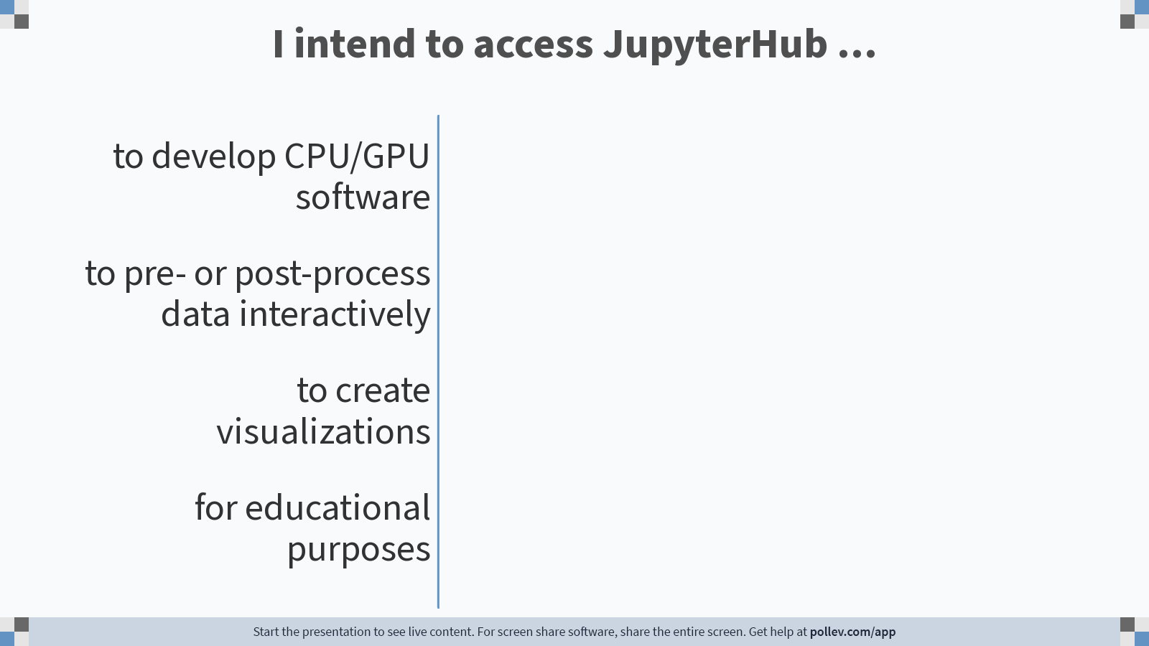
Notes:
Poll Title: Do not modify the notes in this section to avoid tampering with the Poll Everywhere activity. More info at polleverywhere.com/support I intend to access JupyterHub ... https://www.polleverywhere.com/multiple_choice_polls/SdqSVAlSTJQ3dU7FUFUxt

Slide 4
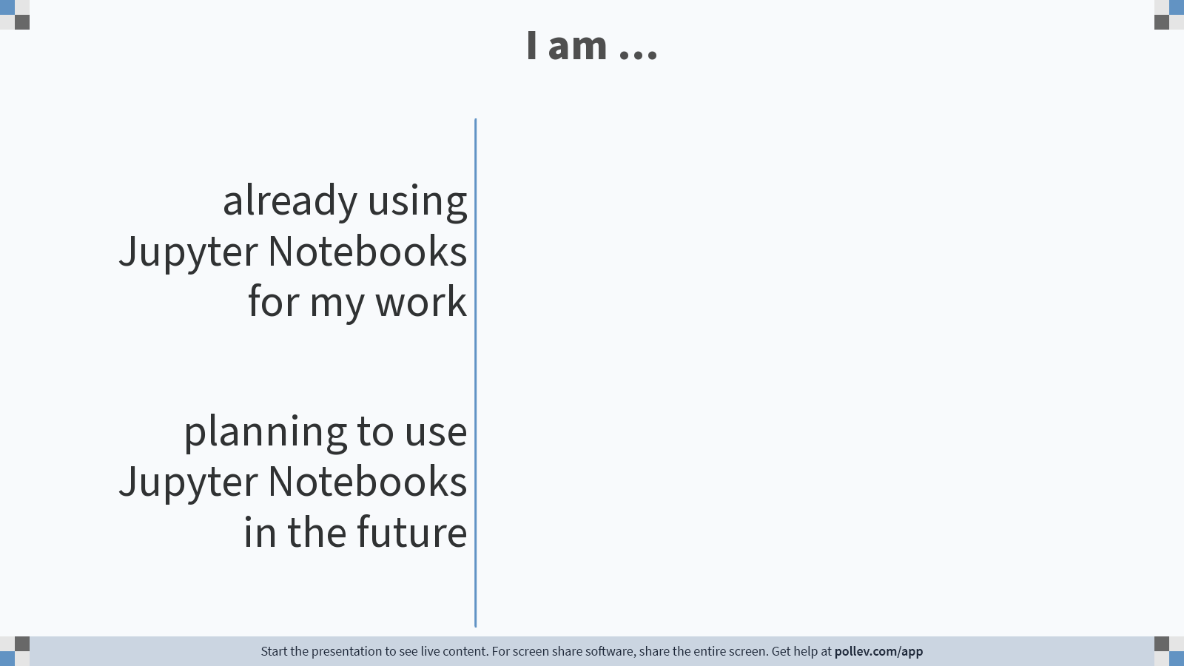
Notes:
Poll Title: Do not modify the notes in this section to avoid tampering with the Poll Everywhere activity. More info at polleverywhere.com/support I am ... https://www.polleverywhere.com/multiple_choice_polls/YOhjeflV688GAyVTcU3VC

Slide 5
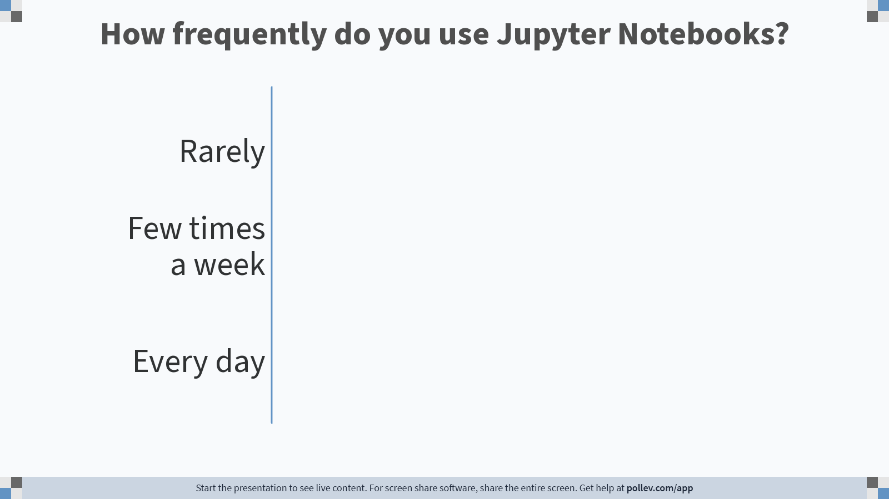
Notes:
Poll Title: Do not modify the notes in this section to avoid tampering with the Poll Everywhere activity. More info at polleverywhere.com/support How frequently do you use Jupyter Notebooks? https://www.polleverywhere.com/multiple_choice_polls/TasMYyY601kAPXP8xjO5g

Slide 6
General – Best practices
Easy use of Jupyter Notebooks on the HPC facilities
Interactive session
Best used for:
Data exploration
Visualization
Education
According to standard rules for HPC courses
Prototyping/development
Don’t use with:
Version control
Complicated dataflows
Notes:
JupyterHUB for educational purposes: it can be used, but this should be for courses related to HPC use, so not for courses to for example for general Linux and Python courses. Best to first talk to the HPC team for more info.
JupyterHUB for prototyping/development: this could include development of new code, testing packages you have never used before, some testing…
Don’t use with version control: JupyterHUB and version control don’t work well together. Best to avoid it in general
Don’t use with complicated dataflows: idem. With complicated dataflows we mean for example: reading data from http sources ->cleaning data ->creating dataframes -> plotting…

Slide 7
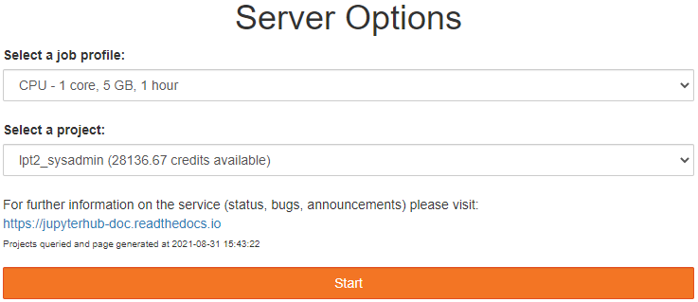
Getting started
Open your browser and go to https://jupyterhub.hpc.kuleuven.be/hub
Select the required resources
1, 4 or 12h
CPU or GPU
Best lowest possible resources, increase if necessary
Select desired project
Standard location is $VSC_DATA
If server doesn’t start in 5 mins,
process will be killed → try again
Notes:
The optimal way of working, is asking the lowest set of resources, as this will also lower your queue time. If you would notice you don’t have enough resources, create a new session and ask for more

Slide 8
Kernels
Two kernels available
Python 3.6.8
R 3.6.3
RStudio also available in NX, but kernel is better for intense calculations
Limited packages available, recommended to create your own kernel
Notes:
These kernels might include more packages in the future, for example to work for basic examples and give you some feel with what you can do with the JupyerHUB

Slide 9
Creating your own kernel
R or Python kernel
Use conda:
Install Miniconda in $VSC_DATA:
Python: https://docs.vscentrum.be/en/latest/software/python_package_management.html#install-miniconda
R: https://docs.vscentrum.be/en/latest/software/r_package_management.html#installing-miniconda
Create new conda environment or use existing environment
Install necessary packages
$ conda install <package_name>
Notes:
Both R and Python kernels can be created. Rstudio in NX might be easier to use, but has its limitations on the level of resources.
Use conda for the installation of resources. Install Miniconda in VSC_DATA (procedure is not explained here). Preferably install all necessary packages before using the kernel, but packages can always be added later in the standard way,

Slide 10
Creating your own kernel: Python
Activate your environment:
$ source activate <envname>
Include the IPython kernel, as well as ipython_genutils
$ conda install ipykernel
$ conda install ipython_genutils
Install environment in $VSC_HOME/.local with ipykernel:
$ python -m ipykernel install --prefix=${VSC_HOME}/.local/ --name ‘<envname> --display-name <name>`
New packages can be added from within JupyterHub.
$ conda install <package_name>
only one conda command per cell
Restarting the kernel is necessary
Notes:
Be sure to have the ipykernel package installed. It could be that you still need to install the ipython_genutils package as well
The env will be installed in your VSC_HOME/.local folder, which will allow it to be found by JupyterHUB,
With Python kernels, it is possible to add new packages from within the notebook. You do have to restart the kernel before using it. You can also use other conda commands in the standard way. You can only run one conda command per line. The second command won’t be recognized otherwise,

Slide 11
Creating your own kernel: R
Activate your environment:
$ source activate <envname>
Install IRKernel and jupyter_client:
$ conda install jupyter_client r-irkernel –c conda-forge
Install the environment to $VSC_HOME/.local with IRkernel:
Rscript -e 'IRkernel::installspec(prefix="${VSC_HOME}/.local/", name=" <envname>", displayname=" <display_name>")’
Conda packages cannot be installed from within Jupyter notebook
Notes:
Both the IRKernel and the jupyter-client package need to be installed in your environment before you can use the kernel. Similar as with Pyhon, you need to install the env in your VSC_HOME/.local folder so that JupyterHUB can find it.
Installing packages from within a Jupyter notebook is not possible, as Irkernel does not provide shell scripting as ipykernel does,

Slide 12
Removing a kernel
Remove kernel in $VSC_HOME/.local
$ rm $VSC_HOME/.local/share/jupyter/kernels/<kernel_name> -r
Be careful: removing a conda env and not removing the kernel as above will result in a non-working kernel. No error/warning is given in the Jupyter Notebook
Notes:
Kernels can be removed from the kernel list by specifically removing the folder of the kernel. This does of course not delete the environment. To delete this one, you need to use the standard way to remove conda environment.
If you remove your conda environment and not your kernel, you will still find the kernel listed, but it won’t work. If you try it, you don’t get any warning from Jupyter though,

Slide 13
Limitations
Not possible to load any extra modules.
Have a look for a conda/pip alternative if possible.
In case you have a specific case where you can only use a specific VSC module, please contact the servicedesk
Other executables (e.g. Tensorboard) cannot be used in Jupyter at the moment
Notes:
A standard set of modules is loaded to be able to run the Jupyter notebook. Loading extra modules is not possible, not from within the notebook nor from the terminal in JupyterHUB, even though it seems like it works when trying so. If you need any extra software, see if there is a conda packages available for it.
If you would need a very specific software that is available on the cluster, do contact our helpdesk
While a standard Jupyter notebook allows to execute some programs like Tensorboard within the notebook itself, this is not available in the JupyterHUB at the moment.

Slide 14
New kernel installation and notebook examples
Python
MNIST on GPU
R
K-means clustering
Notes:
Now two examples will be given on how to install a kernel, together with a small example of a notebook. For Python, we will use the classic MNIST deep learning example, while for R we will use a very simple k-means example,

Slide 15
Poll
https://pollev.com/wouterlampaert916
Notes:
https://pollev.com/wouterlampaert916

Slide 16
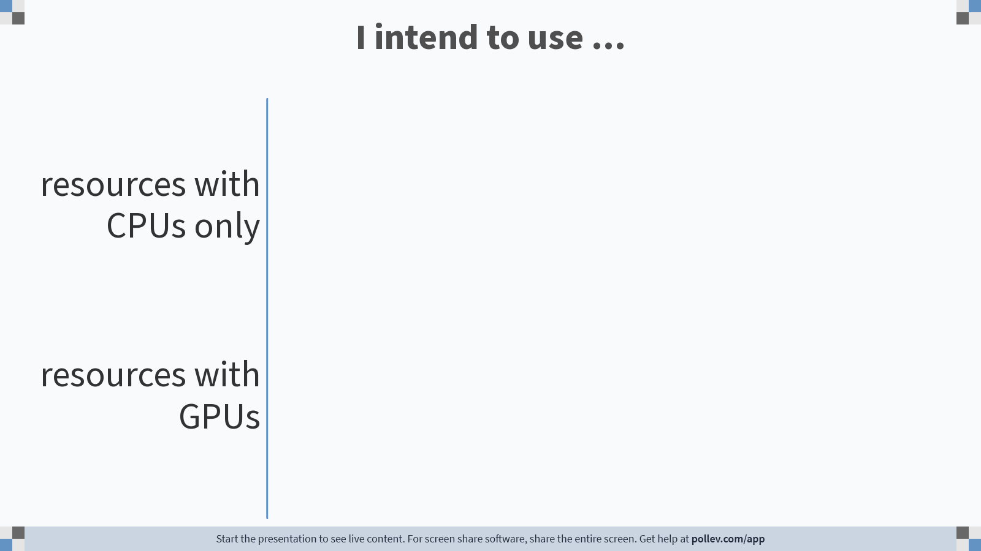
Notes:
Poll Title: Do not modify the notes in this section to avoid tampering with the Poll Everywhere activity. More info at polleverywhere.com/support I intend to use ... https://www.polleverywhere.com/multiple_choice_polls/GoXEygDQKSZrHdhU0w7aB

Slide 17
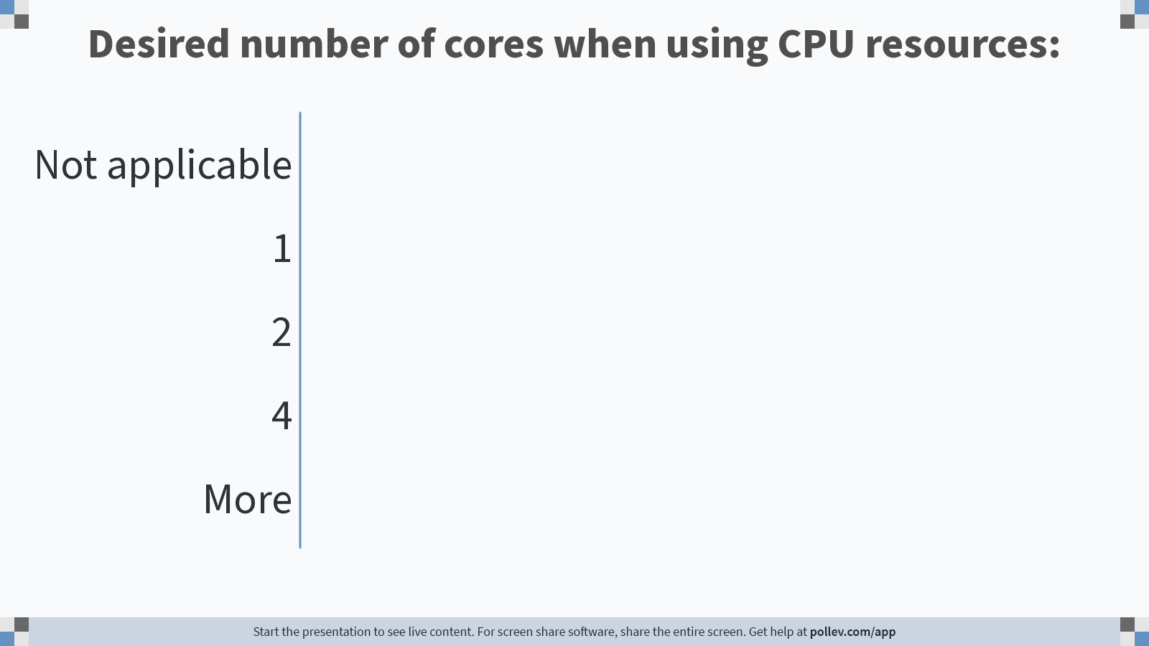
Notes:
Poll Title: Do not modify the notes in this section to avoid tampering with the Poll Everywhere activity. More info at polleverywhere.com/support Desired number of cores when using CPU resources: https://www.polleverywhere.com/multiple_choice_polls/h4AONSVMpWgouGiiVIPIW

Slide 18
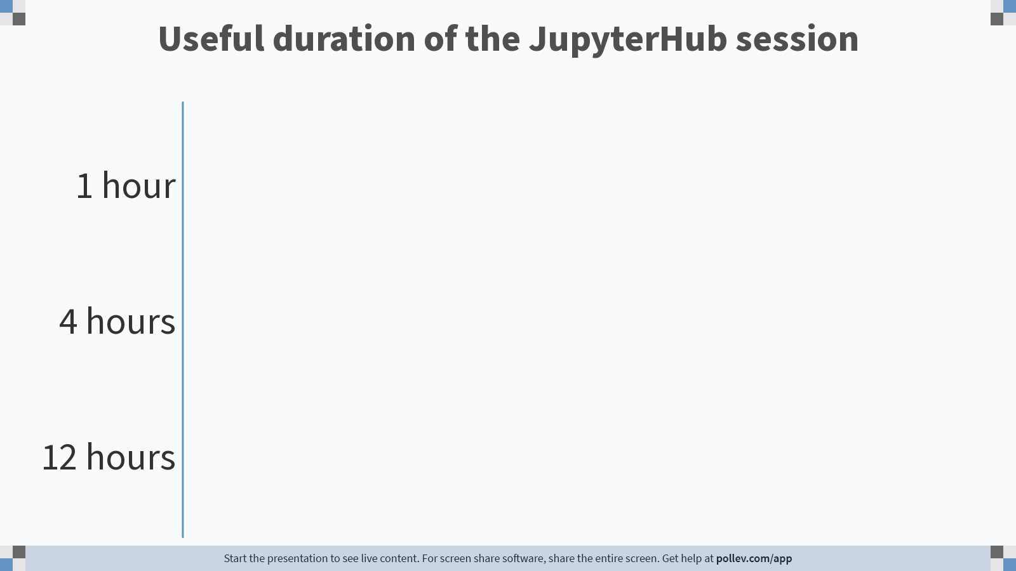
Notes:
Poll Title: Do not modify the notes in this section to avoid tampering with the Poll Everywhere activity. More info at polleverywhere.com/support Useful duration of the JupyterHub session https://www.polleverywhere.com/multiple_choice_polls/rCX9v6x9OrvG0jlnzfNDS

Slide 19
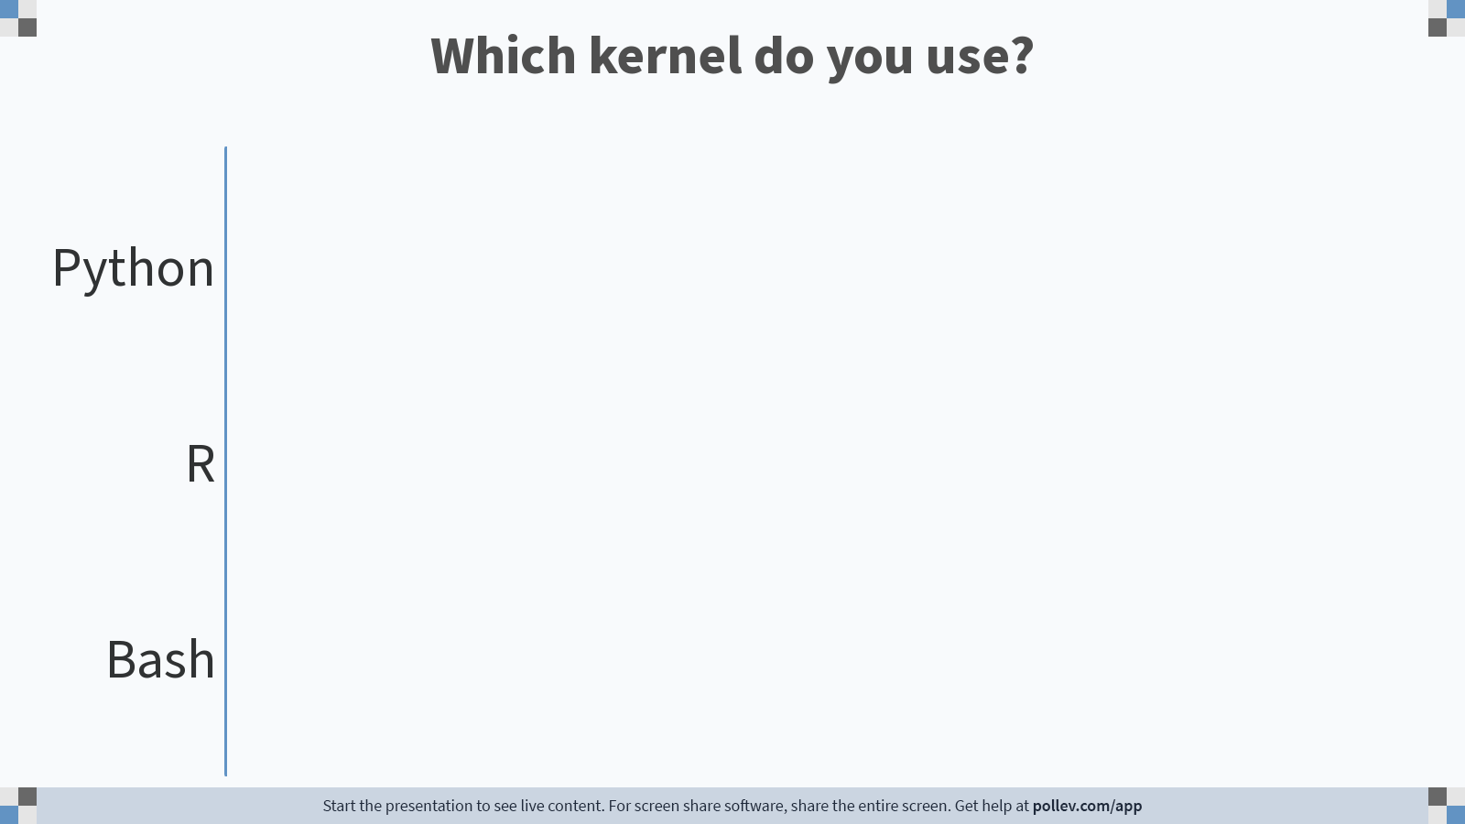
Notes:
Poll Title: Do not modify the notes in this section to avoid tampering with the Poll Everywhere activity. More info at polleverywhere.com/support Which kernel do you use? https://www.polleverywhere.com/multiple_choice_polls/42tacCZW9fP6zJa93KRFD

