Slide 1
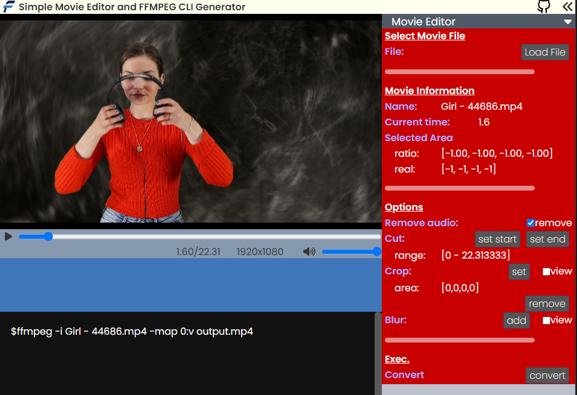
check here to remove audio

Slide 2
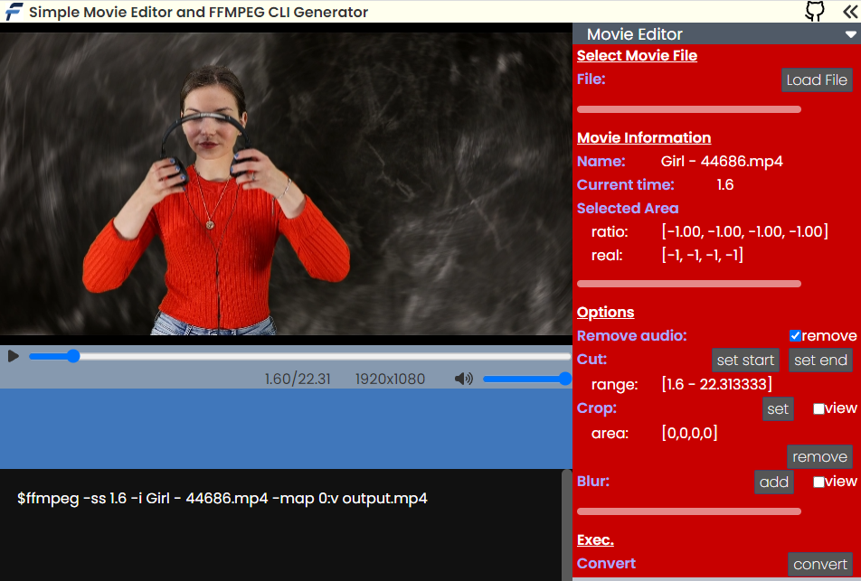
set time to cut out
set time to cut out
seek time

Slide 3
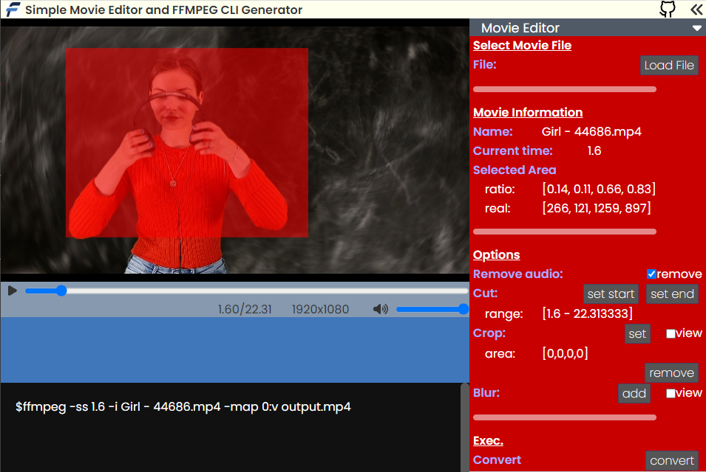
set area
set area to crop

Slide 4
set area
set area to blur

Slide 5
convert

