Slide 1


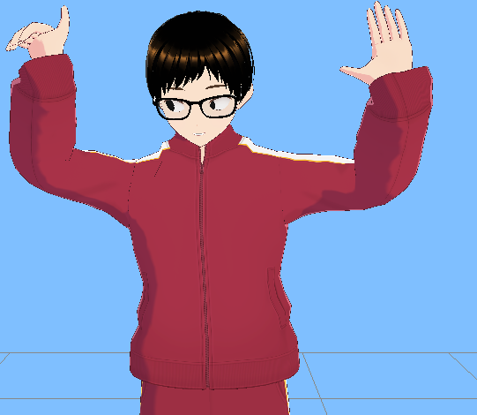
time
CPU (Webworker)
FACE
FACE
FACE
FACE
FACE
FACE
(A) webwoker
with wasm-simd tflite
CPU (Webworker)
HAND
HAND
HAND
CPU (Webworker)
POSE
POSE
Average update time
⇒ about 25msec
update
update
update
update
update
update
update
update
(B) mediapipe JS Solutions
GPU
FACE
HAND
POSE
FACE
HAND
POSE
Average update time
⇒ about 70msec
update
update
update
update
update

