Slide 1
AAS Assignment

Slide 2
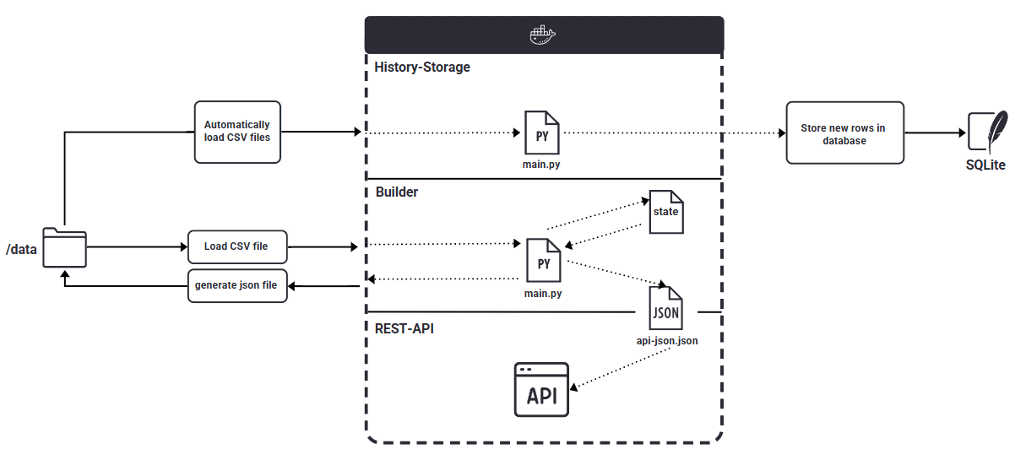
Architecture diagram

Slide 3
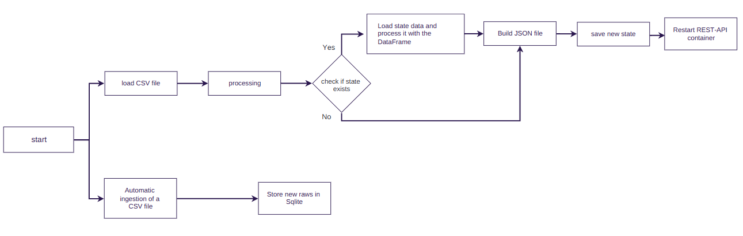
Update Workflow

Slide 4


Improvement ideas
• Automatic ingesting the csv Files from source
• Save each stage of the process data.

Slide 5
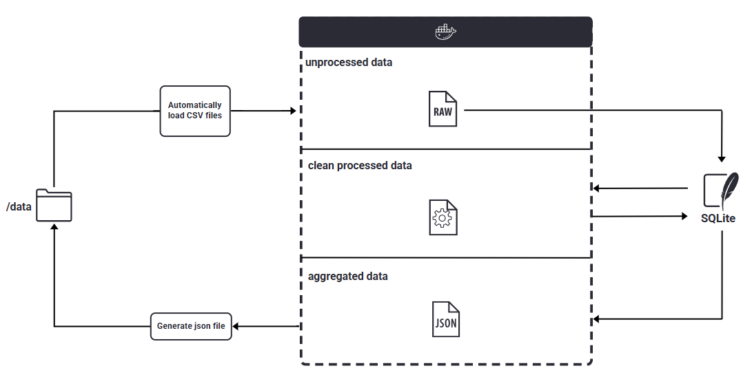
Improvement ideas

