Slide 1

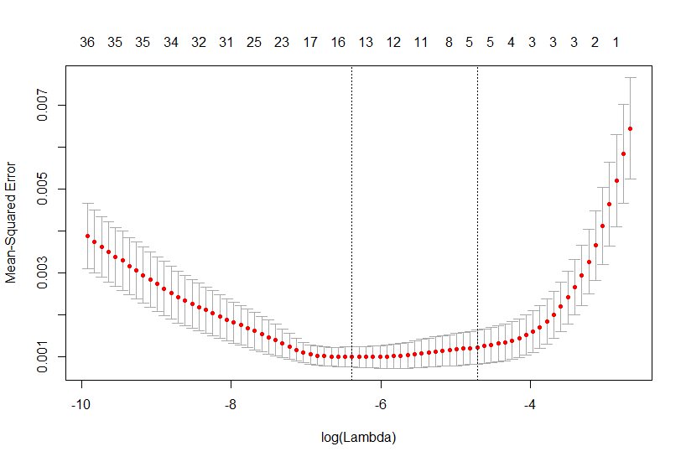
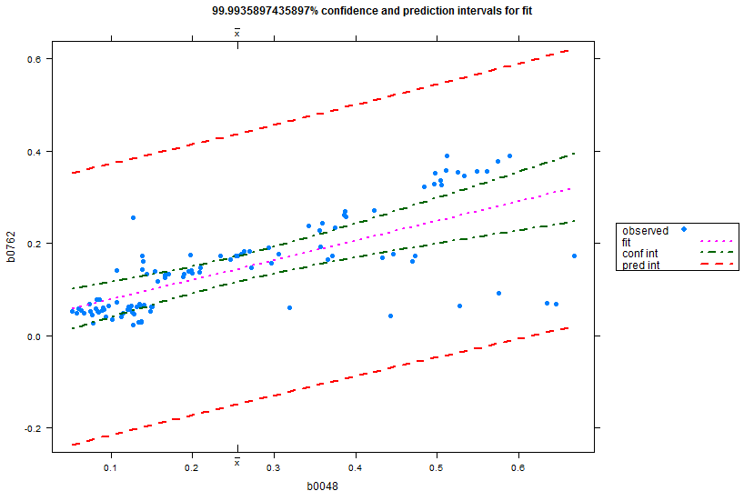
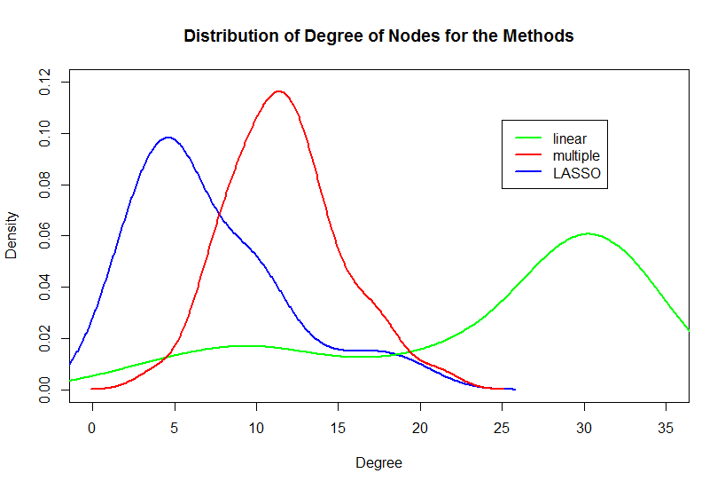
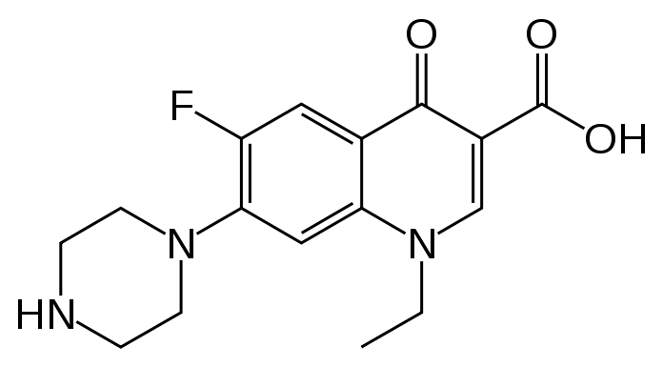
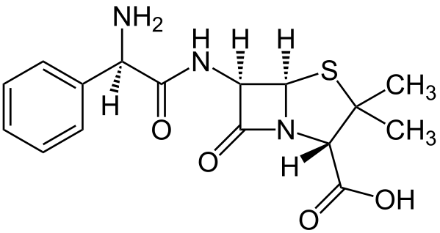
Computational Discovery of Differentially Expressed Genes and Inference of the Related Network in Antibiotic Treated Escherichia coli
Weston Selnaª, Minseung Kim^{b}, and Ilias Tagkopoulos^{b}
College of Agricultural and Environmental Sciencesª, Department of Computer Science and Genome Center^{b}, University of California - Davis, UC Davis Genome Center
Goals
Methods
Identify a set of genes common to antibiotic stress in general.
Infer a network among the genes identified.
Understand the many way of linear model building.
Use increasingly sophisticated linear models to infer more robust and interpretable networks.
Determination of Transcriptional Change due to Antibiotic Exposure ²
Pair-wise Linear Least Squares Regression ³
Multiple Regression with Optimal Subsets⁴
Data Collection from Database
Identification of Differentially Expressed Genes¹
1) Independent 2 sample
t-test were run in R comparing control to Nx and control to Am-Nx. The intersection of these two lists was kept.
2) Determined by the difference in the mean transcription between control and treatment.
3) For every pair of genes, if the regression was significant then the sign of the slope indicated the interaction
4) All possible sizes of subsets of differentially expressed genes were built into models. The one with the lowest BIC score was selected.
5) Using 10X cross validation, the penalty and model were selected.
LASSO ⁵
Introduction
6) Robustness was analyzed by node degree distribution and interaction type distribution.
Escherichia.coli is a Gram-positive rod bacterium. It is both a commensualist in our gut, but infectious in our urinary tract. This study examines expression data of 4096 of its genes.
The data for this study was supplied by the Ecomics database, an unpublished E. coli multi-omics database from our Lab. The data was collected by Mr. Minseung Kim for his Ph.D. project from publically available normalized microarray data.
The specific antibiotics stress groups under study are Norfloxacin treatment (n=10), and Ampicillin-Norfloxacin treatment (n = 3).
Norfloxacin (Nx) is a synthetic, broad-spectrum,
fluroquinolone used
to treat UTIs and
functions by
inhibiting DNA
gyrase and
topoisomerases.
Ampicillin (Am)
is a derivative of
Penicillin. The drug
works by inhibiting
cell wall synthesis.
The control group was made up of 95 samples (n = 95).
Network Analysis ⁶
Results
Number of Differentially Expressed Genes for Different Treatment Groups
Results cont.
Results
Norfloxacin | Ampicillin-Norfloxacin | Intersection
121 | 676 | 40
Figure 2: A typical Cross-Validation plot. The right most vertical line indicates the lambda value used for model selection.
Type of Transcriptional Change Induced by Antibiotic Treatment
Activation | Repression | Total
1 | 39 | 40
Figure 3: The graph demonstrates the distribution of degrees of the nodes for each modeling type. There is a clear trend that with increasing sophistication the mean getting closer to 0. The Phenomenon of “Power Law Distribution” can be seen here. LASSO gives the most Power Law Distributed network implying it is the more robust and biological.
Nx
Am
Acknowledgements
Figure 1: An example passing pair-wise LLS regression. Using a Bonferroni corrected p-value of .05/780, the interval of the slope was calculated.
I would like to thank Mr. Minseung Kim and Prof. Ilias Tagkopoulos for their guidance. This project was supported by a Research Experience for Undergraduates (REU) supplement of the NSF award 1244626 to Prof. Tagkopoulos.

