Slide 1
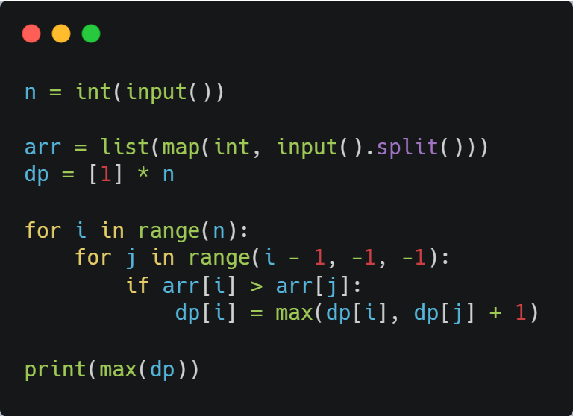
BOJ 11053. 예제
n = 6
arr = [10, 20, 10, 30, 20, 50]
10
20
10
30
20
50
dp = [1, 1, 1, 1, 1, 1]
1
1
1
1
1
1

Slide 2
i = 0
arr
10
20
10
30
20
50
dp
1
1
1
1
1
1
-1 >= j > -1
For문 수행하지 않음

Slide 3
i = 1
arr
10
20
10
30
20
50
dp
1
1
1
1
1
1
0 >= j > -1
i = 1
j = 0
if arr[1] > arr[0]:
dp[1] = max(dp[1], dp[0] + 1)

Slide 4
i = 2
arr
10
20
10
30
20
50
dp
1
2
1
1
1
1
1
1 >= j > -1
i = 2
j = 1, 0
arr[2]보다 큰 arr[j]를 만족하는 j가 없음

Slide 5
i = 3
arr
10
20
10
30
20
50
dp
1
2
1
1
1
1
1
2 >= j > -1
i = 3
j = 2, 1, 0
if arr[3] > arr[2]:
dp[3] = max(dp[3], dp[2] + 1)

Slide 6
i = 3
arr
10
20
10
30
20
50
dp
1
2
1
1
2
1
1
2 >= j > -1
i = 3
j = 2, 1, 0
if arr[3] > arr[1]:
dp[3] = max(dp[3], dp[1] + 1)

Slide 7
i = 3
arr
10
20
10
30
20
50
dp
1
2
1
1
3
1
1
2 >= j > -1
i = 3
j = 2, 1, 0
if arr[3] > arr[1]:
dp[3] = max(dp[3], dp[0] + 1)

Slide 8
i = 4
arr
10
20
10
30
20
50
dp
1
2
1
1
3
1
1
3 >= j > -1
i = 4
j = 3, 2, 1, 0
if arr[4] > arr[2]:
dp[4] = max(dp[4], dp[2] + 1)

Slide 9
i = 4
arr
10
20
10
30
20
50
dp
1
2
1
1
3
2
1
3 >= j > -1
i = 4
j = 3, 2, 1, 0
if arr[4] > arr[0]:
dp[4] = max(dp[4], dp[0] + 1)

Slide 10
i = 5
arr
10
20
10
30
20
50
dp
1
2
1
1
3
2
1
4 >= j > -1
i = 5
j = 4, 3, 2, 1, 0
if arr[5] > arr[4]:
dp[5] = max(dp[5], dp[4] + 1)

Slide 11
i = 5
arr
10
20
10
30
20
50
dp
1
2
1
1
3
2
3
4 >= j > -1
i = 5
j = 4, 3, 2, 1, 0
if arr[5] > arr[3]:
dp[5] = max(dp[5], dp[3] + 1)

Slide 12
i = 5
arr
10
20
10
30
20
50
dp
1
2
1
1
3
2
4
4 >= j > -1
i = 5
j = 4, 3, 2, 1, 0
if arr[5] > arr[2]:
dp[5] = max(dp[5], dp[2] + 1)

Slide 13
i = 5
arr
10
20
10
30
20
50
dp
1
2
1
1
3
2
4
4 >= j > -1
i = 5
j = 4, 3, 2, 1, 0
if arr[5] > arr[1]:
dp[5] = max(dp[5], dp[1] + 1)

Slide 14
i = 5
arr
10
20
10
30
20
50
dp
1
2
1
1
3
2
4
4 >= j > -1
i = 5
j = 4, 3, 2, 1, 0
if arr[5] > arr[0]:
dp[5] = max(dp[5], dp[0] + 1)

Slide 15
dp
1
2
1
1
3
2
4
max(dp) == 4

