Slide 1
Simple User Interface
Android
Russell Shanahan

Slide 2
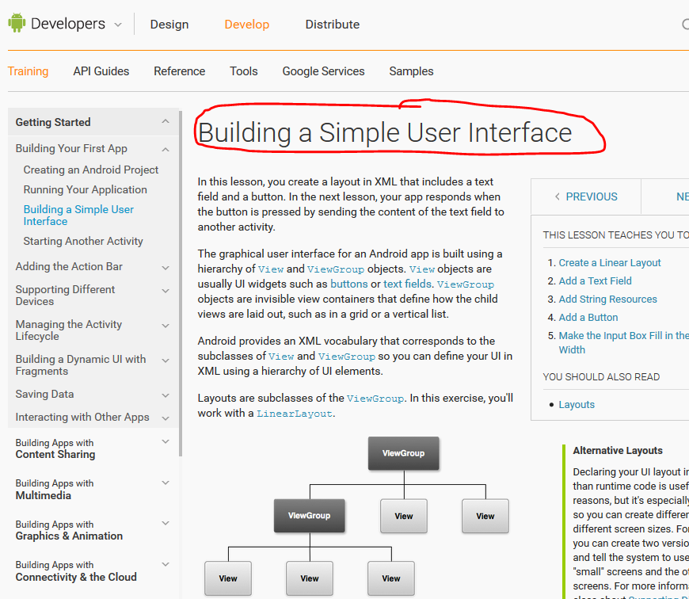
Build an App
Similar to Steps on Web Site
(I supply sample project)

Slide 3
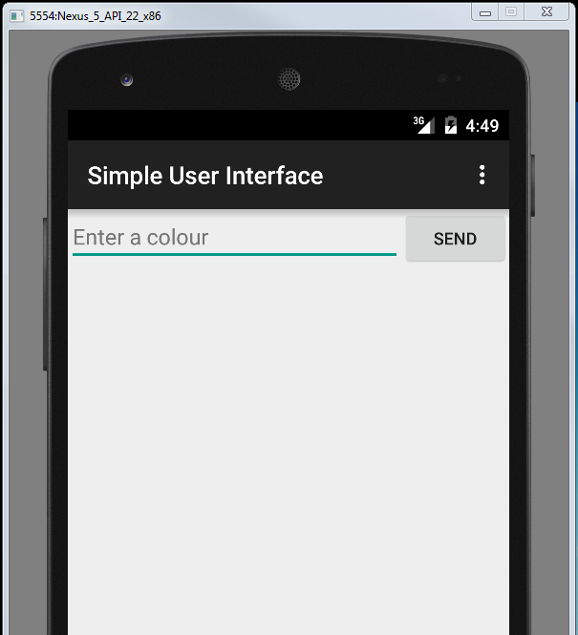
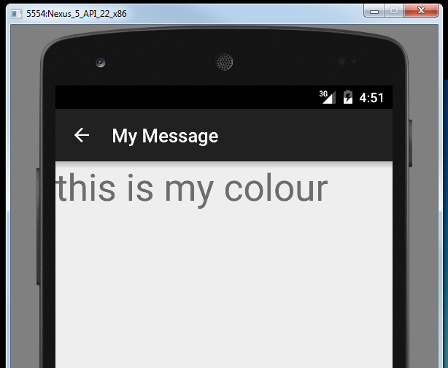
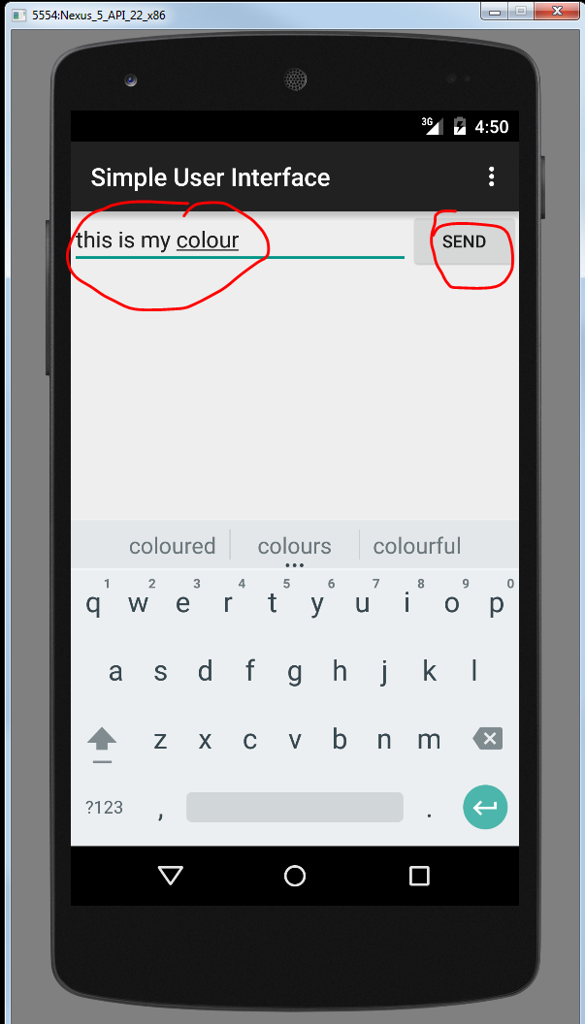
Two Activities:
Simple User Interface
My Message

Slide 4
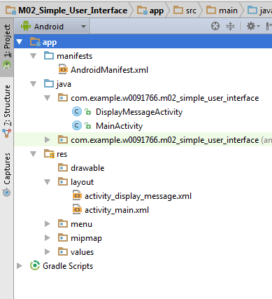

Two Java Activity Classes
Two Activity XML files

Slide 5
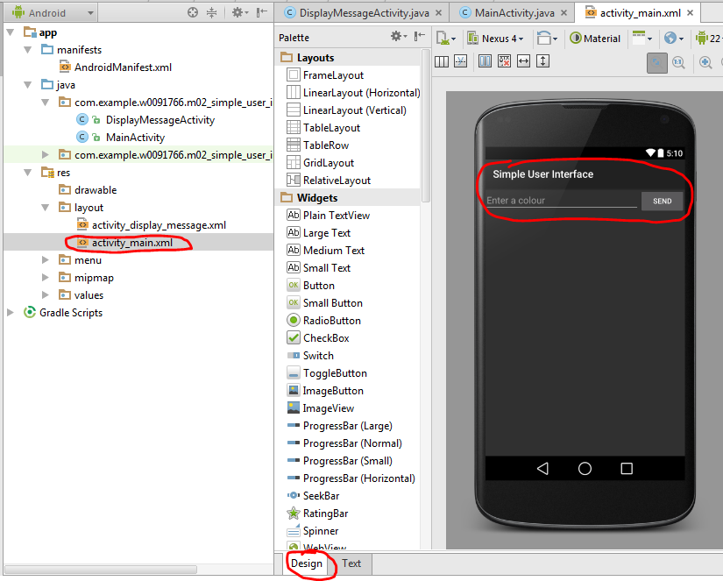
1st Activity
…as seen by Design View

Slide 6
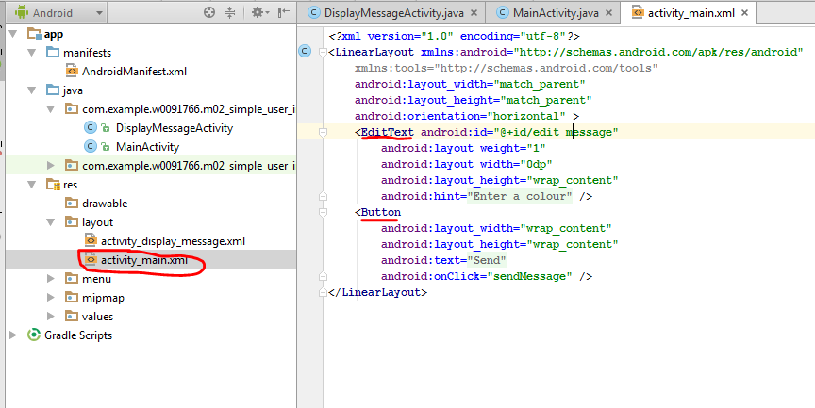

…has Text
…and a Button.

Slide 7
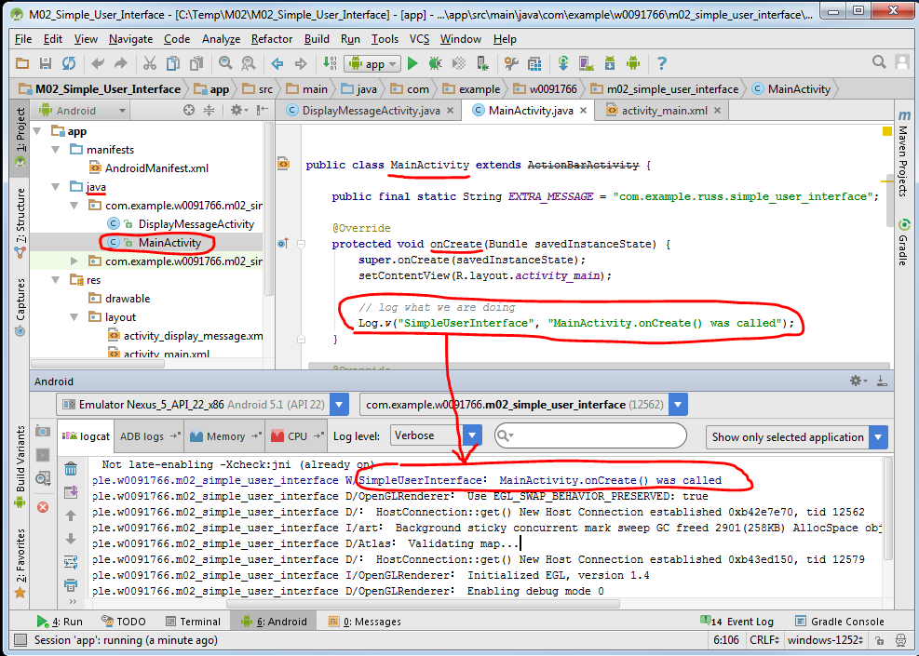
MainActivity Class
…onCreate() gets called.
Verify with log output.

Slide 8
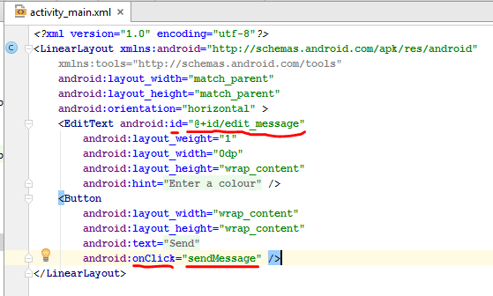
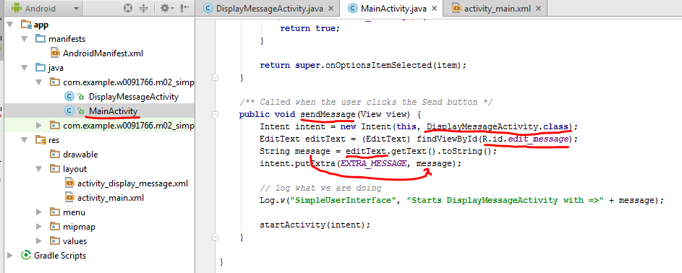
Set up to call the MainActivity sendMessage() method
…get text called “edit_message”

Slide 9
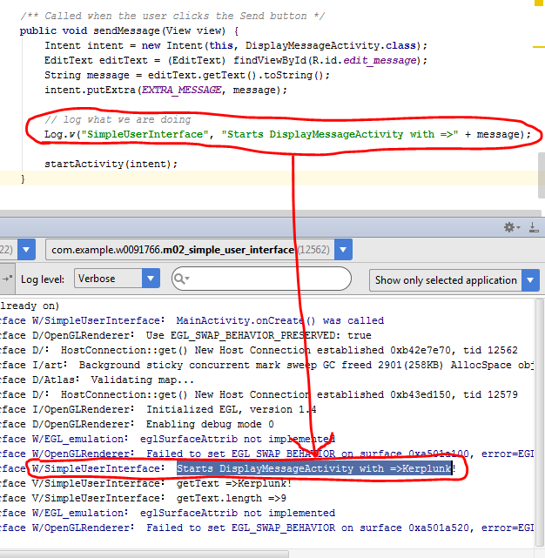
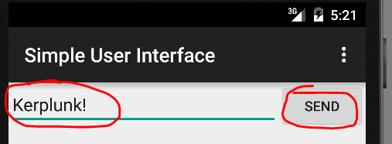
Verify with log output
OK…we are starting another Activity.

Slide 10
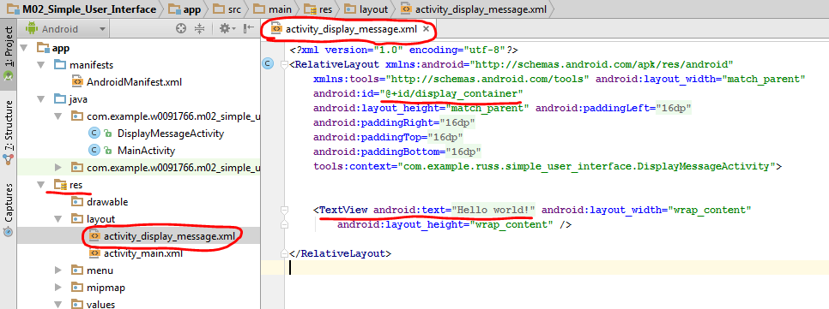
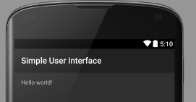

XML defaults to show “Hello World”
(always check every step)

Slide 11
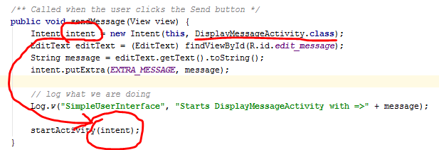
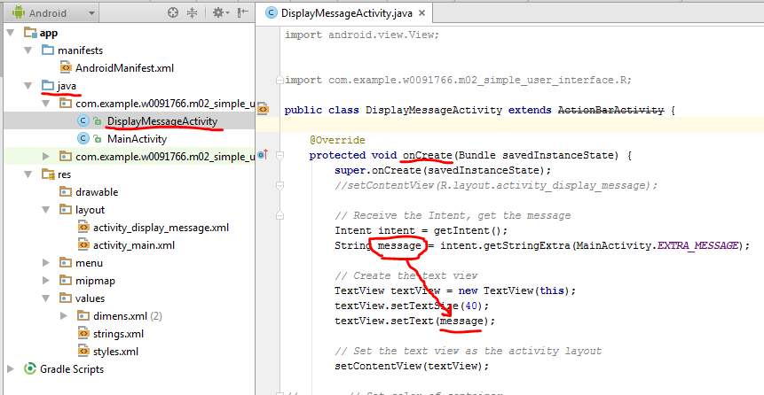
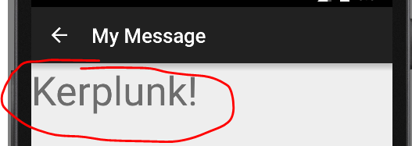
Display the message on second Activity.
Intent pair “This Parent Class” and “That Child Class”

Slide 12
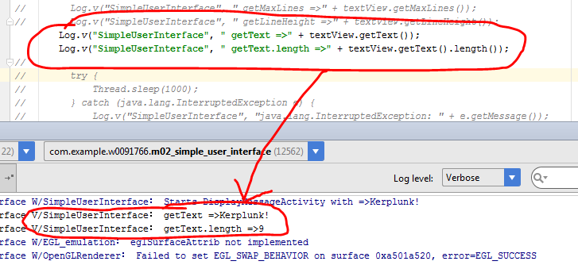
More code added to Sample

Slide 13
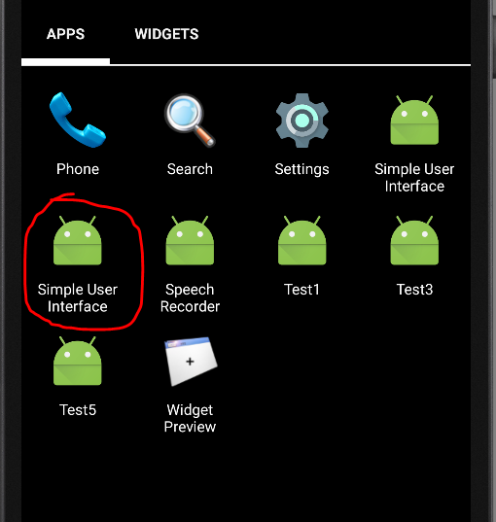
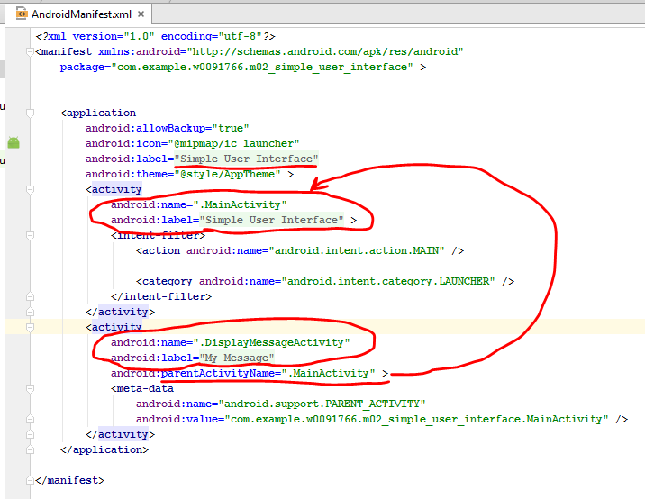

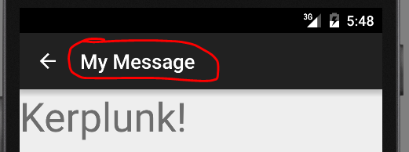
Manifest file

