Slide 1
Android Data #1
Project #6
Russell Shanahan

Slide 2
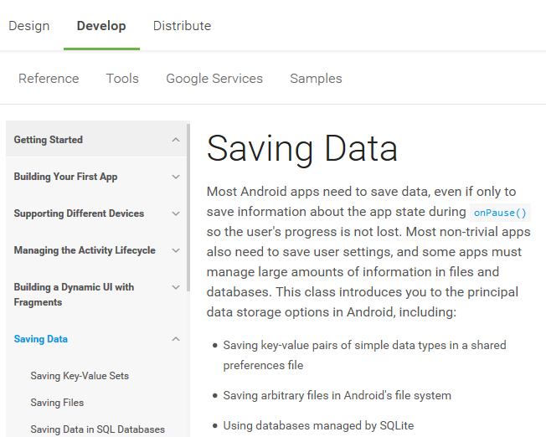
Android Developer Site:
…good reading…it’s the “Book”

Slide 3
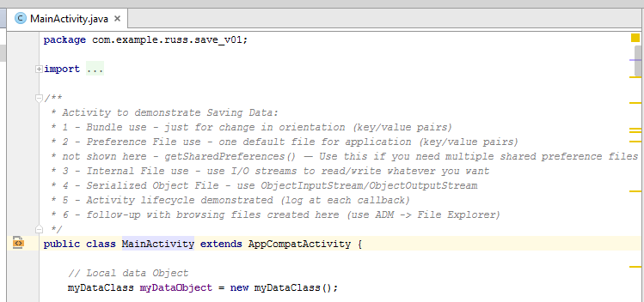
Project Save_01

Slide 4
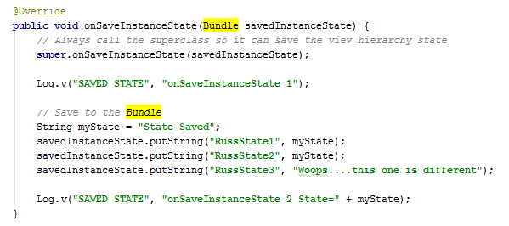
Bundle
Key->Value pairs
Portrait to Landscape change

Slide 5
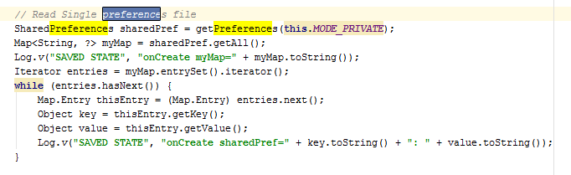
Preference file
Single or Many (I show Single)
Private Mode->Only This App

Slide 6
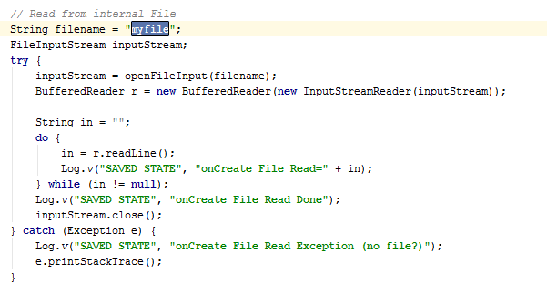
File I/O
Same as standard Java

Slide 7
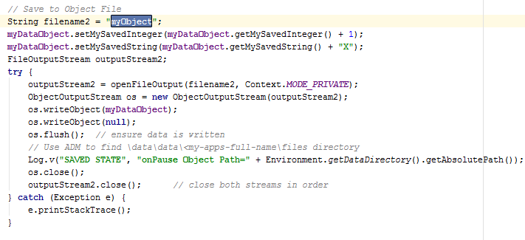
Object File I/O
Same as Standard Java

Slide 8
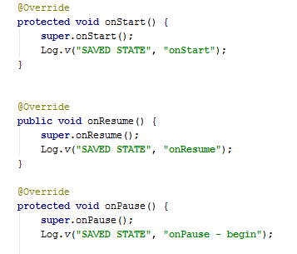
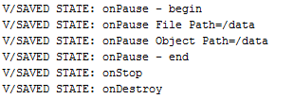
Activity Life Cycle

Slide 9
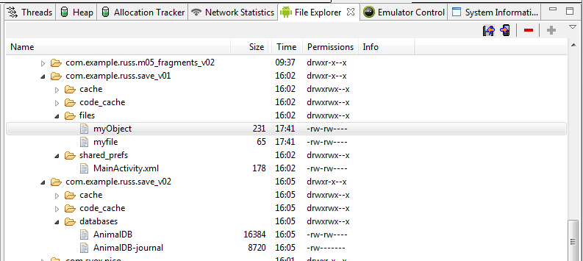
Tools->Android->Android Device Monitor
\Data\Data\<PackageName>

Slide 10
Tools->Android->Android Device Monitor
Copy to/from local PC

