Slide 1
Android Data #2
SQLite
Project #6
Russell Shanahan

Slide 2
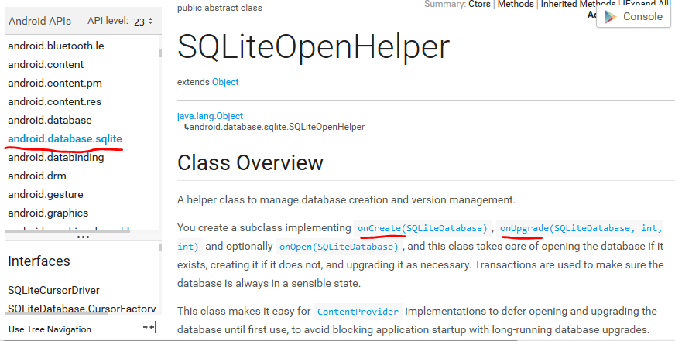
Android Developer Site:
…good reading…it’s the “Book”

Slide 3
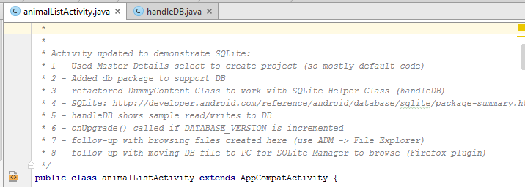
Project Save_V02_API15
SQLite Sample

Slide 4
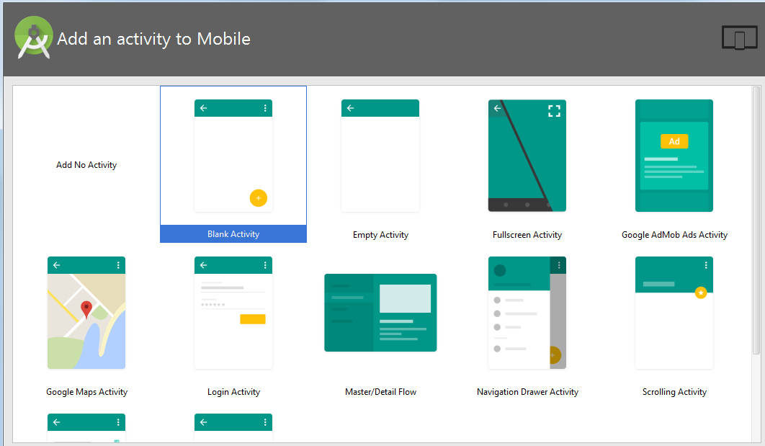
Started with default code
From Master/Detail Flow

Slide 5
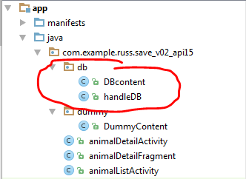

Added db Package
With classes to support SQLite

Slide 6
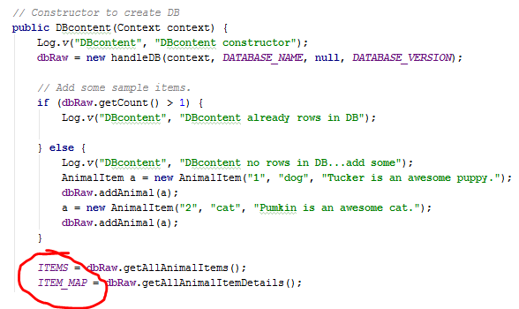
Refactored Dummy Data class
To supply SQLite data

Slide 7
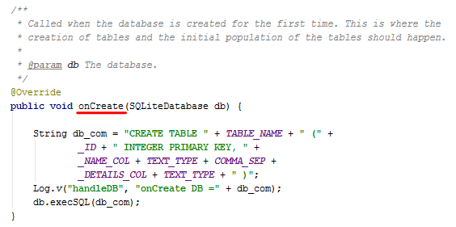
onCreate()

Slide 8
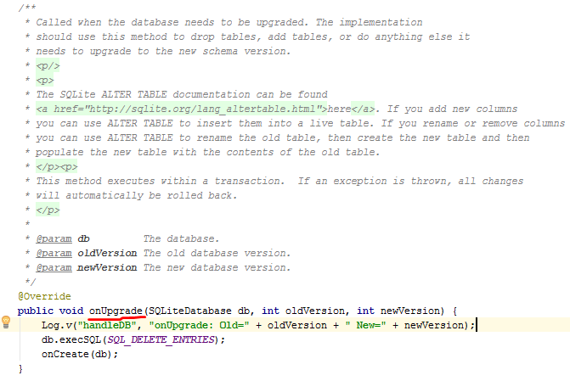
onUpgrade()

Slide 9
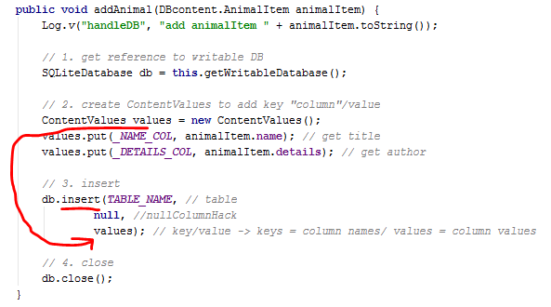
INSERT statement

Slide 10

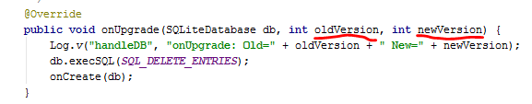
If Version doesn’t Match
onUpgrade() is called
Add Tables, or delete and rebuild

Slide 11
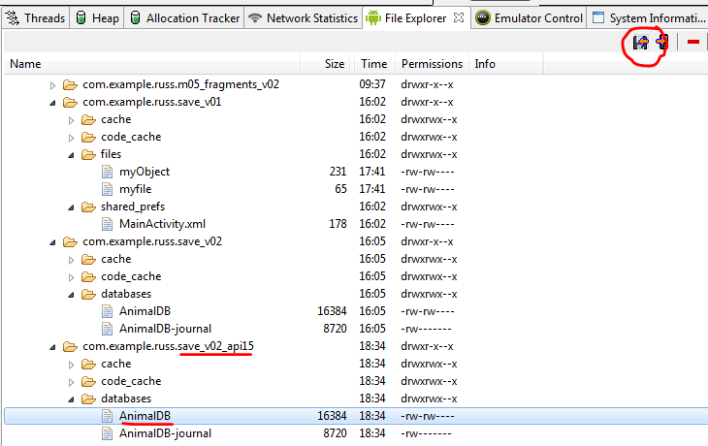
Copy the DB to PC for viewing

Slide 12
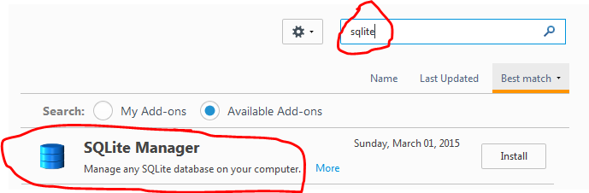
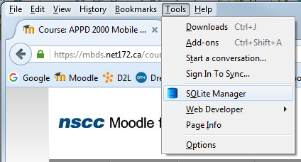
Firefox Plugin: SQLite Manager

Slide 13
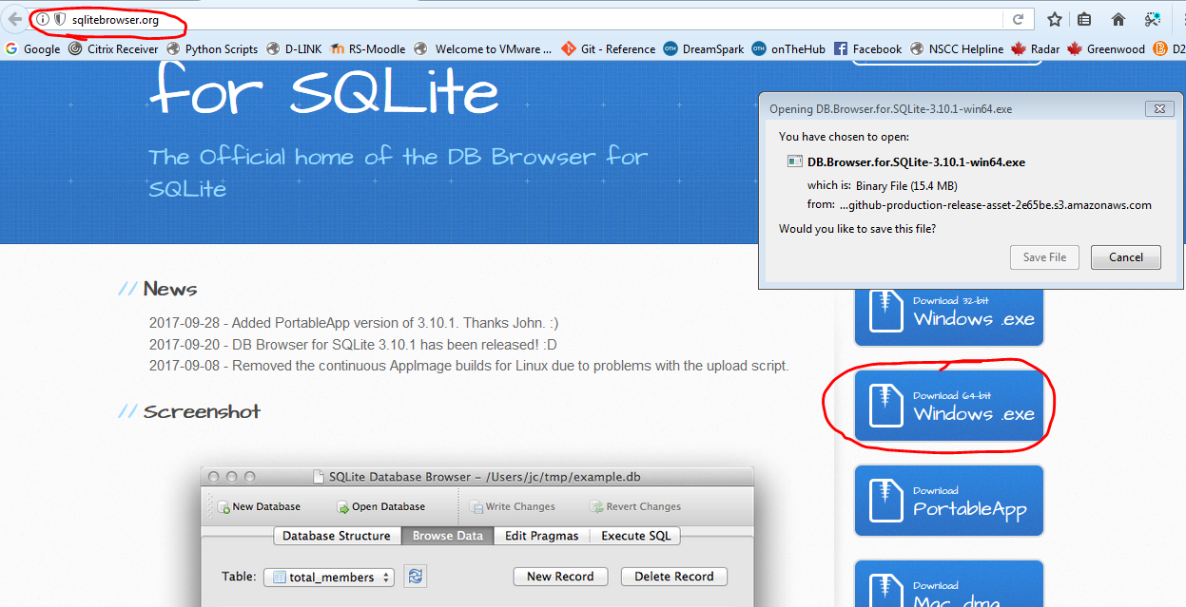
…or Download SQLitebrowser

Slide 14
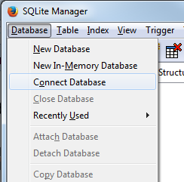
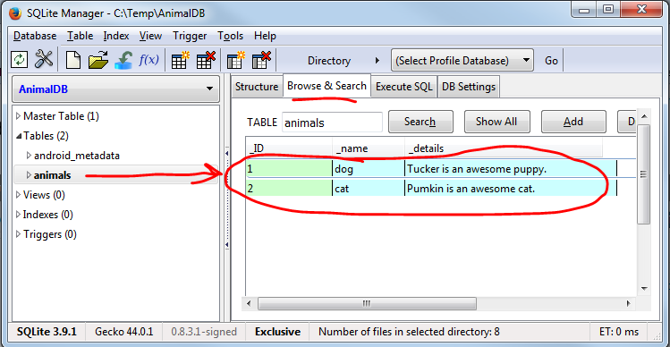
Browse Your DB
…on your PC

Slide 15
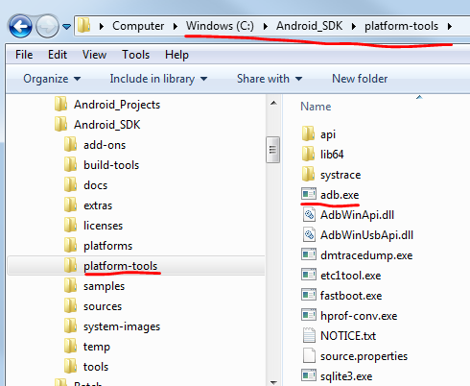
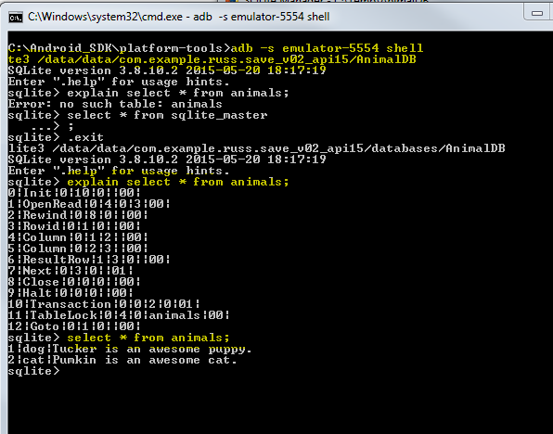
Run the sqlite3 tool on the DB in the emulator, using adb
http://developer.android.com/tools/help/sqlite3.html

Slide 16
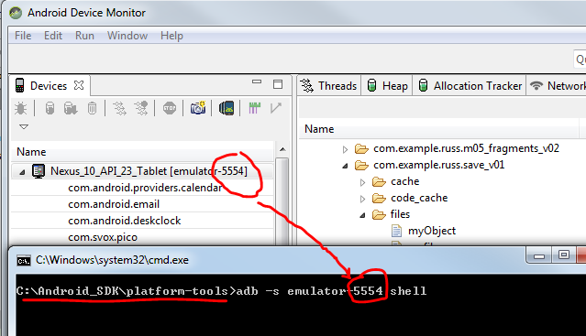
Start CMD Shell
Launch adb for your emulator

Slide 17
Enter Commands
adb -s emulator-5554 shell
sqlite3 /data/data/com.example.russ.save_v02_api15/databases/AnimalDB
explain select * from animals;

