Slide 1
Android Data #3
SQLite
AsyncTask
Russell Shanahan

Slide 2
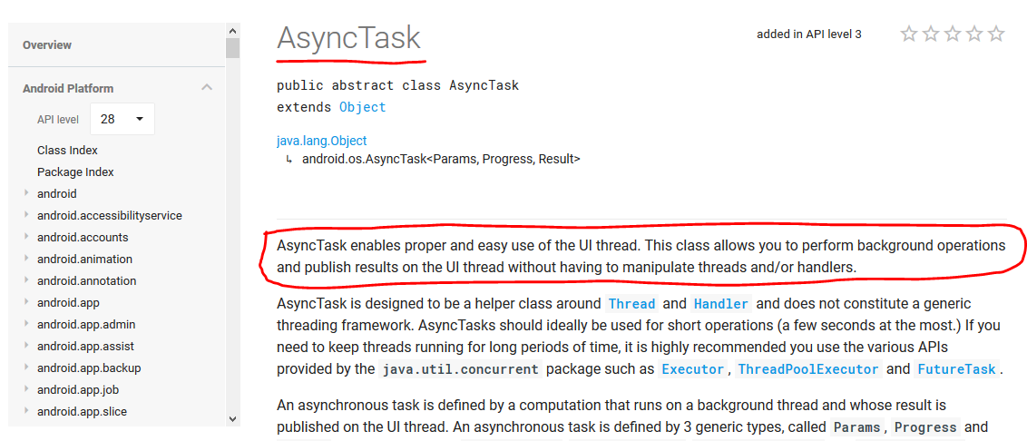
Android Developer Site:
…good reading…it’s the “Book”

Slide 3
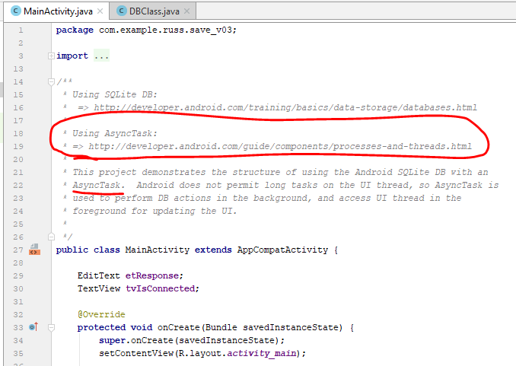
Project Save_V03
SQLite + AsyncTask

Slide 4
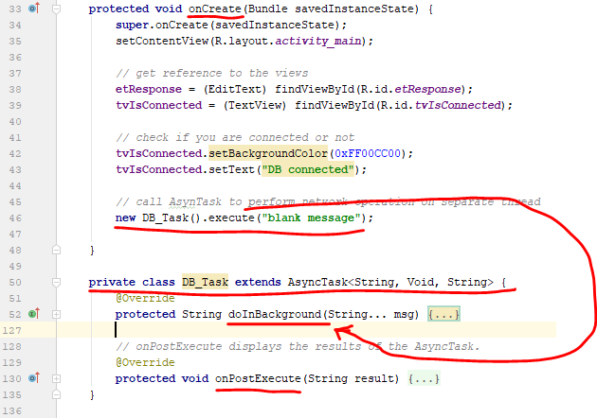
Execute starts the “doInBackground”
… in the background (not direct call)

Slide 5
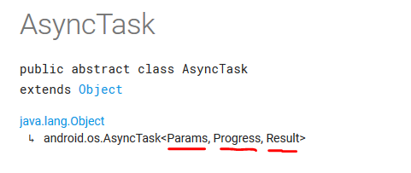
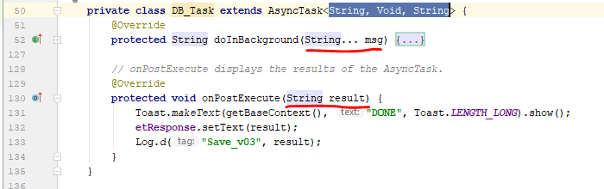
Set types of the parameters

Slide 6
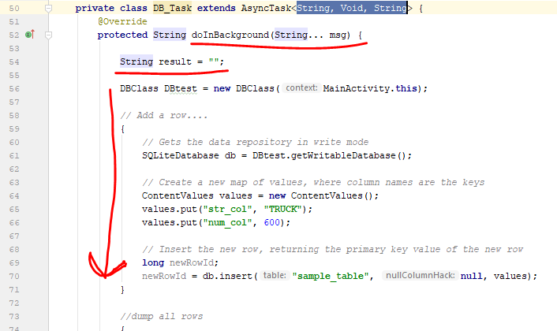
Do DB work in Background.
My example should not put SQL here
(however, code shows how to add and query)

Slide 7
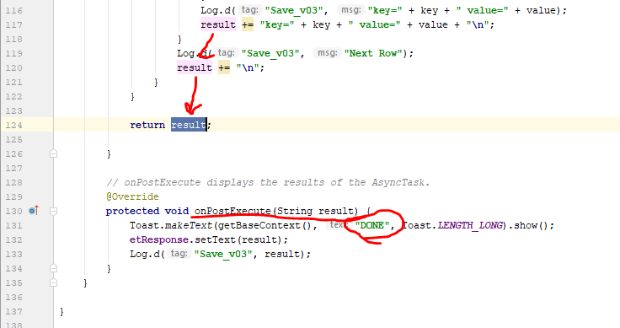
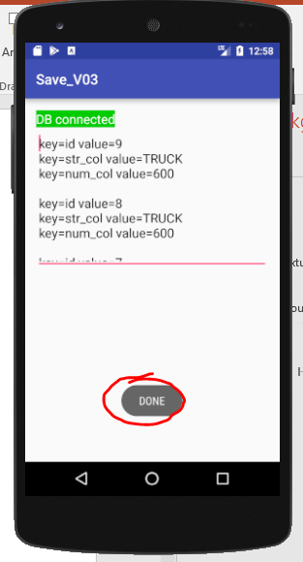
When finished,
onPostExecute() Is called

Slide 8
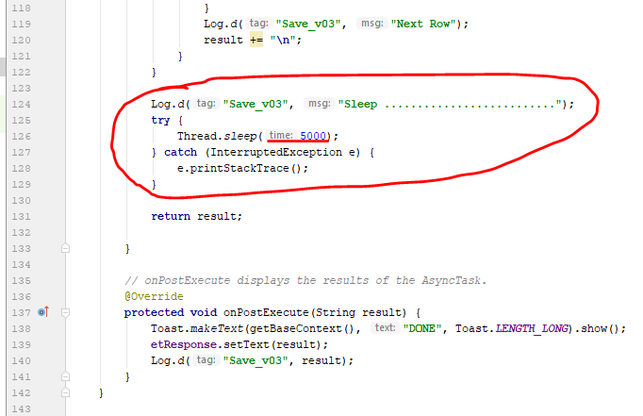
Add a sleep to really make the wait obvious
(simulate network traffic, …)

Slide 9
AsyncTask siblings:
Java: SwingWorker
Java: Executor
Java: ThreadPoolExecutor
Java: FutureTask
C#: BackgroundWorker
…or make your own!!!

