Slide 1
Android 2D Graphics
Bouncing Balls
Project #1
Russell Shanahan

Slide 2
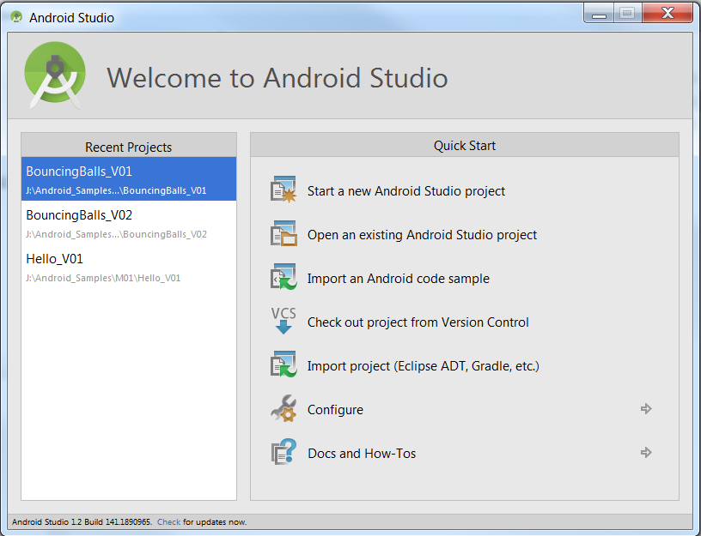
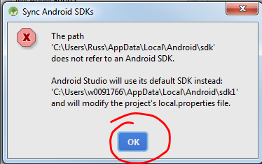
1st of 2 Projects
Your SDK in a different location

Slide 3
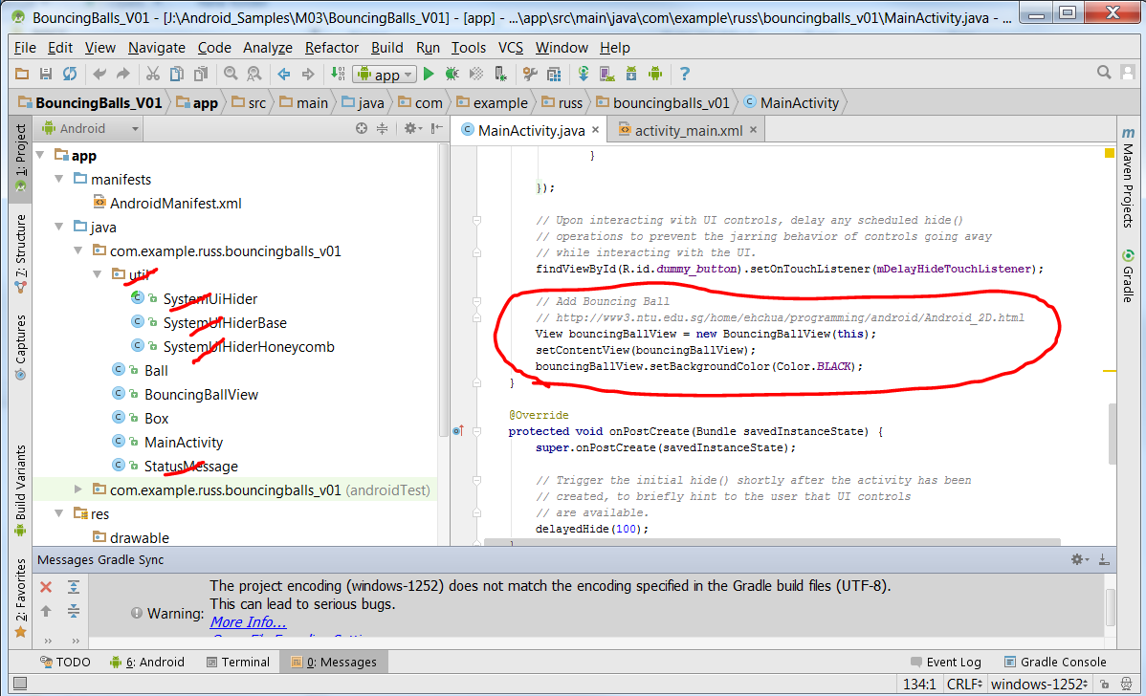
Taken from Internet Example
Lots of unneeded bits for older Android Versions

Slide 4
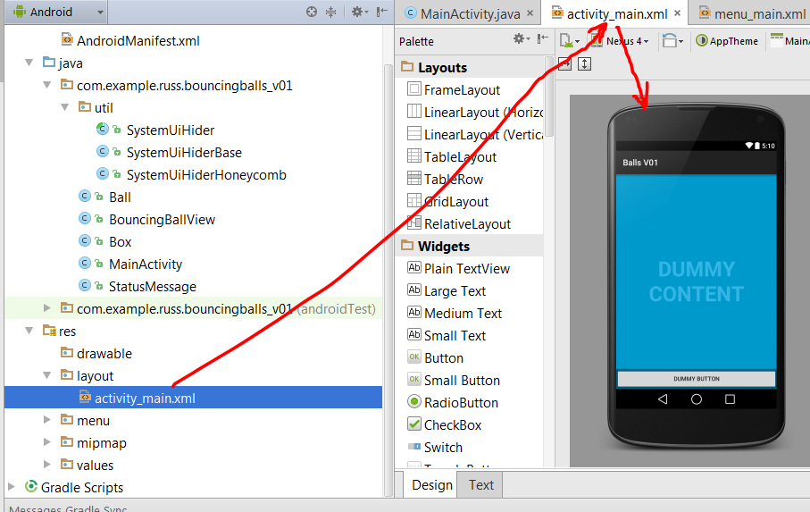
Main Activity
…has dummy content, but that isn’t needed

Slide 5
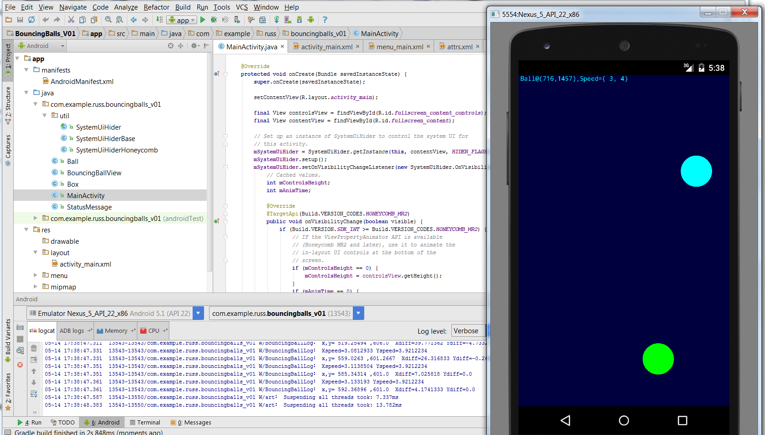
Run it:
Swipe up and right
Notice change in one of the balls

Slide 6
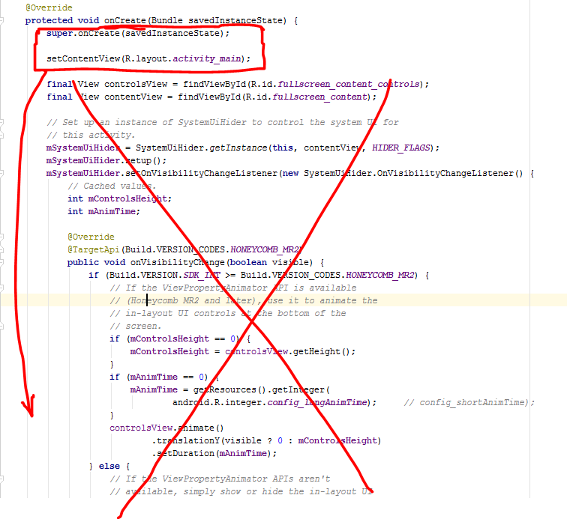
MainActivity onCreate()
…has lots of unneeded handling for older Androids

Slide 7
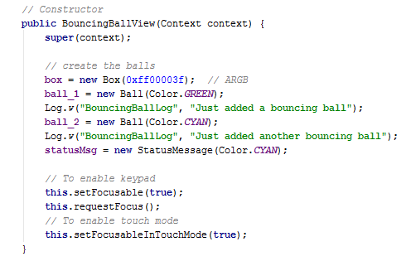
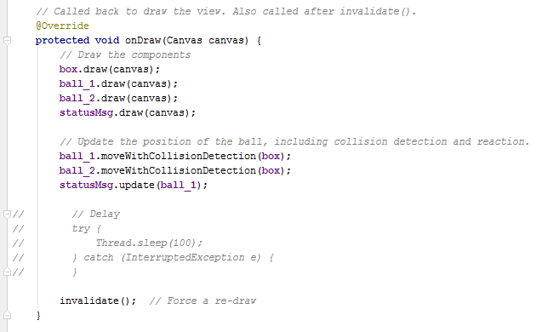
BouncingBallView:
Creates balls
Draws the balls
Invalidates the screen so that onDraw() is called again

Slide 8
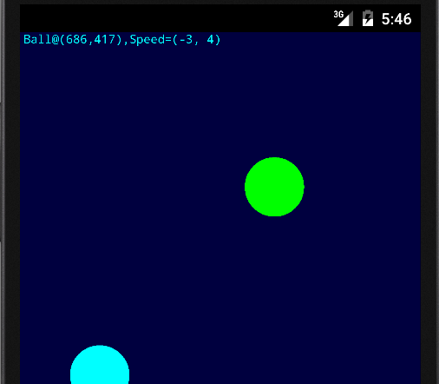
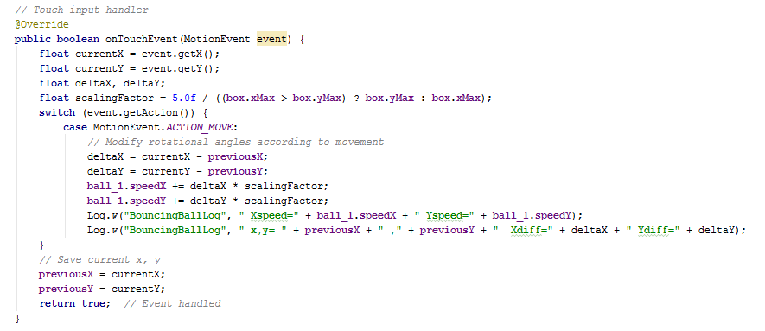
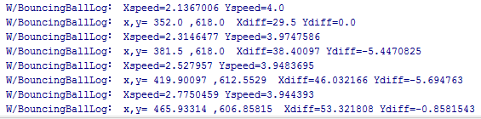
onTouchEvent:
…changes the speed of ball_1

