Slide 1
Android 2D Graphics
Bouncing Balls
Project #2
Russell Shanahan

Slide 2
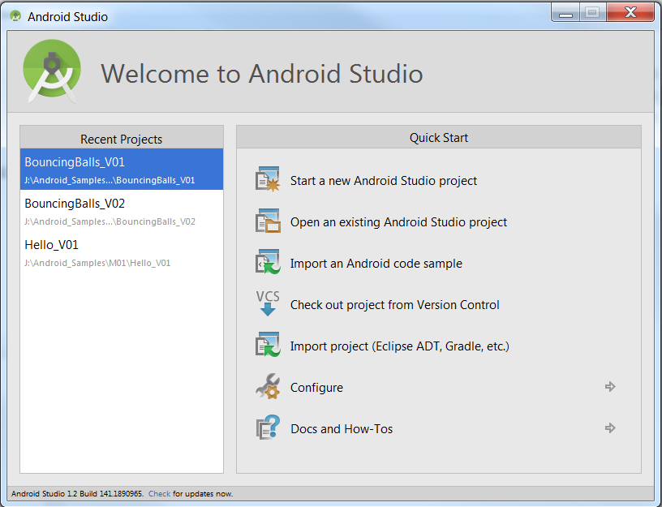
2nd Project of 2

Slide 3
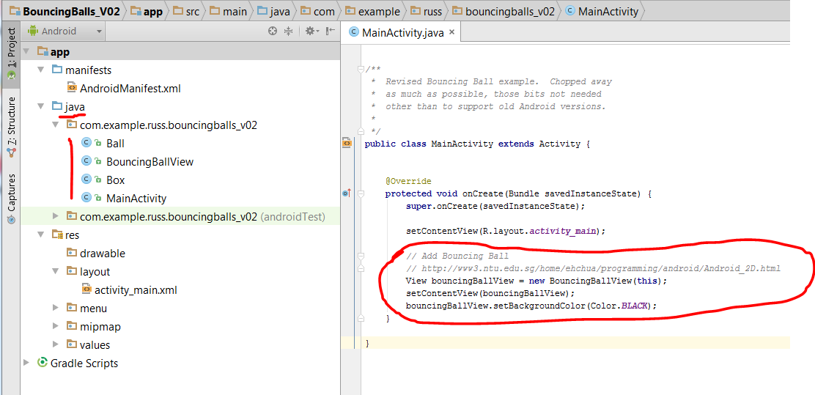
Internet has good samples…
…but you should know what you need
OK…create new bouncingBallView

Slide 4
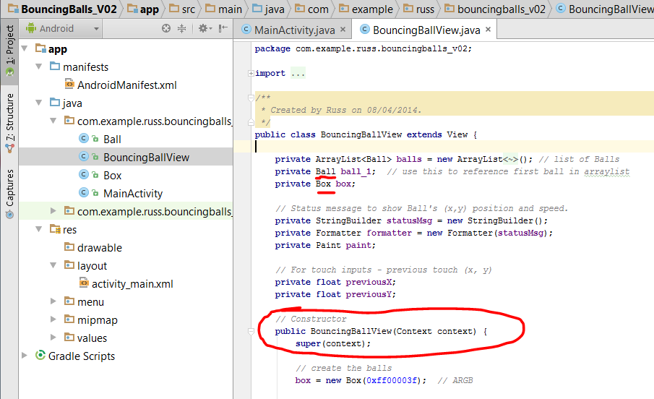
BouncingBallView uses Box and Ball

Slide 5
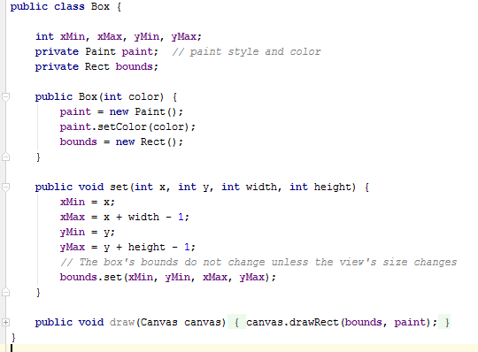
Box uses Paint class
… to draw a rectangle (outer box)

Slide 6
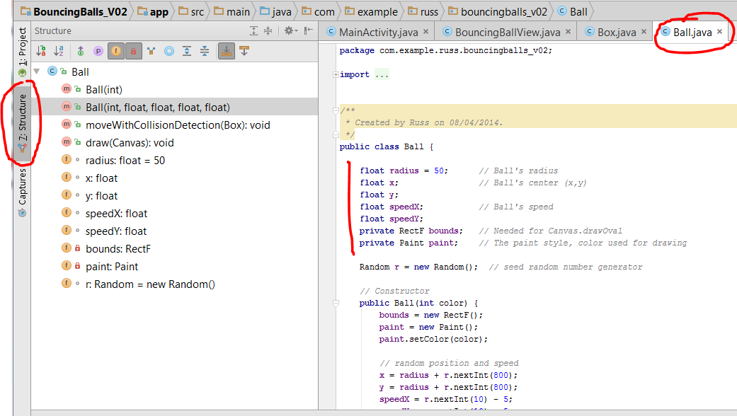
Ball uses Paint class
…to draw a circle (symmetric oval)

Slide 7
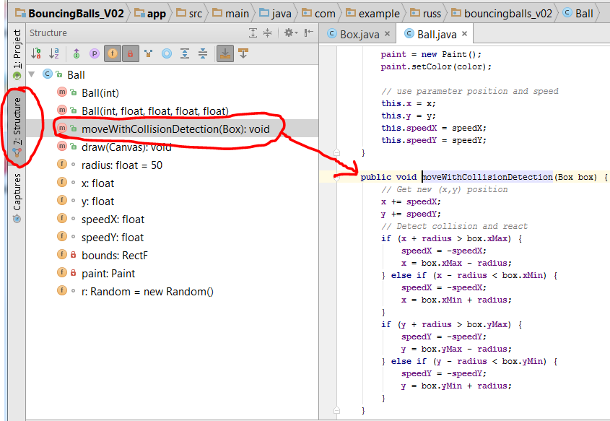
moveWithCollisionDetection()
- moves balls forward
- Changes direction if hit the bounds

Slide 8
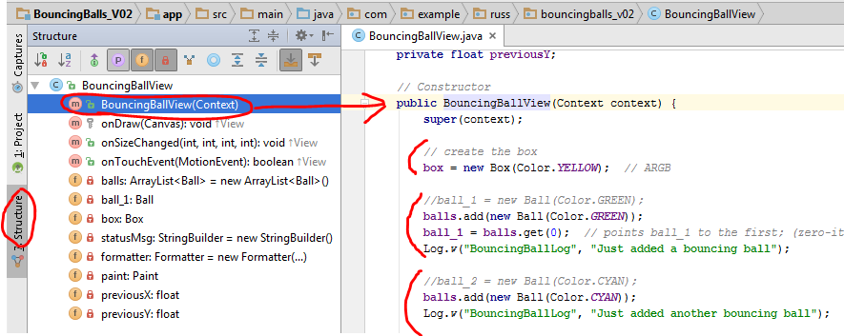
Constructor for BouncingBallView:
Create box (yellow, this time)
First balls
Setup for status message

Slide 9
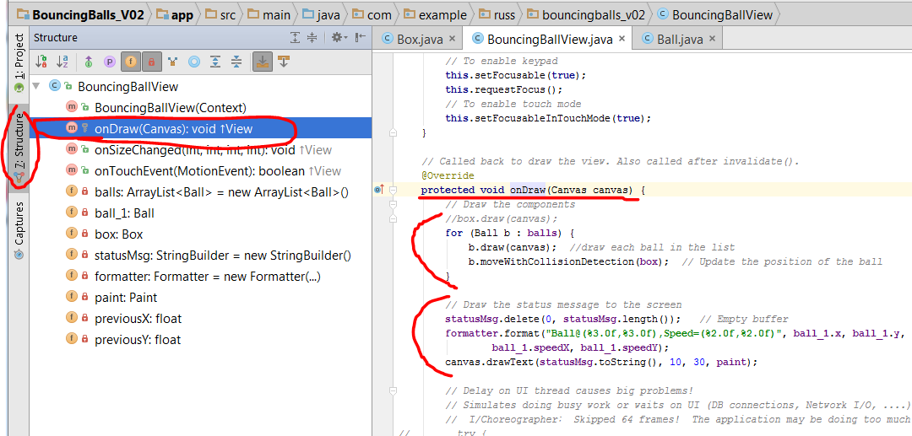

onDraw():
Draw and move balls
Draw status message
Invalidate…View thinks it needs redrawing (causes constant redrawing)

Slide 10
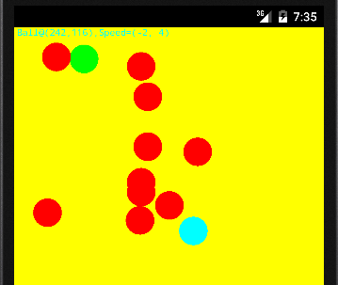
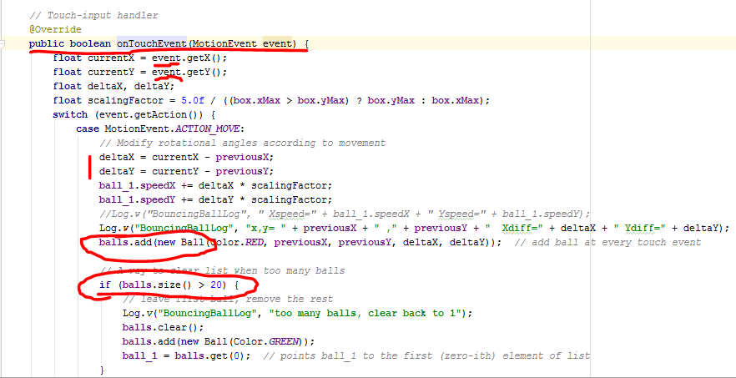
onTouchEvent():
Get the movement from “event”
Use that to make speed of new balls
Clear ball array if more than 20

Slide 11
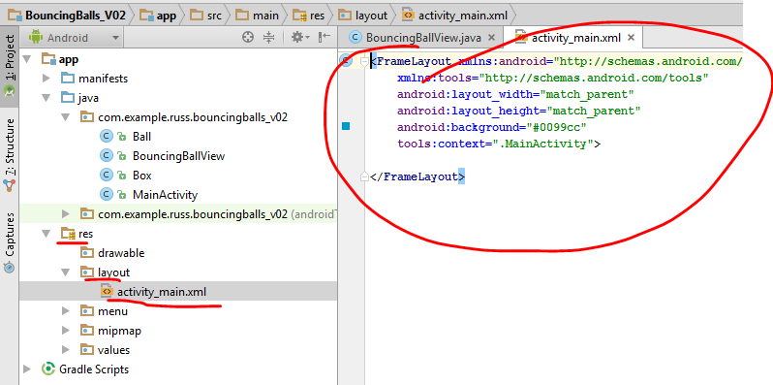
activity_main.xml:
No GUI controls used

