Slide 1

CHATBOTS
ASANGA, ANTOINE
LU, JAMIE
O’HALLORAN, JACK
Notes:
Image from: https://www.userlike.com/en/blog/do-i-need-a-chatbot

Slide 2

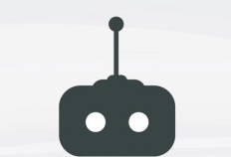
What are CHATBOTS?
A Chatbot is a software or computer program that will perform automatic tasks by communicating with human users through the internet e.g. Cortana, Alexa, and Siri which we might have used to set an alarm, make a call and even send a text message.
Notes:
Question mark image from: https://www.writermag.com/improve-your-writing/revision-grammar/multiple-question-marks/
Robot Design vector created by freepik - www.freepik.com: https://www.freepik.com/vectors/design

Slide 3
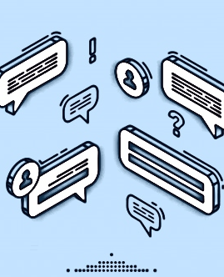
How do Chatbots work?
Uses pattern recognition to understand
Listens for specific words and phrases
Recognize these words/phrases
Deliver a pre-calculated response related to the words/phrases mentioned by the user
Mimics human language
Tries to respond to sentences to the best of its ability
Chatterbots have a set of input and output rules
Other chatterbots learn through user interactions
Notes:
Technology vector created by upklyak - www.freepik.com from: https://www.freepik.com/vectors/technology

Slide 4
How do Chatbots work?
Chatbots require constant internet access to function
More chatbots require larger servers to be more effective, maintain speed
Notes:
Technology vector created by upklyak - www.freepik.com from: https://www.freepik.com/vectors/technology

Slide 5
TURING TEST
Created by Alan Turing
A method of inquiry in artificial language (AI) to determine whether a computer is capable of thinking like a human being
Turing proposed that a human evaluator would judge natural language conversations between human and a machine designed to generate human-like responses
The 65-year-old Turing Test is successfully passed if a computer is mistaken for a human more than 30% of the time during a series of five-minute keyboard conversations.
Notes:
References: https://en.wikipedia.org/wiki/Turing_test

Slide 6
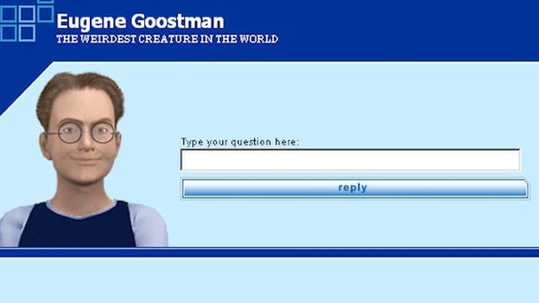
WHO PASSED THE TURING TEST?
Eugene Goostman
A computer program that simulates a 13-year-old Ukrainian boy
The test investigates whether people can detect if they are talking to machines or humans.
The experiment is based on Alan Turing's question-and-answer, Can Machines Think?
No computer has passed the test before under these conditions, it is reported.
However, some artificial intelligence experts have disputed the victory, suggesting the contest had been weighted in the chatbot's favour.
convinced 33% of the judges at the Royal Society in London that it was human.
Notes:
References:
https://www.bbc.com/news/technology-27762088#:~:text=A%20computer%20program%20called%20Eugene,talking%20to%20machines%20or%20humans.

Slide 7
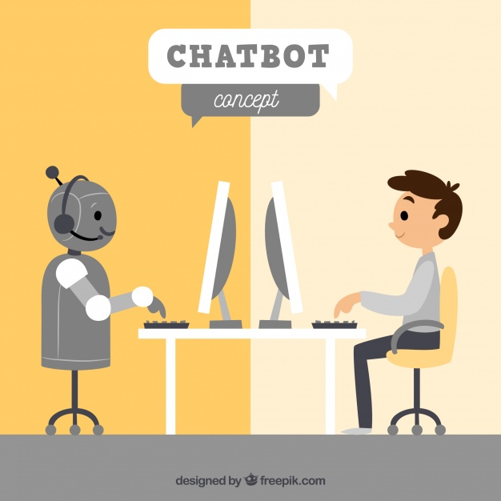
How are Chatbots used?
Conversational Agents
Help direct customers to different customer service employees
Can answer simple questions about a business if a customer has questions
Acts as an information hub
Notes:
Background vector created by freepik - www.freepik.com from: https://www.freepik.com/vectors/background

Slide 8
How are Chatbots used?
SIRI | GOOGLE | ALEXA
Rule-based
Rely on keywords to output properly
Without keywords, won’t properly function
Generative model
Can generate new sentences based on similar patterns of data
Notes:
Background vector created by freepik - www.freepik.com from: https://www.freepik.com/vectors/background

Slide 9
CHATBOTS
THE ROLE OF MACHINE LEARNING
Learns from the inputs it experiences through natural language processing (NLP) that could easily be understood and interpreted with the system to
Offer an informative answer
Maintain the context of the dialogue
Aims to be indistinguishable from a real person

Slide 10
CHATBOTS
THE ROLE OF ARTIFICIAL INTELLIGENCE
Smart chatbots rely on AI’s adaptability to advance current technology
People expect fast response times when interacting with a chatbot, slow speeds will just annoy people

Slide 11
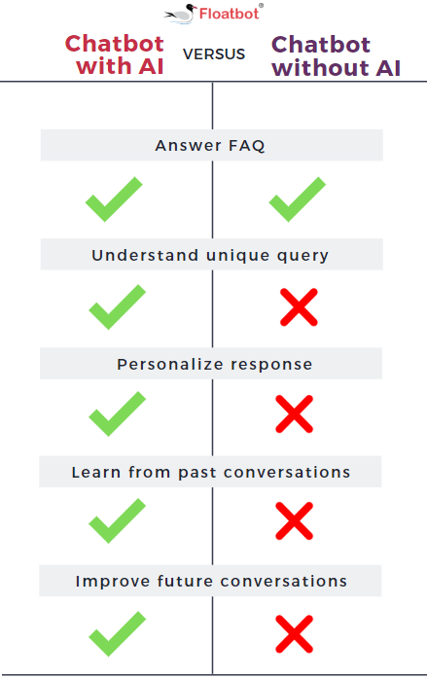
CHATBOTS
THE ROLE OF ARTIFICIAL INTELLIGENCE
Chatbots that have AI..
Can answer more complex queries
Can have more lively and engaging conversations.
Have better capacity to learn from every interaction. It improves with each interaction!
Notes:
Photo sourced from: https://chatbotsmagazine.com/why-artificial-intelligence-plays-an-important-role-in-chatbot-development-7a6da9fd1817

Slide 12
CHATBOTS
THE ROLE OF BIG DATA
Interactions with users are part of the sources of data that the chatbot uses, so they collect the data from these interactions and store them in a database
Big data essential to chatbot progression
Voice patterns are picked up and compiled by millions of phones, other tech that uses voice commands
Data techs must sift through that data and make sense of it for the bots, if not then bots will not improve

Slide 13
CHATBOTS
CHALLENGES IN PROGRAMMING
Chatbot needs to understand the different variations of how a user phrases an inquiry/statement
Voice recognition and understanding of speech patterns still in early stages
Chatbot needs to understand what the context of the conversation is
Chatbot needs to understand QUESTION SEQUENCING, this is when a user would as a question to the chatbot that is related to the previous question

Slide 14
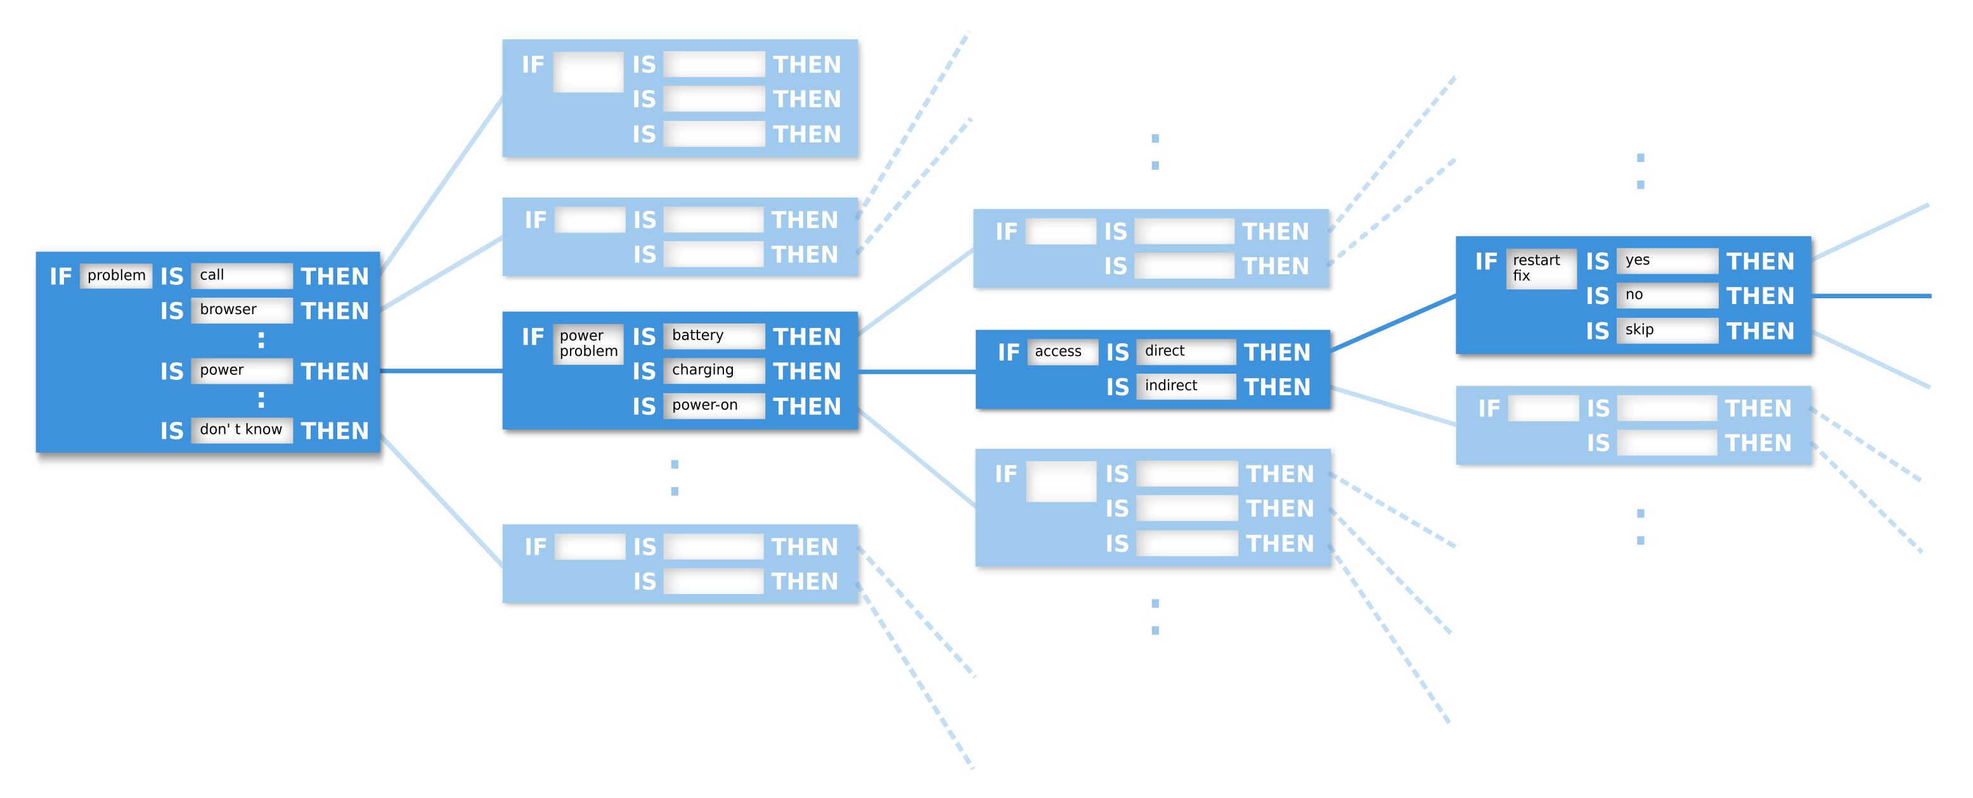
CHATBOT DECISION TREE
Notes:
Photo sourced from:
https://chatbotslife.com/chatbot-decision-trees-a42ed8b8cf32

Slide 15
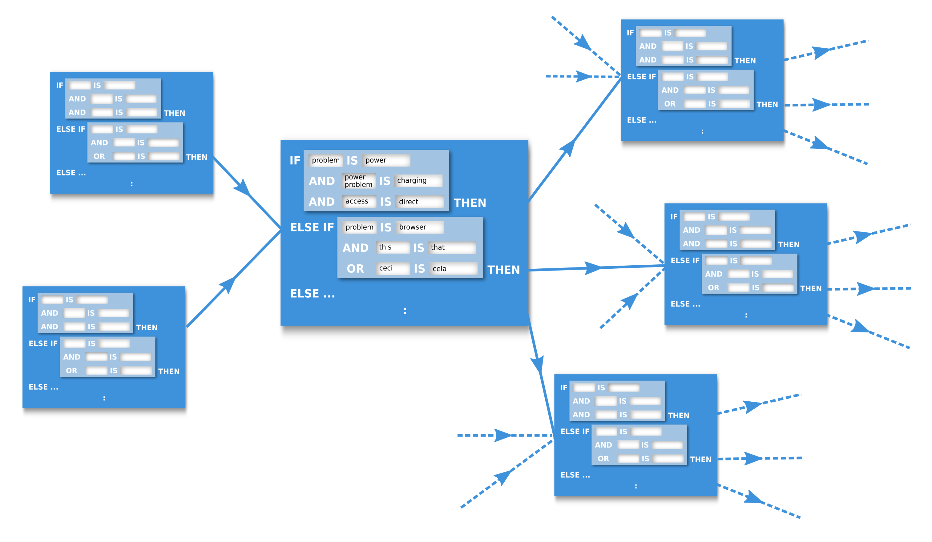
IT CAN GET COMPLICATED…
Notes:
Photo sourced from:
https://chatbotslife.com/chatbot-decision-trees-a42ed8b8cf32

Slide 16
CHATBOTS
THE PROS AND CONS
Pros
Cons
Reduced labour costs
Assist customer support with less important conversations
Available 24/7
Near instant response times
Less human error
Scalability
Can simultaneously manage thousands of conversations
can be easily scalable to handle a large volume of chats without affecting the business costs.
Virtual Assistants always listening
More complex chatbots can get expensive
Can scatter fake information by pretending to be human
Can be used to fill chatrooms with spam and advertisements
Limited Responses
Lacks the feeling or emotion in the conversation
Can frustrate the user
Notes:
References:
https://w2.aivo.co/en/blog/advantages-and-disadvantages-of-chatbots-2/
https://www.revechat.com/blog/chatbot-business-benefits/
https://en.wikipedia.org/wiki/Chatbot#Malicious_use

Slide 17
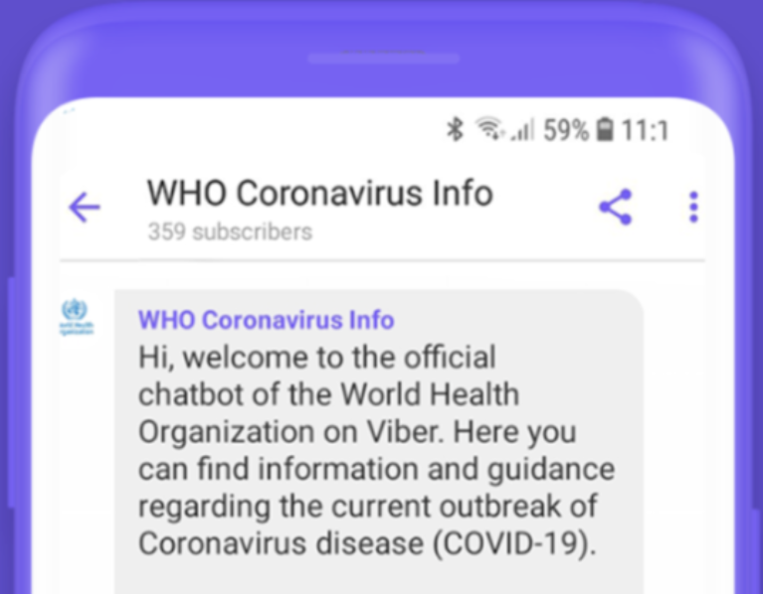
CHATBOTS
MAKE THE WORLD BETTER
Many companies and organizations have been using chatbots
Great examples of chatbots are SIRI, ALEXA, GOOGLE
Another example that is relevant in 2020 is the WHO Coronavirus Info chatbot
Notes:
References: https://www.weforum.org/agenda/2020/04/chatbots-covid-19-governance-improved-here-s-how/

Slide 18

Thank you.

Slide 19
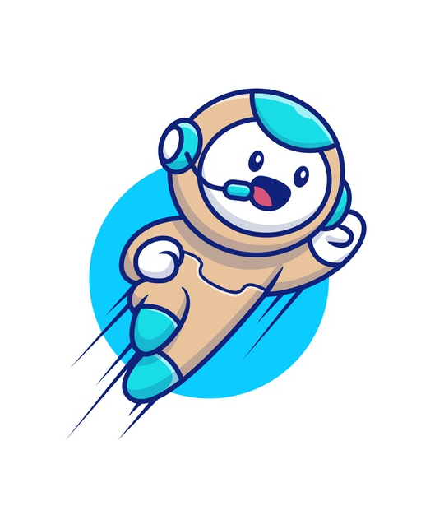
THANK YOU
ANTOINE ASANGA
JAMIE LU
JACK O’HALLORAN
Notes:
Logo vector created by catalyststuff - www.freepik.com from: https://www.freepik.com/vectors/logo

