Slide 1

Exercise for 30 days
PROJECT REPORT FOR COMM1700
Jamie Lu
W0441213

Slide 2

introduction
Health and wellness are things that should be taken care of. Looking good and feeling good might be amazing to have but health is crucial for man’s survival.
I went through a time of depression and anxiety during winter and started to just eat and not exercise. I have conquered both but am now experiencing the effect it had on my weight.
I got a gym membership to supposedly start exercising and being healthy but was never motivated enough to go and exercise. I decided to choose this as my work plan to better myself. Exercise will not only help me physically but also mentally. I will also start doing a couple of changes with regards to my dietary habits to help with giving me the right energy to do daily tasks and be able to complement the exercise I will be doing.
This work plan contains the goals I have set for each week, as well as, a journal entry for each week that I am doing my exercises. Hopefully, by the end of the semester, I will be able to continue the workout routine I have created. My end goal is be a healthier and better version of myself, as well as, lose weight.

Slide 3


Work plan
WEEK |  | MINIMUM REQUIREMENTS | DEMONSTRATION
START | END
09/22 | 09/28 | EXERCISE – 2 KINDS DIET: MAXIMUM 2 BOTTLE POP and 1 &1/2 CUP RICE | JOURNAL ENTRY 1
09/29 | 10/05 | EXERCISE – 2 KINDS DIET: MAXIMUM 1 BOTTLE POP, 3 JUNK FOOD and 1 &1/2 CUP RICE | JOURNAL ENTRY 2
10/06 | 10/12 | EXERCISE – 3 KINDS DIET: MAXIMUM 1 BOTTLE POP, 2 JUNK FOOD and 1 & 1/2 CUP RICE | JOURNAL ENTRY 3
10/13 | 10/19 | EXERCISE – 3 KINDS DIET: WATER & JUICE ONLY, 1 JUNK FOOD and 1 &1/2 CUP RICE | JOURNAL ENTRY 4
10/20 | 10/26 | EXERCISE – 4 KINDS DIET: WATER & JUICE ONLY, 1 JUNK FOOD and 1 CUP RICE | JOURNAL ENTRY 5
10/27 | 11/02 | EXERCISE – 4 KINDS DIET: WATER & JUICE ONLY, NO JUNK FOOD and 1 CUP RICE | JOURNAL ENTRY 6
11/03 | 11/09 | EXERCISE – 5 KINDS DIET: WATER ONLY, NO JUNK FOOD and 3/4 CUP RICE | JOURNAL ENTRY 7
11/10 | 11/16 | EXERCISE – 5 KINDS DIET: WATER ONLY, NO JUNK FOOD, and 3/4 CUP RICE | JOURNAL ENTRY 8

Slide 4


WEEK 1 SEPTEMBER 22 – September 28
DATE | PLACE OF EXERCISE | EXERCISES DONE | DIET?
September 22 Sunday | HOME | 50 jump ropes 10 squats 3 sets
September 23 Monday | HOME | 50 jump ropes 10 squats 3 sets
September 24 Tuesday | HOME | 55 jump ropes 10 squats 3 sets
September 25 Wednesday | HOME | 50 jump ropes 10 squats 3 sets
September 26 Thursday | HOME | 50 jump ropes 30 seconds planking 2 sets
September 27 Friday | HOME | 55 jump ropes 10 squats 3 sets 30 seconds planking 2 sets
September 28 Saturday | REST | REST

Slide 5



Week 2
DATE | PLACE OF EXERCISE | EXERCISES DONE | DIET?
September 29 Sunday | HOME | SICK
September 30 Monday | HOME | 50 jump ropes 10 squats 3 sets
October 1 Tuesday | HOME | 50 jump ropes Planking 20 seconds 3 sets
October 2 Wednesday | HOME | 50 jump ropes 10 Leg Raises 3 sets
October 3 Thursday | HOME | 50 jump ropes; Planking 20 seconds 2 sets 10 Leg Raises 3 sets
October 4 Friday | HOME | 50 jump ropes Planking 20 seconds 3 sets
October 5 Saturday | REST | REST
SEPTEMBER 29 – October 05

Slide 6


WEEK 3 October 06 – October 12
DATE | PLACE OF EXERCISE | EXERCISES DONE | DIET?
October 6 Sunday | HOME | 50 jump ropes 10 squats 3 sets 5 sit ups 3 sets
October 7 Monday | REST | REST
October 8 Tuesday | HOME | 50 jump ropes 10 leg raises 3 sets 20 secs planking 3 sets
October 9 Wednesday | HOME | 50 jump ropes 20secs planking 3 sets 16 arm cycles 3 sets
October 10 Thursday | HOME | 50 jump ropes 5 sit ups 3 sets 5 lunges 3 sets
October 11 Friday | HOME | 50 jump ropes 30 seconds planking 2 sets 10 squats 3 sets
October 12 Saturday | HOME | 50 jump ropes 10 squats 3 sets 5 sit ups 3 sets

Slide 7

Week 4
DATE | PLACE OF EXERCISE | EXERCISES DONE | DIET?
October 13 Sunday | HOME | 50 jump ropes 10 squats 3 sets 5 sit ups 3 sets
October 14 Monday | REST | REST
October 15 Tuesday | HOME | 51 jump ropes 5 sit ups 3 sets 20 secs planking 2 sets
October 16 Wednesday | HOME | 50 jump ropes 20 seconds jog in place 3 sets 10 squats 3 sets
October 17 Thursday | HOME | 50 jump ropes 10 leg raises 3 sets 10 jumping jacks 2 sets
October 18 Friday | HOME | 20 seconds jog in place 5 Plank Push Ups 3 sets 16 arm circles 3 sets
October 19 Satuday | HOME | 10 jumping jacks 3 sets 5 Plank Taps 3 sets 5 sit ups 3 sets
October 13
–
October 19

Slide 8
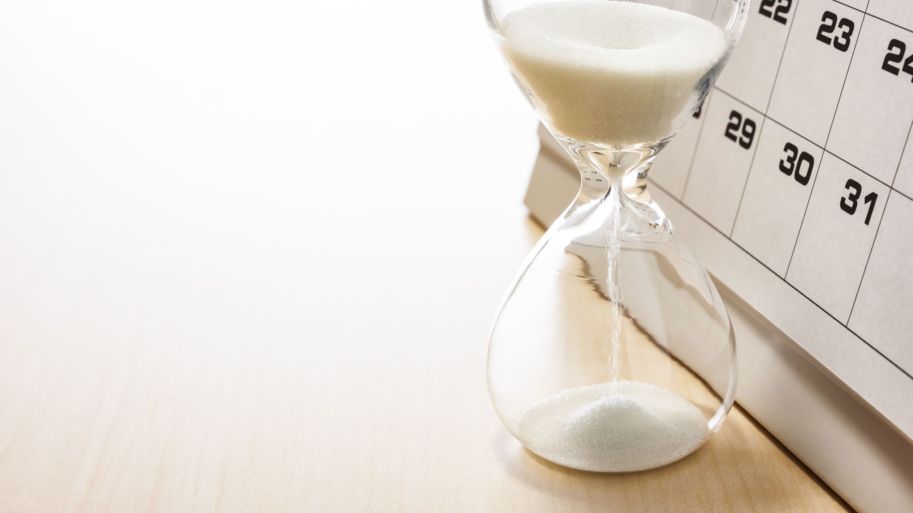
Week 5 October 20 – October 26
DATE | PLACE OF EXERCISE | EXERCISES DONE | DIET?
October 20 Sunday | HOME | 15 secs jog in place 15 squats 3 sets 5 sit ups 2 sets 5 leg raises 3 sets
October 21 Monday | REST | REST
October 22 Tuesday | HOME | 15 seconds jog in place Side Plank 10 secs each side 2sets 10 squats 3 sets 10 jumping jacks 2 sets
October 23 Wednesday | HOME | 50 jump ropes 5 sit ups 3 sets 20 secs planking 3 sets 5 leg raises 3 sets
October 24 Thursday | HOME | 10 jumping jacks 3 sets 5 squats 3 sets 20 secs planking 5 sit ups 2 sets
October 25 Friday | HOME | 20 seconds jog in place 5 sit ups 3 sets 10 jumping jacks 3 sets
October 26 Satuday | HOME | 50 jump ropes 5 sit ups 3 sets 16 arm cycles 3 sets 16seconds Hip rotation 3 sets

Slide 9

Week 6 October 27 – November 2
DATE | PLACE OF EXERCISE | EXERCISES DONE | DIET?
October 27 Sunday | HOME | 10 jump ropes 20 jumping jacks 4 sets 5 sit ups 3 sets 30 seconds jog in place
October 28 Monday | REST | REST
October 29 Tuesday | HOME | 20 jumping jacks 3 sets 5 leg raises 2 sets 15 secs planking 2 sets 5 squats 3 sets
October 30 Wednesday | HOME | 25 jump ropes 10 jumping jacks 3 sets 10 squats 3 sets 16 Arm circles 3 sets
October 31 Thursday | HOME | 10 jump ropes 30 secs jog in place 2 sets 16 arm circles 2 sets 5 lunges 3 sets
November 1 Friday | HOME | 30 secs jog in place 2 sets 10 jump ropes 20 wall push ups 2 sets 5 sit ups 3 sets
November 2 Satuday | HOME | 15 jumping jacks 3 sets 30 secs wall sits 10 squats 3 sets 10 modified push ups 3 sets

Slide 10

DATE | PLACE OF EXERCISE | EXERCISES DONE | DIET?
November 3 Sunday | HOME | 10 leg raises 2 sets 20 jumping jacks 2 sets 5 modified sit ups 3 sets 30 seconds jog in place 10 secs planking 2 sets
November 4 Monday | REST | REST
November 5 Tuesday | HOME | 20 jumping jacks 3 sets 30 secs jog in place 10 secs planking 2 sets 5 squats 3 sets 5 leg raises 2 sets
November 6 Wednesday | HOME | 20 jumping jacks 5 leg raises 2 sets 10 squats 3 sets 16 secs hip rotation 3 sets 10 secs side plank 2 sets
November 7 Thursday | HOME | 10 jump ropes 10 secs side plank 2 sets 5 squats 3 sets 30 secs jog in place 2 sets 5 sit ups 3 sets
November 8 Friday | HOME | 30 jumping jacks 2 sets 10 jump ropes 5 modified push ups 3 sets 5 sit ups 3 sets 10 squats 3 sets
November 9 Saturday | HOME | 20 jumping jacks 3 sets 30 secs wall sits 2 sets 5 lunges 2 sets 5 squats 3 sets 5 modified push ups 3 sets
Week 7
November 3 – November 9

Slide 11

Week 8 November 10 – November 16
DATE | PLACE OF EXERCISE | EXERCISES DONE | DIET?
November 10 Sunday | HOME | 10 leg raises 2 sets 10 squats 3 sets 20 jumping jacks 2 sets 5 modified sit ups 3 sets 50 seconds jog in place
November 11 Monday | REST | REST
November 12 Tuesday | HOME | 20 jumping jacks 3 sets 30 secs jog in place 10 secs planking 2 sets 5 lunges 2 sets 5 squats 3 sets
November 13 Wednesday | HOME | 20 jumping jacks 5 leg raises 2 sets 10 squats 3 sets 30 seconds jog in place 16 secs hip rotation 3 sets
November 14 Thursday | GYM | 40 minutes treadmill 15 squats w/ weights 3 sets 30minutes stationary bicycle 30 secs planking 2 sets 10 modified push ups 3 sets
November 15 Friday | GYM | 30 minutes treadmill 50 jump ropes 30 secs planking 3 sets 15 squats w/ weights 3 sets 20 minutes rowing machine
November 16 Saturday | HOME | 20 jumping jacks 3 sets 30 secs wall sits 2 sets 30 secs jog in place 3 sets 5 lunges 2 sets 10 squats 3 sets

Slide 12

insights
Exercising for me has always been a struggle. I have always found it boring and tiring. I used to get my exercise in school by joining dance clubs. After I moved to Canada, I started working and it was hard for me to exercise since I no longer had that option to join dance clubs provided by schools.
I started to gain so much weight and this is the heaviest I have been ever in my life. It was hard for me even climb up and down a flight of stairs. I looked at how I use to look like and feel before and I get sad at how I can never motivate myself enough to get better.
This project was the exact push I needed to get back into shape or at least start being healthier by exercising and eating right. I plan to continue this project for myself to exercise more and live a healthier lifestyle. This will be hard, but I have learned that
“Nothing that’s worthwhile is ever easy”
I have learned that we will never get anywhere in life, we will never achieve our goals if we continue to stay inside our comfort zones. If we want to move forward and be successful, we must start with living a cleaner and healthier life. We must get up off the couch and move and do things each day. Time goes by fast and each second of everyday should not be wasted. Everything will be worth it once we accomplish our goals.
Nothing that’s worthwhile is ever easy.
- Nicholas Sparks

