Slide 1

ODI12C Data Integrity Controls, Automation and Deployment
Assignment 2 - Dbas 3018 data movement and integration
PRESENTATION BY JAMIE LU

Slide 2

TABLE OF CONTENTS
GBI SCENARIO
DATA MODEL
FIG 5-1
FIG 5-9
FIG 6-1
FIG 7-1
FIG 8-3

Slide 3

INTRODUCTION
This assignment goes through and executes the steps shown in Chapter 5-8 of the Getting Started Guide on my Oracle Data Integrator 12C server virtual machine.

Slide 4
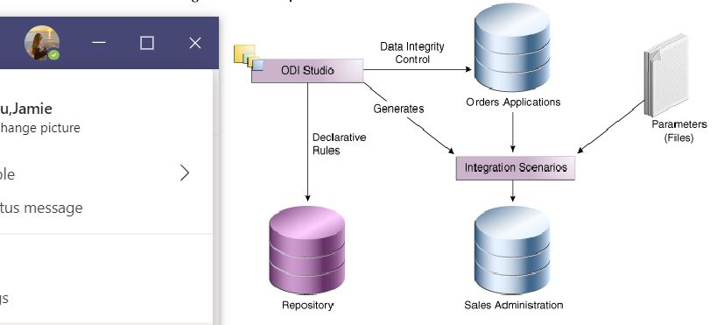
Gbi scenario
Notes:
GBI stands for Global Bikes International
GBI manufactures bicycles and bicycle accessories.
They manufacture in Germany and they sell to bicycle retailers in Germany and in the United States.

Slide 5
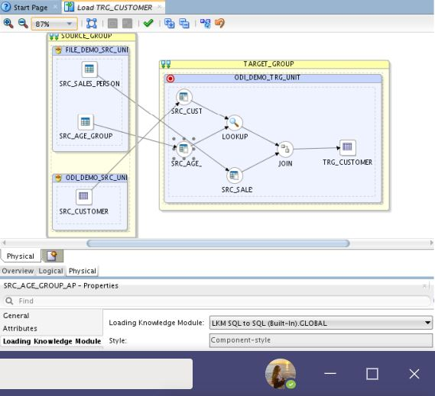
Data model
Notes:
On the left side of the diagram, it shows all of the source objects and source tables (sales transactions). It also shows the two look up tables.
On the right side of the diagram, it shows the target (how many target object were there.
This diagram shows the interactions, joins, transformations (like any filters that were applied) between the two sides.

Slide 6
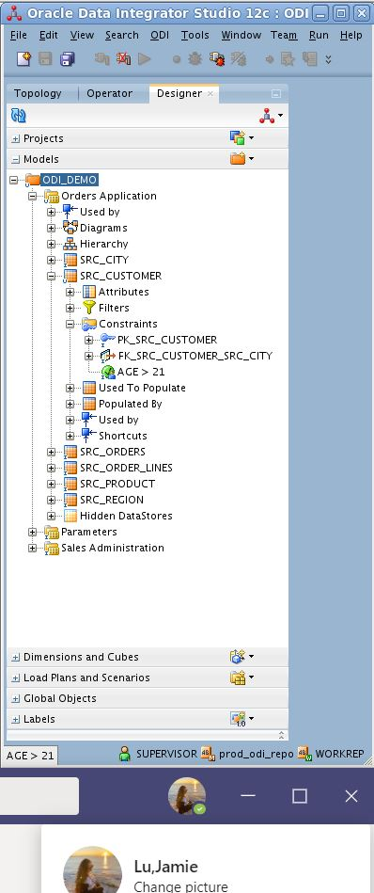
Figure 5-1
Notes:
The image on the left shows the object navigator and it shows the age constraint created. This specific age constraint is “age > 21” with the condition of SRC_CUSTOMER.Age > 21. Which means customers with the age over 21.

Slide 7

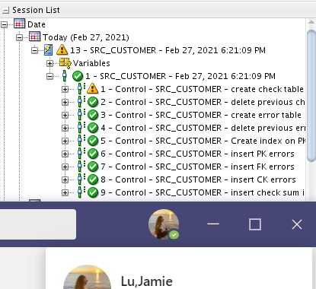
Figure 5-9
Notes:
The image on the right shows the object navigator and it shows the execution of the src_city reference.

Slide 8
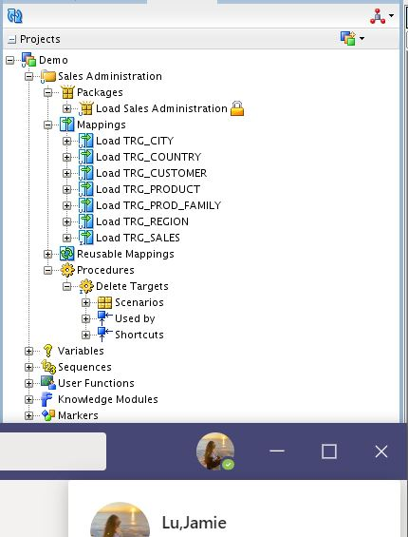
Figure 6-1
Notes:
The image on the right shows the package created in the object navigator.
Packages are used in generating scenarios for production. They represent data integration workflow. They can perform tasks such as starting a reverse-engineering process on a datastore or a model, sending an email to an administrator, downloading a file and unzipping it, defining the order in which mappings must be executed, and defining loops to iterate over execution commands with changing parameter.

Slide 9
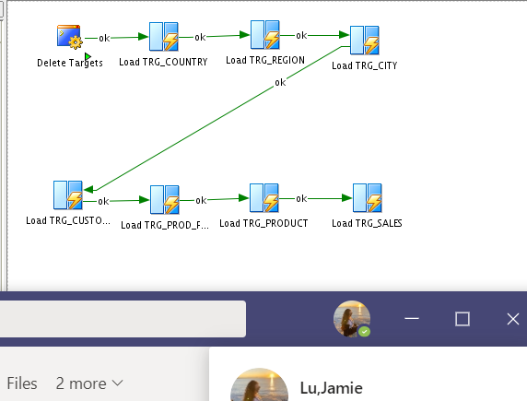
Figure 6-1
Notes:
The image on the right shows the stepwise diagram for the sales administration package that I have created.

Slide 10
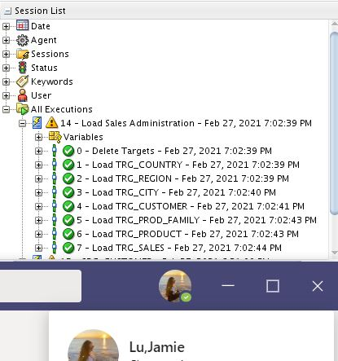
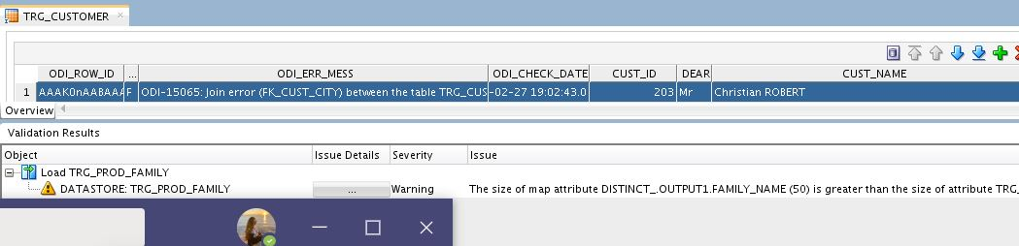
Figure 7-1
Notes:
The image on the left shows the sales admin package session log. The overall execution was successful, but upon going in depth, one can see in the right image that there were errors determined. The left image shows the TRG_CUSTOMER table and one of the rows with the error.

Slide 11
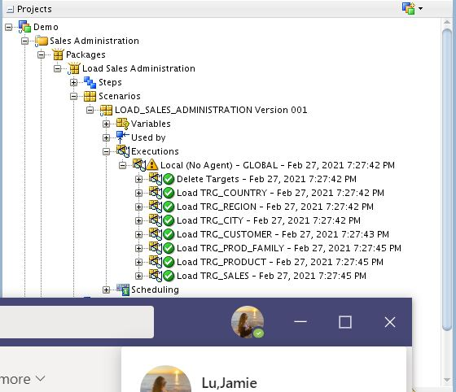
Figure 8-3
Notes:
The image on the right shows the session log of the Load operation for Sales Administration.

Slide 12


THANK YOU
Jamie Lu
W0441213
w0441213@nscc.ca

