Slide 1
Objects Taxonomy:
Workers, Tasks and Services

Slide 2

Workers perform periodic or asynchronous tasks. Each worker is dedicated to a single tasks. Workers can collaborate with each others (e.g. passing data between, notifying) Workers don‘t perfom the heavy lifting themselves, instead they are using services.
Workers

Slide 3

A service is tailored for a single process (e.g. CalculationService, WebAPIService, InitDataService). Workers passes data to a service, invokes and monitors a service (e.g. sendemailservice) Services can be chained together, with or without the help of workers.
Services
Data Process Service
Service Logic
Processed Data
Data

Slide 4

A Worker delivers data to a service

Slide 5

Services working together

Slide 6

A Worker gets data from one service and passes it to another one

Slide 7
Objects Taxonomy:
Databasemanagement

Slide 8


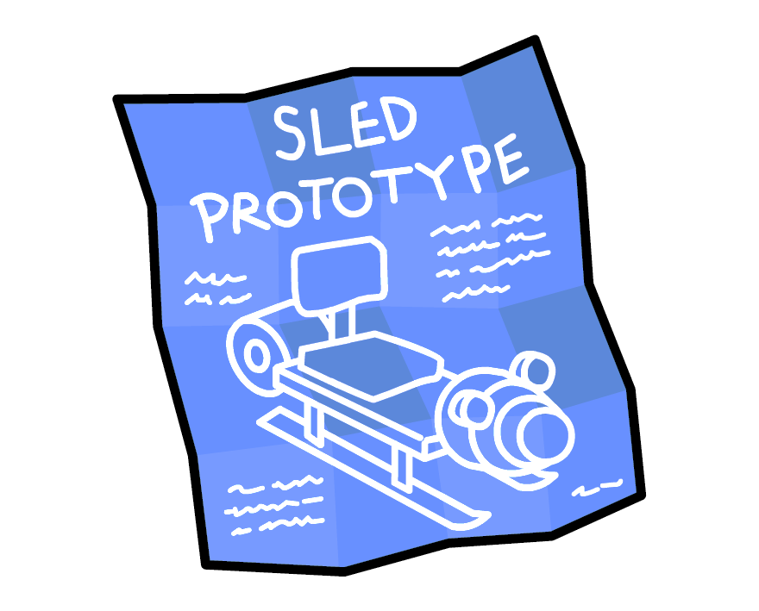


..From Data to Database..
Data
Database
Model
Manager
Queryset

Slide 9
When to use a model method :
Any sort of logical operation on only a single model instance should be a method on the model class.
If you need more complex fetching of related objects from a single model instance, do it as a method on that model class.
Model

Slide 10
Source: https://www.b-list.org/weblog/2020/mar/16/no-service/
When to use a manager I:
If you need an alternate constructor for model instances, do it as a manager method (not as a classmethod on the model, or in some other class or code elsewhere).
In my ORM tutorial I use the example of a model that stores an RGB color as three integer fields, and implementing a manager method that can build an instance from a hexadecimal value, like RGBColor.objects.from_hex('#000080').
Database
Manager

Slide 11
When to use a manager or queryset method:
Queryset
If you have a custom, complex and/or often-used query against the model’s entire table, do it as either a manager method (if you think you’ll never need to use it chained after other query methods), or as a QuerySet method (if you will need to be able to chain it after other things).
Any sort of logical operation on a set of instances of the same model should be a method on the model’s manager or its QuerySet.
And remember you can write a QuerySet subclass with your custom method(s) and then auto-generate a model manager from it.
Also see: Django: Custom Manager With Chainable QuerySets
https://blog.toast38coza.me/django-custom-manager-with-chainable-querysets/
Manager

Slide 12
Source: https://www.b-list.org/weblog/2020/mar/16/no-service/
When to use a manager or querset method:
Database
Manager
If you have a custom, complex and/or often-used query against the model’s entire table, do it as either a manager method (if you think you’ll never need to use it chained after other query methods), or as a QuerySet method (if you will need to be able to chain it after other things).
And remember you can write a QuerySet subclass with your custom method(s) and then auto-generate a model manager from it.
Queryset

