Slide 1
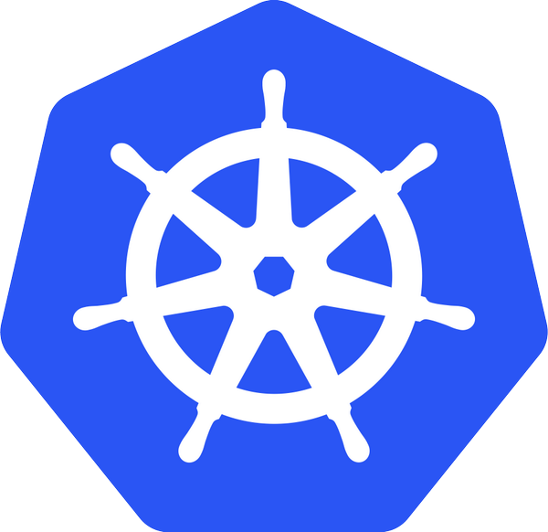
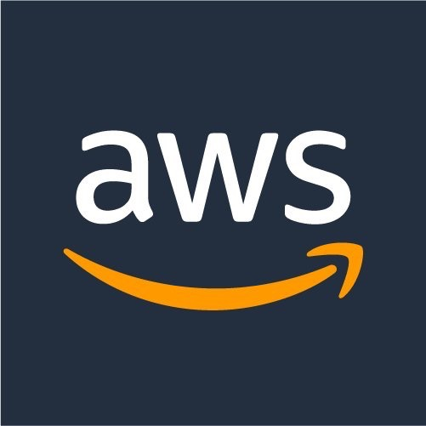
Kubernetes on AWS Workshop
Presenter Name:
Date:

Slide 2
Agenda
Title
Introduction to Kubernetes [Concepts, Cluster Deployments (Kops, Heptio, Tectonic etc.)]
Beginners tutorials [Setup Dev Environment, Install K8s Cluster, Deployment Concepts]
Kubernetes Ecosystem (Networking, Storage)
Mid-level tutorials [Service Discovery, Cluster-* (Monitoring, Logging, Upgrades, Scaling), Helm Charts, App Scaling, Configuration and Secrets Management)
Kubernetes Ecosystem (Service Discovery, Service Mesh, Distributed Tracing)
Advanced tutorials (Network policies with Calico, IAM roles with kube2iam, Statefulsets with EBS, Service mesh with Linkerd)

Slide 3
What is Kubernetes?
Ancient greek for “Helmsman”. Root of the word “Governor”, “Cybernetics”
Open source orchestration system for containers
Docker, rkt, OCI, …
A Cloud Native Computing Foundation (CNCF) project
Active open source project and growing ecosystem
>28K stars, >1900 contributors
Written in Go
Provide declarative primitives for the “desired state”
Self-healing
Horizontal scaling
Automatic binpacking
Service discovery and load balancing

Slide 4
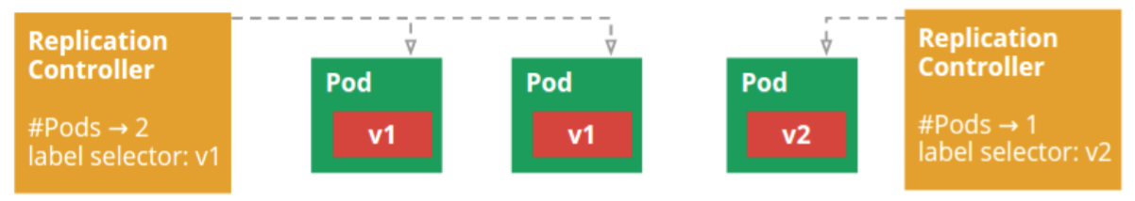
Kubernetes Concepts - Developer
Pods: colocated group of containers that share an IP, namespace, storage volume
Deployment: manages the lifecycle of pods and ensures specified number of replicas are running
Service: Single, stable name for a set of pods, also acts as LB
Label: used to organize and select group of objects
Node
Docker
Pod
Containers
“web”
port 8080
port 8080

Slide 5
Kubernetes Concepts - Developer
Namespaces: Isolated workspaces for users/projects
Ingress controller: L7 load balancing
Jobs: Run to completion
Autoscale: Automatically adjust number of Pods
Network Policies: aka Security Groups for Pods
StatefulSet: Support for long term stateful distributed systems
More …

Slide 6
Cluster Deployments

Slide 7
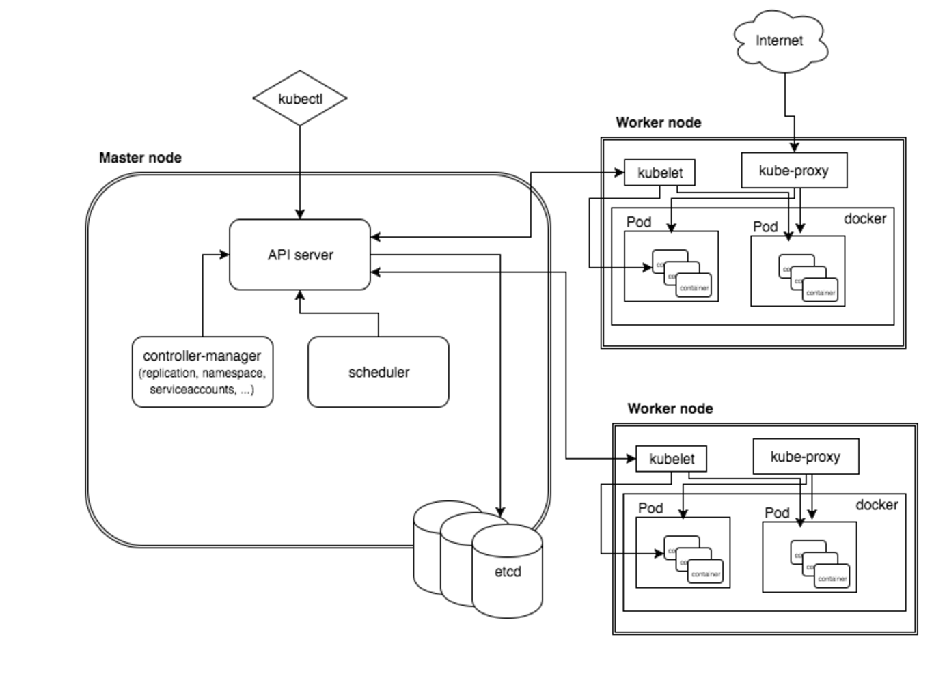
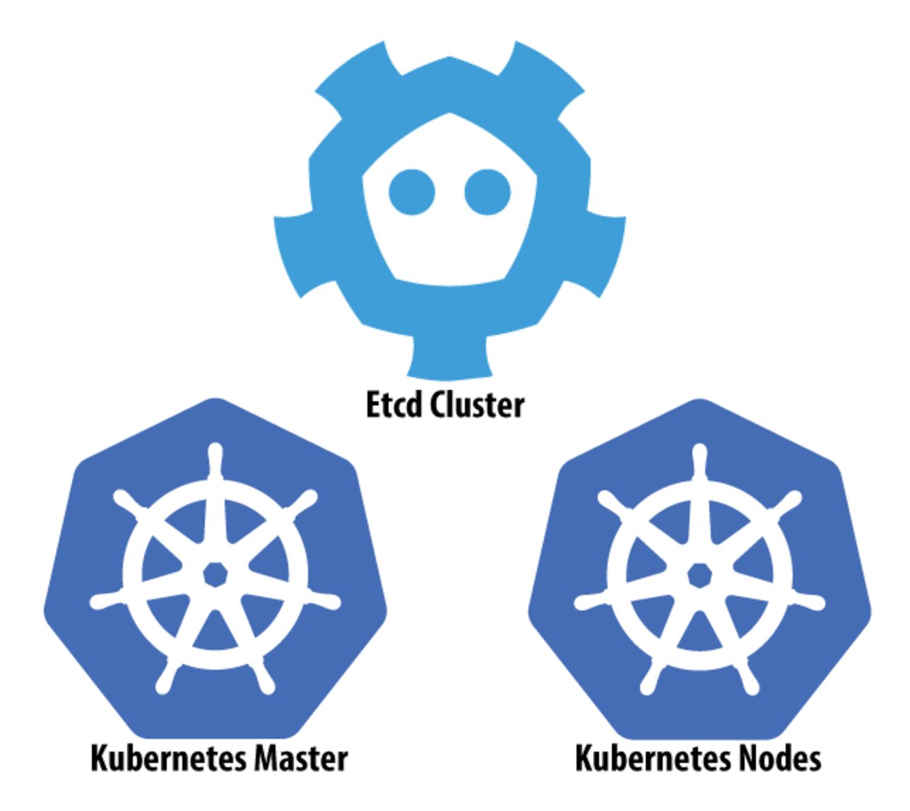
Architecture
Notes:
** Provides a series of loosely coupled and extensible components that can apply to a wide range of differing workloads

Slide 8
KOPS (Kubernetes Ops)
Created by Kubernetes AWS SIG; successor to kube-up.sh
CLI tool for launching and managing clusters on AWS
Can provision simple single-AZ clusters or multi-AZ clusters
Stores cluster state in S3
Provides choice of networking configuration
Manages DNS configuration in Route53, or gossip-based
Can generate Terraform config and basic CloudFormation

Slide 9
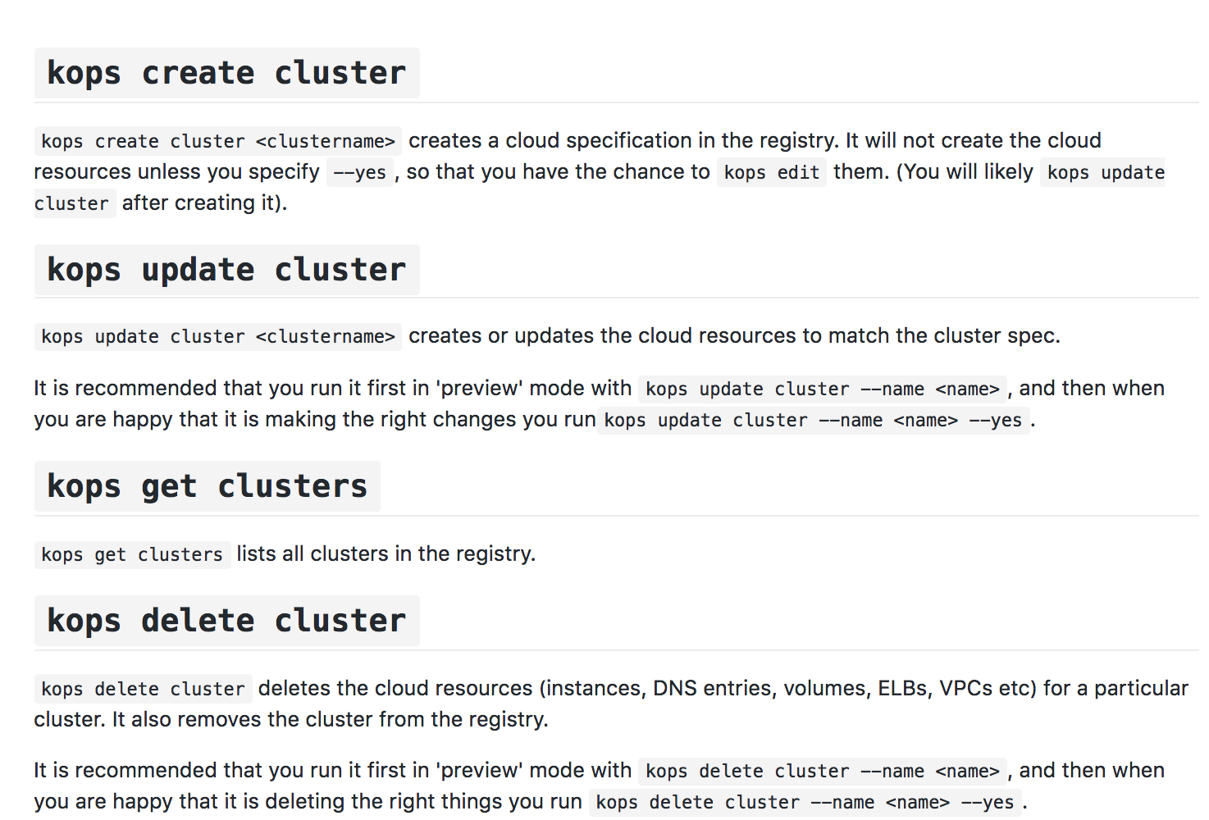
KOPS (Kubernetes Ops)

Slide 10
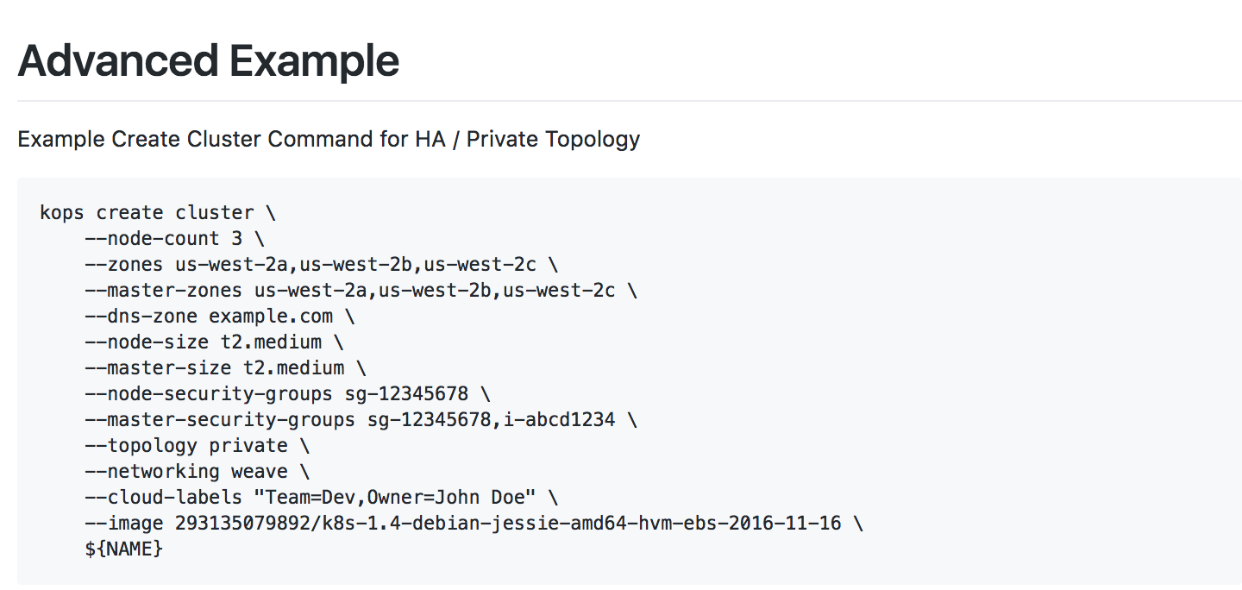
KOPS (Kubernetes Ops)

Slide 11
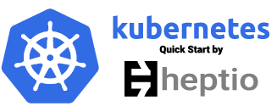
Heptio: Open Source “knowledge base” company founded by Joe Beda + Craig McLuckie
Heptio quick start uses CloudFormation to automate deployment.
Recommends to run one cluster per AZ and use tooling* to coordinate across Azs
Heptio’s position is that the cost and complexity to make the master node highly available isn’t always justified
Uses EC2 Auto Recovery in case of hardware failure on a singleton master
* No guidance on tooling
Notes:
-KOPS are contributing to this
-Weave are contributing to this
-New things: Elasticsearch service integration by default

Slide 12
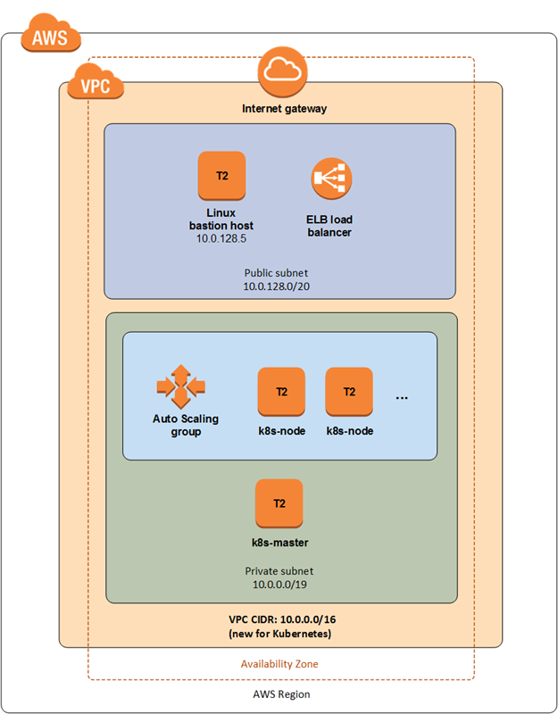
Not for Production usage
Calico and Weave networking support included
AMI config based off https://github.com/weaveworks/kubernetes-ami
Notes:
-KOPS are contributing to this
-Weave are contributing to this
-New things: Elasticsearch service integration by default
Kubernetes 1.5.2
A VPC in a single Availability Zone
2 subnets, one public and one private
1 EC2 instance acting as a bastion host in the public subnet
1 EC2 instance with automatic recovery for the master node in the private subnet
1-20 EC2 instances in an Auto Scaling Group for additional nodes in the private subnet (2 with default settings)
1 ELB load balancer for HTTPS access to the Kubernetes API
Ubuntu 16.04 LTS for all nodes; the base image is a custom AMI based on Ubuntu 16.04
kubeadm for bootstrapping Kubernetes on Linux
Docker for the container runtime, which Kubernetes depends on
Calico or Weave for pod networking
One stack-only security group that allows port 22 for SSH access from the bastion host, port 6443 for HTTPS access to the API, and inter-node connectivity on all ports

Slide 13
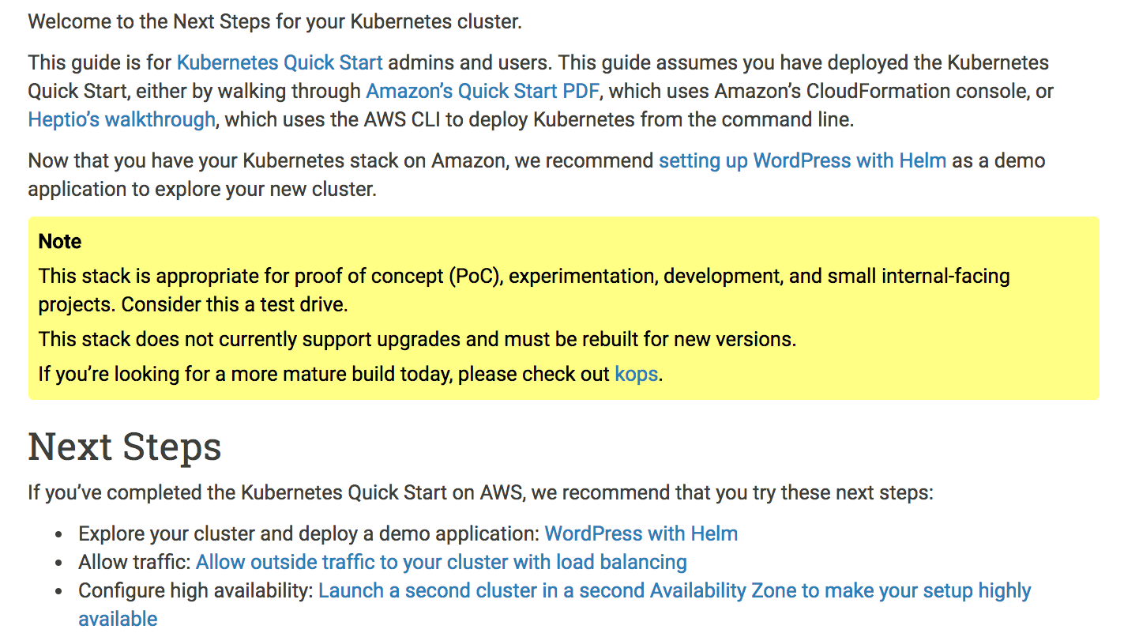
Notes:
-KOPS are contributing to this
-Weave are contributing to this
-New things: Elasticsearch service integration by default

Slide 14
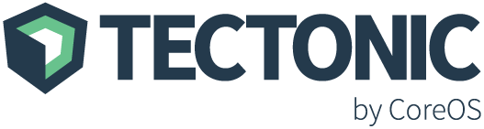
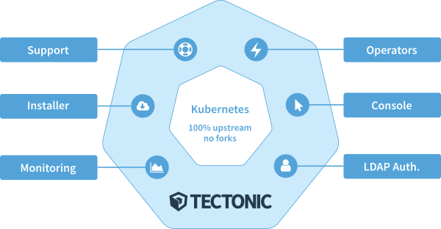
Tectonic is an “enterprise distribution” of Kubernetes produced by CoreOS
Packaged with most current upstream version of Kubernetes, commercial offering comes with features
Up to 10 nodes can be created with free account
Installed using GUI installer or Terraform scripts

Slide 15
Self-hosted: uses Kubernetes to schedule and manage its own components
Uses “Operators” to provide logic for how to manage Kubernetes and Tectonic components
Zero-downtime upgrades of Container Linux and the Cluster itself
Generates and manages all TLS components
LDAP integration + RBAC

Slide 16
AWS Integrations:
KMS to encrypt secrets sent to the control plane
Intelligent distribution of components across three AZs
Etcd + S3 backup and restore
Route 53 zone configuration
ELBs for API server and Nodes

Slide 17
Others: Kube-AWS
github.com/coreos/kube-aws
kube-aws is a templating engine for AWS Cloudformation templates
All assets (CloudFormation, userdata for instances) are declarative templates that can be checked into git and version controlled
Uses Amazon KMS to encrypt all secrets before putting them into assets files. Secrets are unlocked once the machines boot into their IAM roles
Spreading of workers and control plane nodes across AZs

Slide 18
KubeADM
OS level tool for bootstrapping a cluster
Does not manage any underlying infrastructure
Intended to be used as part of another provisioning tool, i.e. in userdata, cloudformation, terraform, etc
Requires installation of docker, kubelet, kubectl
`Kubeadm init` initializes a master, `kubeadm join` joins the cluster

Slide 19
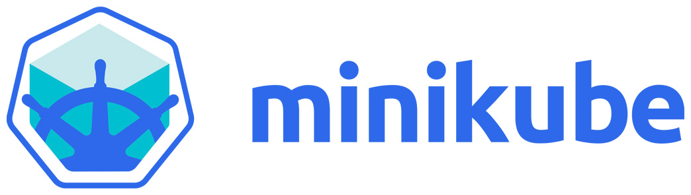
Minikube
Runs a single node cluster in a VM
OSX: xhyve, VirtualBox or VMWare Fusion
Linux: VirtualBox or kvm
Windows: VirtualBox or Hyper-V
Targeted for local development
Flow
brew cask install minikube
minikube start
kubectl create –f <file>
https://github.com/kubernetes/minikube

Slide 20
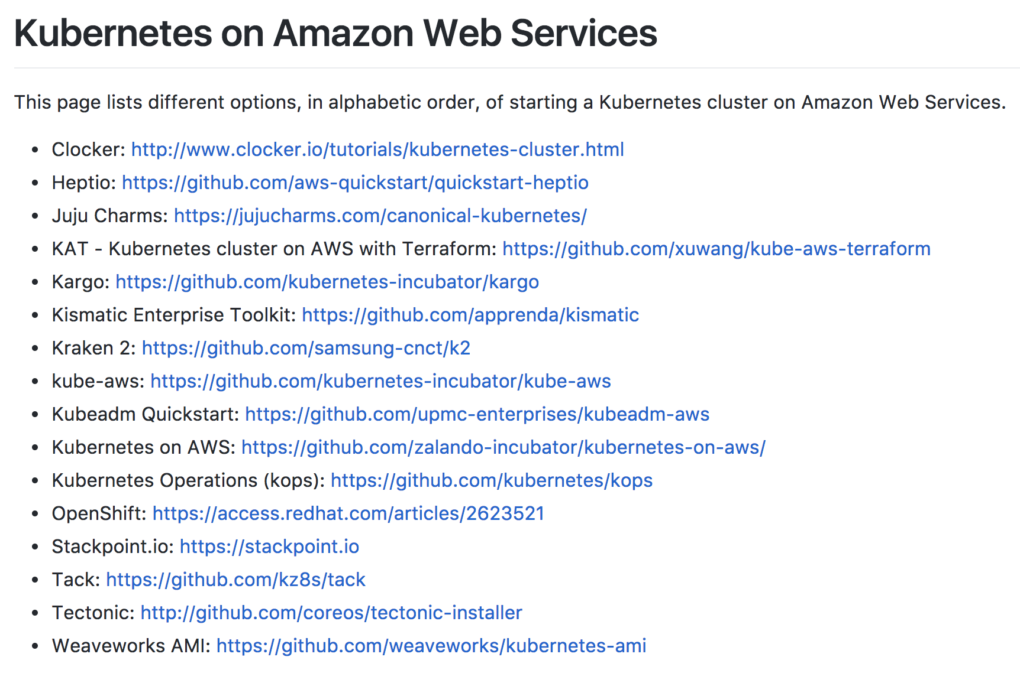
Kubernetes on AWS – Getting Started
kubernetes-aws.io

Slide 21
Networking

Slide 22
CNI Plugins
The Container Network Interface is a set of specs and libs for writing networking plugins
Handles standards around namespace and interface configuration
Configured by passing “—networking CNI” flag in cluster spec; then installing the desired plugin as a daemonset (run once on all hosts)
CNI standards have allowed for a number of networking approaches in Kubernetes, each with their own advantages and disadvantages
https://github.com/containernetworking/cni/blob/master/SPEC.md ← you should read this
Notes:
Each CNI plugin is implemented as an executable that is invoked by the container management system (e.g. rkt or Docker).
A CNI plugin is responsible for inserting a network interface into the container network namespace (e.g. one end of a veth pair) and making any necessary changes on the host (e.g. attaching other end of veth into a bridge). It should then assign the IP to the interface and setup the routes consistent with IP Address Management section by invoking appropriate IPAM plugin.
The intention is for the container runtime to first create a new network namespace for the container. It then determines which networks this container should belong to and for each network, which plugin must be executed. The network configuration is in JSON format and can easily be stored in a file. The network configuration includes mandatory fields such as "name" and "type" as well as plugin (type) specific ones.

Slide 23
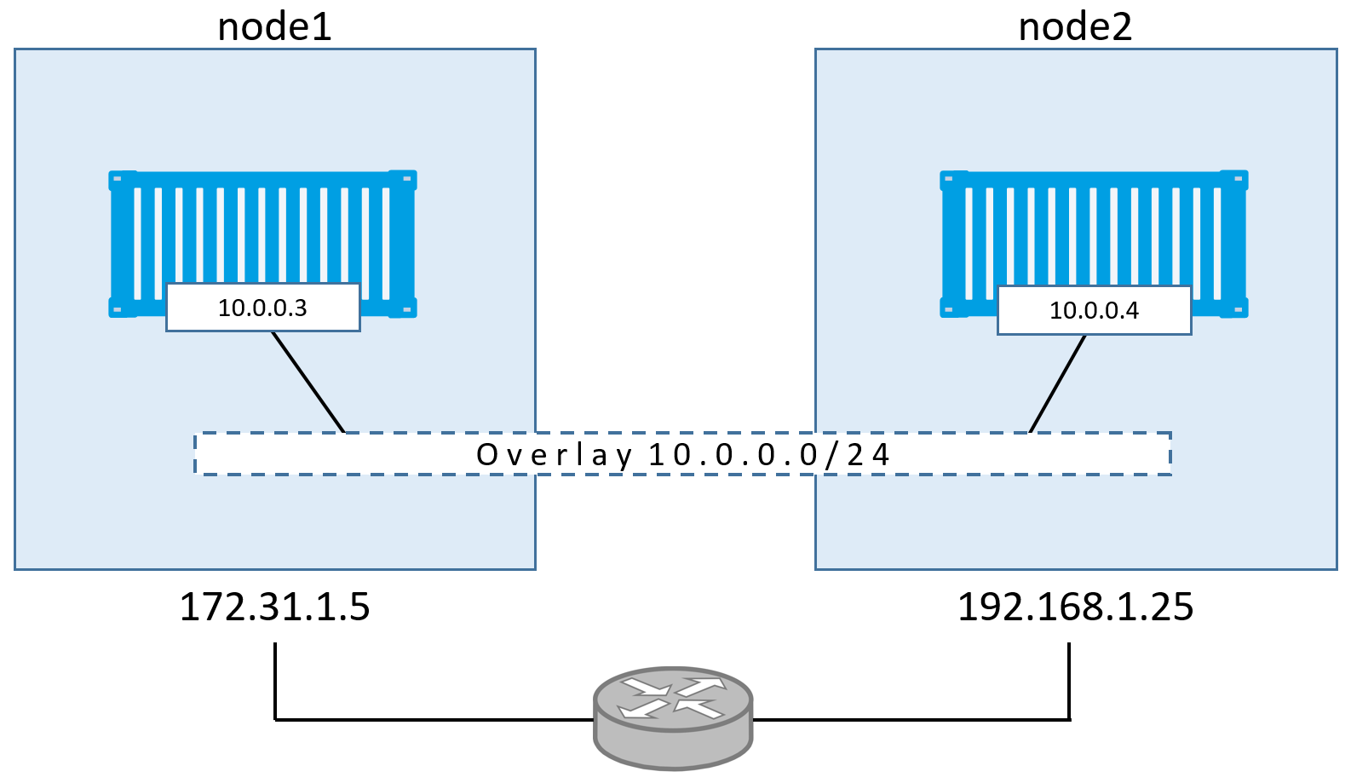
Overlay Networks
http://blog.nigelpoulton.com/demystifying-docker-overlay-networking/
Notes:
Overlay networks implement a common network address space across the entire cluster on which containers can communicate. Most overlays use the Docker0 bridge interface, but they “extend” the bridge network by providing information about the Docker0 network on other hosts, and coordinate IP addressing to prevent conflicts. Information about the network is commonly stored in a backing key/value datastore like Etcd, with the one exception being Weave Net, in which information about the overlay is stored in-memory and replicated across the cluster.
One advantage of overlay networks is that the container orchestration platform maintains complete control over the networking functionality and feature set. This makes overlay networks platform agnostic, and doesn’t require custom integration development when workloads are deployed across networks with different features and capabilities.

Slide 24
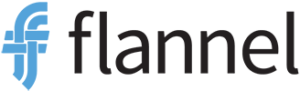
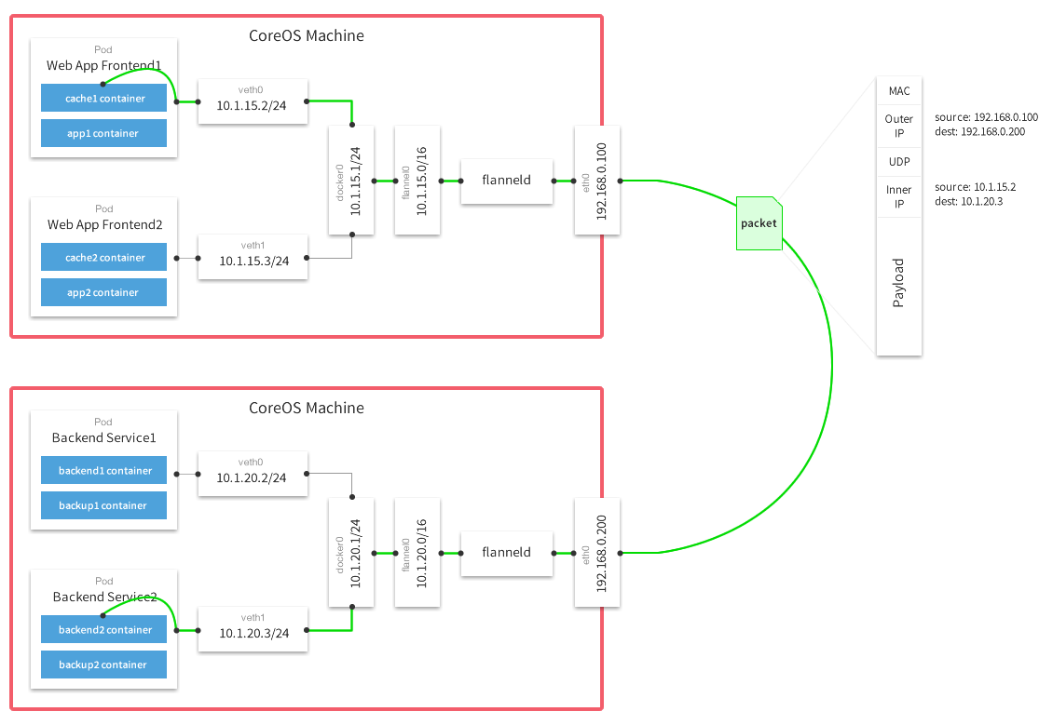
CoreOS project
Stores configuration data in etcd
VXLan for L2 encap (default)
Each pod gets a /24 subnet on the flannel /16 overlay

Slide 25

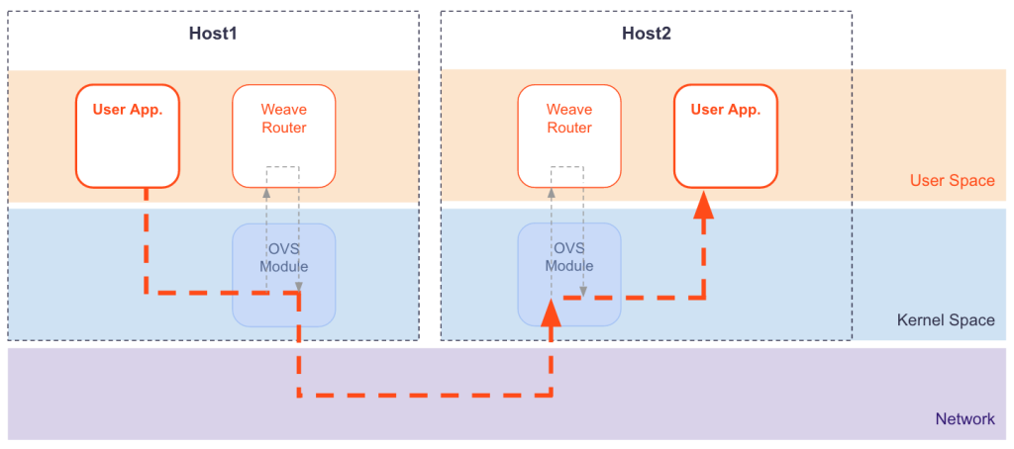
Open source project owned by Weaveworks
No backing k/v store required; cluster state replicated in memory
Supports multicast + NaCL encryption
Has DNS service discovery and load balancing built in
Notes:
https://github.com/weaveworks/weave/issues/2045

Slide 26
Overlay Networks
Pros:
Cons:
Agnostic to underlying topology and platform
Can easily span networks and platforms
Some offer cool functionality (encryption, multicast)
No cluster size limitations due to routes or hosts
Can be difficult to troubleshoot due to encapsulation
Require port mapping on host or load balancers for access from other networks
Performance overhead
Can’t use security groups
Notes:
Overlay networks implement a common network address space across the entire cluster on which containers can communicate. Most overlays use the Docker0 bridge interface, but they “extend” the bridge network by providing information about the Docker0 network on other hosts, and coordinate IP addressing to prevent conflicts. Information about the network is commonly stored in a backing key/value datastore like Etcd, with the one exception being Weave Net, in which information about the overlay is stored in-memory and replicated across the cluster.
One advantage of overlay networks is that the container orchestration platform maintains complete control over the networking functionality and feature set. This makes overlay networks platform agnostic, and doesn’t require custom integration development when workloads are deployed across networks with different features and capabilities.

Slide 27
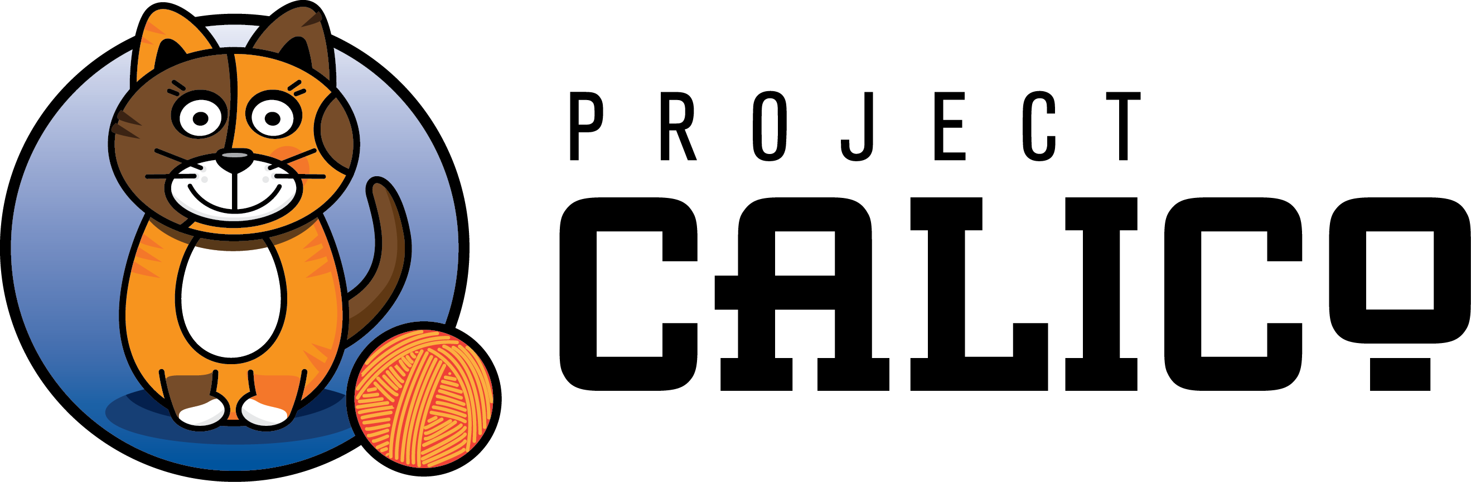
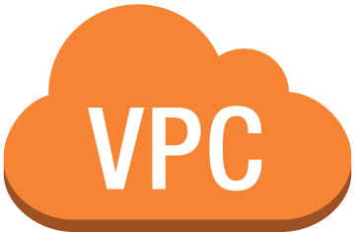


Calico Subnet – 172.16.1.0/16
172.16.0.1/24
172.16.0.2/24
Src/dst disabled
instance1
instance2
10.0.0.10
10.0.0.12
Calico BGP daemon
IF on Calico Subnet –
172.16.0.2/24
Calico IPIP tunnel across subnets
instance3
Instance2 route table:
172.16.0.1/24 via 10.0.0.10
10.0.1.20
instance4
10.0.1.22
instance2
10.0.0.12
172.16.0.3/24
172.16.0.4/24
Calico Subnet – 172.16.1.0/16
VPC – 10.0.0.0/16

Slide 28
Layer 3 networking (Calico)
Pros:
Cons:
No encap/decap overhead*
Easier debugging, well known tools/protocols (iptables, BGP)
Uses BGP for routing - supports large clusters
No cluster size limitations due to routes or hosts
Limited to UDP/ICMP/TCP protocol support
Uses BGP for routing - complexity
Can’t use security groups*
*except across subnets

Slide 29
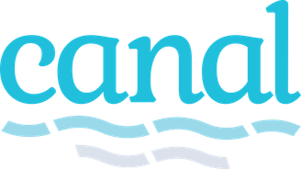
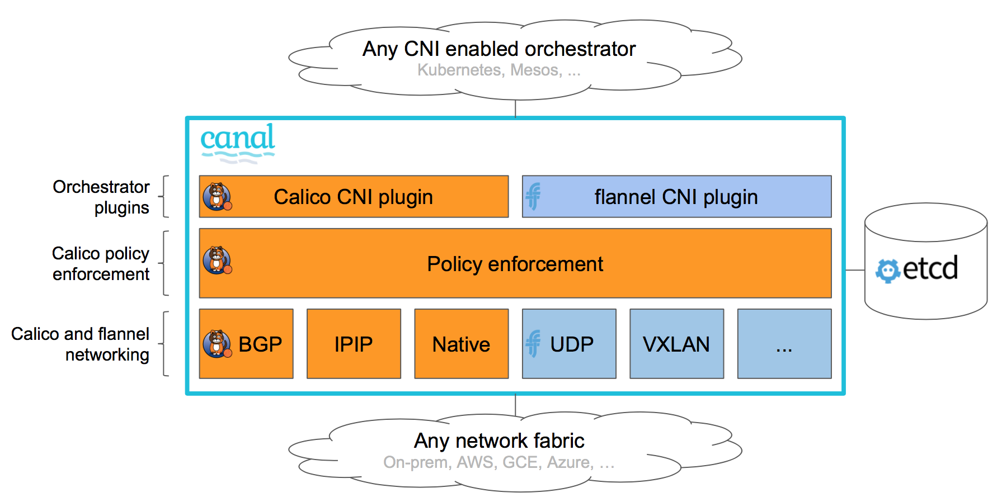

Slide 30
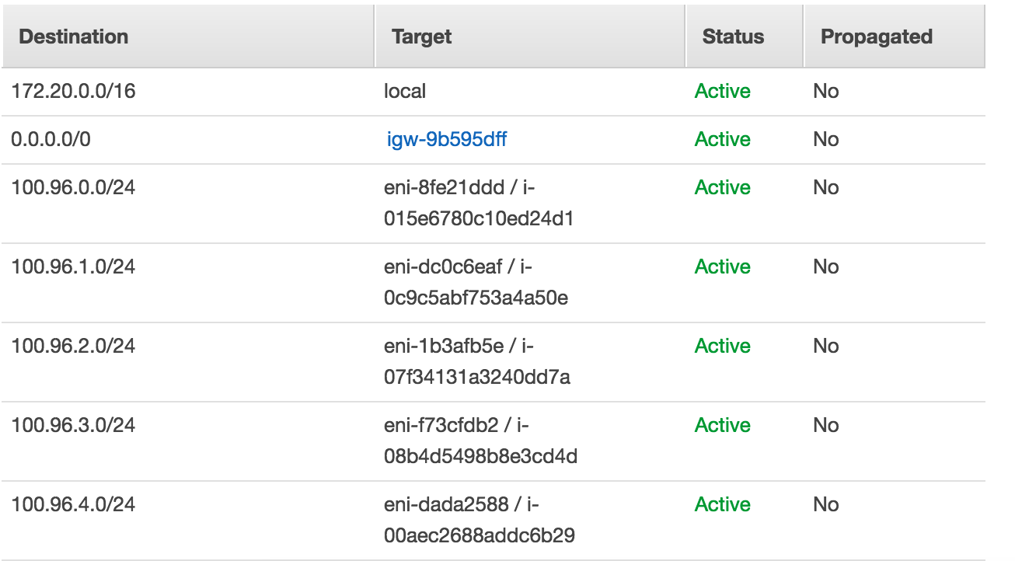
VPC Networking (Kubenet)
Default networking mode for KOPS
--network-plugin=kubenet
Creates a bridge called cbr0; connects a Veth pair to each pods
Manages an out-of-band subnet across the cluster (like Calico, so src/dst = disabled is required)

Slide 31
VPC Networking (Kubenet)
Pros:
Cons:
Interacts directly with the VPC
No encap/decap overhead
Easier debugging
Uses VPC routing tables*
Cluster size limited to number of routes per subnet
Can’t use security groups
Doesn’t automatically update routes on scaling events (userdata/lifecycle hooks?)
Is recommended to be used in its own subnet to prevent route table conflicts
*maybe also a negative

