Slide 1
Wait Wait ...
Don‘t shell me!
2018, PlaidCTF
Theodor Mittermair

Slide 2

About
Theodor Mittermair
  Almost BsC Computer Engineering
  Interested in hardware & low level stuff
Not a complete success story,
  but a learning experience.
Questions during presentation are welcome!

Slide 3
Overview
Challenge
Attempt
  Idea
  Trial and Error
  Realizations
Solution
Analysis

Slide 4

Challenge
Wait Wait … Don‘t shell me! [1]
  The hint was released only later

Slide 5
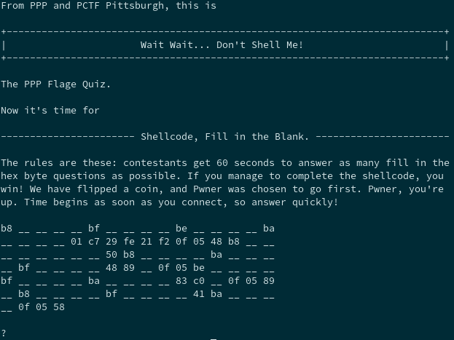
Challenge

Slide 6
Idea
remote code execution
analyze existing instructions
  4 syscalls (socket, connect, dup2, execve, ...)
  we seem to control (at least some) arguments
  variable length instructions?
Later: no stdin/stdout → no shell
  Flag on filedescriptor 3?

Slide 7
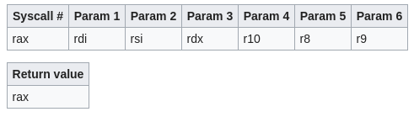
Calling Conventions
Syscalls & Parameters [4]

Slide 8
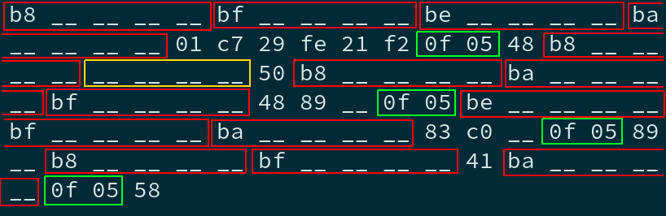
main() { while(!solved()); }
What do we have?

Slide 9
rasm2
rasm2 -a x86 -b 64 -d "b801234567“
  mov eax, 0x67452301
rasm2 -a x86 -b 64 -D "01 c7 29 fe 21 f2 0f 05"
  add edi, eax
  add esi, edi
  and edx, esi
  syscall

Slide 10
rasm2
rasm2 -a x86 -b 64 -d
  "83" → invalid
  "83c0" → invalid
  "83c000" → add eax, 0
  "83c00000“ → add eax, 0; invalid

Slide 11
rasm2
for i in {0..255}; do
  byte=$(printf "%02X" $i);
  echo "==== $byte";
  rasm2 -a x86 -b 64 -d "4889$byte";
done | less
→ variants of
  „mov [reg1], reg2“
  „mov reg1, reg2“

Slide 12
rasm2
rasm2 -a x86 -b 64 -d "41"
  Invalid ???
  Part of previous or next Instruction?
Got stuck.

Slide 13

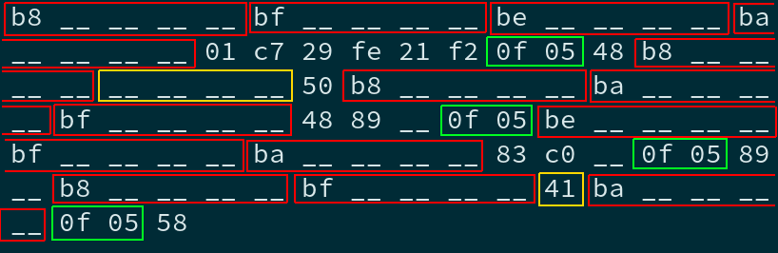
break;
The beautiful pattern broke
Complexity in our minds jumped

Slide 14
Problems Encountered
Socket Struct: sa_length?
architecture differences: x86 / amd64?
variable length instructions?
intermediate step necessary?

Slide 15
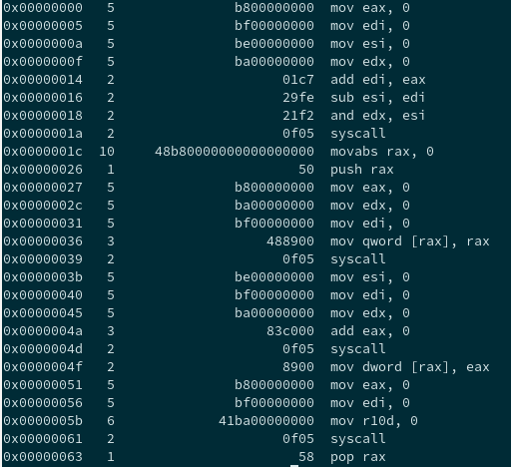
?
rasm2

Slide 16
continue;
Write-Up [2]
  Two-Step Procedure
  Get pointer to „flag.txt“:
    Socket → Connect → Write
  open and send flag file contents
    Socket → Connect → Open → Sendfile

Slide 17

DEMO TIME

Slide 18
Analysis - Risk
crafted & unrealistic, but …
… not-so-distant real-world similarities …
-> unsanitized user input.
-> access to currently unused resources.

Slide 19
Analysis - Mitigation
Well … don‘t let others tell you assembly code you are going to execute :)
→ ASLR
→ Sanitize Input.
→ Limit access to minimum necessary.

Slide 20
Thank you for your attention!

Slide 21
References
[1] https://ctftime.org/task/6070
[2] https://fortenf.org/e/ctfs/pwn/2018/05/07/plaidctf-2018-waitwait.html
[3] https://www.amd.com/system/files/TechDocs/24594.pdf
[4] https://en.wikibooks.org/wiki/X86_Assembly/Interfacing_with_Linux#Syscalls

Slide 22
\0

