Slide 1
Important Elements in ML
Speaker: 呂瑞麟
國立中興大學資管系教授
Email: jllu@nchu.edu.tw
URL: http://web.nchu.edu.tw/~jlu

Slide 2
Outline
Why
Data formats
Learnability
Statistical Learning Approaches
Elements of Information Theory

Slide 3
Why
There are some important elements and approaches which span through all machine learning topics and also create a philosophical foundation for many common techniques
About (Training/Testing) Data
Multiclass Strategies
Learnability
Statistical Learning Approaches
Elements of Information Theory

Slide 4
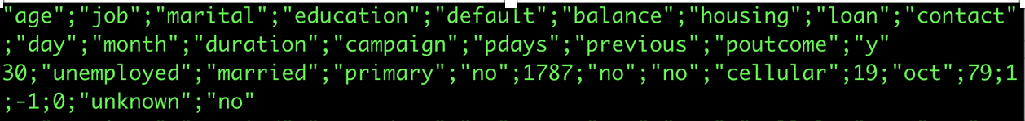
About Data
In a supervised learning problem, there will always be a dataset, defined as a finite set of real vectors with m features:
D = {X₁, X₂, …, X_{n}} where X_{i} ∈ ℝ^{m}
以第一個範例為例，我們選擇三個 features（loan, age, balance），所以 m = 3，而範例資料顯示 X₁ = [0, 30, 1787]. （ loan是no； 每一筆資料也稱之為 sample）

Slide 5
About Data
Considering that our approach is always probabilistic, we need to consider each X_{i} as drawn from a statistical multivariate distribution D.
多變量的、多維度的（例如，m=3）
We expect all samples to be independent and identically distributed (i.i.d). This means all samples belong to the same distribution D.

Slide 6
About Data
The output values ŷ obtained from a learning model can be either numerical-continuous or categorical.
以 categorical 為例，若 ŷ ∈ {red, black, white, green}
如果是 hard classification，且假設 ŷ 是 black，則 ŷ = [0 1 0 0]
如果是 soft classification，且假設 ŷ 是 black，則 ŷ = [0.1 0.4 0.25 0.25] (加總是 1，可以想像是 probability distribution)

Slide 7
About Data
訓練的目的是為了找到最佳的參數，這組參數一般以 θ 代表
以第一個範例中，LinearRegression 的 coef_ 就是

Slide 8
Multiclass Strategies
Classifying instances into one of the two classes is called binary classification (ex. spam/not spam)
Multiclass or multinomial classification（多分類）is the problem of classifying instances into one of three or more classes. (ex. red/black/white/green)
Multi-label classification（多標籤分類） is a generalization of multiclass classification. In the multi-label problems, there is no constraint on how many of the classes the instance can be assigned to. (ex. Apple watch can be both 3C and fashion)

Slide 9
Multiclass Strategies
When the number of output classes is greater than one, there are two main possibilities to manage a classification problem:
One-vs-all
One-vs-one

Slide 10
Multiclass Strategies
One-vs-all
This is probably the most common strategy and is widely adopted by scikit-learn for most of its algorithms.
If there are n output classes, n classifiers will be trained in parallel considering there is always a separation between an actual class and the remaining ones.
This approach is relatively lightweight (at most, n-1 checks are needed to find the right class, so it has an O(n) complexity) and, for this reason, it's normally the default choice

Slide 11
Multiclass Strategies
One-vs-one
training a model for each pair of classes
The complexity is no longer linear (it's O(n²) indeed) and the right class is determined by a majority vote.
In general, this choice is more expensive and should be adopted only when a full dataset comparison is not preferable.

Slide 12
Outline
Why
Data formats
Learnability
Statistical Learning Approaches
Elements of Information Theory

Slide 13
Learnability
The purpose of a machine learning model is to approximate an unknown function (在 learning theory 時，常稱之為 concept) that associates input elements to output ones
簡單的說：f(X) = Y
However, a training set is normally a representation of a global distribution, but it cannot contain all possible elements

Slide 14
Learnability
我們接觸的 models 大多為 parametric models.
A parametric model can be split into two parts: a static structure and a dynamic set of parameters (ie. θ).
The former is determined by choice of a specific algorithm and is normally immutable,
while the latter is the objective of our optimization

Slide 15
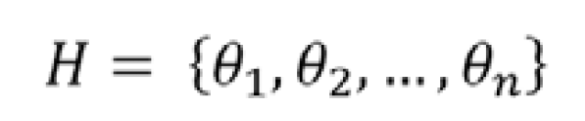
Learnability
Considering n unbounded parameters, they generate an n-dimensional space where each point, together with the immutable part of the estimator function, represents a learning hypothesis H (associated with a specific set of parameters):

Slide 16
Learnability
The goal of a parametric learning process is to find the best hypothesis whose corresponding prediction error is minimum and the residual generalization ability is enough to avoid overfitting.

Slide 17
Learnability
It's important to consider two different dangers:
Underfitting: It means that the model isn't able to capture the dynamics shown by the same training set.
Overfitting: the model can associate almost perfectly all the known samples to the corresponding output values, but when an unknown input is presented, the corresponding prediction error can be very high.

Slide 18
Learnability
It's very important to avoid both underfitting and overfitting.
Underfitting is easier to detect considering the prediction error, while
Overfitting may prove to be more difficult to discover as it could be initially considered the result of a perfect fitting

Slide 19
Learnability
The prediction error for any machine learning algorithm can be broken down into three parts:
Bias Error
Variance Error
Irreducible Error: cannot be reduced regardless of what algorithm is used. It is the error introduced from the chosen framing of the problem and may be caused by factors like unknown variables that influence the mapping of the input variables to the output variable.

Slide 20
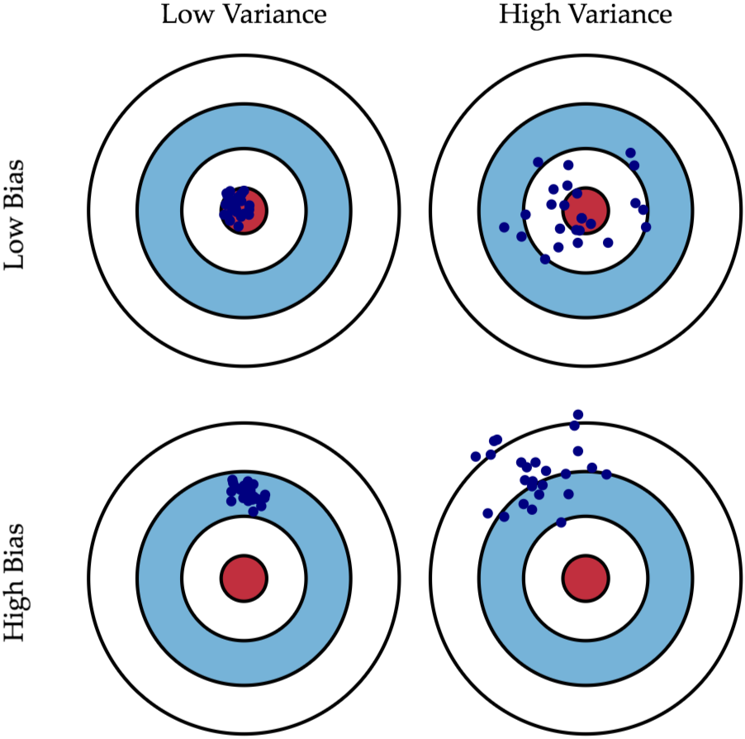
Learnability
Bias vs. Variance
如果說​你打靶打得很精 "準"，意味你子彈射中的地方離靶心很近，即 Low Bias；
如果說​你打靶打得很精 "確"，意味你在發射數槍之後這幾槍彼此之間在靶上的距離很近，即 Low Variance。

Slide 21
Learnability
那麼我們能不能找出一個 model 既準又確？很不幸的，這是一個非常著名的問題，叫做”Bias-Variance Trade-off”
也就是：如果 bias error 變小了，Variance error 就變大了；反之亦然。
為什麼會這樣呢？

Slide 22
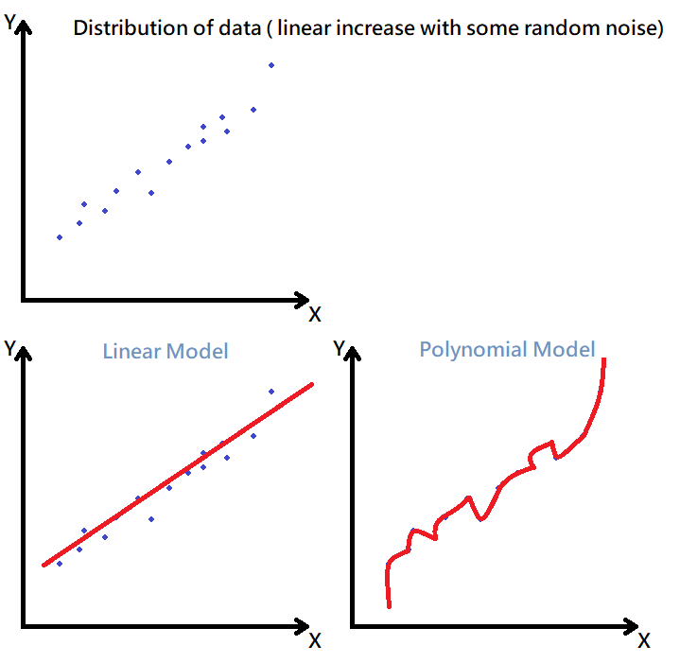
Learnability
資料的分布如右圖上方，而我們分別採用了 linear model 和 polynomial model
很明顯的，polynomial 很準（low bias），而 linear 相對不準（high bias）
若有一筆新資料出現，以 linear model 預測，variance 的變化不大（low variance），但是如果以 polynomial model 預設則比原來的 variance 大很多（high variance）
也就是說，polynomial model 在這個範例中是 overfitting

Slide 23
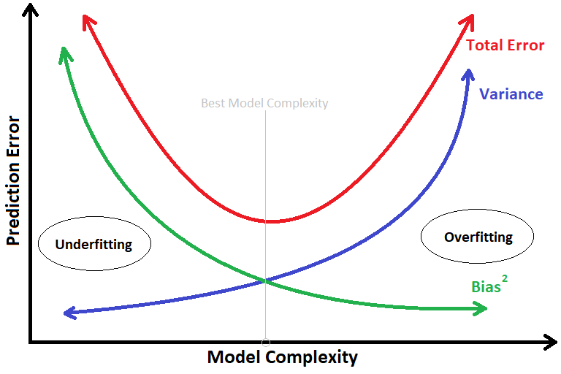
Learnability
根據之前的概念，我們以 prediction error 和 model complexity 作為圖的兩個軸
Polynomial model 的 model complexity 比 linear model 高，因此 bias 低，而 variance 高
Linear model 的 model complexity 低，因此 bias 高，而 variance 低

Slide 24
Learnability
雖然理論上，我們可以找到那個 total error 的最低點，但是實務上不容易，一般來說，我們需要調整 hyper-parameters 來找出比較好的 model。
實際操作上，一般我們會將 dataset 切割成 training set 跟 validation set（test set?），training set 用於訓練模型；而 validation set 將不會參與訓練，用於評估模型是否 overfitting。

Slide 25
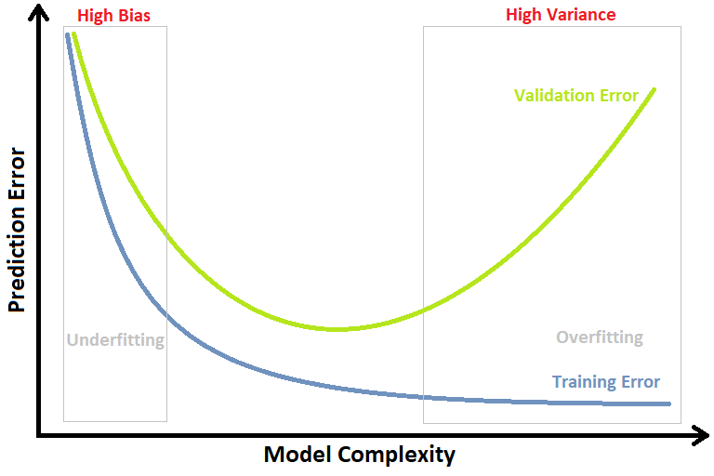
Learnability
在 Underfitting 的時候，不論是在 Training set 還是 Validation set 的 Error 都很高。
在 Overfitting 的時候，Training set 的 Error 已經將降低了，但 Validation set 上的 Error 會很高。

Slide 26
Learnability
Error Measures
Define a non-negative error measure (or function) e_{m.} For a dataset of n samples,
This value is also implicitly dependent on the specific hypothesis H through the parameter set, therefore optimizing the error implies finding an optimal hypothesis (ie. an acceptable approximation).
If e_{m} is mean square error, then

Slide 27
Learnability
Error Measures
This measure is also called loss function because its value must be minimized through an optimization problem
Another useful loss function is called zero-one-loss and it's particularly efficient for binary classifications (also for one-vs-rest multiclass strategy):
This function is implicitly an indicator and can be easily adopted in loss functions based on the probability of misclassification

Slide 28
Learnability
Given only training examples and a set of candidate hypotheses:
how many training examples are sufficient to successfully learn the target function （就是 model）, and
how many mistakes will the learner make before succeeding?
為了回答這個問題，L. Valiant 在 1984 年提出了 PAC (Probably Approximately Correct) Learning Theory

Slide 29
Learnability
PAC Learning Theory
簡單的說，該理論的結果說明：如果訓練用的資料夠多，那麼我們很有可能（probably）找到一個 model，且該 model 可以足夠正確的（approximately correct）進行分類或者預測
只是這個理論無法保證可以找到“有效”的 model（time complexity 可能是 exponential）。

Slide 30
Outline
Why
Data formats
Learnability
Statistical Learning Approaches
Elements of Information Theory

Slide 31
Probability Theory
Probability is all about the possibility of various outcomes.
The set of all possible outcomes is called the sample space.
The sample space for a coin flip is {heads, tails}. → discrete
The sample space for the temperature of water is all values between the freezing and boiling point. → continuous

Slide 32
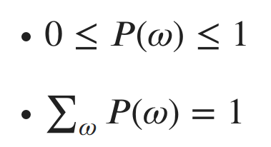
Probability Theory
Only one outcome in the sample space is possible at a time, and the sample space must contain all possible values.
The sample space is often depicted as Ω (capital omega) and a specific outcome as ω (lowercase omega). We represent the probability of an event ω as P(ω).
The two basic axioms of probability are:

Slide 33
Probability Theory
A random variable x, is a variable which randomly takes on values from a sample space. (ex. x represents the outcome of flip coins, thus x=‘head’ or x=‘tail’)
Random variables can either be discrete like the coin, or continuous
To describe the likelihood of each possible value of a random variable x, we specify a probability distribution.
We write x ~ P(x) to indicate that x is a random variable which is drawn from a probability distribution P(x)
Probability distributions are described differently depending on if the random variable is discrete or continuous.

Slide 34
Probability Theory
Discrete random variables are described with a probability mass function (PMF).
A PMF maps each value in the variable’s sample space to a probability.
One such PMF is the uniform distribution over n possible outcomes: P(x=x) = 1/n.
例如，coin 的 n = 2; dice 的 n = 6.
Another common discrete distribution is the Bernoulli. A Bernoulli distribution specifies the probability for a random variable which can take on one of two values. The PMF of a Bernoulli distribution is P(x) = {p if x =1, and 1-p if x=0}.

Slide 35
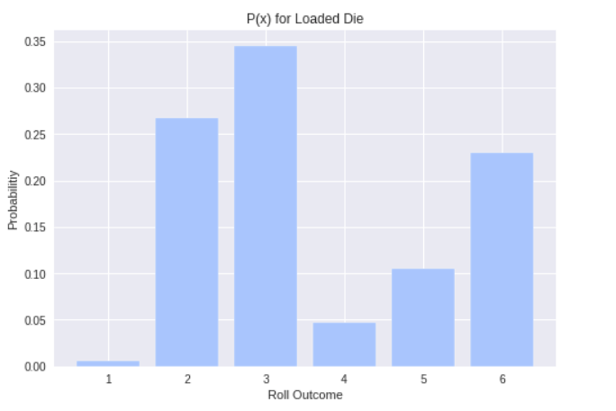
Probability Theory
Loaded dice with P(x=3) = P(3) ~= 0.35

Slide 36
Probability Theory
Continuous random variables are described by probability density functions (PDF)
We generally indicate the PDF for a random variable x as f(x). [注意：不再是 PMF 的 P(x).]
PDFs map an infinite sample space to relative likelihood values

Slide 37

Probability Theory
For example, the Gaussian (Normal) distribution is one of the most famous continuous distributions.
it is parameterized by two values: the mean μ (mu) and variance σ² (sigma squared).
To indicate that x is a random variable drawn from a Gaussian with mean μ and variance σ², we write:

Slide 38
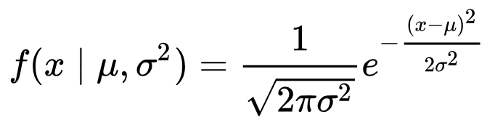
Probability Theory
The functional form of the PDF for the Gaussian is:
The left hand side of the equation says “The PDF of x given μ and σ² ”. The vertical bar represents the word “given” and indicates that we already know all of the values after it in the parenthesis

Slide 39
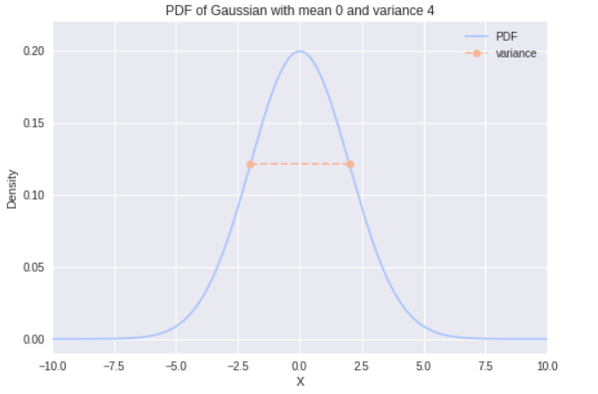
Probability Theory
An example PDF

Slide 40
Probability Theory
So what is relative likelihoods?
Unlike discrete distributions, the value of the PDF at x = x is not the actual probability of x. This is a common misconception when people first start dabbling with probability theory
The value of the PDF at x = x can be interpreted as a (relative) likelihood of x = x

Slide 41
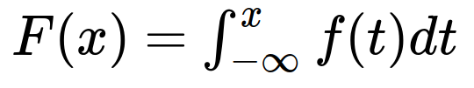
Probability Theory
Because the area is what we’re interested in, it’s often more useful to work with a continuous random variable’s cumulative distribution function (CDF).
We write the CDF, F(x) as
so F(x) gives us P(x≤x)

Slide 42
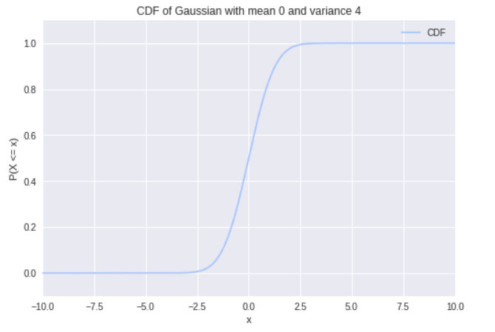
Probability Theory
An example CDF

Slide 43
Probability Theory
Now, we can use the CDF to determine the probability of any given range [a,b] by noticing that P(a≤x≤b) = F(b)-F(a)
Asking for P(x=x) is equivalent to asking P(x≤x≤x) = F(x)-F(x) = 0.

Slide 44
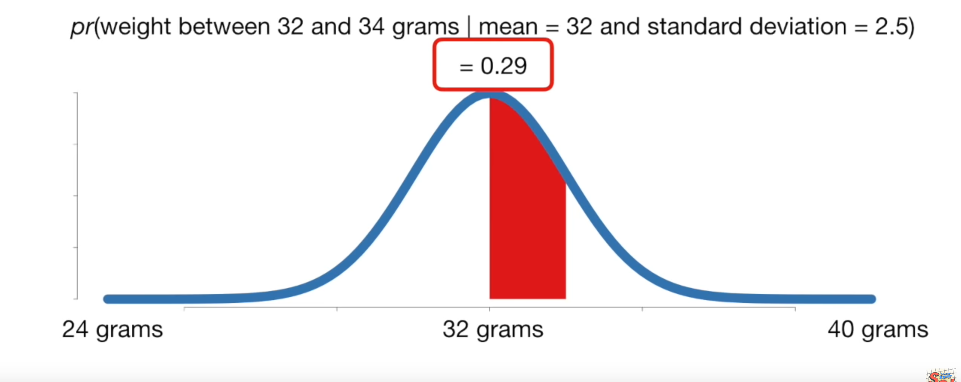
Probability Theory
Probability vs. Likelihood for continuous random variable x.
In the following distribution, it is a mouse-weight distribution.

Slide 45
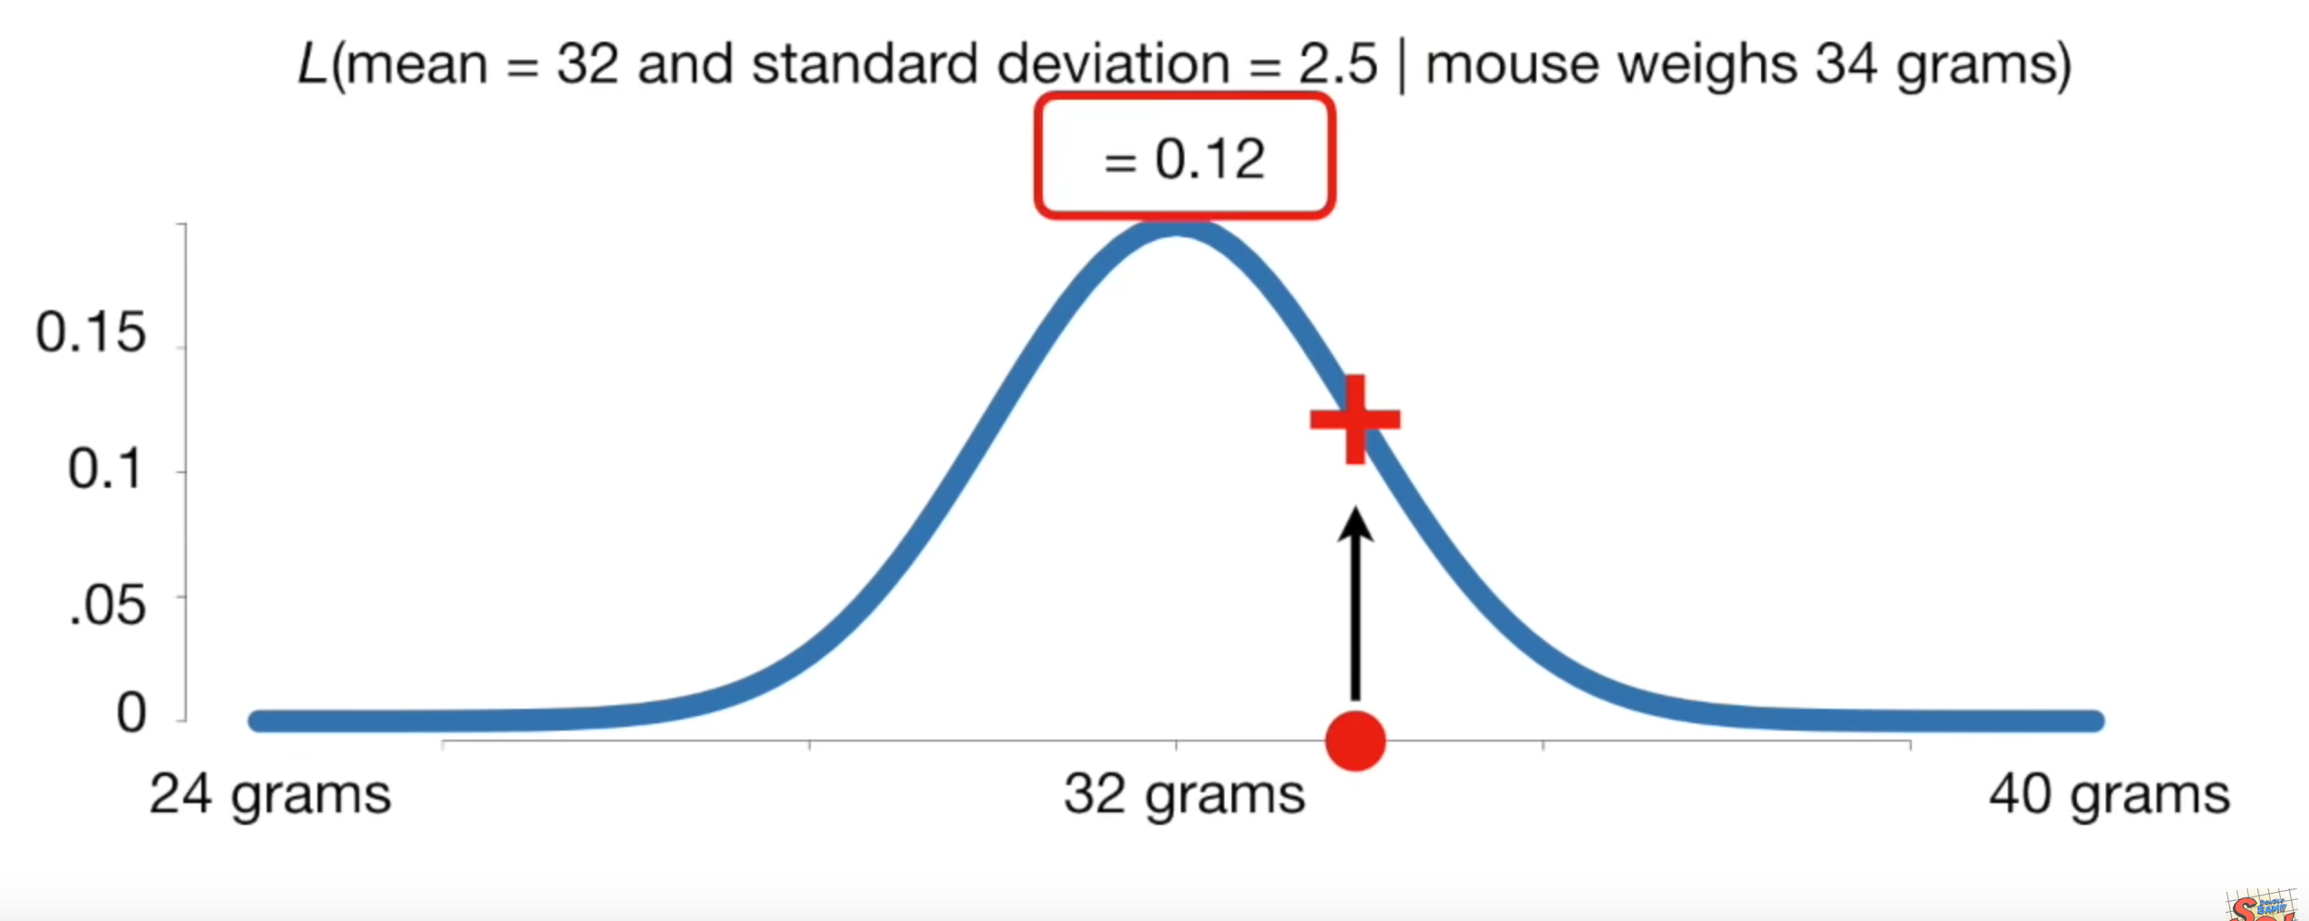
Probability Theory
Probability vs. Likelihood for continuous random variable x.
L is likelihood.

Slide 46
Probability Theory
Likelihood is thus denoted as L(θ | x_{i}) or L_{xi}(θ).
θ, in general, represents a model (in machine learning); is also the parameter to be estimated.

Slide 47

Likelihood
我個人認為最難翻譯清楚的部分，請仔細閱讀
之前介紹機率的時候，we talked about the likelihood of a continuous random variable taking on a specific value
We got this likelihood from the probability density function (PDF) for the distribution with the parameters fixed at some value
For a continuous distribution with PDF f(x|θ), the likelihood function becomes:
𝙻_{x}(θ) 也有人寫成 𝙻(θ | x)

Slide 48

Likelihood
Similarly, for a discrete distribution with probability mass function (PMF) P(x|θ), the likelihood function becomes:
這兩頁請了解並熟記

Slide 49
Joint Probability Distribution
A distribution over multiple random variables is called a joint probability distribution.
We can write a collection of random variables as a vector x.
let’s consider two random variables x and y. We write the joint probability as P(x=x, y=y) or just P(x, y) for short. (ie. “The probability that x=x and y=y”).

Slide 50
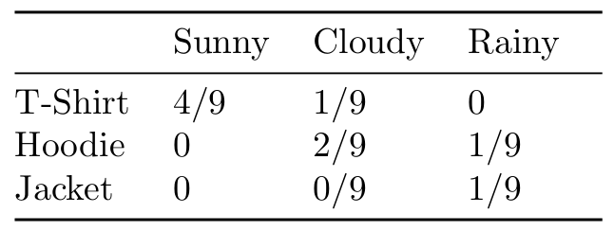
Joint Probability Distribution
If both random variables are discrete, we can represent the joint distribution as a simple table of probabilities.
For example, let’s consider the joint distribution of which outer garment I wear with the weather conditions
P(clothes=T-Shirt, weather=Sunny) = ?

Slide 51

Marginal Probability Distributions
Let’s look at the sum rule:
The term P(x) is called the marginal probability distribution, since we’ve “marginalized” away the random variable y.
Let’s use the sum rule to calculate the probability I’ll wear a hoodie. P(Hoodie) = P(Hoodie, Sunny) + P(Hoodie, Cloudy) + P(Hoodie, Rainy) = 3/9.
If P(x, y) was a joint distribution over continuous random variables, then to marginalize out y we turn the summation into an integration over y just like before

Slide 52

Conditional Probability
We denote the conditional probability distributions of x given y as:
In other words, if I’ve observed that y=y, then the probability that x=x is P(x, y)/P(y)
Why does observing y change the probability of x?
Well, imagine you saw me walk inside with a jacket on. Knowing that I’m wearing a jacket gives you information about the weather without observing the weather directly.

Slide 53
Conditional Probability
By multiplying both sides of the last equation by P(y) we get the chain rule of probability, P(x, y) = P(x|y) ⋅ P(y).
The chain rule can be generalized to joint distributions with any number of random variables: P(x, y, z) = P(x|y, z) ⋅ P(y, z) = P(x|y, z) ⋅ P(y|z) ⋅ P(z).

Slide 54
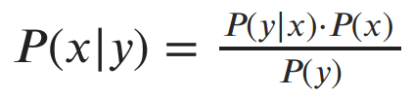
Bayes’ Rule
Notice that we can write the chain rule for two variables in two equivalent ways: P(x, y) = P(x|y) ⋅ P(y) and P(x, y) = P(y|x) ⋅ P(x)
Then the Bayes’ rule:

Slide 55
Independence and Conditional Independence
在前一個衣服/天氣的範例中，P(x|y) ≠ P(x)，this indicates that the random variables x and y are not independent of each other
P(x|y) = P(x, y) / P(y)
若 x and y are independent，則 P(x, y) = P(x) ⋅ P(y) [寫成 x ⊥ y ]
即 P(x|y) = P(x) if x and y are (statistically/ stochastically) independent

Slide 56
Independence and Conditional Independence
A similar concept is that of conditional independence.
Two variables x and y are called conditionally independent given another variable z if P(x, y|z) = P(x|z) ⋅ P(y|z)
根據 wiki 的說法：x and y are conditionally independent [given z] if and only if, given knowledge of whether z occurs, knowledge of whether x occurs provides no information on the likelihood of y occurring, and knowledge of whether y occurs provides no information on the likelihood of x occurring.

Slide 57
Independence and Conditional Independence
Example: Weather and delays
Let the two events be the probabilities of persons A and B getting home in time for dinner, and the third event is the fact that a snow storm hit the city. While both A and B have a lower probability of getting home in time for dinner, the lower probabilities will still be independent of each other.
That is, the knowledge that A is late does not tell you whether B will be late. (They may be living in different neighborhoods, traveling different distances, and using different modes of transportation.)
However, if you have information that they live in the same neighborhood, use the same transportation, and work at the same place, then the two events are NOT conditionally independent.

Slide 58
Independence and Conditional Independence
Example: Height (身高) and vocabulary (同一個人所知道的字彙)
Height and vocabulary are dependent since very small people tend to be children, known for their more basic vocabularies.
But knowing that two people are 19 years old (i.e., conditional on age) there is no reason to think that one person's vocabulary is larger if we are told that they are taller.

Slide 59
Statistical Learning Approaches
對機率有了基本了解之後，它和機器學習有什麼關係呢？
For example, given a sample of observation (X) from a domain (x₁, x₂, x₃, …, x_{n}), where each observation is drawn independently from the domain with the same probability distribution (so-called independent and identically distributed, i.i.d., or close to it).
由於有 n 筆資料，這是一個 joint probability distribution，因此是乘法（之後會轉成加法）

Slide 60
Statistical Learning Approaches
一般從統計來說，我們的工作就是 selecting a probability distribution function and the parameters of that distribution that best explains the observed data (X).
選哪一個distribution呢？我們可以選擇 Gaussian for features like temperature or height, exponential for features regarding time, like length of phone calls or the life of bacterial populations, or Poisson for features like the number of houses sold in a specific period of time
不過，在機器學習，我們對這個 distribution function 或稱 function，直接認定為 unknown target function。

Slide 61
Statistical Learning Approaches
Machine learning, specifically supervised learning, can be described as the desire to use available data to learn a function that best maps inputs to outputs.
Called function approximation, where we are approximating an unknown target function (that we assume exists) that can best map inputs to outputs on all possible observations from the problem domain.

Slide 62
Statistical Learning Approaches
An example of a model that approximates the target function and performs mappings of inputs to outputs is called a hypothesis in machine learning.
The choice of algorithm (e.g. neural network) and the configuration of the algorithm (e.g. network topology and hyperparameters) define the space of possible hypothesis that the model may represent.
Learning is a search through the space of possible hypotheses for one that will perform well, even on new examples beyond the training set.
這裡的 hypothesis 跟傳統統計的說法不同

Slide 63
Statistical Learning Approaches
但是要如何判斷哪一個 hypothesis “can best map inputs to outputs on all possible observations from the problem domain”？
Two common approaches:
Maximum a Posteriori or MAP for short is a Bayesian-based approach.
Maximum Likelihood Estimation (MLE), a frequentist method.

Slide 64
Statistical Learning Approaches
假設我們想利用分類器來判斷一封 email 是否是 spam email (y)
假設我們認為如果一封信 X 包含多於五個黑名單上的字或者信的內容少於二十個字的信都非常可能是 spam email.
因此，”多於五個黑名單上的字”是第一個特徵（feature），常見的表達方式有：f₁(X)、x₁、h_{p1}（最後這一種用法是課本的，不常見）
“信的內容少於二十個字”是 f₂(X)、x₂、或者h_{p2}
課本的說法似乎有錯

Slide 65
Statistical Learning Approaches
從機器學習的角度來看，假設我們選擇了 linear model（我們在未來幾章就會提到有哪些常用的 models；每一種用來解決一個 model 的 algorithm 和 configuration 都是一個 hypothesis），則我們以下列 equation 來代表：
y = θ₀ + θ₁ x₁ + θ₂ x₂
假設我們使用 logistic regression 這個 algorithm，而經由訓練而得出一組 {θ_{i}} ，這組 {θ_{i}} （+logistic regression）可以視為一個 hypothesis

Slide 66
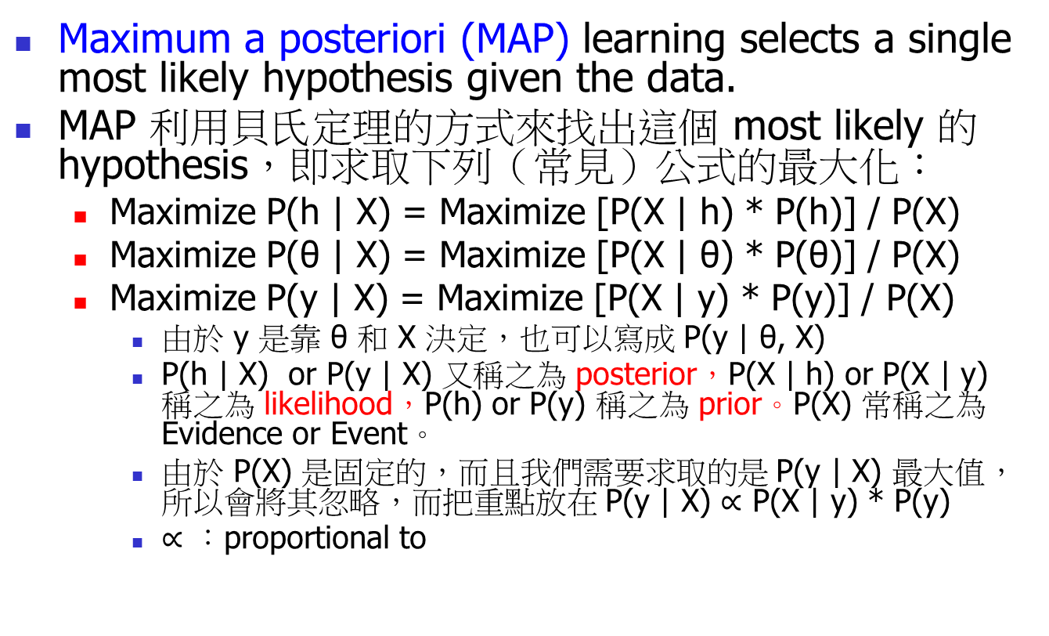
Statistical Learning Approaches
Maximum a posteriori (MAP) learning selects a single most likely hypothesis given the data.
MAP 利用貝氏定理的方式來找出這個 most likely 的 hypothesis，即求取下列（常見）公式的最大化：
Maximize P(h | X) = Maximize [P(X | h) * P(h)] / P(X)
Maximize P(θ | X) = Maximize [P(X | θ) * P(θ)] / P(X)
Maximize P(y | X) = Maximize [P(X | y) * P(y)] / P(X)
由於 y 是靠 θ 和 X 決定，也可以寫成 P(y | θ, X)
P(h | X) or P(y | X) 又稱之為 posterior，P(X | h) or P(X | y) 稱之為 likelihood，P(h) or P(y) 稱之為 prior。P(X) 常稱之為 Evidence or Event。
由於 P(X) 是固定的，而且我們需要求取的是 P(y | X) 最大值，所以會將其忽略，而把重點放在 P(y | X) $∝$ P(X | y) * P(y)
$∝$ ：proportional to

Slide 67
Statistical Learning Approaches
That is, argmax_{yi} P(y_{i} | X) = argmax_{yi} P(X | y_{i}) * P(y_{i})
y₁ = spam, y₂ = not-spam
ex. P(spam | X) = 0.6, and P(not-spam | X ) = 0.4
then, max P(y_{i} | X) = 0.6 而 argmax P(y_{i} | X) = spam.

Slide 68
Statistical Learning Approaches
Maximum-Likelihood Estimation (MLE):
We can write down (or choose) a model for our data in terms of probability distributions.
Next, we can write down a function over the parameters of our model which outputs the likelihood (or log-likelihood) that those parameters generated our data.
The purpose of MLE is to find the maximum of that function, i.e. the parameters θ which are most likely to have produced the observed data.
We arrive at an optimization problem dependent on θ

Slide 69
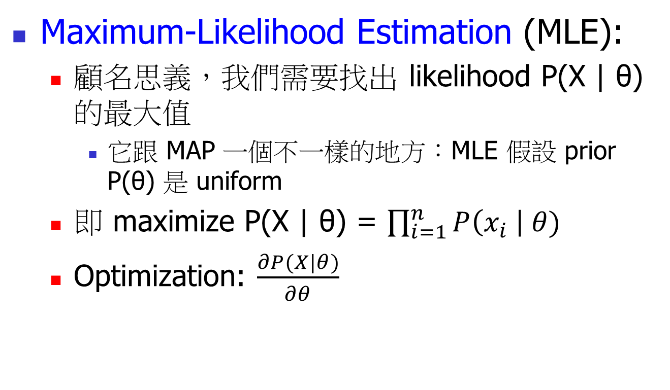
Statistical Learning Approaches
Maximum-Likelihood Estimation (MLE):
顧名思義，我們需要找出 likelihood P(X | θ) 的最大值
它跟 MAP 一個不一樣的地方：MLE 假設 prior P(θ) 是 uniform
即 maximize P(X | θ) = $\prod_{i=1}^{n}{P\left(x_{i} \right| θ)}$
Optimization: $\frac{∂P(X|θ)}{∂θ}$

Slide 70
Statistical Learning Approaches
Maximum-Likelihood Estimation (MLE):
以之前的範例而言，即 argmax_{yi} ∏_{k} P(x_{k} | y_{i})
因為 P(x_{k} | y_{i}) _{yi} 的值相當小，多個小的值相乘很容易接近零，而算不出任何有意義的結果，因此會加上 log 把它變成加法，也就是定義 L(x_{k}; y_{i}) 是 log-likelihood function，則
L(x_{k}; y_{i}) = argmax ∑ log P(x_{k} | y_{i})

Slide 71
Statistical Learning Approaches
為了計算方便，也有從計算最小值的角度來看，即 argmax ∏ P(x_{k} | y_{i}) → argmin 1 / ∏ P(x_{k} | y_{i})
取 log 之後，轉換成 argmin ∑ -log P(x_{k} | y_{i})
這就成了找最小值，這也是為什麼許多機器學習的方法利用 gradient descent 找最小值的原因

Slide 72
Outline
Why
Data formats
Learnability
Statistical Learning Approaches
Elements of Information Theory

Slide 73
Elements of Information Theory
entropy 又稱 Shannon entropy （Shannon 是所謂的 information theory 之父）
它最原始（訊號處理）的說法：希望能找出一個 encoding 的方式能夠使用最少的資訊量而把所需要訊息傳出去。

Slide 74
Elements of Information Theory
如果出現機率都相同，而總共有八種訊息，我們最小的訊息量就是 3 個 bits（ie. 2³）
H(X) = - 8 * 1/8 * log₂ 1/8 = 3
如果出現機率不同，例如出現第一種訊息的機率是 ½，而其他訊息出現的機率都是 1/14。
H(X) = - ½ * log₂ ½ + -7 * 1/14 * log₂ 1/14 =
~= ½ + ½ * 3.8 ~= 2.4

Slide 75

Elements of Information Theory
何謂 cross-entropy?
由於 y 和 ŷ 各有各的 probability distribution，而我們的目標就是希望 y 和 ŷ 的 probability distribution 越相似越好
用來衡量兩個 probability distribution 相似性（similarity 或者 distance）的就是 cross-entropy.
若 p for y and q for ŷ，則 p 和 q 的 cross entropy 定義如下：

Slide 76
Elements of Information Theory
在 logistic regression 和 neural network 中，若 cross entropy 被視為 loss function，
從前一個範例中我們知道：若 p(x) 和 q(x) 相同，則 cross entropy 最小

Slide 77
Elements of Information Theory
除了 cross entropy，另一種常見的方法稱之為 KL Divergence。它基本上就是結合 entropy 和 cross entropy，其公式如下：

Slide 78
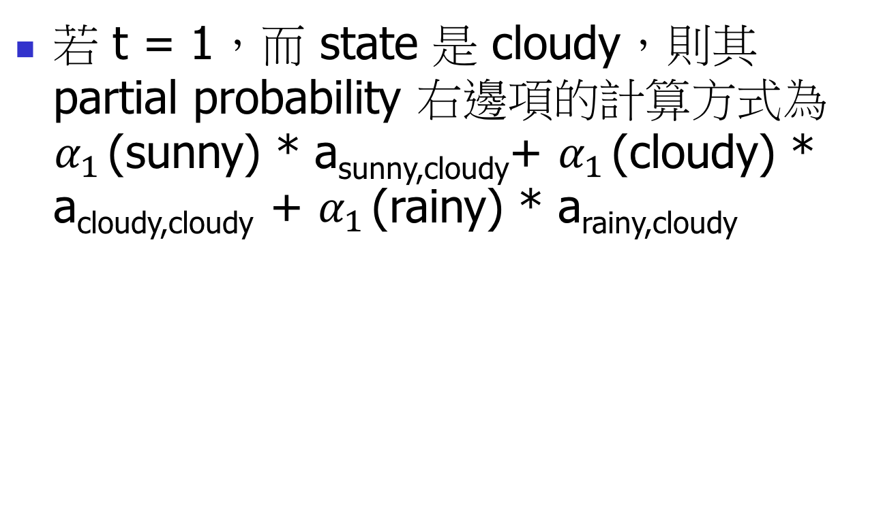
Reference
【機器學習】偏差與方差之權衡 Bias-Variance Tradeoff
What does PAC learning theory mean?
How to analyze “Learning”: Short tour of Computational Learning Theory
What is a Hypothesis in Machine Learning?
A Gentle Introduction to Maximum Likelihood Estimation and Maximum A Posteriori Estimation

Slide 79
Reference
Probability Learning: Maximum Likelihood
Understand Bayes Theorem (prior/likelihood/posterior/evidence)
How Bayes’ Theorem is Applied in Machine Learning
StatQuest: Probability vs Likelihood
What is “entropy and information gain”?
Shannon entropy in the context of machine learning and AI

Slide 80
References
Probability Theory: Fundamentals of Machine Learning (Part 1)
Fundamentals of Machine Learning (Part 2): Maximum Likelihood Estimation
Could someone explain conditional independence?

