Slide 1
Tizen 3.0(ish)
Jack Hess

Slide 2
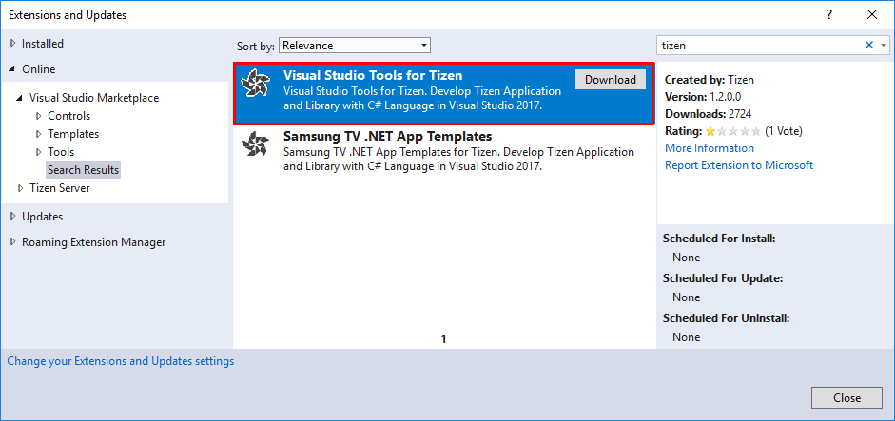
Installing the SDK
Visual Studio 2017**
Tizen Extension for VS
https://developer.tizen.org/development/visual-studio-tools-tizen/installing-visual-studio-tools-tizen#install
In VS IDE Menu: Tools → Extensions and Updates → Visual Studio Marketplace
Search Tizen
If you cannot find it, go here:
https://marketplace.visualstudio.com/items?itemName=tizen.VisualStudioToolsforTizen
Update your to Java JDK 8
JDK 9 will be supported soon.
https://developer.tizen.org/development/visual-studio-tools-tizen/installing-visual-studio-tools-tizen#install
**It states that VS 2017 is necessary, however, I don’t think you need it. Tizen Studio is all I used for this**

Slide 3
Emulator Setup
Similar to Android Studio Emulator
For Windows 10+ OS, we need to disable Hyper-V
“Intel® Hardware Acceleration Execution Manager (Intel® HAXM) speeds up the Tizen emulation on Intel-VT-enabled systems. The Intel® HAXM installation is started automatically as part of the Visual Studio Tools for Tizen installation. ”
Start → Settings → Apps & Features → Scroll all the way down
→ Programs and Features → On the left, Turn Windows Features on or off
→ Uncheck Hyper-V
Reboot the computer.
https://developer.tizen.org/development/visual-studio-tools-tizen/installing-visual-studio-tools-tizen
More Emulator Help:
https://developer.tizen.org/zh-hans/development/tizen-studio/native-tools/running-and-testing-your-app/emulator?langredirect=1

Slide 4
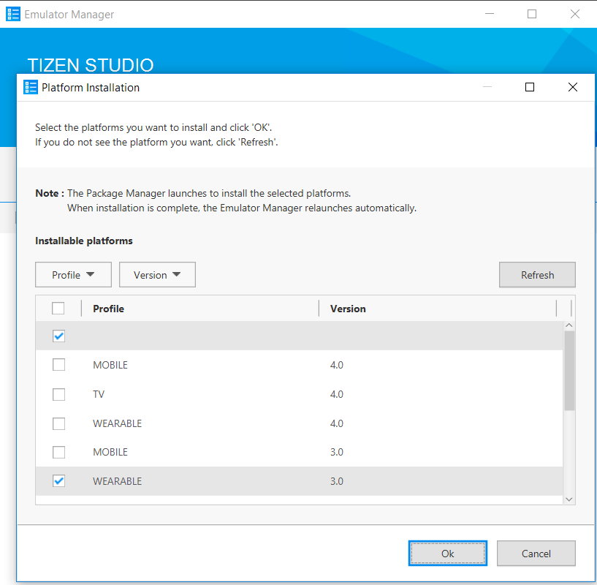
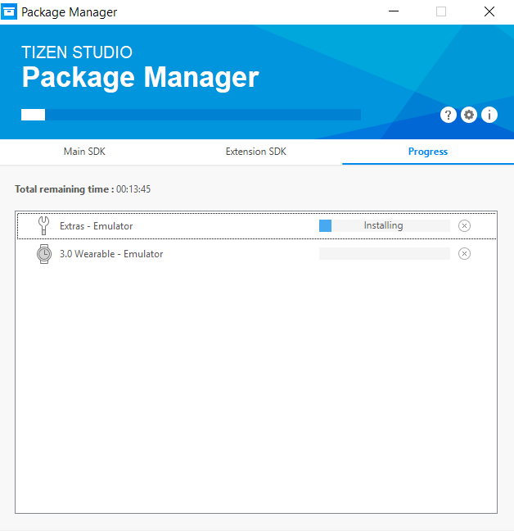
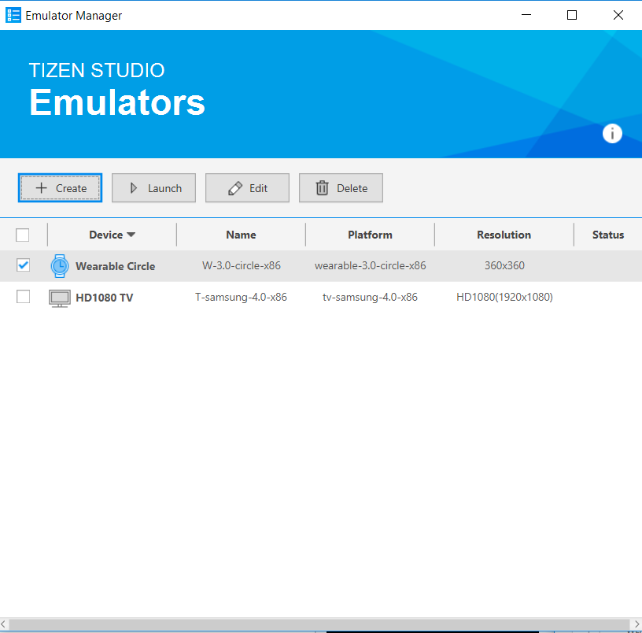
Emulator Setup (2)
Creating the Emulator
It’ll ask if you want to launch the emulator
Launch if you want
At least the first time, it’ll install what it needs

Slide 5

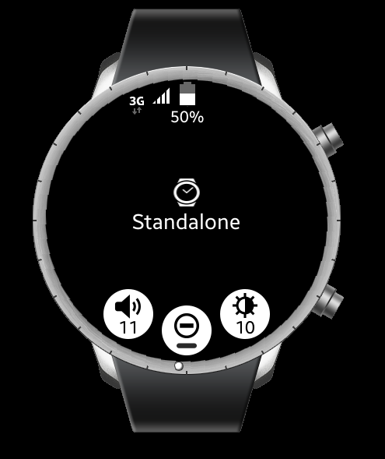
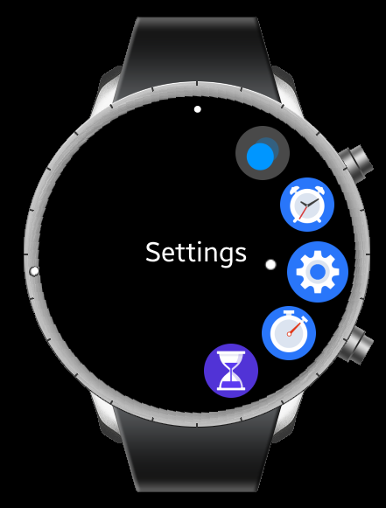
Emulator
Swipe down
→
Press These buttons
Press these buttons

Slide 6

Let us do something
https://i0.wp.com/cannonballread.com/wp-content/uploads/2015/06/9415570.png?ssl=1

Slide 7
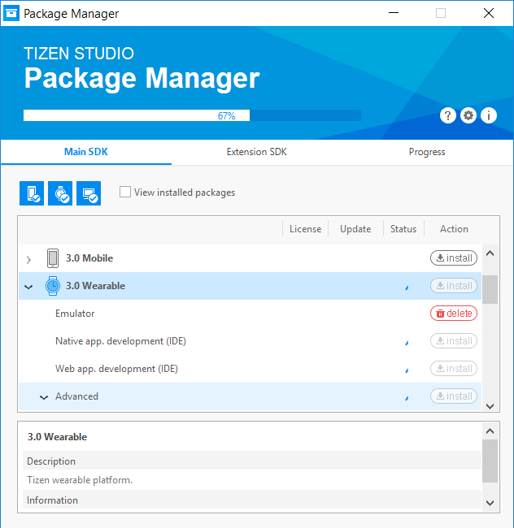
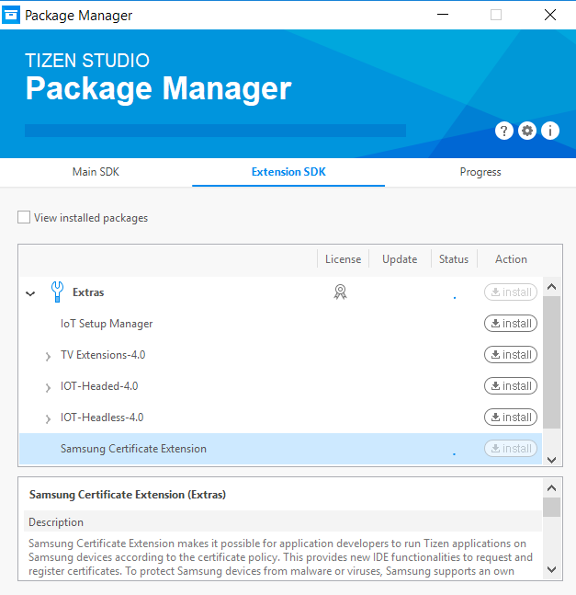
Tizen Studio: Package manager
Open the Package Manager and select the device you would like and click install
This takes a while. Just a heads up!
Failed the first time, had to force quit and do the install again.
Select Samsung Certificate Extension
I also setup all the Tizen SDK tools

Slide 8
Creating a certificate
https://developer.samsung.com/z/develop/getting-certificates/create

Slide 9
Privilege level
https://developer.tizen.org/ko/development/training/native-application/understanding-tizen-programming/security-and-api-privileges?langredirect=1
<privileges>
<privilege>http://tizen.org/privilege/dpm.security</privilege>
</privileges>
</manifest>

Slide 10
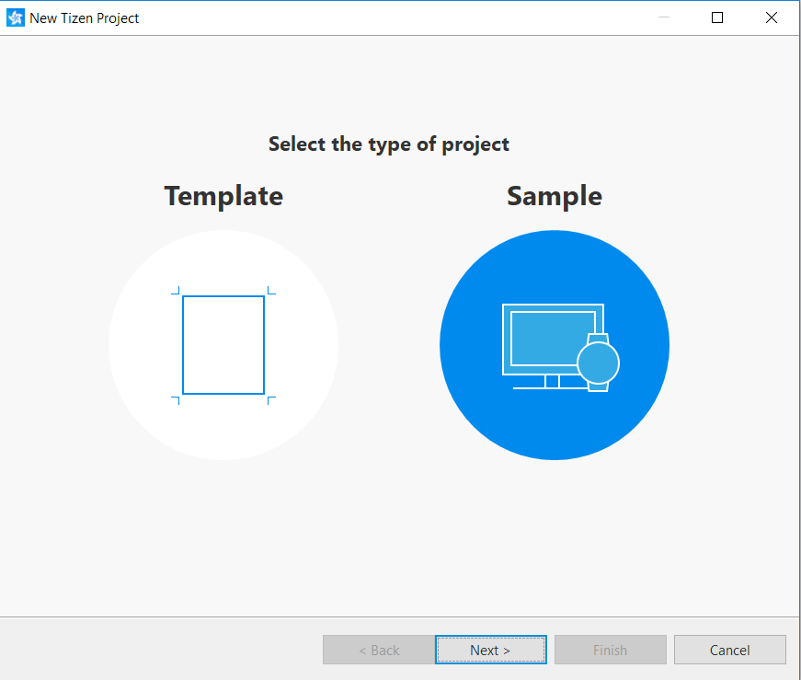
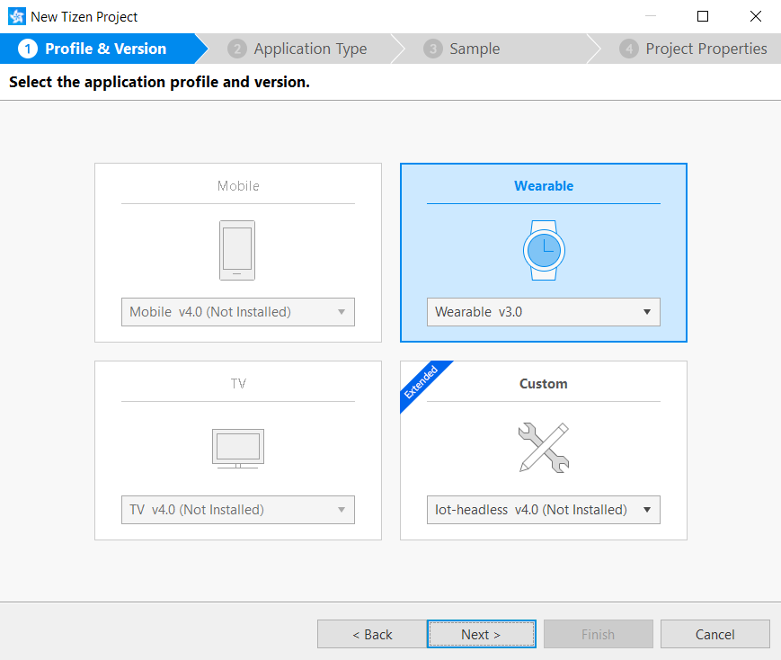
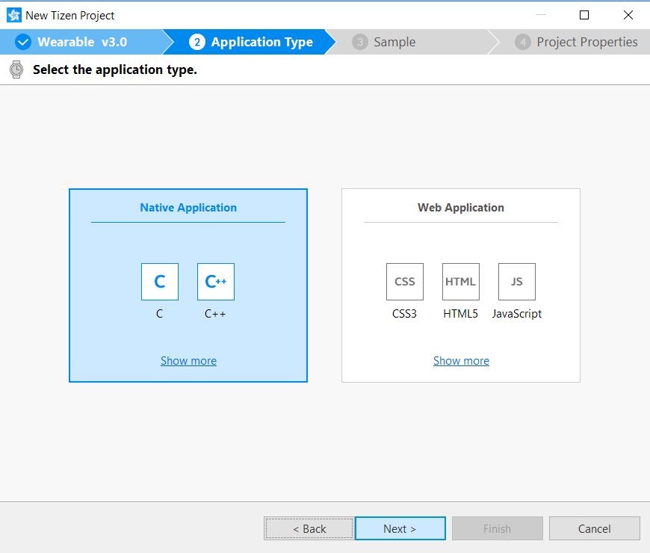
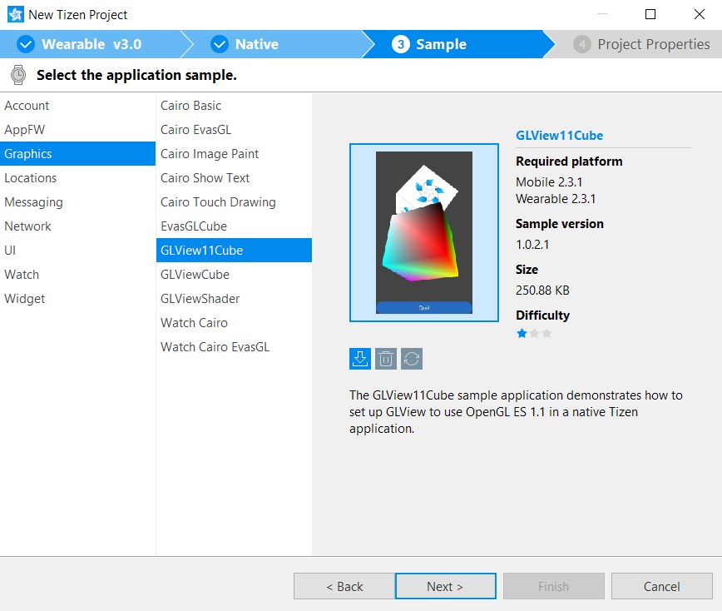
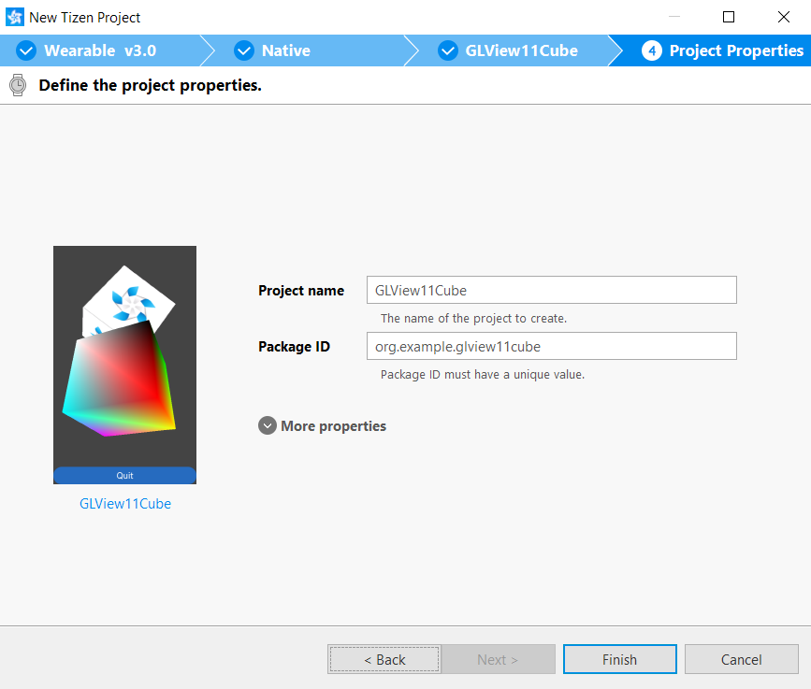

Slide 11
Using an actual tizen device
https://developer.samsung.com/gear/develop/testing-your-app-on-gear
This has the general how-to
Settings → About Gear → Debugging
Connect VIA Bluetooth if needed
**I don’t believe this is necessary
Get the IP address of the device
Settings → Connections → Wi-Fi → Wi-Fi Networks → Select Network
IP Address

Slide 12
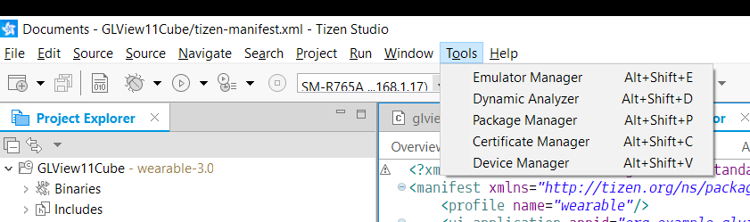
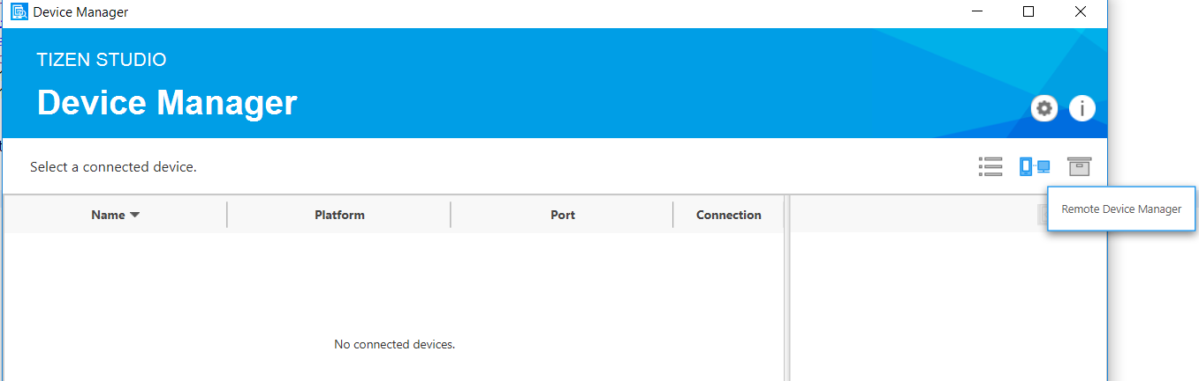
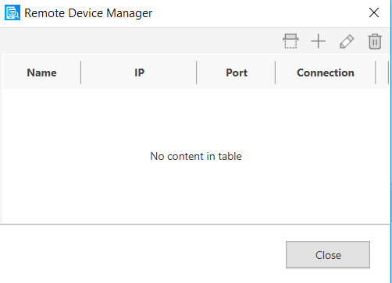
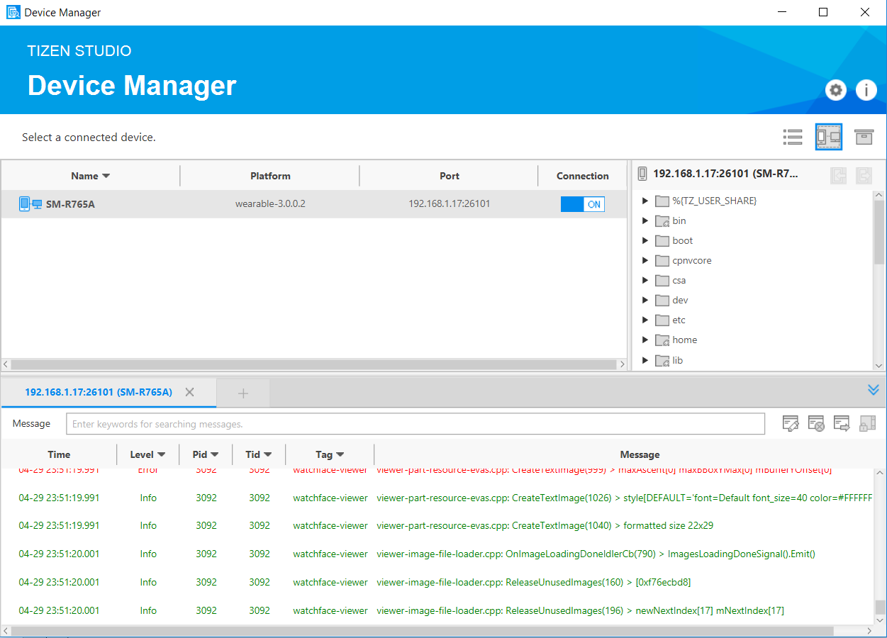
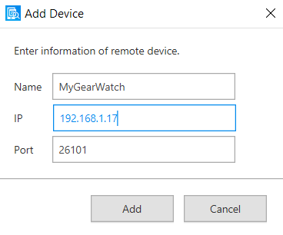
Connecting to the Device

Slide 13
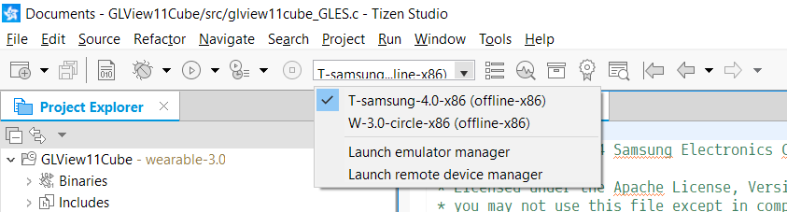
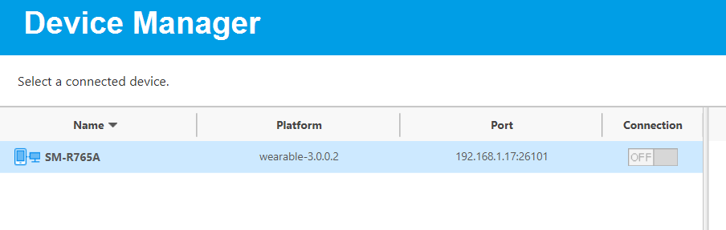
Getting the app to the device

Slide 14
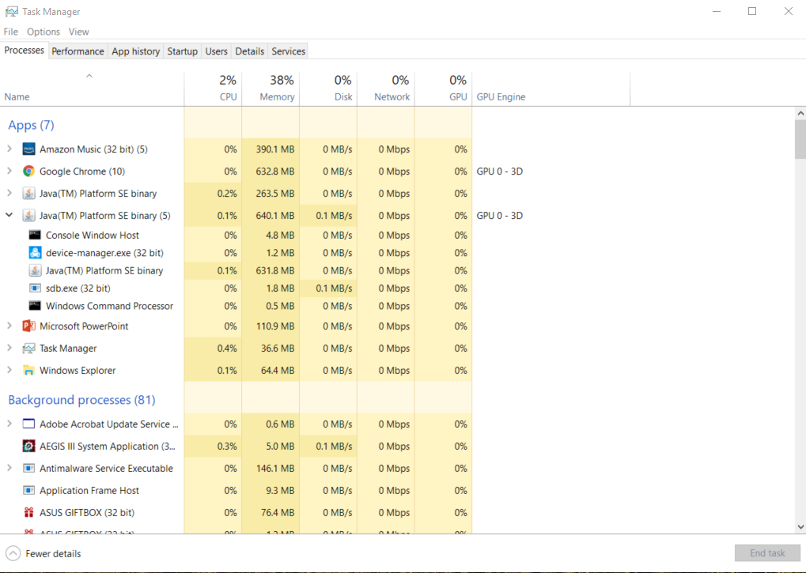
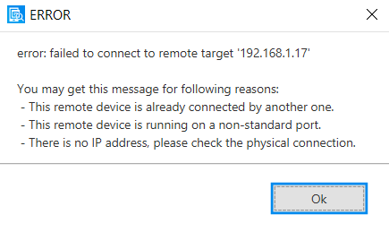
Getting the App to the device
End this task!

Slide 15
Getting the APP on the device
That may not work!
Turn the Wi-Fi off for the device, and try again.

Slide 16
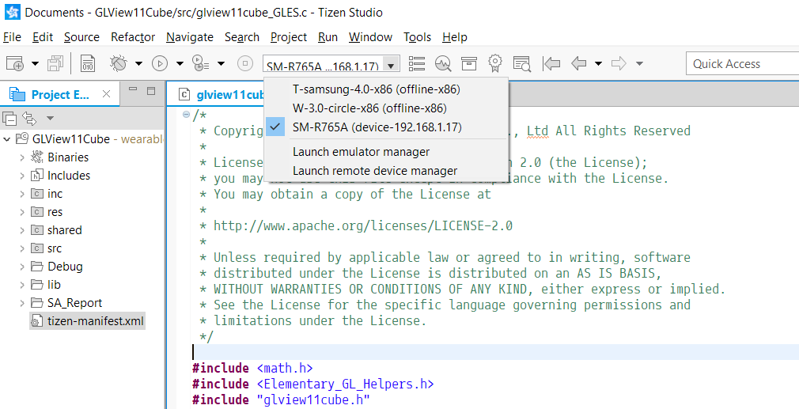
Getting the app on the device
Look for your device
If it’s found, and online, run the program

Slide 17
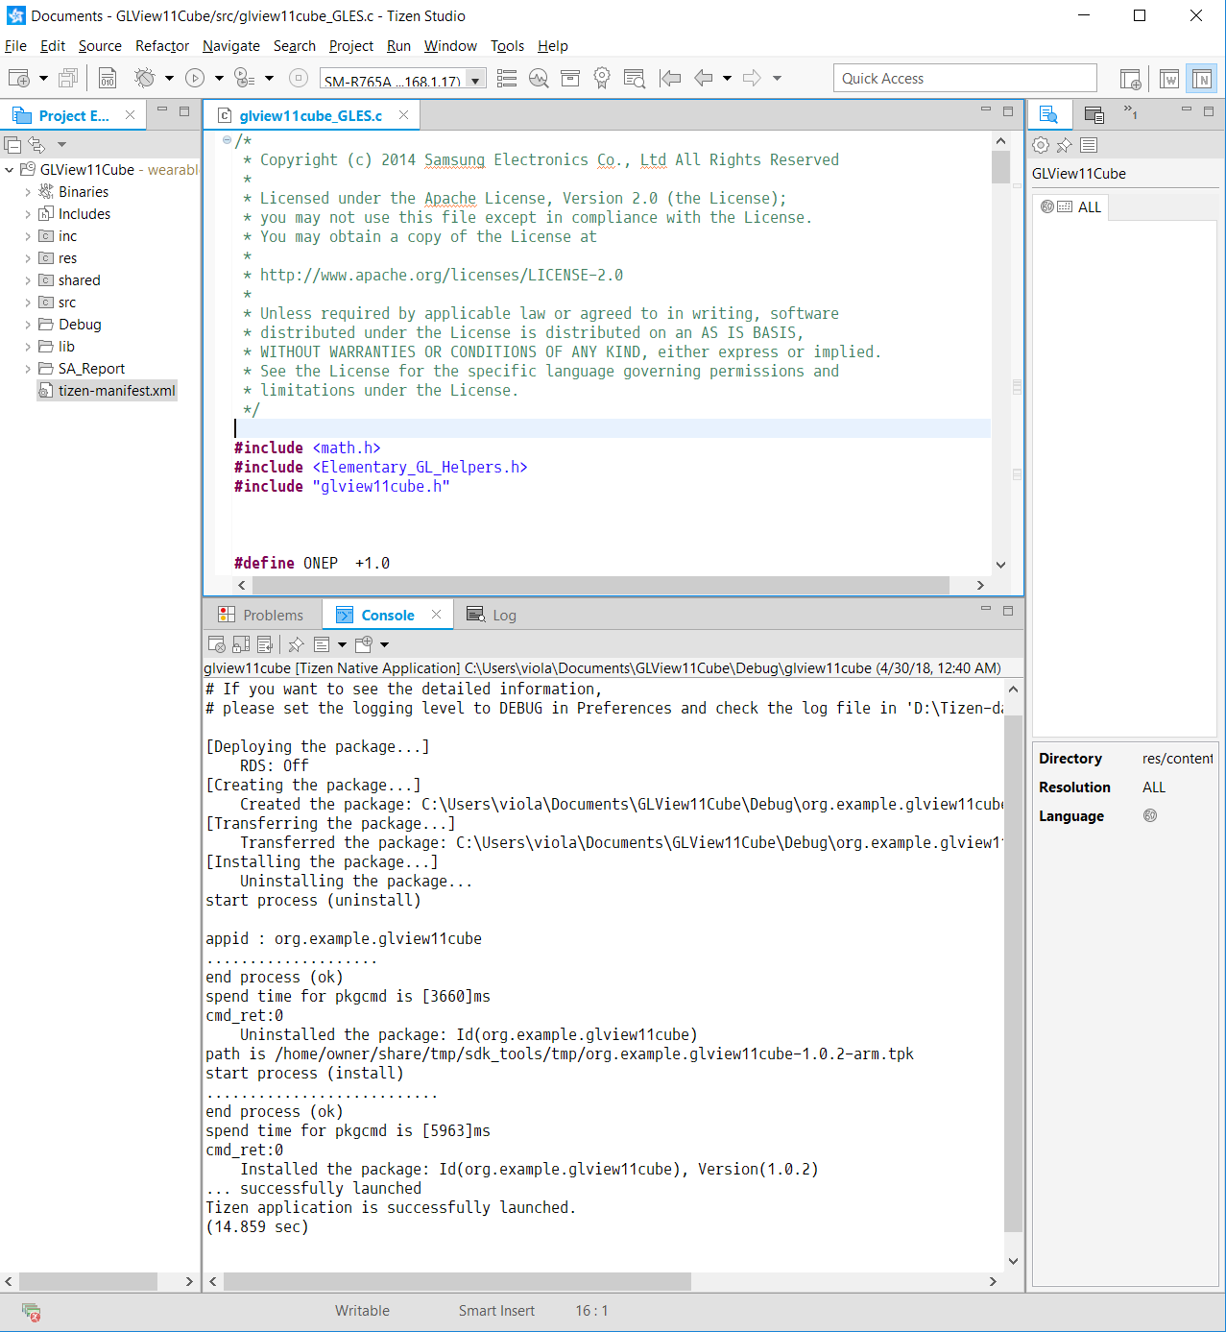
Getting the app on the device

Slide 18
Show the live demo!

Slide 19
More Cool stuff
https://developer.tizen.org/development/training/native-application/getting-started/creating-your-first-tizen-wearable-native-application#create
The Project is located:
https://github.com/w1ck3l/TizenPresentation/tree/master

