Slide 1
Using Reinforcement Learning and Algorithmic Techniques to Develop Strategies for Tournament-Style Backgammon Matches
Will Farmer
Computer Science (Level 3)
9/12/2024

Slide 2
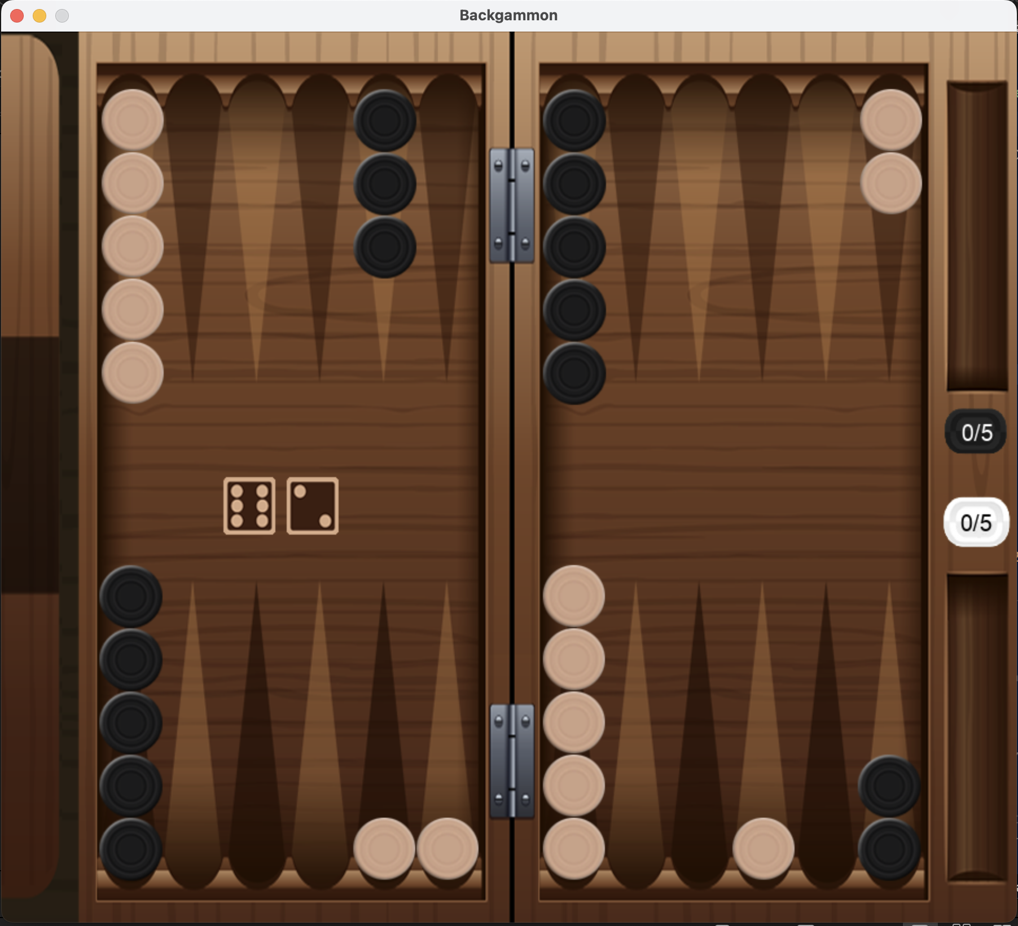
What is Backgammon?
A Two-player zero-sum probabilistic game
Both players attempt to move their pieces around the board into their ‘home’
First player to move all their pieces into their home and bear the pieces off the board wins
Moves are dictated by the dice rolls

Slide 3
Motivation
All popular backgammon algorithms focus on winning individual games
Backgammon is played in a first-to format, where the victor is the first player to reach the score limit
You can strategize for a better point return by using the Doubling Cube, or aiming to win by gammon or backgammon, which yield additional points

Slide 4
Motivation
Tesauro’s TD-Gammon is almost 20 years old and is still the leading Backgammon AI
A reinforcement learning model focused on winning individual games
Uses heuristic doubling algorithm
Model didn’t include information about backgammons
Is it possible to make a model that performs better in tournament-style matches?

Slide 5
Deliverables
Basic
Random Agent
Robust Game Environment
Graphical User Interface (GUI)
Intermediate
Greedy Agent
Genetic Agent
Ant Colony Agent
Advanced
Reinforcement Learning Agent
Machine Learning Agent
Agent that changes strategy based on state of the game

Slide 6
Robust Game Engine
Critical to ensure the deep learning and reinforcement learning agents are trained on accurate rules of the game so that they don’t make illegal moves
Allows the simulation of real-life backgammon games
Allows for direct comparison between different agents
Confirmed by viewing and playing hundreds of games with no illegal moves or errors

Slide 7
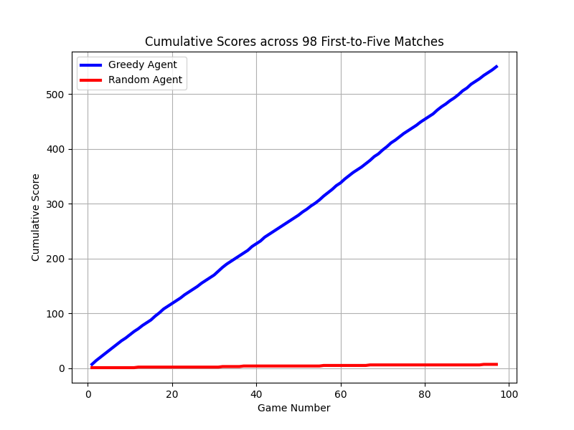
Random Agent
Generates random integers until they form valid moves
Developed to test the robustness of the game engine and provide a beginner-level opponent for user and baseline testing
Helped locate errors with rolling doubles, entering and bearing off
Loses convincingly against any opponent
Final Score: 545-0
Rounded Average score: 6-0

Slide 8
GUI
Extremely useful for viewing games and analysing decisions
This has been vital in debugging various issues with agents
Especially with the Greedy Agent
Allows humans to play agents without knowledge of backend program, paramount for user testing
Allows for direct comparison between different agents

Slide 9
Greedy Agent
Scores each possible resulting board
Utilises 17 hard-coded weights and nested conditional statements
In the case where multiple resulting boards have the same score, a tiebreaker occurs.
Tiebreaker was introduced to remedy unintended bias
Always chooses the predefined best move
No lookahead
Completed before all other intermediate deliverables
They would require features present in the Greedy Agent’s code

Slide 10
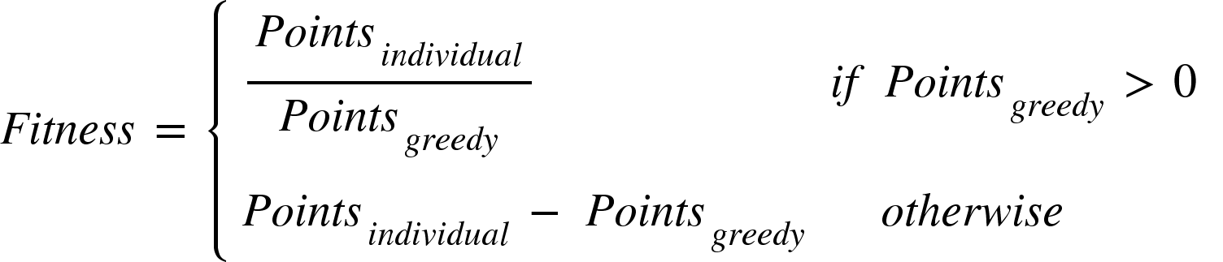
Genetic Agent
All the nested conditions from the greedy agent were flattened
Initial population has randomly generated weights
Fitness is determined by first-to-five matches of the individual vs the greedy agent:
All individuals with a fitness greater than 5 then coevolve against each other in first-to-25 matches until only one remains.
Remaining individual is then chosen to be the genetic agent

Slide 11
Expectimax Agent
The agents checks which move is theoretically worst for the opponent and plays it
Uses the greedy agent’s evaluation function to score each of the opponent’s possible follow-up moves
Then chooses the move that minimizes the score of the opponent’s follow-up

Slide 12
Agent Head-to-Head Performance
Expectimax vs Greedy across 5000 games
2436-2574 wins.
Expectimax vs Genetic across 1000 games
431-569 wins
Genetic vs Greedy across 10,000 games
5478-4522 wins
3157-3898 final score
567-898 final score
7401-6068 final score

Slide 13
Adaptive Agent
Utilises different strategies at different phases of the game
Turn 1 uses the Greedy evaluation function
In a bear-off race uses Matussek’s game-winning-chance formula for optimally bearing-off and positioning checkers
If high risk of being gammoned, moves furthest piece back
Otherwise uses 30-parameter equity calculation to board strength and game-winning-chance
If equity tie, uses one-move lookahead to probabilistically make best move
Notes:
https://bkgm.com/articles/Matussek/BearoffGWC.pdf?utm_source=chatgpt.com

Slide 14
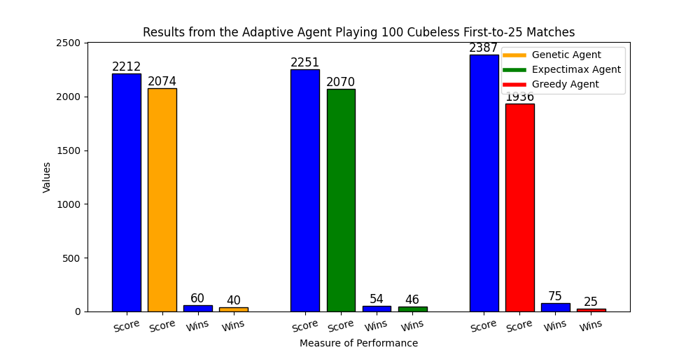
Performance of the Adaptive Agent

Slide 15
Adaptive Agent Doubling
Uses theoretical formula in conjunction with its equity calculator to make doubling decisions

Slide 16
Deep Agent
Utilises Deep Neural networks
Trained using Supervised Learning on expert preferences
GNUBG
Was initially trained to output an estimated value for the state on Mean Squared Error loss
Small inaccuracies led the model to perform poorly in practice even with low MSE loss
Later trained to output a preference between two board states and was trained on Binary Cross Entropy loss
Huge increase in performance

Slide 17
Deep Agent
Initially had 1 general-purpose model but had identifiable weaknesses
3 networks for different types of position
Initial general-purpose network for contact positions
Bear-in network for getting pieces home when in a race
Bear-off network for bearing pieces off the board when home
Different network structure

Slide 18
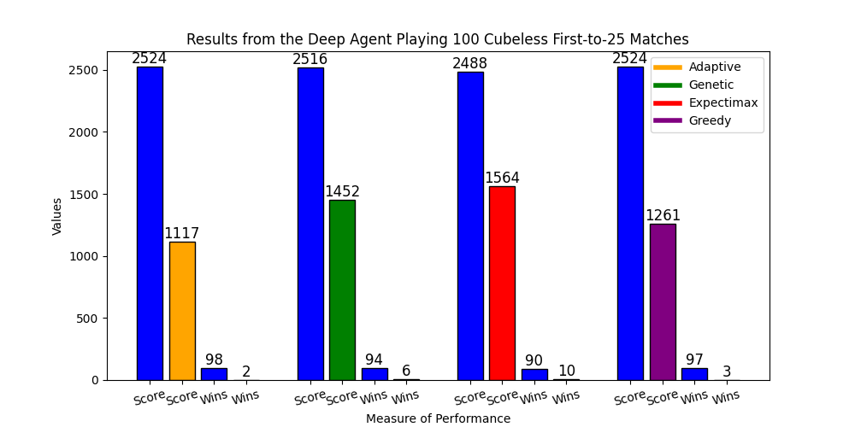
Performance of the Deep Agent

Slide 19
Deep Agent Doubling
Contact doubling network has same structure as contact move-decision network
Doubling network for race positions has same structure as bear-in and bear-off move-decision networks

Slide 20
Reinforcement Agent
Uses Temporal-Difference(lambda) learning
Trained in hundreds of thousands of games playing against itself
Rudimentary board encoding without any precomputed features
Uses 2-ply selective lookahead to minimise the impact of counterplays while maximising equity
Uses Deep Agent’s doubling strategy

Slide 21
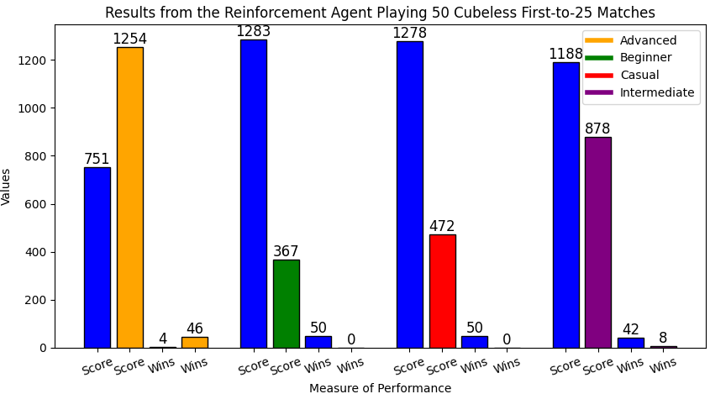
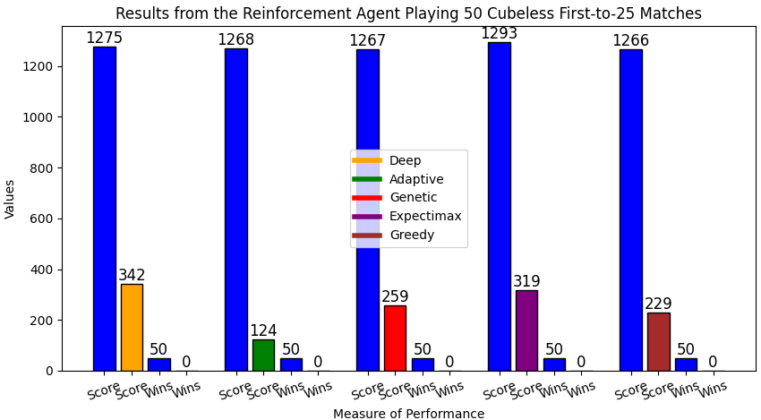
Performance of the Reinforcement Agent
Achieves advanced-level play
Far superior to all other agents presented in this project

Slide 22
Evaluation of Agent move selection
Reinforcement agent outperforms TDGammon 1.0
Both were trained on self-play and a similar board encoding
Deep Agent has dramatically higher accuracy than Neurogammon on bear-in and bear-off positions but slightly lower accuracy on contact positions

Slide 23
Evaluation of Agent Doubling Strategies

