Slide 1

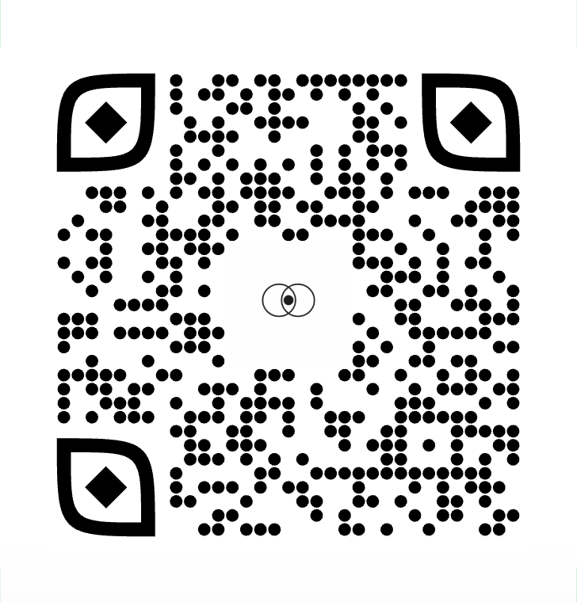

Slide 2

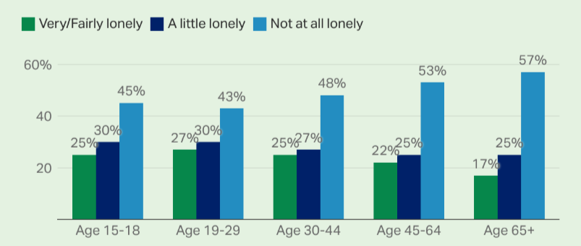
Identifying the Problem
Many traditional social structures are beginning to deteriorate, leaving many people to experience loneliness and social fragmentation
circle co.

Slide 3
Our Target Market
Our primary market is recent college grades who have moved into a new location due to new employment
These recent graduates will be in a new environment, around new people, and will benefit from the expansion to their social network and opportunities to meet others
circle co.

Slide 4
Introducing Circle
Circle is a digital platform revolutionizing how people connect
All in one platform people can
Find fun local events
Meet people with similar interests
Maintain friendships built through our app
circle co.

Slide 5
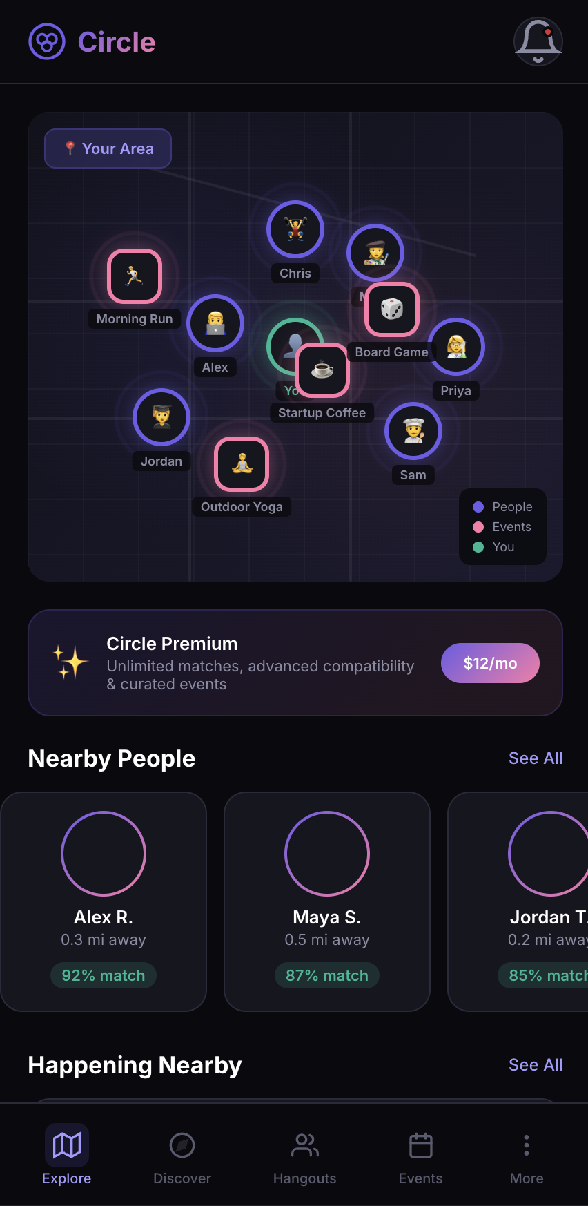
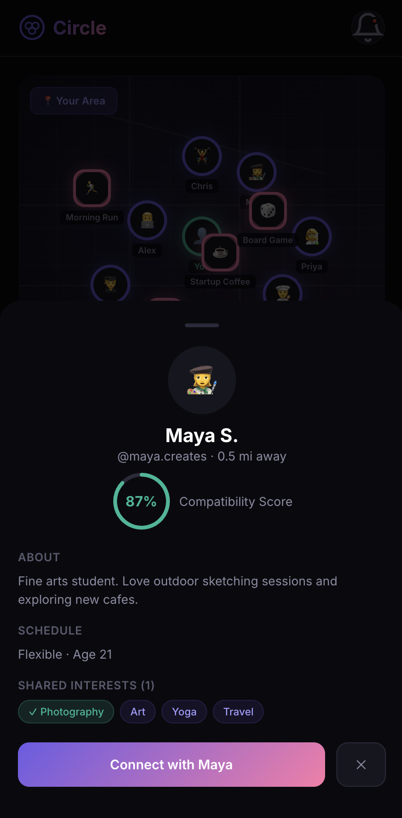
Seamless UI
Detailed information at a glance
circle co.

Slide 6
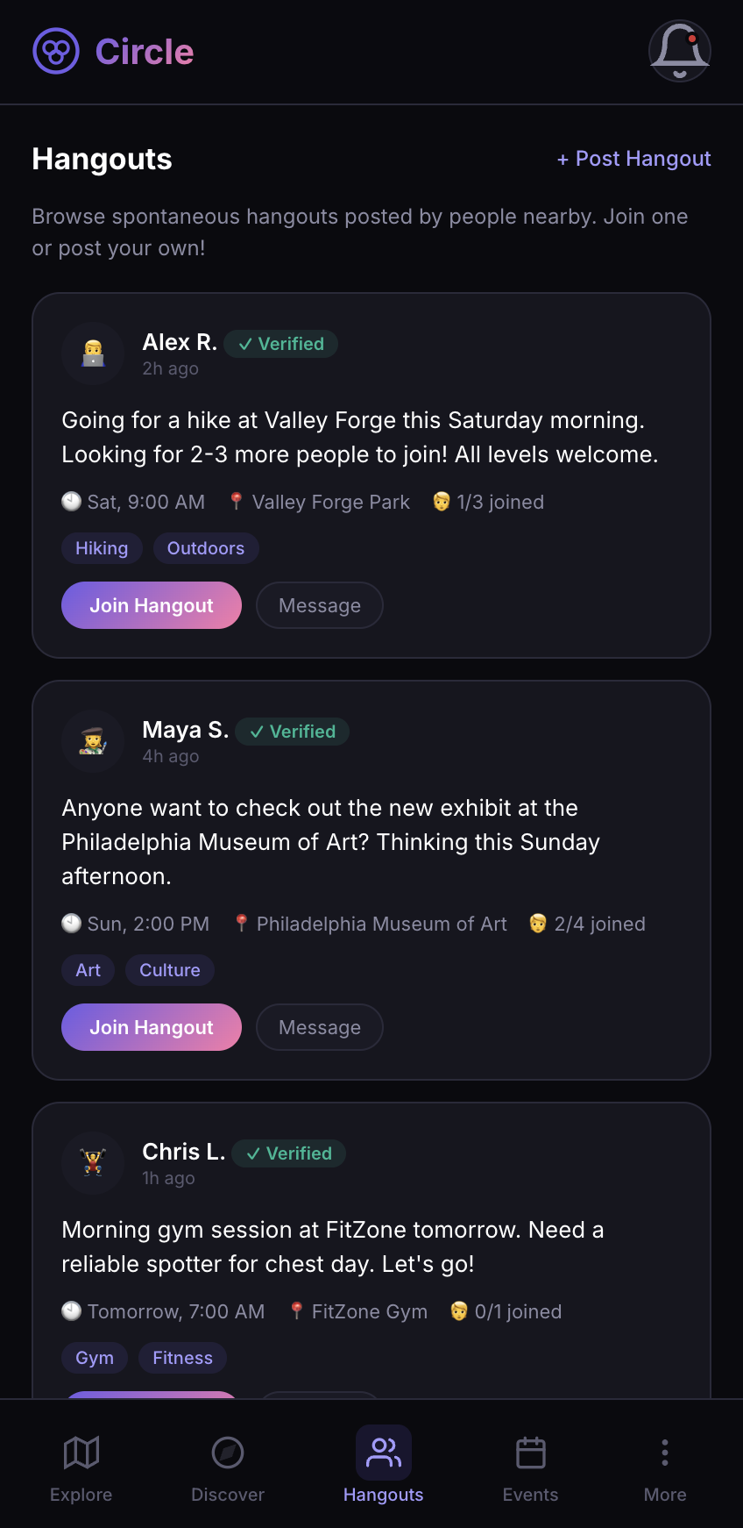
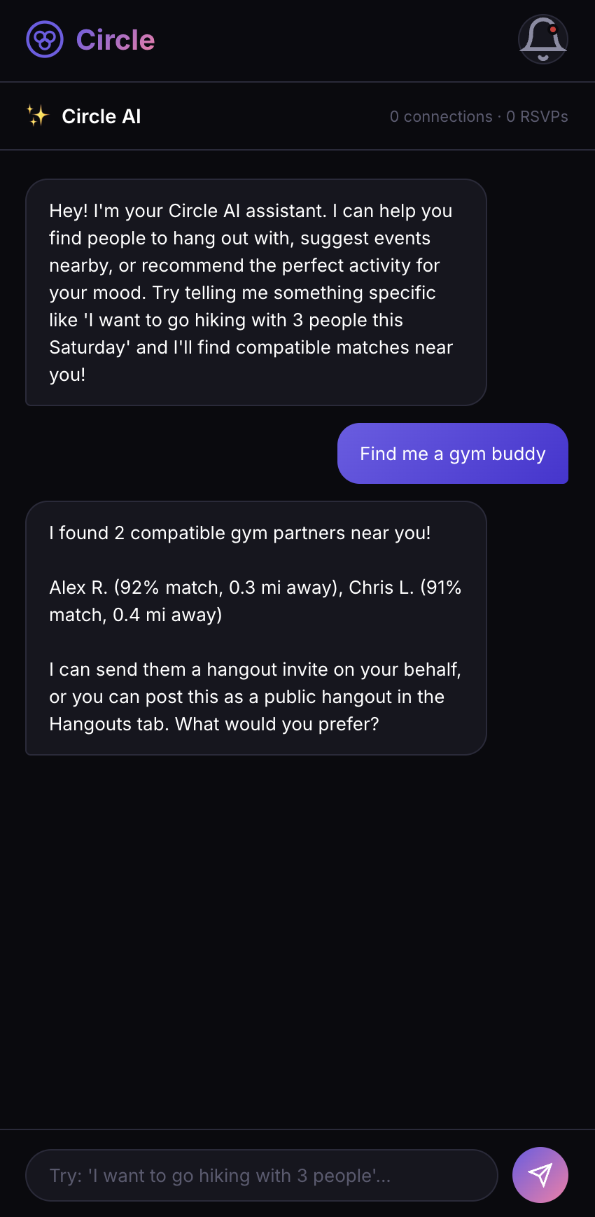
Nearby Hangouts
Personalized-AI Assistant
circle co.

Slide 7
What Makes us Stand Out:
Circle | Other platforms
Specific Communities Join people that graduated from your college or people that work at the same company as you User based postings Individuals can make posts when they want to hang out with different people, not just companies running promotions | Just event postings
circle co.

Slide 8
Revenue Stream From B2C
Customers will pay $12 a month to unlock premium features like
AI assistant
Unlimited access to communities
We expect 380,000 premium customers by year 5
circle co.

Slide 9
Revenue Stream From B2B
Companies will purchase sponsored posts, promoting events like
Trivia night
Happy hour special
Holiday discounts
We expect $7,999,950 in revenue by year 5
circle co.

Slide 10
Critical Assumptions
People will engage with the platform
People will connect in real app through the app
A city by city launch can reach a target audience so it feels active and not empty.
People will keep coming back to the app
People will want to pay for the premium version
Businesses will want to advertise on our app
circle co.

Slide 11
VALUATION & EXIT
Meta (Instagram)
Snap
Strava
Eventbrite / Meetup
Target exit: Years 4–6
5–8x Revenue multiple (consumer social SaaS)
At Year 5 projection (~$65M+ revenue):
→ $325M – $520M valuation range
circle co.

Slide 12
Customer Feedback
We met with two mentors that gave us valuable insights on how to move forward.
Showcased our app to around 20 individuals in our target audience
Everyone that we interviewed had positive reviews with app and expressed interest
circle co.

Slide 13
