Slide 1
A07 Manual CNN
Hayden Wood, Joshua Herold, Jade Sanchez

Slide 2
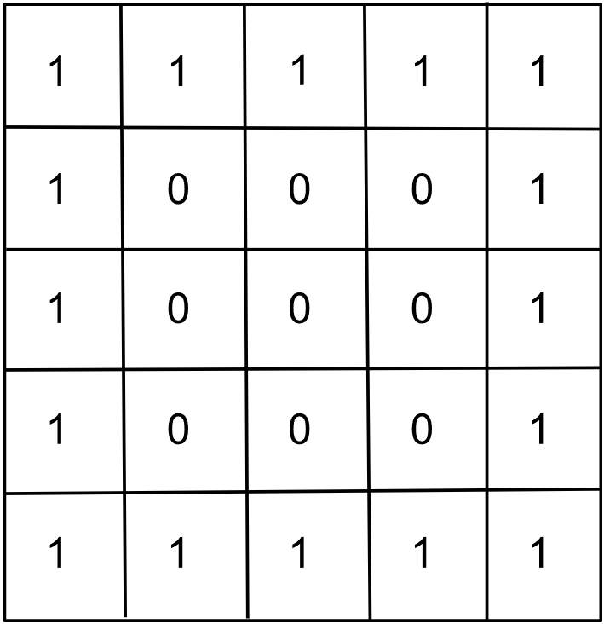
Our Image
Made with the Google Docs “Drawing” function. We made a simple square using the zeroes.

Slide 3
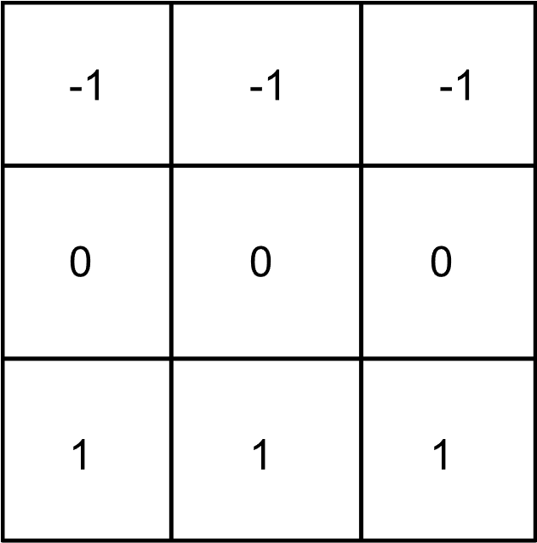
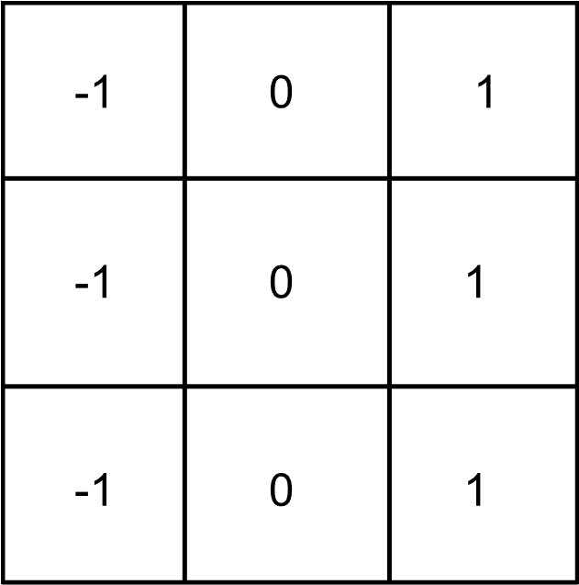
Filters
Horizontal Edge Detector
Vertical Edge Detector
The horizontal filter detects changes along the horizontal direction. It highlights areas where there are horizontal edges, like the top and bottom edges of a shape.
The vertical filter detects changes along the vertical direction. It emphasizes vertical edges, such as the left and right sides of an object.

Slide 4
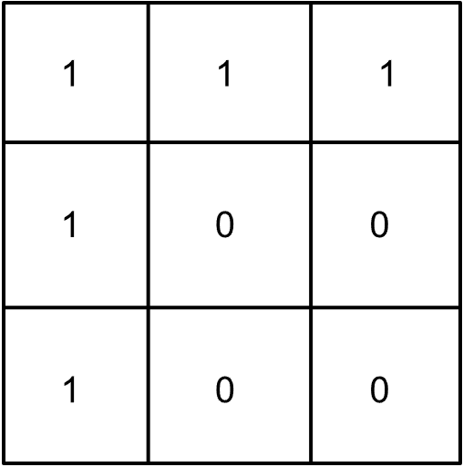
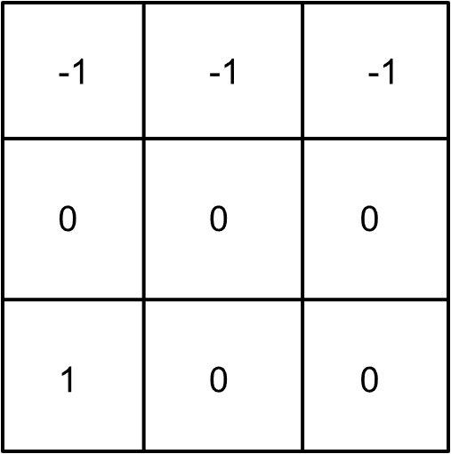
Horizontal Filter Results
1 of 6
Before
After
After applying the horizontal filter it detected strong horizontal edges at the top and bottom of the square, indicated by the values in the first and last rows.
Convolution Results:
[ -2 -3 -2]
[ 2 3 2]

Slide 5
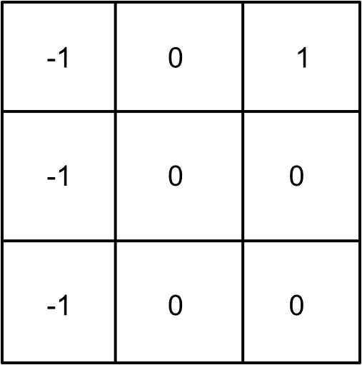
Vertical Filter Results
1 of 6
Before
After
After applying the vertical filter it detected strong vertical edges on the left and right sides of the square, indicated by the positive values in the first and last columns.
Convolution Results:
[ -2 0 2 ]
[ -2 0 2 ]

