Slide 1
Machine Learning Pipeline Overview
Data loading, cleaning, and preprocessing
Train/test split
Model selection and baseline training
Hyperparameter tuning via GridSearchCV
Evaluation and interpretation

Slide 2
Data Preparation
Handled missing values and encoded categorical features
Scaled numerical features for model stability
Ensured no data leakage during preprocessing

Slide 3
Model Selection
Considered multiple algorithms (Logistic Regression and Random Forest)
Established baseline performance before tuning
Prepared pipeline for GridSearch optimization
Notes:
Grid Search :creating a grid of all possible combinations of parameter values and testing each combination to find the best one. This grid of parameters is defined before the optimization/search step, hence the name grid search

Slide 4
GridSearchCV Results
Systematically searched hyperparameter combinations
Identified the best estimator and parameter set
Improved model generalization and reliability

Slide 5
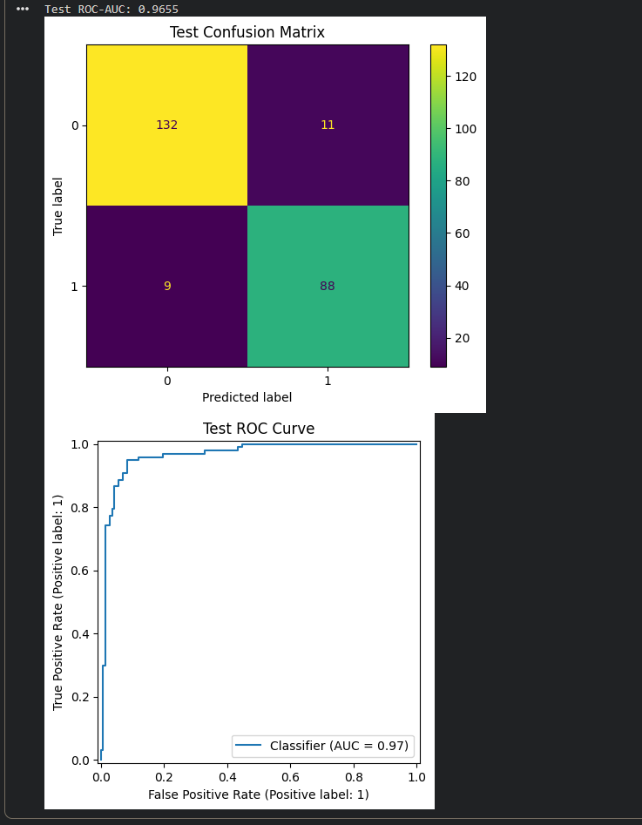
ROC Curve Interpretation
ROC curve visualizes true positive rate vs false positive rate
AUC score indicates overall discriminative ability
Higher AUC = better separation between classes
Notes:
The Random Forest model performed better with a ROC-AUC score of 0.9781, compared to the Logistic Regression model, which achieved an ROC-AUC of 0.9676.
This small difference suggests that the Random Forest, as a non-linear ensemble model, was likely better equipped to capture more complex relationships and interactions within your data than the linear Logistic Regression model.

Slide 6
Confusion Matrix Analysis
Provides insight into TP, TN, FP, FN counts
Helps identify common misclassification patterns
Supports decisions on threshold adjustments

Slide 7
Bias & Deployment Considerations
Evaluated potential dataset imbalance or sampling bias
Considered fairness, transparency, and model drift
Prepared steps for real-world deployment and monitoring

Slide 8
Key Takeaways
Pipeline improves reproducibility and consistency
GridSearch significantly enhances performance
Interpretability tools guide trustworthy deployment
Continuous monitoring essential post-deployment

