Slide 1




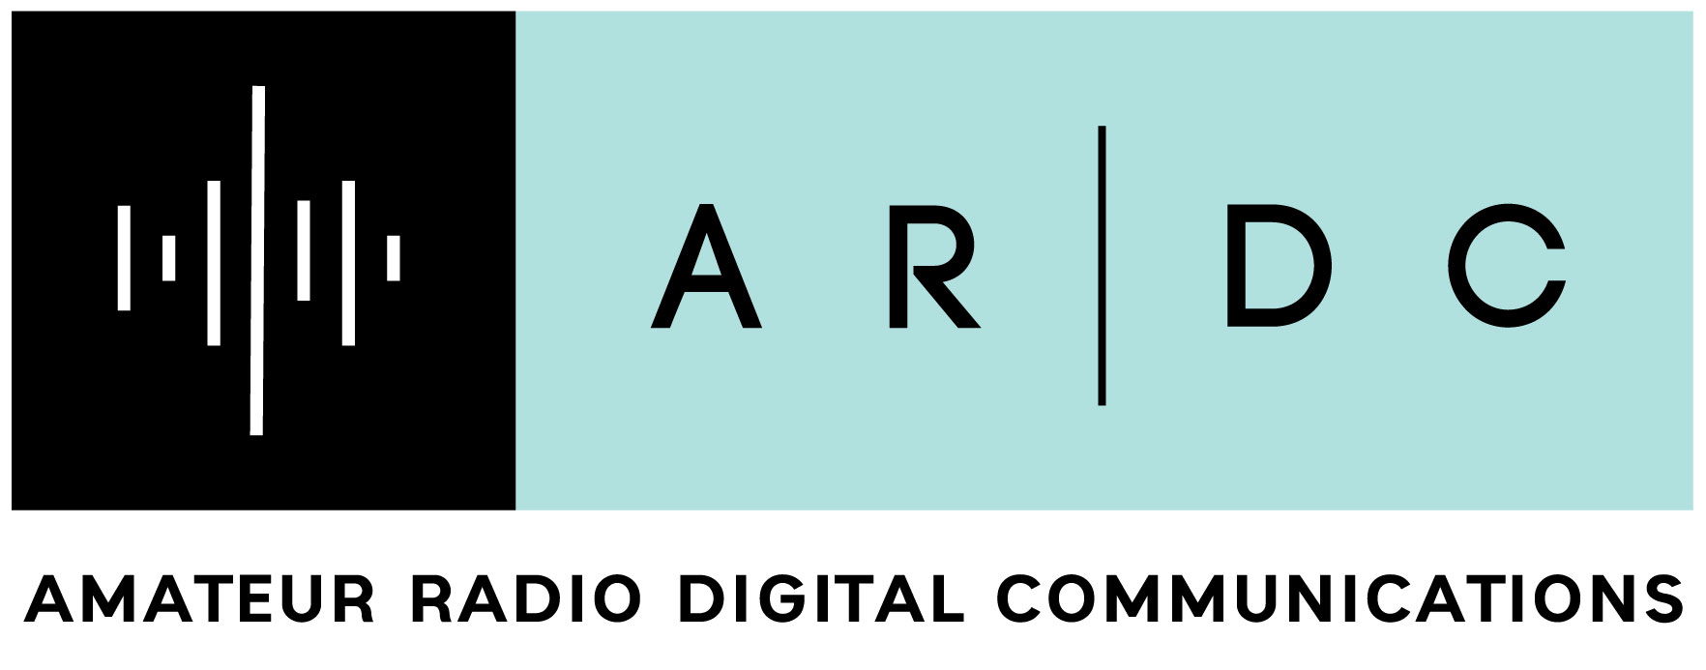
The Communications Revolution, 1775–1848
Charlie Cebula, AC2ZU
From his tri-fold exhibit “The Communications Revolution” · Part 1 of 3
THE COMMUNICATIONS REVOLUTION
The communication revolution from 1775 to 2020 transitioned from physical, print-based media to instant, global digital connectivity. It evolved through four major stages: the revolutionary press and postal systems, the 19th-century electric telegraph, early 20th-century mass media (radio/TV), and the internet-driven digital information age
COMMUNICATIONS
REVOLUTIONARY WAR AND WAR OF 1812
1775-1818
Beginnings of the Communications Revolution
1820-1848
Documents and Publications
Pamphlets and Broadsides: Distributed widely to inform and persuade the public about revolutionary ideas.
Common Sense: Thomas Paine's influential pamphlet that argued for independence and rallied support among colonists.
The Declaration of Independence: A formal statement that articulated the colonies’ grievances and justified their break from Britain.
Letters and Essays: Writings by influential figures like John Adams and Benjamin Franklin that spread revolutionary sentiments.
Newspapers: Local and colonial newspapers published articles and editorials that fostered discussion and unity among colonists.
Committees of Correspondence: Networks that shared information and coordinated resistance efforts across the colonies.
Flags
Flags served as visual signals to convey messages over long distances.
Different colors and patterns represented specific commands or alerts.
Signal flags were used to coordinate troop movements and strategies.
The use of flags allowed for quick communication without the need for written messages.
Naval forces utilized flags to communicate between ships and with shore commands.
The system of flag signaling was crucial for maintaining secrecy and surprise in military operations.
The Birth of the Electric Telegraph
Concept & Development (1832-1835): After learning about electromagnetism, Morse conceived an electric telegraph that used electric impulses to move a marker, recording codes on paper.
Morse Code (1838): Together with partner Alfred Vail, Morse developed a system of dots, dashes, and spaces representing letters and numbers, enabling complex messages to be sent.
Technical Refinements: Vail improved the device by adding weights to the turning key, substituting a stylus for a pencil, and enhancing the recorder.
First Official Line & Message (1844): Morse secured US government funding to build a 40-mile line between Washington D.C. and Baltimore. On May 24, 1844, he sent the first message
Application in the Mexican-American War (1848) First used in military action in the Mexican-American War supporting logistics, and enabling of battlefield updates. This also provided a means to transmit battle progress from Mexico back to the United States as the war progressed.
Future Advantages Recognized: Military Officers recognized the importance of the telegraph and set the stage for it's widespread use in the Civil War.
These Trifolds will cover the following
1775–1800s (Print & Post): The American Revolution was fueled by newspapers, pamphlets (e.g., Common Sense), and committees of correspondence, establishing the press as a critical, politically active force.
1800s–1900s (The Electric Age): The telegraph and telephone eliminated the constraint of distance, turning news and business into real-time endeavors and enabling rapid expansion.
20th Century (Mass Communication): Radio and television created a shared culture, allowing information to reach mass audiences instantly.
1990s–2020 (The Digital/Information Age): The internet democratized information, shifting from one-way communication to interactive social media. Communication became, via smart devices, ubiquitous, mobile, and almost instantaneous.
Pigeons
Pigeons were used as messengers to carry important military communications.
They could fly long distances and navigate back to their home lofts.
The Continental Army utilized trained pigeons for quick and reliable information transfer.
Pigeons helped relay messages during critical battles, enhancing coordination.
Some pigeons were even awarded medals for their service in the war
Bugles and Drums
Drums and bugles were essential for communication on the battlefield.
They signaled commands and movements to troops, especially in noisy environments.
Drummers maintained the rhythm for marching, helping soldiers keep in step.
Buglers conveyed specific messages, such as calls for assembly or retreat.
These instruments fostered morale and unity among soldiers during combat.
They were also used in ceremonies and parades to honor victories and fallen soldiers.
Expansion of the Postal Service
Postal Reform Act of 1845: Faced with declining revenue due to cheaper private express competitors, Congress drastically lowered rates (to 5 or 10 cents based on distance) and strengthened the Post Office's monopoly, which increased volume from 24.5 million letters in 1843 to 62 million by 1849.
Infrastructure Expansion: The use of railroads officially recognized as post roads increased in 1838, accelerating in the 1840s to replace horse-drawn stages in the East.
Connecting the West: The department financed steamship routes through the Isthmus of Panama to reach California and utilized stagecoaches from Tennessee and Missouri, crucial for communication during the western settlement boom.
Crackdown on Private Firms: To regain control, the government passed laws in 1845 restricting private express companies from carrying letters on routes where the U.S. Mail was regularly transported.
International Reach: By the mid-1840s, the Post Office began expanding its network to includeinternational treaties and better services for connecting to foreign locations.
This transformation diminished the importance of distance, allowing for immediate sharing of information and making global connectivity a standard feature of a modern future
Cryptography
Cryptography was employed to secure communications among revolutionary leaders.
Invisible Ink was one method to hide critical messages
Codes and ciphers helped protect sensitive information from British interception.
The use of secret messages facilitated coordination of military strategies.
Encrypted letters allowed for safe communication between distant troops.
Revolutionary pamphlets sometimes used coded language to rally support.
The concept of decentralized communication foreshadowed modern cryptographic practices.
Smoke Signals
Used by Native American tribes and some colonial forces for long-distance communication.
Employed to signal troop movements or alert nearby forces of danger.
Created distinct patterns, colors and puffs of smoke to convey specific messages or codes.
Allowed for quick transmission of information across difficult terrain.
Served as a means to coordinate attacks or retreats without using written messages.
Helped maintain secrecy and avoid interception by enemy forces.
Impact of Steam-Powered Printing (Technological Shift)
Mass Production Capability: Steam-driven presses (such as the two-cylinder press) replaced hand-powered presses, raising production from roughly 125 papers per hour to over 18,000 per hour.
Continuous Production: The shift to printing on continuous rolls rather than individual sheets allowed for rapid, continuous printing.
Reduced Unit Costs: Increased speed drastically reduced the cost per paper, making it financially viable to sell papers for only one cent.
Resulting Impacts: Improved communication of news for the public at reasonable cost (ie. Like the Penny Press)
hamsci.org
Part 1 of 3

