Slide 1




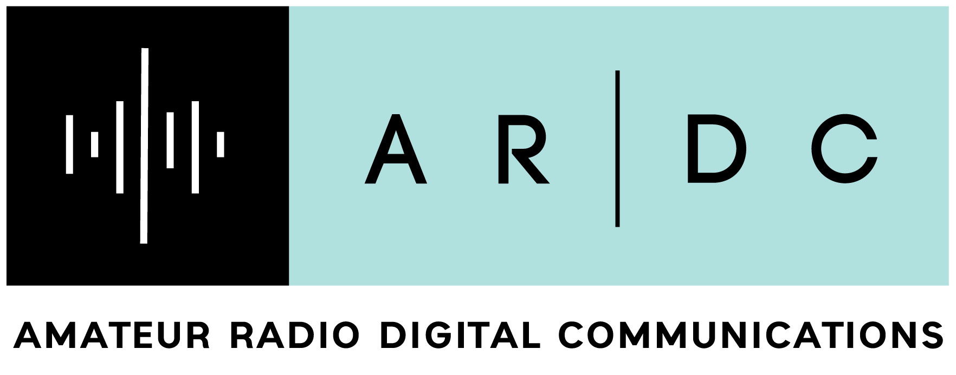
The Communications Revolution, 1850–1940
Charlie Cebula, AC2ZU
From his tri-fold exhibit “The Communications Revolution” · Part 2 of 3
1850 -1870
1880-1910
1910-1920
1920-1940
The Telegraph Age
Expansion: Telegraph lines became commonplace, connecting cities and supporting business with speed.
Civil War Use: Expansion of the telegraph network makes President Lincoln to implement and utilize to gain situational awareness of the battlefield and issue orders during the Civil War. The telegraph played a major role in the success of the Union and culminating in the end to the Civil War.
Semaphore Flag Signaling: Developed and implemented by BG Myers during the Civil War and complemented Telegraph Use where telegraph lines were unavailable (1860s)
Transatlantic Cables (1858, 1866): The first successful, lasting transatlantic cable was completed, connecting Europe and America, making communication nearly instant.
Commercial Growth: Western Union was established and monopolized the US industry, overseeing a vast network of hundreds of thousands of miles of telegraph lines.
Professional Use: The US Department of State adopted the telegraph for diplomacy (1866).
Wireless Telegraphy/Radio (1890s–1900s)
Guglielmo Marconi began experimenting with radio in 1894, transmitting signals over longer distances.
Nikola Tesla develops patent for Tuned Circuit and Antenna forming the basis for wireless receive and transmit capabilities
Nikola Tesla demonstrates the first use of remote control by inventing and demonstrating a remote control boat at Madison Square Garden, NYC
In 1901, Marconi transmitted the first radio signal (the letter 'S') across the Atlantic Ocean.
In 1908, Lee de Forest broadcasted music from the Eiffel Tower, demonstrating the potential for audio transmission.
Wireless Telegraphy and Radio Advancement
Wartime Radio Expansion: World War I forced rapid advancements in radio technology, moving it beyond specialized nautical use to critical military application
The “Regenerative” Circuit (1913) is invented and tested by Edwin Armstrong at Marconi Wireless Station in Belmar NJ. The circuit significantly increased the amplification of radio signals by 5000 times using feedback
The "Superheterodyne" Circuit (1918): Inventor Edwin Armstrong developed the superheterodyne receiver, which drastically improved the sensitivity and selectivity of radio receivers, setting the standard for future radio technology.
Voice Transmission: Following the first long-range voice transmission in 1906, voice broadcasting continued to mature throughout the 1910s, laying the foundation for commercial radio.
Wartime/Radar and Radio Technology
Frequency Modulation (FM)
Major Edwin Armstrong invents Frequency Modulation (FM) circuit and patents in 1933. FM utilizes a limiter and discriminator that eliminates static noise making communications clear a crisp. Armstrong gave US Government patent rights during WWII resulting fielding of reliable clear communications equipment
RADAR (Radio and Direction Finding)
1935/1939: Sir Robert Watson-Watt developed the first practical radar system (1935), leading to the British "Chain Home" radar network to detect aircraft/sea vessels by 1939.
1940: The resonant-cavity magnetron was perfected, significantly increasing radar power and allowing for smaller, microwave radar systems
NOTE: 1941: The SCR 271 Radar was fielded in Pearl Harbor by the US Army. It detected aircraft but was not identified as enemy aircraft
Telephony Expansion (1880s–1910)
Following the 1876 patent, telephone exchanges began opening, with rapid growth in the 1880s.
By 1900, there were roughly 600,000 phones in the Bell system, rising to 5.8 million by 1910.
The introduction of the multiplex switchboard in 1887 allowed for faster, more efficient call routing.
Key Themes in 1870s Telephony Research
The Harmonic Telegraph Quest (Early 1870s): Inventors, including Alexander Graham Bell and Elisha Gray, initially aimed to create a "multiple telegraph" to send several messages simultaneously over one wire.
Shift to Voice Transmission (1874-1875): Bell shifted focus from multiple notes to sending vocal tones via variable resistance, realizing electric current could reproduce voice.
The 1876 Breakthrough: On March 7, 1876, Bell was awarded the "master patent" for the electric telephone, which used a diaphragm and electromagnetic signaling to transmit voice.
The Patent Race: Both Bell and Elisha Gray independently developed prototypes and filed documents within hours of each other in February/March 1876, sparking legal battles that Bell eventually won.
Telephone Improvements: In 1878 Thomas Edison patented the carbon transmitter (microphone) that enhanced sound quality for Bell's Telephone
Telephone Network Expansion
Transcontinental Line (1915): The first official transcontinental telephone line was opened, allowing direct voice communication across the United States.
Rapid Adoption: Telephone usage grew rapidly, with the number of phones in the Bell system reaching millions, becoming an essential tool for business and personal communication.
Mass Media and Information
Propaganda & Print: Newspapers and early film industries were utilized to spread government propaganda during WWI, establishing new models for mass communication.
Technological Roles: The era created new professional positions, including thousands of new typists and telegraphers, supporting the industrialization of information.
Television Development (1920s-1930s)
1925/1926: John Logie Baird transmitted the first recognized television signal (1925) and publicly demonstrated the device (1926).
1930s: Experimental television broadcasts began, with regular, limited broadcasting schedules starting in some cities towards the end of the 1930s.
Mass Communication and Office Technology
The widespread adoption of typewriters revolutionized business correspondence.
Advancements in printing technology made mass distribution of newspapers and information faster.
Early Recordings:
Thomas Edison's phonograph, patented late in the 1870s, was refined in the 1880s/90s to become a popular entertainment medium.
Note: These innovations allowed for the rapid growth of large-scale, efficient, and direct communication networks that formed the basis for modern, interconnected global systems.
Advancements in Telephony (1920s-1930s)
1924: Bell Laboratories developed the first two-way, voice-based radio telephone, enabling crucial long-distance maritime and aviation communication.
1930s: The telephone shifted from a luxury to a critical business and personal tool, improving communication between companies and customers.
Audio Recording (Phonography)
1877: Invention of the Phonograph
Thomas Edison invented the phonograph, the first machine capable of recording and reproducing sound (initially on tinfoil)
1878: Demonstration ; The device was perfected at his Menlo Park, NJ laboratory introducing the ability to store audio information
Improvements in Information Technology
1870's: Printing Press Improvements: Technical advancements allowed for faster printing, supporting the rapid spread of news through mass circulation newspapers
1880: Photophone Experimentation: Alexander Graham Bell and Charles Tainer invented the photophone in 1880 which transmitted voice via light beams = a precursor to fiber optics
Early Experimental Broadcasting
Amateur to Commercial: While 1920 is considered the official start of commercial radio with KDKA, 1916 marked a critical shift when radio enthusiasts (like Frank Conrad) began transmitting regular, scheduled music programs.
Note: This decade transformed the “job market” with the rise of new positions trained typists and telegraphers to handle the accelerating flow of information . Additionally, this era laid the foundation for the “Golden Age of Radio” that began shortly after the 1920s
hamsci.org
Part 2 of 3

