Slide 1



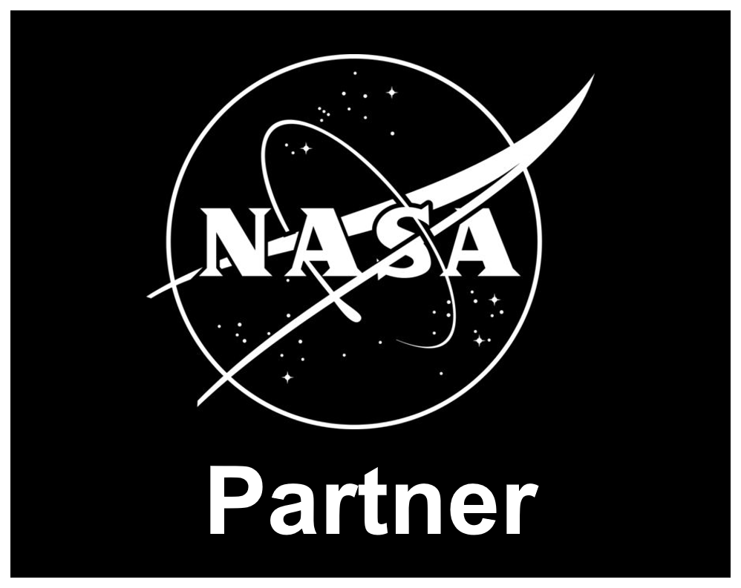

The Communications Revolution, 1940–2020
Charlie Cebula, AC2ZU
From his tri-fold exhibit “The Communications Revolution” · Part 3 of 3
1940-1960
1960-1980
1980-2000
2000-2020
Television Advancements in Communications
Wartime Freeze (1940-1945): Television development took a back seat to WWII. Manufacturing shifted to military equipment, stalling the industry.
The 1941 Milestone: In 1941, the US implemented the 525-line standard. The first commercial television ad (Bulova watches) aired on July 1, 1941, confirming that advertising would fund the industry.
Postwar Surge (1946-1949): Production began, but in 1946, only about 44,000 homes had a set, growing to over 4 million by 1949.
Technological Advancements: Better camera tubes (image orthicon) improved picture quality after 1945.
Early Programming: The first regularly scheduled programs appeared in 1947, such as Howdy Doody and Meet the Press.
NOTE: Television brought news and entertainment that offered more than just audio with radio in the early part of the 20th Century.
The Dawn of the Internet (Late 1960s - 1970s)
1969 (ARPANET): The U.S. Department of Defense launched the Advanced Research Projects Agency Network (ARPANET), the first node-to-node computer network.
Packet Switching: This technology allowed data to be broken into smaller chunks (packets) and sent over a decentralized network, creating the foundation for the Internet.
1972 (Email): Ray Tomlinson introduced network email, providing the first interpersonal messaging system.
1974 (TCP/IP): Vinton Cerf and Bob Kahn published the design for a Protocol for Packet Network Interconnection, establishing the fundamental architecture for the internet.
1979 (USENET): The first news and discussion groups were formed, marking an early step towards online social networking.
1990–2000: The Internet & Mobility Explosion
The World Wide Web: In 1989, Tim Berners-Lee invented the World Wide Web, which became publicly accessible in 1991, shifting the internet from a research tool to a public medium.
Web Browsers: The 1993 release of Mosaic, the first web browser capable of displaying inline images, made the internet user-friendly, followed by Netscape Navigator.
SMS and Mobile Growth: The first SMS text message was sent in 1992, and by 1999, mobile cellular subscriptions were growing rapidly.
Email and Early Social Media: Email became mainstream in professional environments, and early online platforms like AOL connected consumers.
Personal Computing: Personal computers became a standard feature in U.S. households by 2000, and laptops became more common with models like the IBM ThinkPad in 1992.
Search Engines: The first web search engines, such as Archie, were released, and Google launched in 1998, providing instant access to information.
Mobile Revolution and Smartphone Adoption (2000–2010)
3G Networks (2001): The introduction of 3G, or third-generation mobile networks, enabled faster data transmission, transforming mobile phones from voice-only devices into data-capable tools.
Supported Speeds of 2 Mbps and a latency between 100 to 500 ms, suitable for basic data services
4G Networks (2013): Next generation after 3G offers faster speed and facilitated high- definition video streaming and advanced mobile applications.
Supported speeds of 100 Mbps to 1 Gbps and a latency of 30 ms to 100 ms, enabling faster data transfer and improved user experience..
5G Networks (Beginning in 2019): Provides significantly more speed and reduced latency and enabling IoT, smart cities and autonomous vehicles
Supports speeds exceeding 10 Gbps and aims to reach latencies as low as 1 ms, supporting real-time applications and enhanced connectivity
Expanding the Horizon for Satellite and Space Communications
Project Diana: Jan 1946 US Army Project Diana successfully bounced a radar signal off the moon and back. This accomplishment established that radio signals could penetrate the ionosphere and therefore confirmed the feasibility of launching satellites that could provide reliable communications and opened the door to the space race:
Sputnik Program (USSR, 1957–1958): Sputnik 1 (1957) was the world's first artificial satellite, followed by Sputnik 2 carrying the dog Laika.
Explorer Program (USA, 1958): Explorer 1, the first U.S. satellite, discovered the Van Allen radiation belts.
Vanguard Program (USA, 1958–1959): Vanguard 1 (1958) was the first satellite to use solar cells, providing data for over 6 years.
Project SCORE (USA, 1958): Launched in December 1958, this was the world's first communications satellite, transmitting a Christmas message from President.
The 1960s: Satellites, Data, and Early Networking
Satellite Communications (1962): The launch of Telstar 1, the first active, direct-relay communications satellite, enabled transatlantic television and telephone signals.
Computer Networking (ARPANET) (1969): The U.S. Department of Defense's ARPANET became operational, introducing packet-switching technology, which allowed different computers to share information, laying the foundation for the internet.
Fiber Optics (1964-1966): Research at Standard Telecommunication Laboratories (UK) demonstrated that fiber could be used for telecommunications, promising vastly higher data capacity.
Touch-Tone Telephones (1963): AT&T introduced the 12-button push-button phone, improving dialing speed and setting the stage for interactive services.
Advanced Modems (1965): Robert W. Lucky of Bell Labs developed adaptive equalization, allowing data transmission over regular telephone voice channels at much higher speeds (\(9600 \text{ b/s}\))
1980–1989: The Dawn of Digital & Personal Communication
Mass Communication Shift: The launch of CNN in 1980 revolutionized news, introducing 24-hour cable television news and global satellite broadcasting.
Fax Machine Explosion: Fax machines became a standard business tool in the 1980s, enabling instant transmission of documents over telephone lines.
Early Mobile Technology: Pagers grew in popularity, acting as a key step toward mobile communication. The first commercial handheld mobile phone (Motorola DynaTAC) was introduced in 1984.
Computer Networking: The internet began to take shape with the establishment of TCP/IP (Transfer Control Protocol/Internet Protocol) as the standard, connecting computers with a universal language.
Digital Tools: Microsoft Word was launched in 1983, accelerating the shift toward digital document creation.
Camera Phones & Bluetooth (Early 2000s): The integration of cameras and wireless technology like Bluetooth became standard, popularizing instant photo sharing.
The iPhone and App Ecosystem (2007): Apple's introduction of the iPhone revolutionized the mobile market by combining a phone, internet browser, and media player with a touch interface.
Rise of Mobile Apps: The subsequent rise of apps for navigation, communication, and information changed how people access services, leading to the phrase "there's an app for that"
Transistor Technology and Miniaturization (1947–1950s)
Invention of the Transistor (1947): Bell Laboratories invented the first transistor, which allowed electronics to become smaller, more reliable, and energy-efficient.
Transistor Radio (1954): Regency introduced the TR-1, the first pocket transistor radio, powered by a standard battery, which made media portable. This brought youth an opportunity to listen to news and music of the day.
Sony Transistor Radio (1960): Sony introduced a smaller transistor radio that could fit in a pocket, enhancing the spread of portable, personal audio communication.
NOTE: The transistor revolutionized communications by replacing bulky, fragile, and hot vacuum tubes with small, reliable, and energy-efficient solid-state components. This enabled the miniaturization of electronics, leading to portable radios, advanced telephone switching, and the foundations of modern digital, instantaneous global communication. Many enjoyed music and news using portable small radios possible by miniaturization using transistors.
Social Media and Instant Communication (2004–2015)
Birth of Social Platforms: The launch of platforms such as Facebook (2004) and Twitter (2006) transformed how people consume news, connect, and interact.
Instant Messaging Shift: Messaging moved from SMS to internet-based apps like WhatsApp, Facebook Messenger, and Skype, allowing free international messaging and voice calls.
Citizen Journalism: Smartphones allowed individuals to document and share news directly on social media, bypassing traditional media channels.
Summary of Major Shifts (2000 vs. 2020)
Texting: From SMS limitations to unlimited instant messaging (WhatsApp).
Photos: From digital cameras to instant cloud-synced smartphone photography.
Information: From printed media and desktop browsing to mobile apps and social media feeds.
Work: From in-person, desk-bound work to video conferencing and cloud collaboration.
Advancements in Telephony and Data Transmission
Adaptive Equalized Modems (1965): Robert Lucky at Bell Labs developed modems that enabled faster and more reliable data transmission over standard telephone voice channels (up to 9600 b/s).
Touch-Tone Telephone (1960s): Widespread adoption of push-button phones began replacing rotary phones, speeding up calling and introducing dual-tone multi-frequency (DTMF) signaling.
First Mobile Phone Call (1973): Martin Cooper at Motorola made the first handheld cellular phone call.
First Cellular Network (1979): The first commercial automated cellular phone network was launched by Nippon Telegraph and Telephone (NTT) in Japan.
Impact on Society
This era significantly reduced the cost of long-distance calls and, for the first time, provided the infrastructure to link computers globally. It moved the world from an era dominated by one-way mass communication (radio/TV) towards an interactive, "always-connected" environment
Summary of Key Advancements (1980–2000)
Mobile Communication: From briefcase-sized phones to smaller "bricks" and early flip phones.
Internet Access: From academic networks to the World Wide Web.
Data Transfer: From postal mail to fax and then to email.
News Consumption: From nightly news to 24-hour live coverage.
Information Age - Wikipedia
1989–2005: Invention of the World Wide Web, mainstreaming of the Internet, Web 1.0 • Tim Berners-Lee invented the World Wide Web i...
hamsci.org
Part 3 of 3

