Slide 1
RqmtMgmt: Requirements & Test Management Platform
Enterprise-Grade Solution Built with .NET & AI-Powered Development
Version 1.0.15

Slide 2
Project Overview
Web-based enterprise tool for managing requirements and test cases
Built for Product Owners, Engineers, and QA Teams
Modern architecture: Blazor WebAssembly + .NET 8 Web API
Deployed on Kubernetes (Rancher Desktop)
Comprehensive test coverage: 732 automated tests
Full traceability from requirements to test execution

Slide 3
Technical Architecture
Frontend: Blazor WebAssembly (C#) - Modern SPA framework
Backend: .NET 8 Web API - High-performance RESTful API
Database: SQL Server with Entity Framework Core
Authentication: Duende IdentityServer with OAuth 2.0/OIDC
Containerization: Docker containers orchestrated by Kubernetes
Security: HTTPS/TLS with certificate management
Shared Library: RqmtMgmtShared for type-safe DTOs

Slide 4
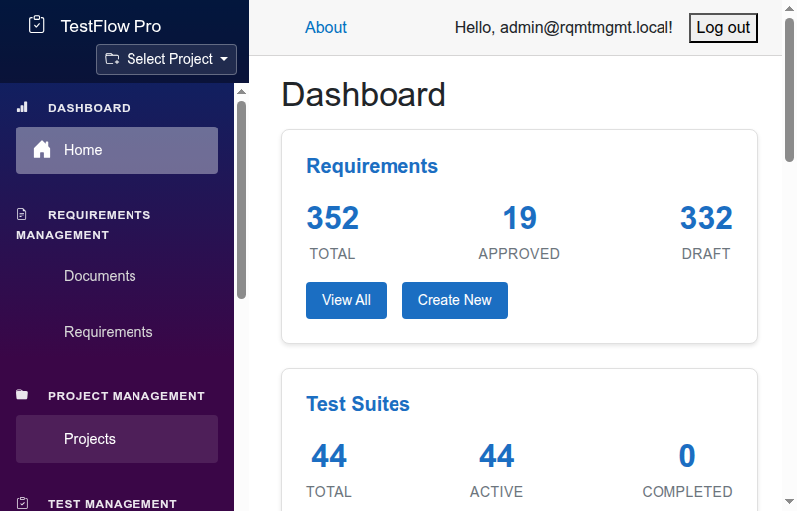
Application Dashboard
Modern, responsive UI built with Blazor WebAssembly

Slide 5
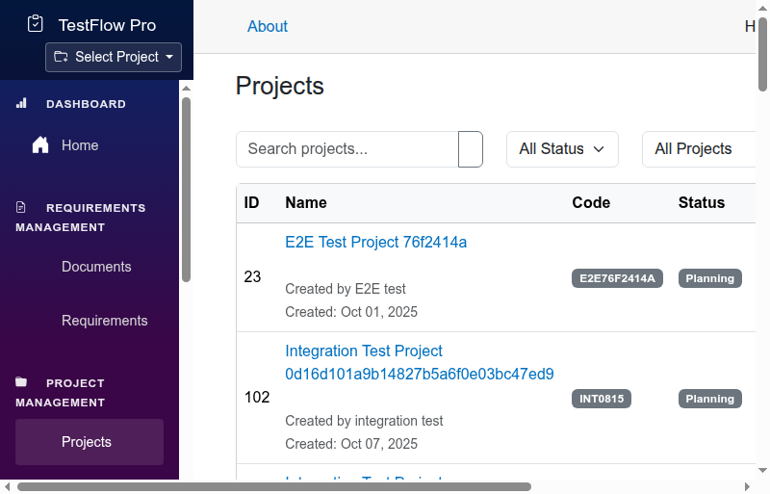
Project Management
Organize requirements and tests by project with comprehensive search and filtering

Slide 6
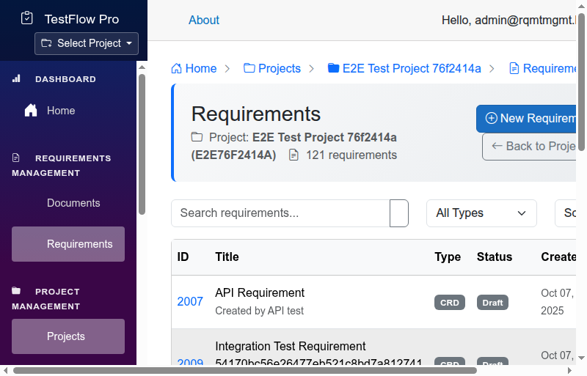
Requirements Management
Hierarchical requirements with versioning and traceability

Slide 7
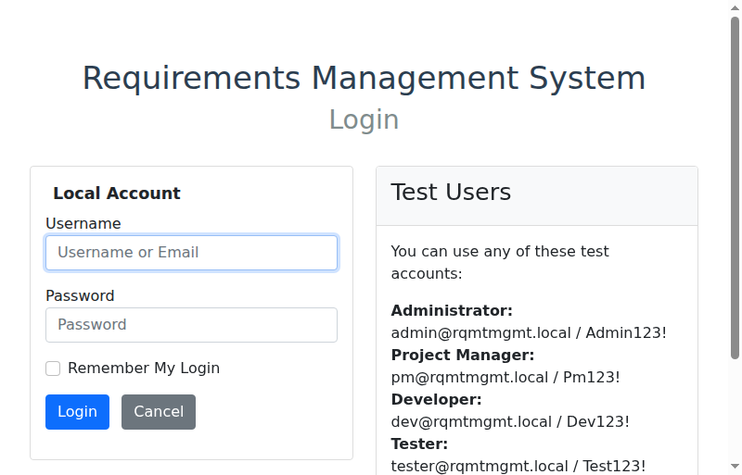
Document Management
Attach and manage specification documents with requirement linking

Slide 8
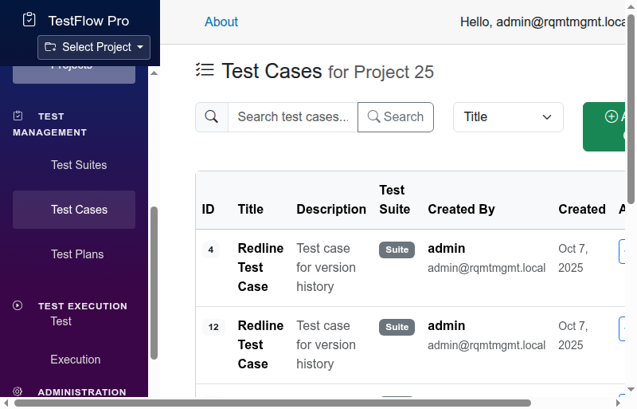
Test Case Management
Comprehensive test case management with execution tracking

Slide 9
Kubernetes Deployment
Running on Rancher Desktop Kubernetes cluster
Namespace: rqmtmgmt
Active Pods:
• backend-67cd869c47-fb4lc (Running)
• frontend-64cbfff58c-9l948 (Running)
• identityserver-7d69c95f89-cx7sb (Running)
• mssql-0 (StatefulSet - Running)
Services:
• backend-service (ClusterIP: 10.43.184.190)
• frontend-service (ClusterIP: 10.43.106.137)
• identityserver-service (ClusterIP: 10.43.232.135)
• mssql-service (ClusterIP: 10.43.114.158)
Ingress: rqmtmgmt.local (Traefik) - HTTPS enabled

Slide 10
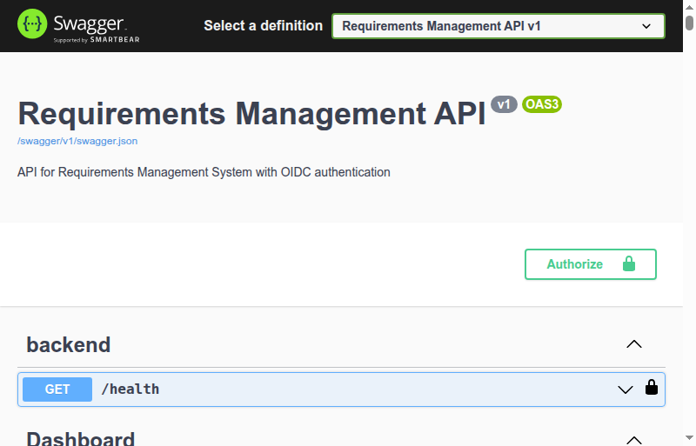
RESTful API with Swagger
Comprehensive API documentation with OAuth 2.0 authentication

Slide 11
Comprehensive Test Coverage - 732 Tests
Frontend Component Tests (73): bUnit-based isolation testing
End-to-End Tests (53): Playwright browser automation
Backend Unit Tests (499): Service and business logic validation
Backend API Tests (160): Integration testing with real database
CI/CD Integration: All tests run automatically on commits
Test Isolation: Each test runs in isolated context
Performance: Optimized fixture sharing reduces test time

Slide 12
AI-Enhanced Development Process
GitHub Copilot: Code generation and completion throughout development
AI-Assisted Architecture: Design decisions validated by AI models
Automated Code Review: AI-powered analysis for quality and security
Test Generation: AI-suggested test cases and edge case detection
Documentation: AI-assisted technical documentation creation
Refactoring: AI-guided code improvements and pattern recognition
Result: Accelerated development with enterprise-quality output
732 comprehensive tests all generated with AI assistance

Slide 13
Key Features & Capabilities
Hierarchical Requirements: Parent-child relationships with full traceability
Version Control: Complete audit history for all requirements and tests
Test Execution: Track test runs, results, and metrics over time
Document Management: Link specifications to requirements
Role-Based Access: Secure authentication with IdentityServer
Real-time Collaboration: Multi-user support with concurrent editing
Search & Filter: Advanced querying across all entities
Export & Reporting: Generate compliance documentation

Slide 14
Future Enhancements
AI-Powered Test Generation from requirements
Automated Redline Document Generation for version comparison
Advanced Analytics and Dashboards
Integration with CI/CD pipelines for automated test execution
Mobile-responsive UI improvements
Azure DevOps and Jira integration
Multi-tenancy for enterprise deployment
Real-time notifications and collaboration features

