Slide 1

2026 · FIELD NOTE · OFFICEKIT CALIBRATION
Saffron Editorial: a claim worth testing
An editorial reference for evidence, identity, and measured activation.
One visual language · six page roles · native editable content
FIELD NOTE · A visual idea is useful when the evidence can travel with it.
01 / 06
OfficeKit original clean-room calibration · fictional content · 2026-08-29

Slide 2
SAFFRON EDITORIAL · CHAPTER INDEX
02 / 06
CONTENTS · SIX SHIFTS
A campaign becomes memorable when each chapter changes the question.
Six beats · each one carries a proposition, a proof, and a direction.
01
Signal
02
Context
03
Choice
Name the audience tension.
Show where the pattern lives.
Make the proposition concrete.
04
Proof
05
System
06
Next
Attach a measure to the claim.
Turn one idea into repeatable moves.
Give the audience one action.
OfficeKit original clean-room calibration · chapter colors are a visual index, not data

Slide 3

SAFFRON EDITORIAL · MARKET BASE
03 / 06
MARKET BASE
The signal is useful only when the audience can see the behavior behind it.
Illustrative cohort read · every number carries a unit, period, and measurement note.
31%
repeat visits become the growth signal
SCALE
46,000
paired visits in the measured window
TIME
24%
of visits land after the first encounter
SPEND
91 min
median dwell time for returning visitors
ONE FRAME · THREE BEHAVIORS
Source: illustrative calibration brief · values are fictional

Slide 4
SAFFRON EDITORIAL · TIME-BLOCK ECONOMICS
04 / 06
TIME-BLOCK ECONOMICS
A measured rhythm turns one proposition into repeatable behavior.
Four moments · the same unit · one comparison rule.
AM
DAY
EVE
NIGHT
INSIGHT
19%
64%
47%
38%
52%
first-use rate
midday repeat
return window
highest margin
median repeat share
when the proposition
arrives after dark
07:00
10:00
17:00
20:00
Source: illustrative calibration brief · values are fictional

Slide 5



SAFFRON EDITORIAL · CASE BOOK
05 / 06
CASE BOOK
Three spaces, one repeatable proposition.
Like-for-like cases make the creative system legible without flattening the context.
24/7 STUDY
ROOF LOUNGE
NIGHT GALLERY
NORTH ISLE
ROOFTOP FARM
MIDNIGHT MUSEUM
Small interventions create a reason to return.
The same ritual holds in a different setting.
The proposition survives a new audience cue.
The image carries context; the caption carries the comparable field.
Source: illustrative calibration brief · cases are fictional

Slide 6
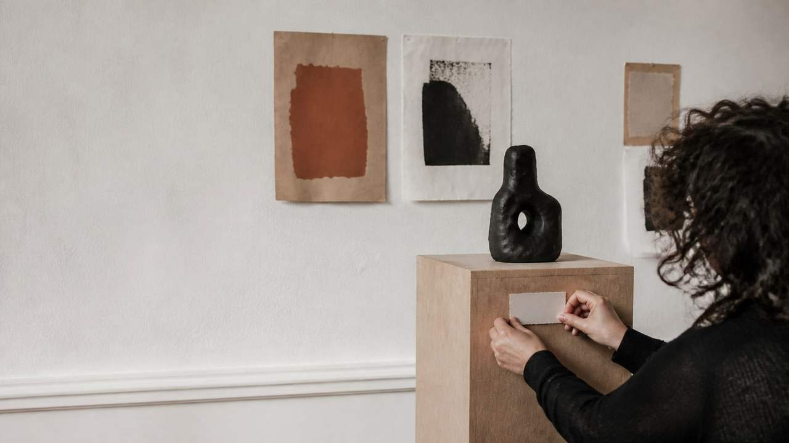
SAFFRON EDITORIAL · NEXT MOVES
06 / 06
ACTION · NEXT MOVES
Make the invitation impossible to miss.
The close is a decision surface: promise, proof, and one move.
01
PROMISE
The proposition is legible.
NEXT MOVE
Publish the invitation.
02
PROOF
The response is measurable.
03
MOVE
Give the audience one action.
OfficeKit original clean-room calibration · fictional content · 2026-08-29

