Slide 1

CONSULTING · OFFICEKIT CALIBRATION
Apricot Dossier: a claim worth testing
A clean-room reference for evidence, direction, and a decision.
One visual language · four page roles · native editable objects
The synthesis matters more than the inventory.
OfficeKit original clean-room calibration · fictional content · 2026-08-29
1 / 6

Slide 2
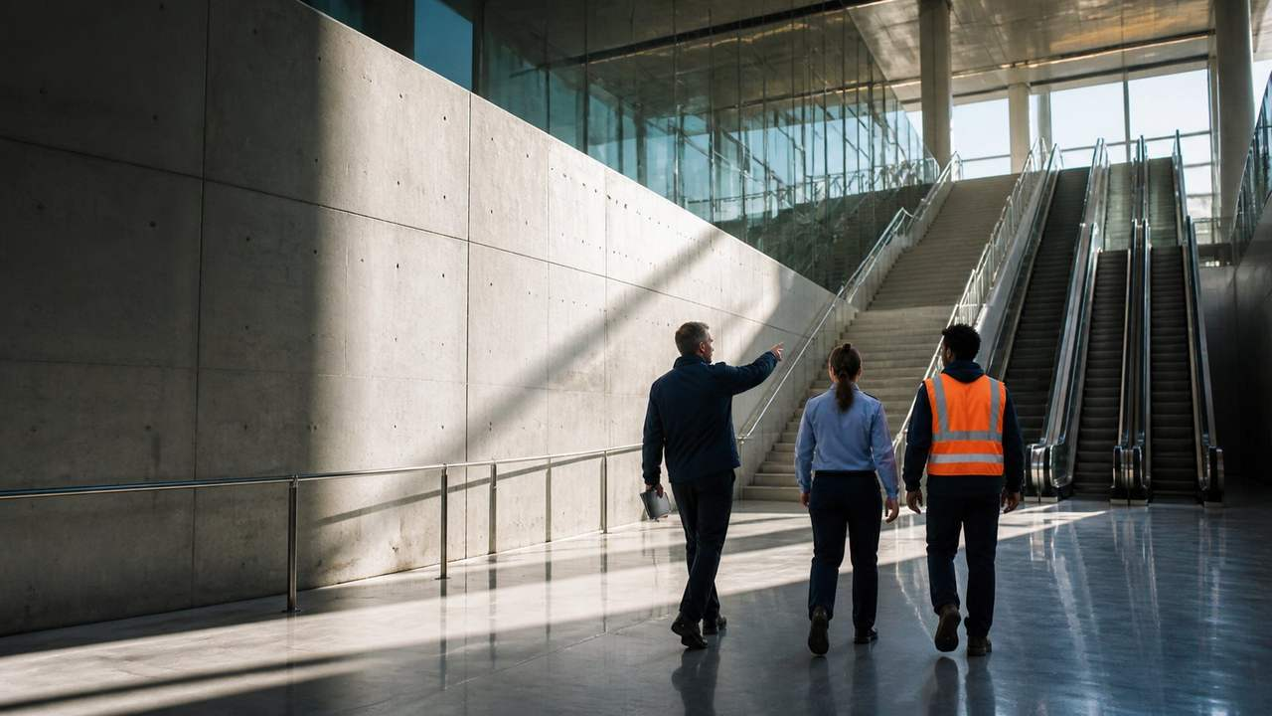
APRICOT DOSSIER · ARGUMENT
One finding should reorganize the decision
Finding, implication, recommendation: evidence stays adjacent to the synthesis.
FINDING
The constraint is concentration, not demand.
RECOMMENDATION
One constrained move
IMPLICATION
subject to the next evidence gate
Protect the strongest channel before adding volume.
PRESSURE PROFILE · CURRENT CASE
Concentration
82%
Price power
56%
Operating friction
34%
Source: illustrative calibration brief · every claim is fictional and bounded
2 / 6

Slide 3

APRICOT DOSSIER · EVIDENCE
The evidence narrows the decision to one lever
Comparable cases · same basis · direct labels instead of a legend-only chart.
READ-THROUGH
The comparison narrows the move.
Locate the constraint; choose the lever.
EVIDENCE · Keep the unit, time window, and limitation adjacent to the number.
Source: illustrative calibration brief · values are fictional
3 / 6

Slide 4
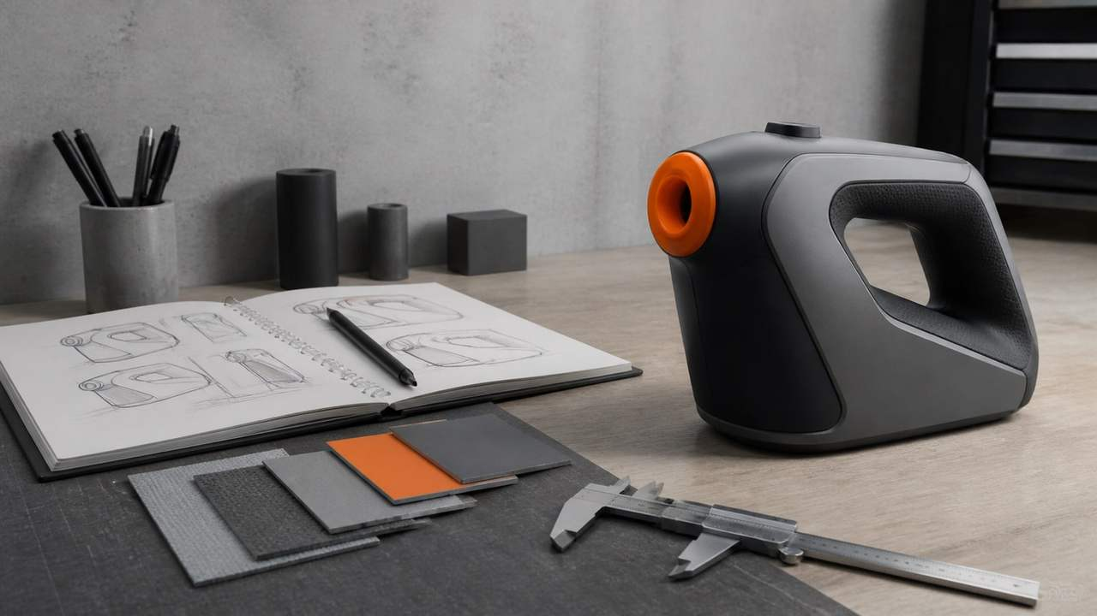
APRICOT DOSSIER · DETAIL
A decision page needs a visible sequence
Finding → constraint → move · each line changes the choice.
01
Signal
Demand is stable
DECISION LOGIC
A page earns density when each line changes the choice.
02
Constraint
Concentration drives variance
03
Move
Protect the strongest channel
ONE LEVER · ONE OWNER · ONE DATE
Source: illustrative calibration brief · labels and values are fictional
4 / 6

Slide 5
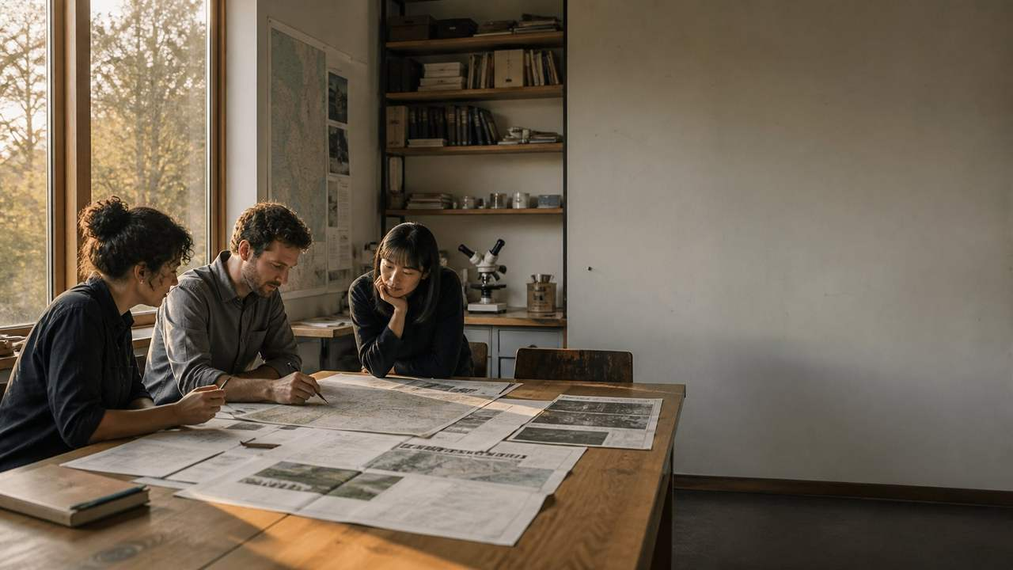
APRICOT DOSSIER · SECTION
Make the choice legible
A single visual cue can make the recommendation easier to remember.
ONE IMAGE · ONE THESIS · ONE TURN
Approve one lever
OfficeKit original clean-room visual field · fictional content
5 / 6

Slide 6

APRICOT DOSSIER · CLOSE
The recommendation is narrow by design
A reference page must leave the reader with a bounded next move.
01
Finding
Concentration drives the variance.
NEXT MOVE
Approve one lever
02
Choice
Protect the strongest channel first.
Owner · reviewer · date
03
Owner
Return with a gated decision.
OfficeKit original clean-room calibration · reference deck is editable and inspectable
6 / 6

