Slide 1

PROMOTION · OFFICEKIT CALIBRATION
Noir Field Pictorial: a claim worth testing
A clean-room reference for a visual proposition.
A proposition earns attention when it gives a next move.
OfficeKit original clean-room calibration · fictional content · 2026-08-29
1 / 6

Slide 2





NOIR FIELD PICTORIAL · ARGUMENT
The proposition is the page's visual center
Scale, crop, and color invite attention without hiding the evidence.
BRIEF
SIGNAL
EVIDENCE
CHOICE
NEXT
ONE PROPOSITION
Make the next action visible.
A clear invitation earns attention when evidence and access arrive together.
INVITE · PROVE · MOVE
Source: illustrative calibration brief · every claim is fictional and bounded
2 / 6

Slide 3
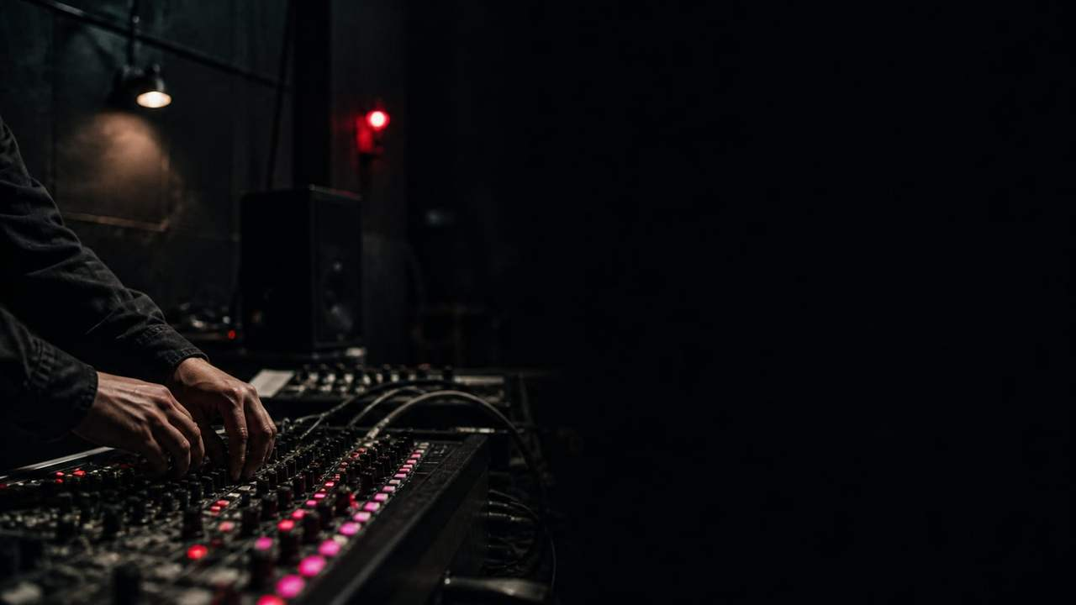



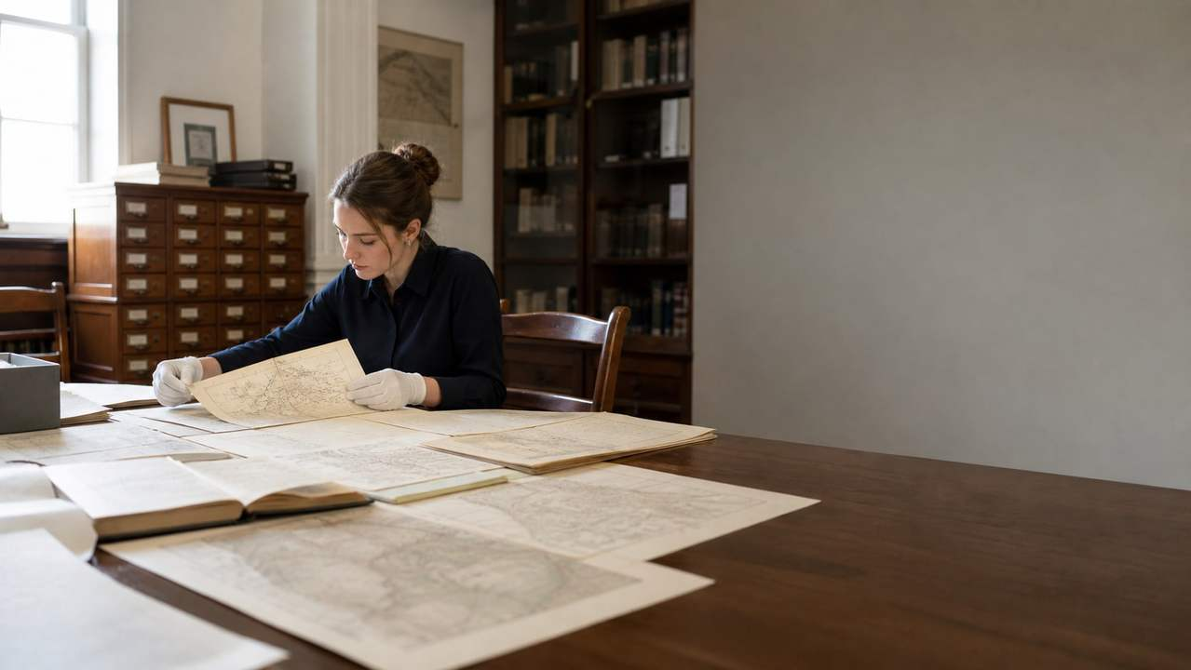


NOIR FIELD PICTORIAL · EVIDENCE
The signal grows when the invitation stays measurable
Illustrative reach and response · source and measurement convention remain attached.
BRIEF
SIGNAL
EVIDENCE
CHOICE
NEXT
IMAGE EVIDENCE
The same subject can carry several proofs.
Use a dominant frame for context and smaller crops for comparable detail. Every image needs a role, source, and readable caption.
EVIDENCE · Keep the unit, time window, and limitation adjacent to the number.
Source: illustrative calibration brief · values are fictional
3 / 6

Slide 4






NOIR FIELD PICTORIAL · DETAIL
The same idea can hold several views
Unequal image frames · visual variety without decorative filler.
BRIEF
SIGNAL
EVIDENCE
CHOICE
NEXT
IMAGE MATRIX
One subject, five ways to notice it.
One dominant frame plus four
supporting crops. Image carries
mood; labels carry the claim.
Source: illustrative calibration brief · labels and values are fictional
4 / 6

Slide 5

NOIR FIELD PICTORIAL · VISUAL CARRIER
Let the subject do the work
BRIEF
SIGNAL
EVIDENCE
CHOICE
NEXT
A strong crop gives the proposition a place to live.
THE IMAGE IS EVIDENCE, NOT FILL
OfficeKit original clean-room visual field · fictional content
5 / 6

Slide 6
NOIR FIELD PICTORIAL · CLOSE
Turn the shared invitation into an action plan
A reference page must leave the reader with a bounded next move.
BRIEF
SIGNAL
EVIDENCE
CHOICE
NEXT
01
Promise
The proposition is legible.
NEXT MOVE
02
Proof
The response is measurable.
Publish the invitation
03
Move
Give the audience one action.
Owner · reviewer · date
OfficeKit original clean-room calibration · reference deck is editable and inspectable
6 / 6

