Slide 1
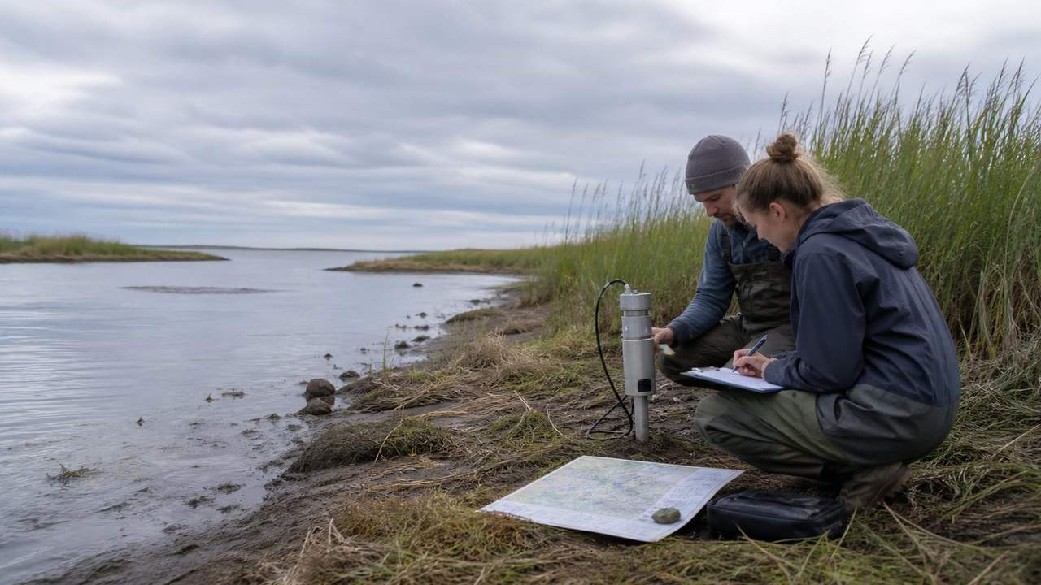
PROMOTION · OFFICEKIT CALIBRATION
River Handbook: a claim worth testing
A clean-room reference for a visual proposition.
A proposition earns attention when it gives a next move.
OfficeKit original clean-room calibration · fictional content · 2026-08-29
1 / 6

Slide 2


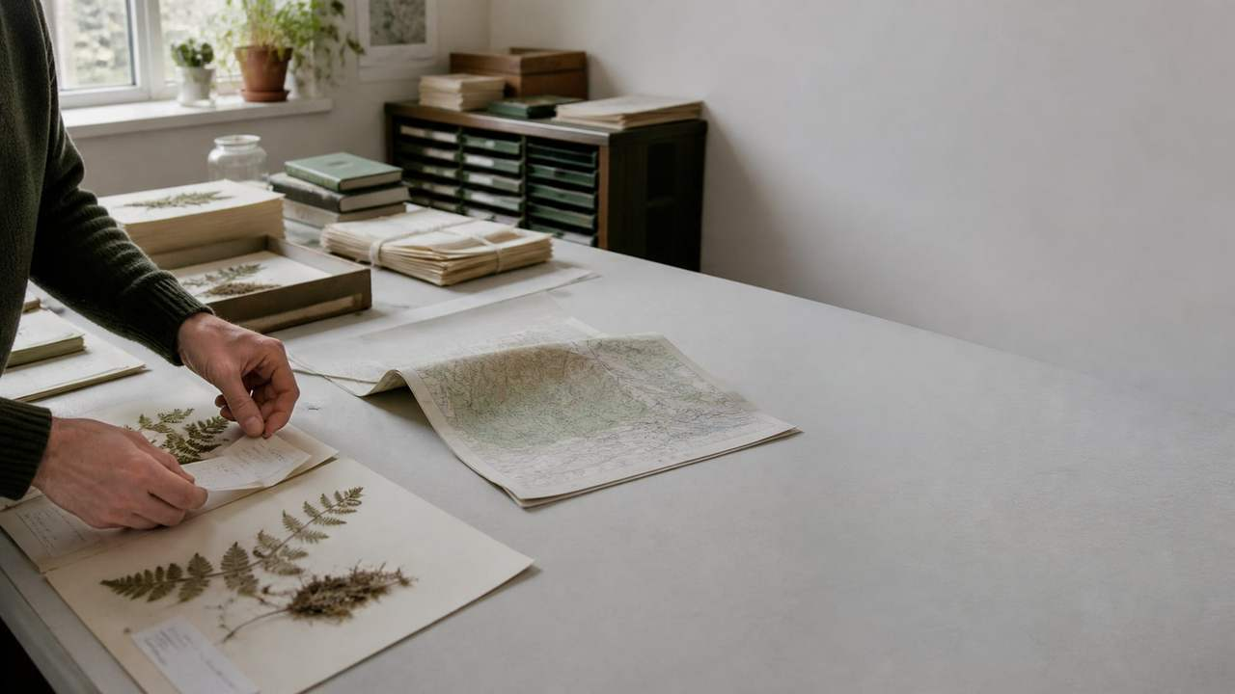

RIVER HANDBOOK · ARGUMENT
The proposition is the page's visual center
Scale, crop, and color invite attention without hiding the evidence.
ONE PROPOSITION
Make the next action visible.
A clear invitation earns attention when evidence and access arrive together.
INVITE · PROVE · MOVE
Source: illustrative calibration brief · every claim is fictional and bounded
2 / 6

Slide 3






RIVER HANDBOOK · EVIDENCE
The signal grows when the invitation stays measurable
Illustrative reach and response · source and measurement convention remain attached.
IMAGE EVIDENCE
The same subject can carry several proofs.
Use a dominant frame for context and smaller crops for comparable detail. Every image needs a role, source, and readable caption.
EVIDENCE · Keep the unit, time window, and limitation adjacent to the number.
Source: illustrative calibration brief · values are fictional
3 / 6

Slide 4



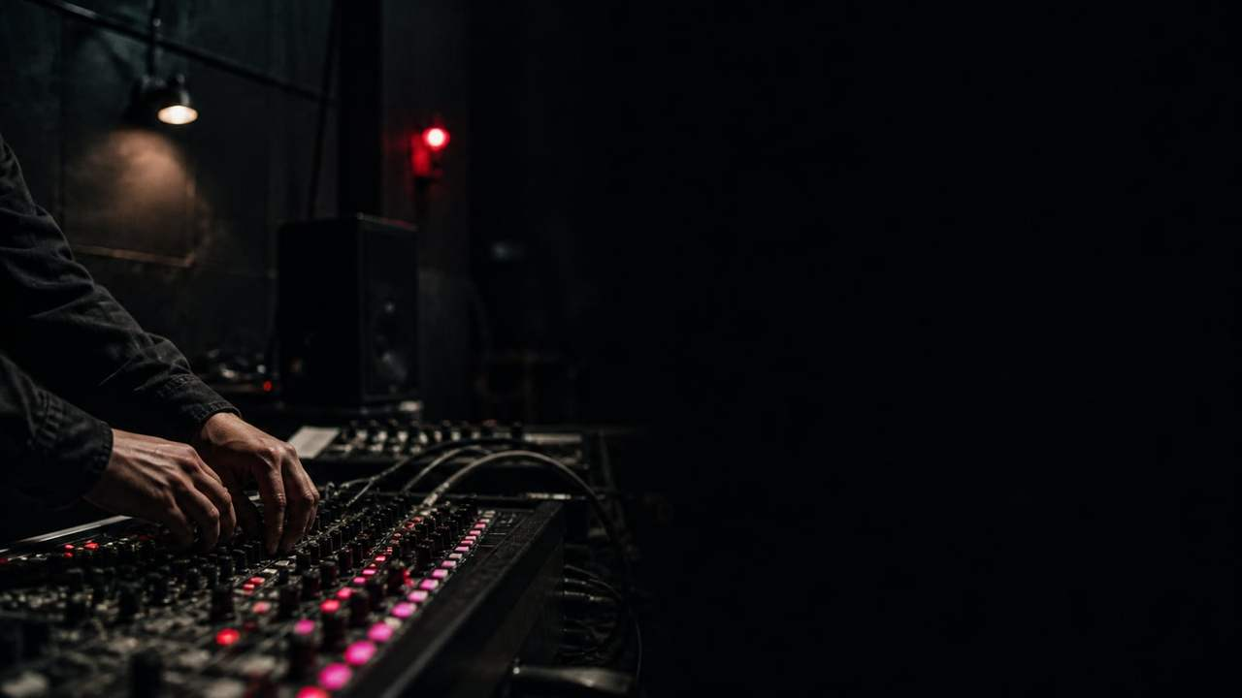


RIVER HANDBOOK · DETAIL
The same idea can hold several views
Unequal image frames · visual variety without decorative filler.
IMAGE MATRIX
One subject, five ways to notice it.
One dominant frame plus four
supporting crops. Image carries
mood; labels carry the claim.
Source: illustrative calibration brief · labels and values are fictional
4 / 6

Slide 5

RIVER HANDBOOK · SECTION
Let the subject do the work
A strong crop gives the proposition a place to live.
ONE IMAGE · ONE THESIS · ONE TURN
Publish the invitation
OfficeKit original clean-room visual field · fictional content
5 / 6

Slide 6

RIVER HANDBOOK · CLOSE
Turn the shared invitation into an action plan
A reference page must leave the reader with a bounded next move.
01
Promise
The proposition is legible.
NEXT MOVE
02
Proof
The response is measurable.
Publish the invitation
03
Move
Give the audience one action.
Owner · reviewer · date
OfficeKit original clean-room calibration · reference deck is editable and inspectable
6 / 6

