Slide 1

WORK · OFFICEKIT CALIBRATION
Violet Operations: a claim worth testing
A documentary operating review turns status into a decision.
MEASURED WORK · VISIBLE CONSEQUENCE
OfficeKit original clean-room calibration · fictional content · 2026-08-29
1 / 6

Slide 2

VIOLET OPERATIONS · ARGUMENT
The constraint owns the page
Status, cause, owner and date stay together.
OPERATING SIGNAL
01
Queue
On target
The queue is healthy; the handoff is not.
02
Handoff
At risk
Three visible signals point to one owner and one date.
03
Owner
Named
Source: illustrative calibration brief · every claim is fictional and bounded
2 / 6

Slide 3

VIOLET OPERATIONS · EVIDENCE
Signal up; exception stays
Illustrative operations ledger · current state and exception share one frame.
DIRECT-LABELLED DISTRIBUTION
READ-THROUGH
Central · 68%
East · 55%
The geography changes the decision.
North · 42%
Use a map only when position, distribution, or concentration carries the argument. Direct labels stay next to the region they qualify.
South · 31%
EVIDENCE · Keep the unit, time window, and limitation adjacent to the number.
Source: illustrative calibration brief · values are fictional
3 / 6

Slide 4

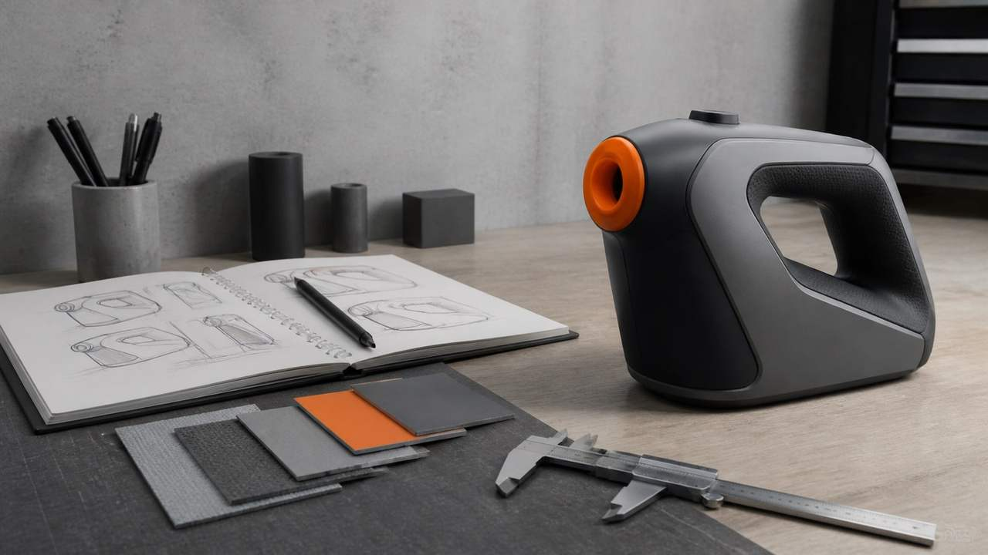


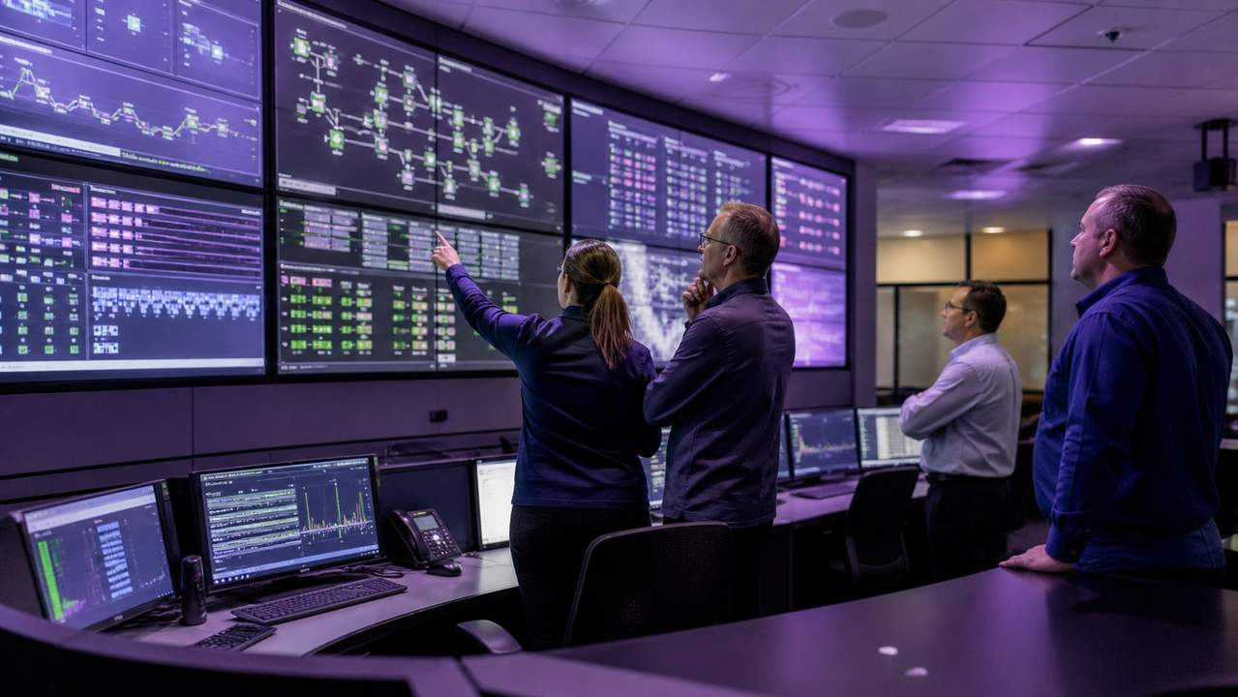
VIOLET OPERATIONS · DETAIL
The gap becomes useful when it has an
owner
Target, current state and exception share a single operating frame.
IMAGE MATRIX
One subject, five ways to notice it.
One dominant frame plus four
supporting crops. Image carries
mood; labels carry the claim.
Source: illustrative calibration brief · labels and values are fictional
4 / 6

Slide 5

VIOLET OPERATIONS · VISUAL CARRIER
Show the operating shape
The image carries context; the page names the move.
THE IMAGE IS EVIDENCE, NOT FILL
OfficeKit original clean-room visual field · fictional content
5 / 6

Slide 6

VIOLET OPERATIONS · CLOSE
Name the owner and next date
A reference page must leave the reader with a bounded next move.
01
Status
The queue is on target.
NEXT MOVE
Assign the handoff
02
Exception
The handoff is the constraint.
Owner · reviewer · date
03
Next
Name the owner today.
OfficeKit original clean-room calibration · reference deck is editable and inspectable
6 / 6

