Slide 1
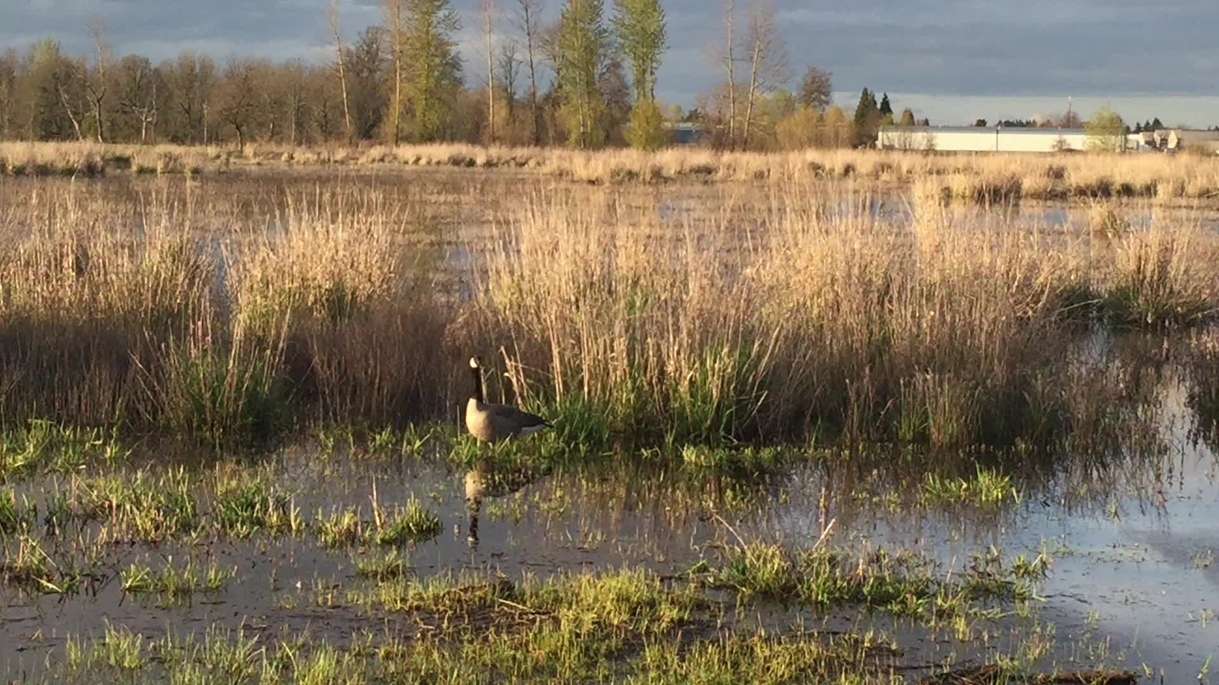
BLUE BELT PILOT · CIVIC IMPACT NOTE 07
2027
BLUE BELT
FOR THE CITY'S
EVERYDAY LIFE
A six-month pilot connecting flood relief, habitat, and public access
All figures are synthetic calibration data. Photography is contextual, not project evidence.
8 districts
14 blue nodes
38,000 residents
6-month window
Photo · BLM Oregon and Washington · public domain

Slide 2
NETWORK PRESSURE · SYNTHETIC BASELINE
Four drainage gaps concentrate the pilot's risk and opportunity
The corridor behaves as one connected water system; isolated projects miss the handoffs.
NORTH GATE
MARKET CUT
RAIL MARSH
SOUTH REACH
11 flood calls −18% shade
2.1 ha gap 4 schools
31% runoff 1 habitat break
8 access points +22 min walk
42% of calls cluster within four linked gaps.
Source · Fictional calibration ledger · values are illustrative
02 / 06

Slide 3
DELIVERY CHAIN · THREE LINKED PHASES
Restore—connect—measure operates as one field chain
The next phase starts only when the previous handoff leaves verifiable evidence.
01 · RESTORE FLOW
02 · CONNECT ACCESS
03 · VERIFY OUTCOMES
Jan–Feb · 8 weeks
Mar–May · 12 weeks
Jun–Aug · 12 weeks
14
7.2 km
286 ha
144
24
wetland nodes
continuous path
habitat restored
water samples
community checks
hydrology assessment
mobility audit
field survey
quality protocol
open review
31 partners · 6 public agencies · 9 technical reviewers · 16 community groups
Source · Fictional calibration plan · durations and outputs are illustrative
03 / 06

Slide 4
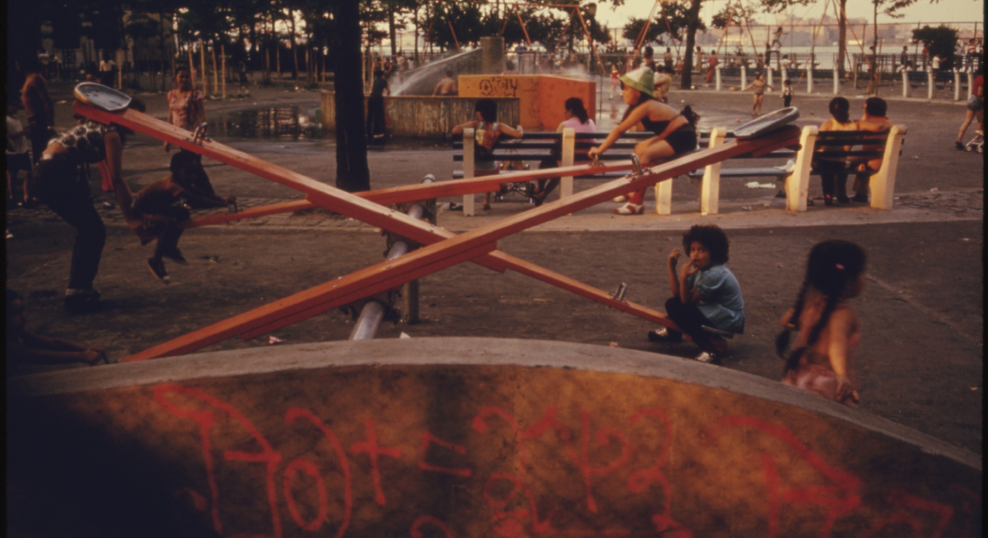
PUBLIC VALUE · ACCESS BEFORE SLOGAN
A corridor matters only when everyday use becomes easier
The pilot treats access as an outcome alongside flood relief and habitat. The image establishes the public-space question; it is not project evidence.
−11 min
+38%
median walk to water illustrative
weekly public use illustrative
Photo · East River Park · Danny Lyon / NARA · public domain · contextual only
04 / 06

Slide 5
OUTCOME LEDGER · BASELINE TO FOLLOW-UP
Four indicators move together; no single metric carries the claim
Follow-up improves water, habitat, access, and participation against one declared baseline.
INDICATOR | BASELINE | FOLLOW-UP | CHANGE
Water-quality compliance | 66% | 84% | +18 pp
Native breeding success | 52% | 68% | +16 pp
Access within 15 minutes | 41% | 63% | +22 pp
Verified public records | 1,820 | 3,460 | +1,640
DIRECTION
Water ↑ Habitat ↑ Access ↑ Participation ↑
MEASUREMENT BASIS
Same six-month window Same definitions Synthetic calibration only
Source · Fictional calibration ledger · synthetic 2027 values
05 / 06

Slide 6
FUNDING DECISION · NETWORK LOGIC
Fund the network, not isolated sites
A balanced second phase keeps restoration dominant while protecting access, verification, and maintenance.
SECOND-PHASE GATES
4 / 4
24.0m
01 · water target holds 02 · access gap closes 03 · habitat signal persists 04 · public record stays open
TOTAL BUDGET
APPROVE A BOUNDED SECOND PHASE
Source · Fictional calibration budget · values are illustrative
06 / 06

