Slide 1
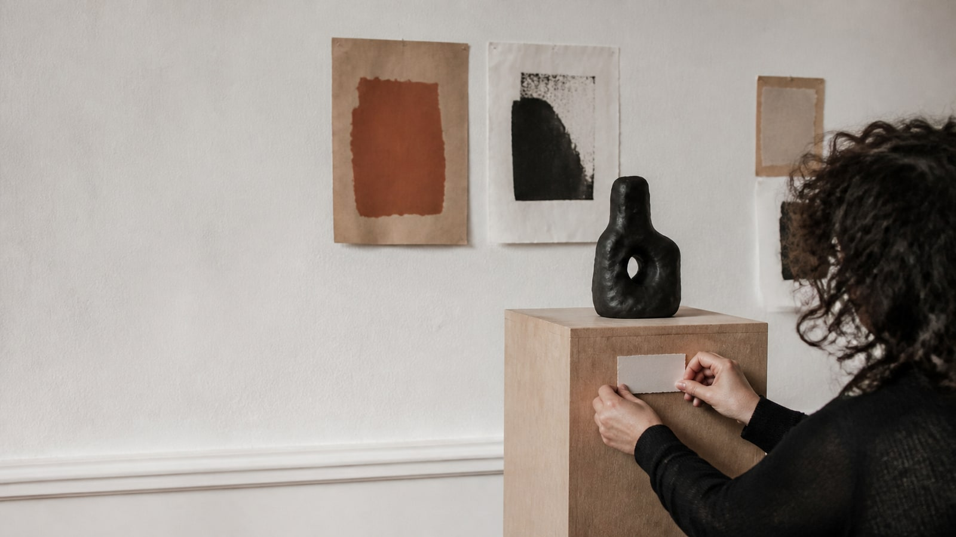
PROMOTION · OFFICEKIT CALIBRATION
Silver Atelier: a claim worth testing
A clean-room reference for a visual proposition.
A proposition earns attention when it gives a next move.
OfficeKit original clean-room calibration · fictional content · 2026-08-29
1 / 6

Slide 2
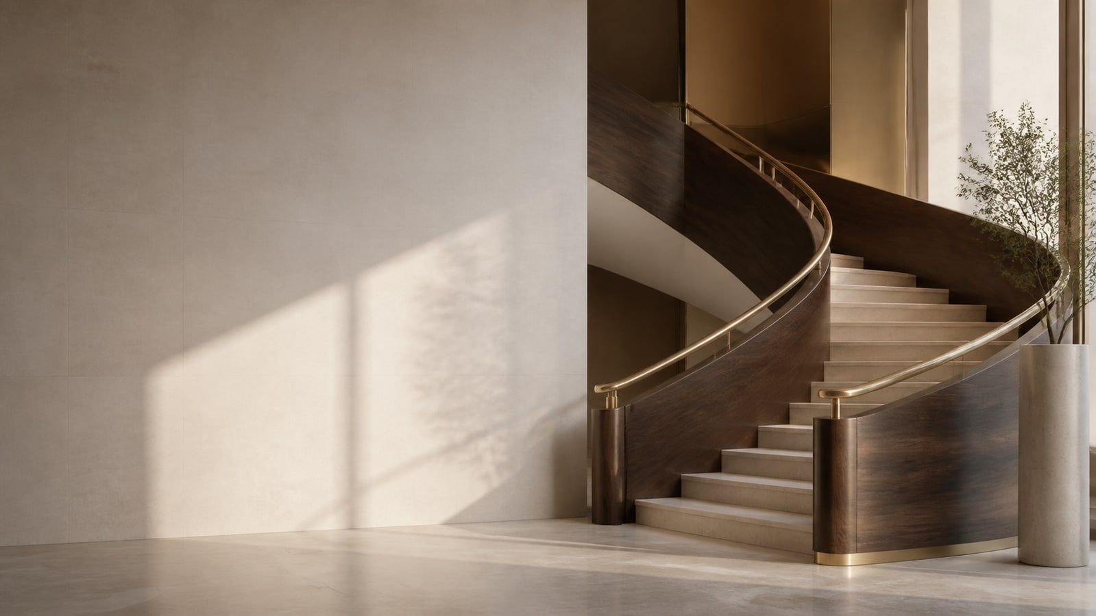
SILVER ATELIER · ARGUMENT
The proposition is the page's visual center
Scale, crop, and color invite attention without hiding the evidence.
ONE PROPOSITION
Make the next action visible.
A clear invitation earns attention when evidence and access arrive together.
INVITE · PROVE · MOVE
Source: illustrative calibration brief · every claim is fictional and bounded
2 / 6

Slide 3

SILVER ATELIER · EVIDENCE
The signal grows when the invitation stays measurable
Illustrative reach and response · source and measurement convention remain attached.
68
qualified response · campaign close
Reach is useful only when the audience can see and take the next step.
EVIDENCE · Keep the unit, time window, and limitation adjacent to the number.
Source: illustrative calibration brief · values are fictional
3 / 6

Slide 4
SILVER ATELIER · DETAIL
The same idea can hold several views
Unequal image frames · visual variety without decorative filler.
01
02
03
04
READ-THROUGH
The sequence is the evidence.
Frame
Test
Read
Decide
Name the question
Hold the rule
Separate signal
Set the next gate
Keep each handoff adjacent to the condition that unlocks it; do not turn a real dependency into a decorative arrow.
Source: illustrative calibration brief · labels and values are fictional
4 / 6

Slide 5

SILVER ATELIER · VISUAL CARRIER
Let the subject do the work
A strong crop gives the proposition a place to live.
THE IMAGE IS EVIDENCE, NOT FILL
OfficeKit original clean-room visual field · fictional content
5 / 6

Slide 6

SILVER ATELIER · CLOSE
Turn the shared invitation into an action plan
A reference page must leave the reader with a bounded next move.
01
Promise
The proposition is legible.
NEXT MOVE
02
Proof
The response is measurable.
Publish the invitation
03
Move
Give the audience one action.
Owner · reviewer · date
OfficeKit original clean-room calibration · reference deck is editable and inspectable
6 / 6

