Slide 1
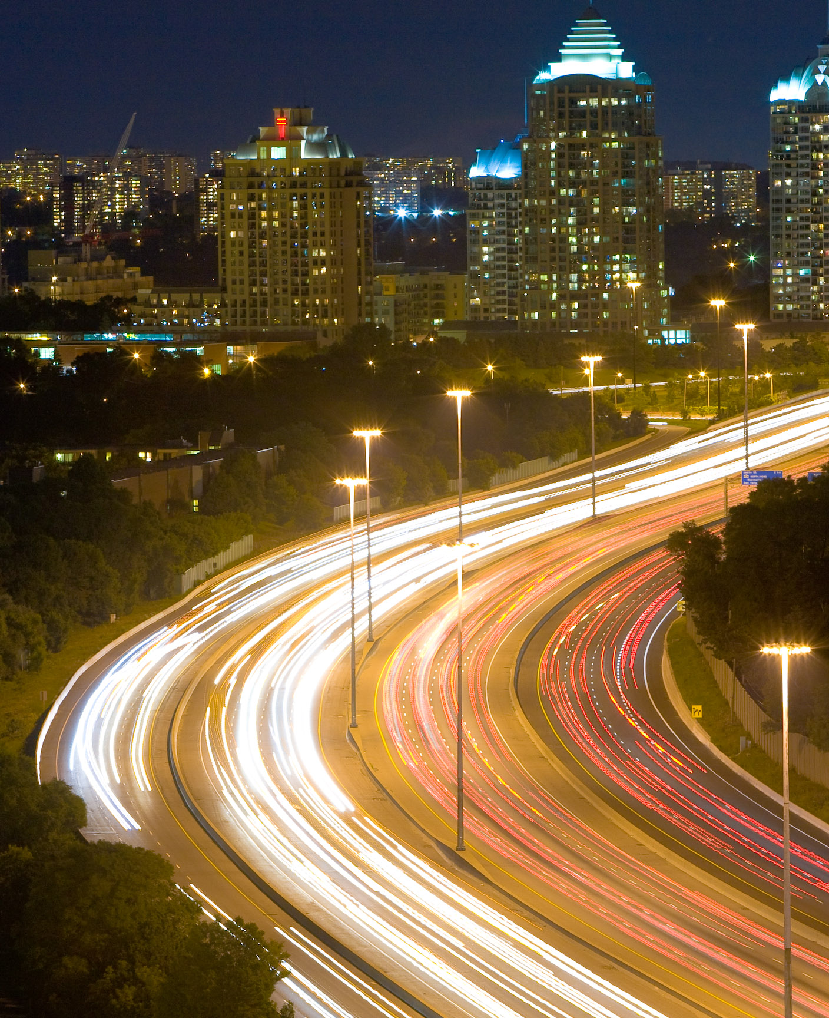
URBAN OPERATIONS · NIGHT CORRIDOR
Night Shift Signal System
From fragmented night demand to one observable dispatch window
4 calibration pages · synthetic data · 2026
Photo · kennymatic · CC BY 2.0

Slide 2
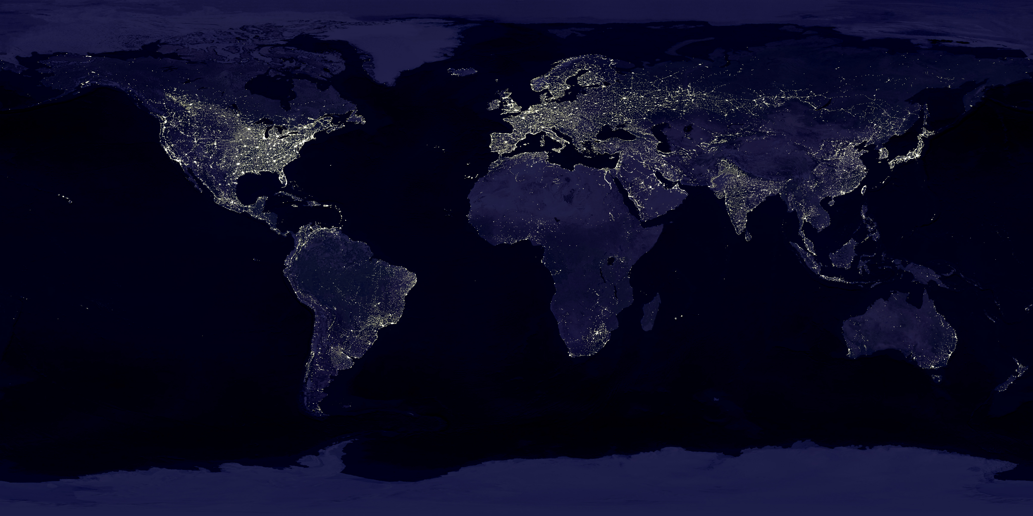
SIGNAL SCALE · SYNTHETIC NIGHT DEMAND
68% of night requests cluster along twelve connected corridors
68%
DEMAND 12 corridors
DETECTION 4-minute window
DISPATCH 2 control zones
ILLUSTRATIVE REQUEST SHARE 20:00—02:00
Source · Synthetic calibration model · image: NASA GSFC / NOAA NGDC · public domain
02 / 04

Slide 3
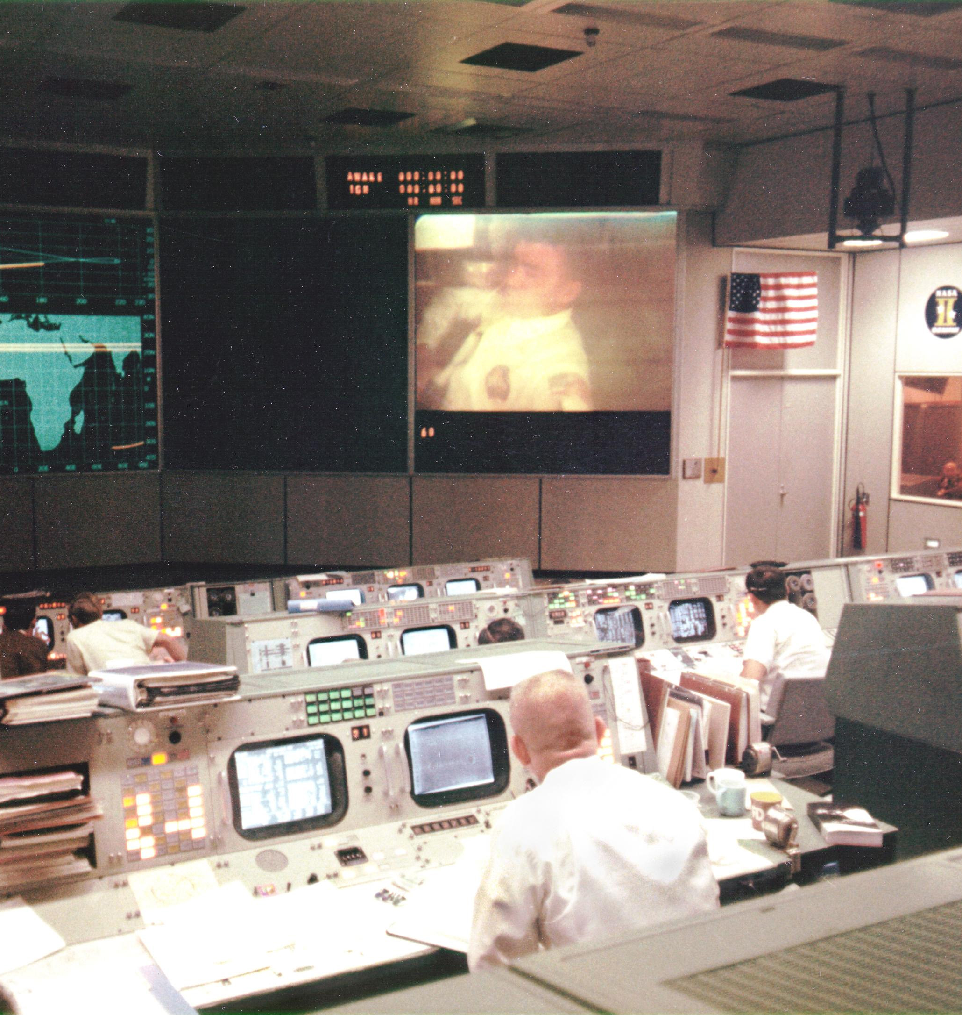
CONTROL WINDOW · RESPONSE CHAIN
Every handoff stays inside fourteen minutes
DETECT 03:40
DECIDE 07:10
RECOVER 14:20
The pilot fails if any stage loses its timestamp, owner, or decision basis.
Photo · Apollo 13 Mission Control · NASA · public domain · contextual only
03 / 04

Slide 4
PILOT DECISION · OBSERVABILITY BEFORE SCALE
Open two corridors. Scale only after every signal survives.
APPROVE NOW
SCALE GATES
Two corridors One shared event ledger Four-week observation window
≥95% event capture <15 min end-to-end response No unresolved handoff ownership
Source · Synthetic OfficeKit calibration brief · values are illustrative
04 / 04

